Slide 2
Diving into Mastery Guidance for Educators
Each activity sheet is split into three sections, diving, deeper and deepest, which are represented by the following icons:
These carefully designed activities take your children through a learning journey, initially ensuring they are fluent with the key concept being taught; then applying this to a range of reasoning and problem-solving activities.
These sheets might not necessarily be used in a linear way. Some children might begin at the ‘Deeper’ section and in fact, others may ‘dive straight in’ to the ‘Deepest’ section if they have already mastered the skill and are applying this to show their depth of understanding.
Diving
Deeper
Deepest

Slide 3
Aim
Recall multiplication and division facts for multiplication tables up to 12 × 12.

Slide 4
6 Times Table and Division Facts
Diving
Use doubling and halving to help calculate the missing multiples from the 3× and 6× tables.
3×
6×
4 lots of 3
double
24
11 groups of 3
double
66
24
halve
8 times 6
3
halve
1 multiplied by 6

Slide 5
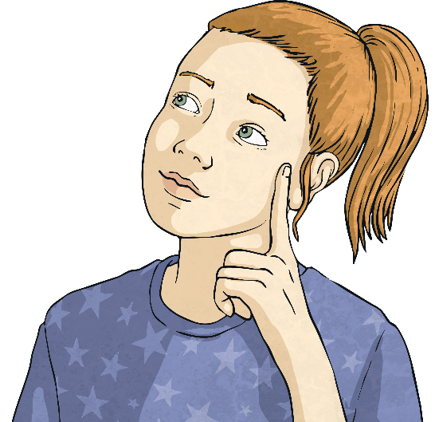
6 Times Table and Division Facts
Diving
Fill in the missing boxes in each calculation.
24
10
4
4 × 6 =
× 6 = 60
600 × = 2400
60
60
10 × 6 =
4 × = 240
600
× 10 = 6000
Connect each fact to another related fact in a different column.

Slide 6
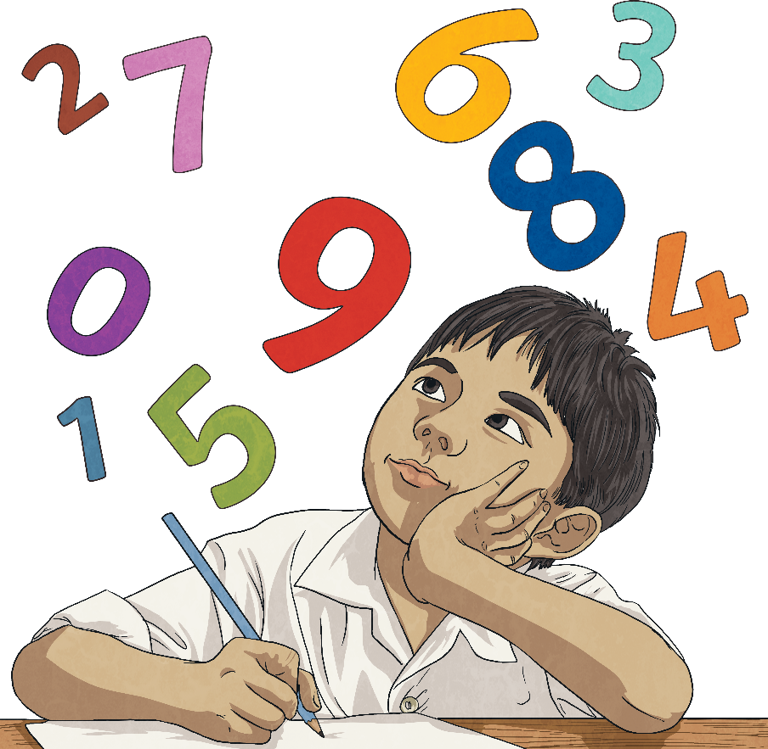
6 Times Table and Division Facts
Diving
Colour the multiples of 6 and associated multiples from the 60× or 600× tables to reveal a number. What is the number?
6
66
12
18
15
21
5400
42
240
72
9
180
60
7200
600

Slide 7
6 Times Table and Division Facts
Deeper
Explain which one is the odd one out.
2 × 6 =
12
5 × 6 =
30
12 × 6 =
72
6 × 6 =
36
Did you come up with another way of explaining which is the odd one out?
5 × 6 = 30 is the odd one out because it is the only answer that is in the 10× table as well as the 6× table.

Slide 8
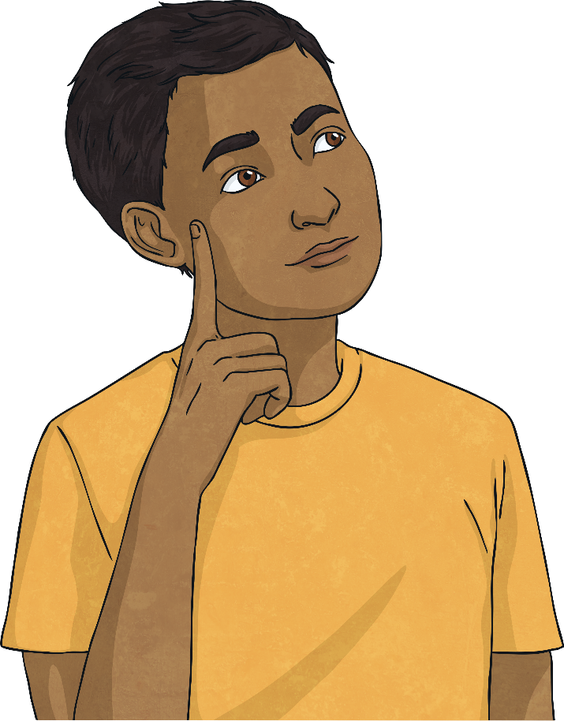
6 Times Table and Division Facts
Deeper
Read the statement below. Is it true or false? Explain your answer.
The greatest number in the 6 times table is 72 because 12 × 6 = 72.
This is false because, if we wanted, we could continue to 13 × 6 and beyond: 13 × 6 = 78, 14 × 6 = 84, 15 × 6 = 90. Times table are endless; we just choose to stop at 12 × because these are the most used facts.

Slide 9
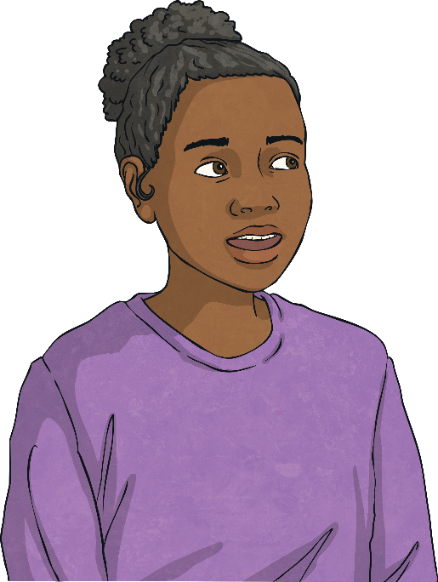
6 Times Table and Division Facts
Deepest
Use the numbers in the target board to create the target number 6 from division and multiplication calculations that contain 3× and 6× table facts and related facts.
The numbers on the board may be used more than once per calculation. Find as many solutions as you can.
Some possible answers:
3 × 2 = 6
2 × 3 = 6
12 ÷ 2 = 6
24 ÷ 2 ÷ 2 = 6
24
2
6
3
12

Slide 10
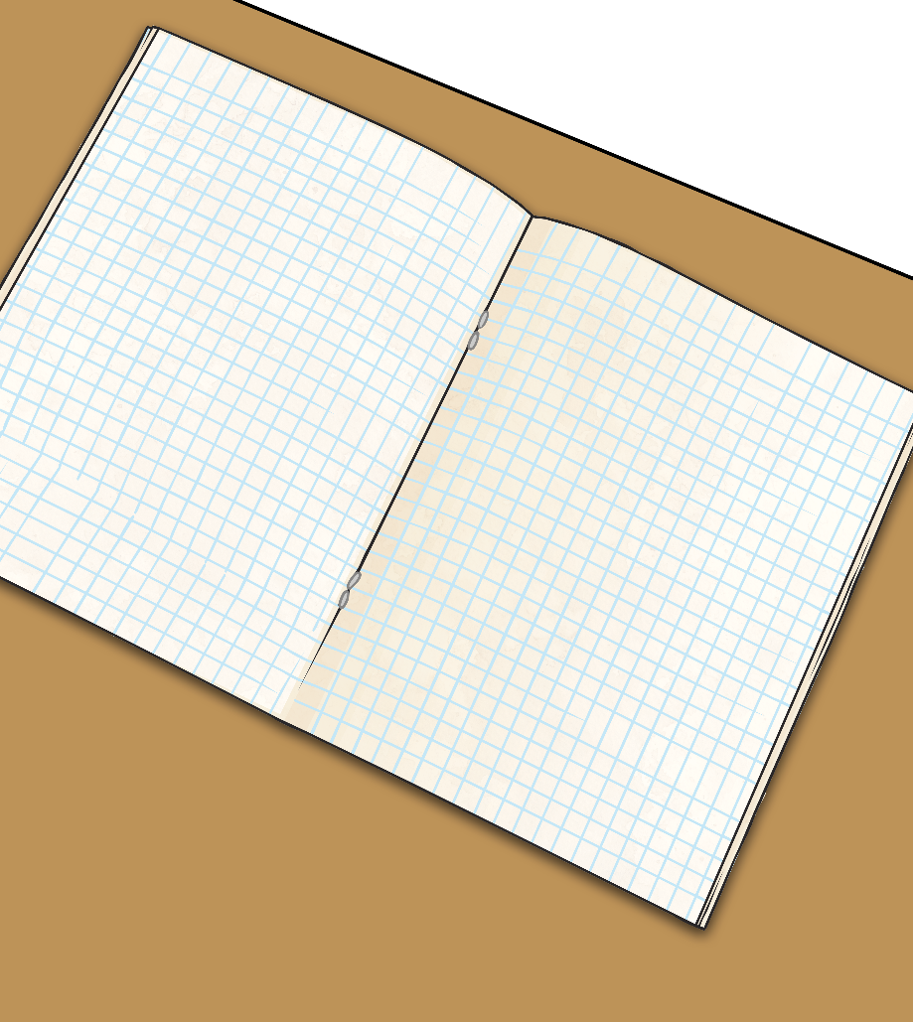
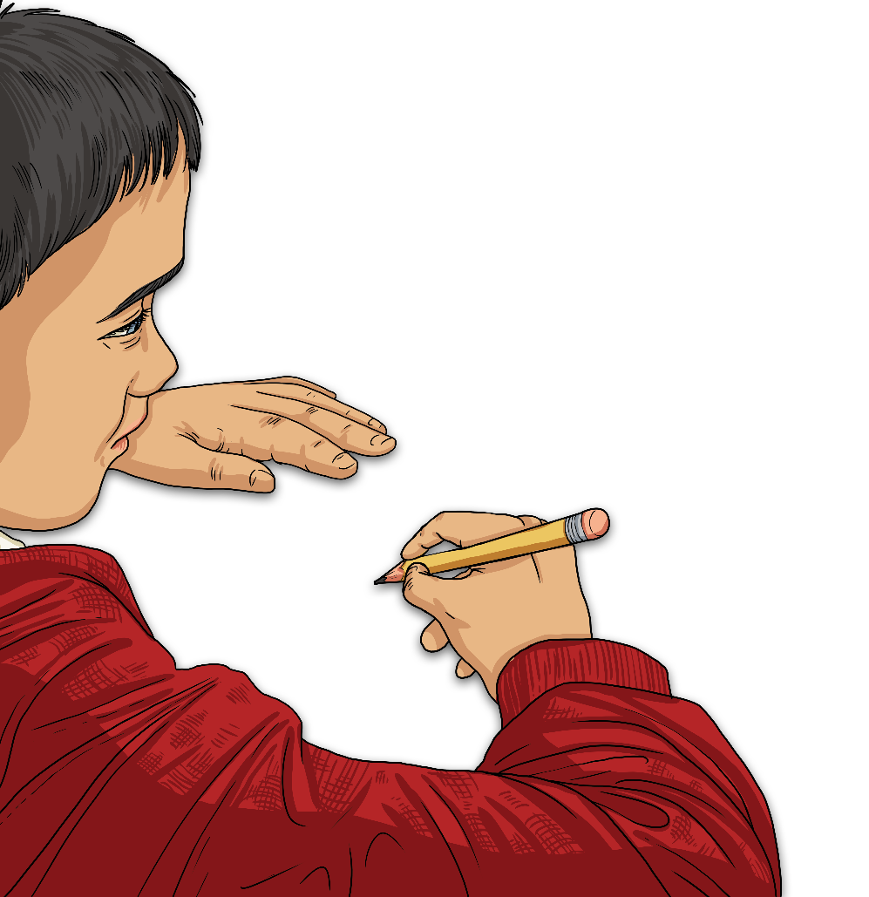
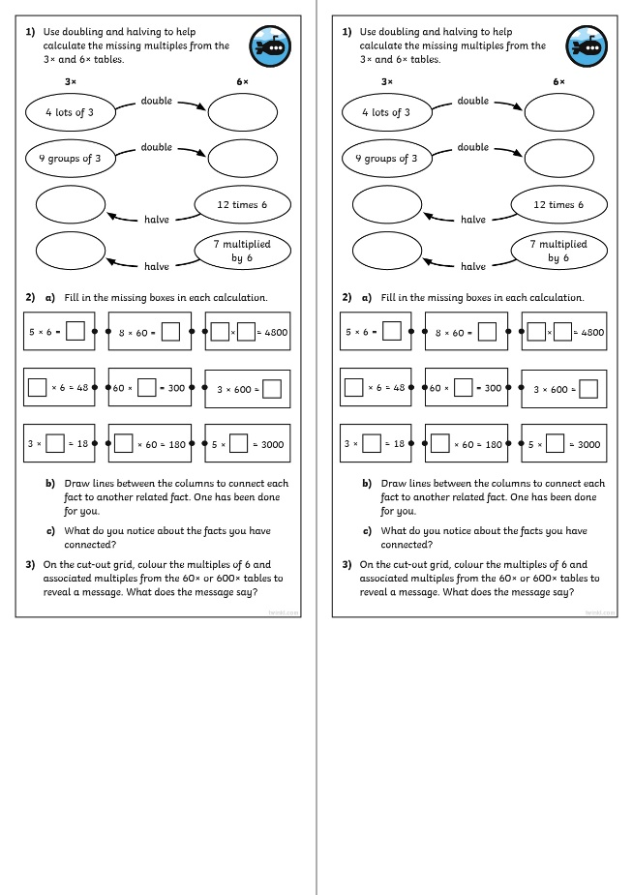
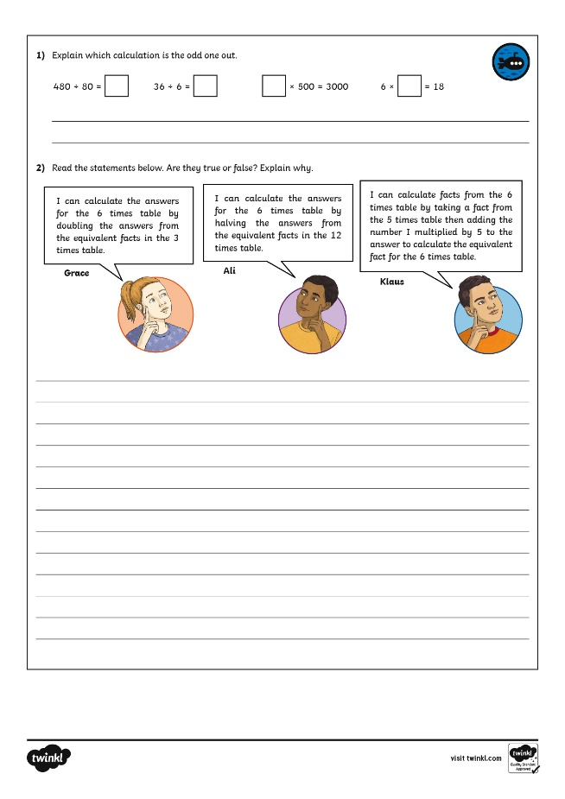
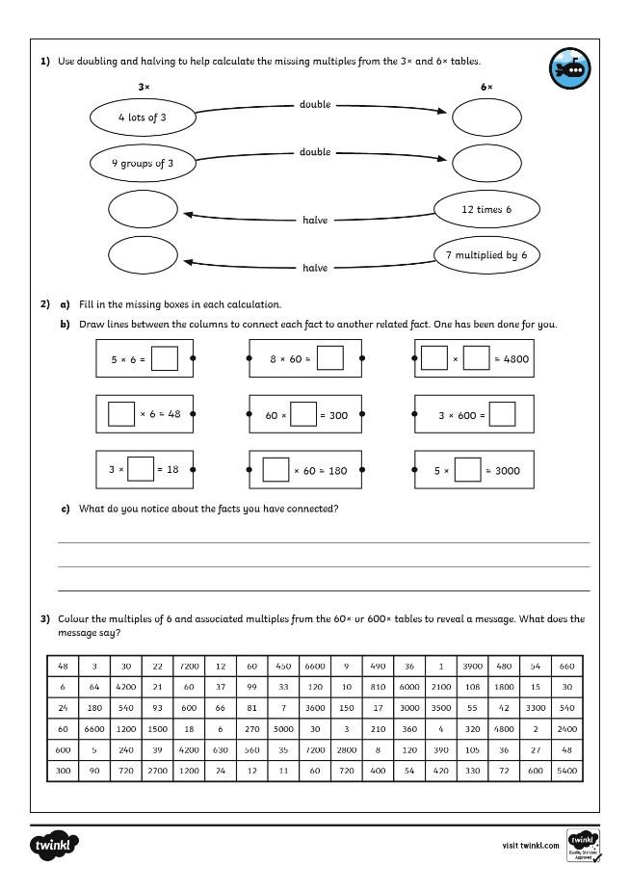
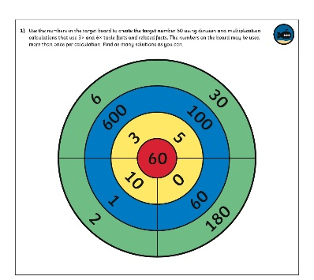
6 Times Table and Division Facts
Dive in by completing your own activity!

Slide 11
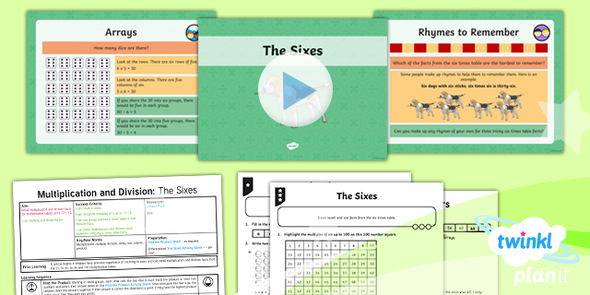
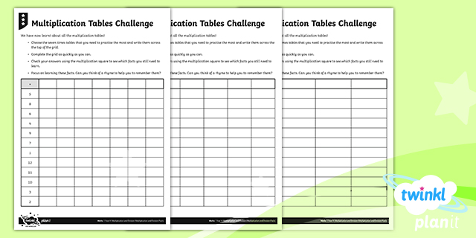
Need Planning to Complement this Resource?
National Curriculum Aim
Recall multiplication and division facts for multiplication tables up to 12 × 12.
For more planning resources to support this aim, click here.
Twinkl PlanIt is our award-winning scheme of work with over 4000 resources.

