Slide 1
Guidance for Video/Audio in PowerPoints
1. Open the folder and copy all the files.
2. Paste the copied files into a new folder.
3. Open the PowerPoint file, enable editing and enter presentation mode (start the slide show).
Please note the embedded audio may not be compatible with early versions of PowerPoint.
You may wish to delete this slide before beginning the presentation.

Slide 3
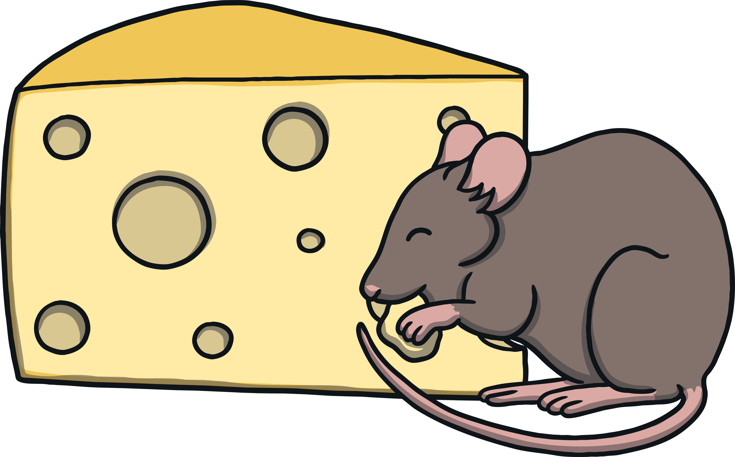
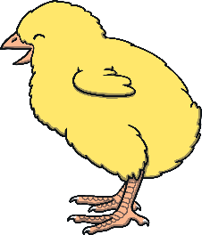
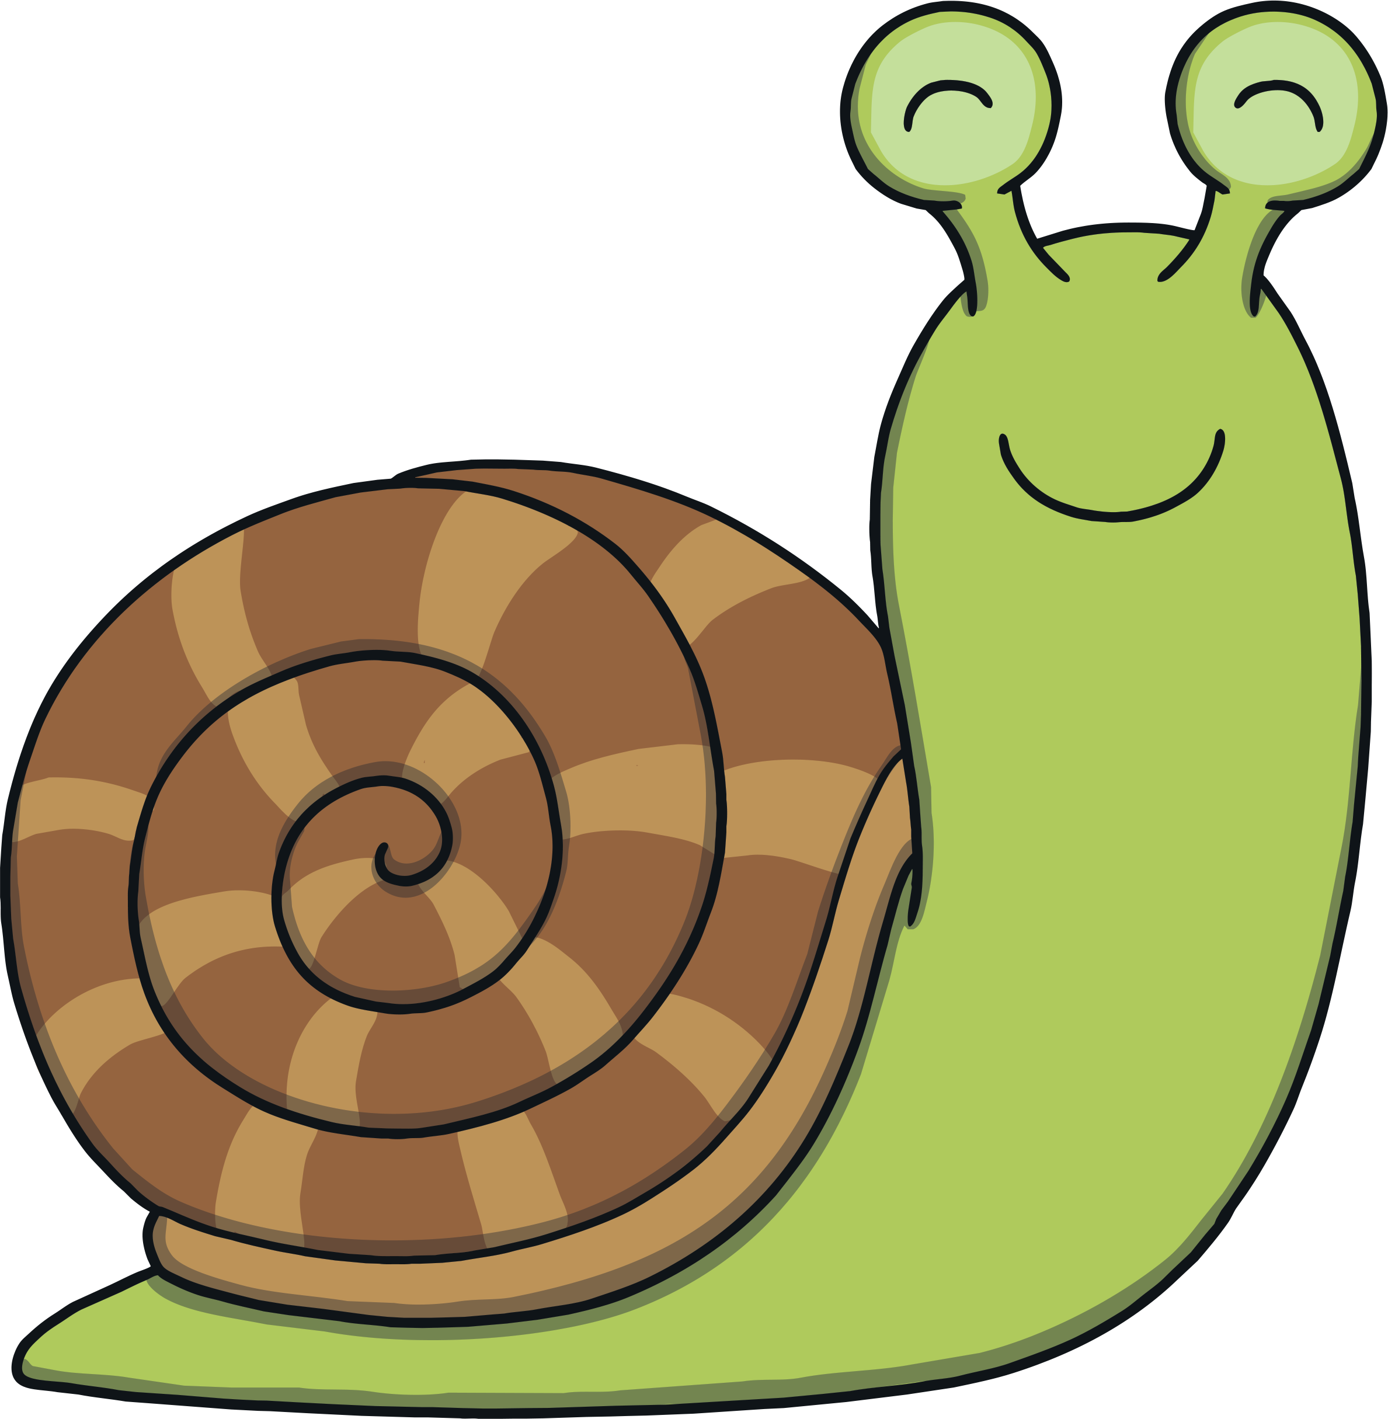
Revisit and Review
Let’s practise Sam’s Sounds and Tricky Words!
v
j
y
oa
x
qu
ch
ng
w
zz
z
th
igh
ee
ai
sh
th
she
me
we
he
be
was

Slide 4
Teach
This week, we meet our next tricky word – my.
Tricky words are words that can’t be sounded out. We just have to learn them off by heart!

Slide 5
Tricky Stars
Teach
Shout out the tricky words on the stars. Watch out for tricky word my!
X
Remember, tricky words from this level are shown in red in the story and decodable or familiar words are in purple. Digraphs and trigraphs are underlined.
Click me for Kit’s teaching tips!

Slide 6
me
was
was
be
was
me
my
me
be
be
my
my

Slide 7
Teach
“It’s time for bed,” said Mum and Dad, so Kit and Sam went upstairs and got on their pyjamas as quickly as they could.

Slide 8
Teach
Sam was ready first so she went to peep out of the window before she closed the curtains. “Look at the moon tonight!” she called.

Slide 9
Teach
Kit looked out and to his surprise there was a big, bright and beautiful full moon. “Ooh!” he said.

Slide 10
o
o
Teach
Teach
X
Encourage children to make the long /oo/ sound here. You could ask them to try continuing the sound for a couple of seconds, to help them differentiate from the short /oo/ sound coming later.
Sometimes, an o and another o partner up. They say oo.
Click me for Kit’s teaching tips!

Slide 11
Teach
oo

Slide 12
Teach
Action
Point at the moon.
Say ‘oo’.

Slide 13
Write the Letters
Teach
oo
Around the orange and around the orange.
Play

Slide 14
Teach
oo Point at the moon.
(To the tune of ‘I See the Moon’)
I see the moon,
The bright moon sees me,
oo - in the dark night,
It shines down on me.
Play Song

Slide 15
Shooting Stars
Practice
Kit and Sam also see some shooting stars. Each star leaves a word behind it. Can you help to read the words?

Slide 16
Practice
boot
Check

Slide 17
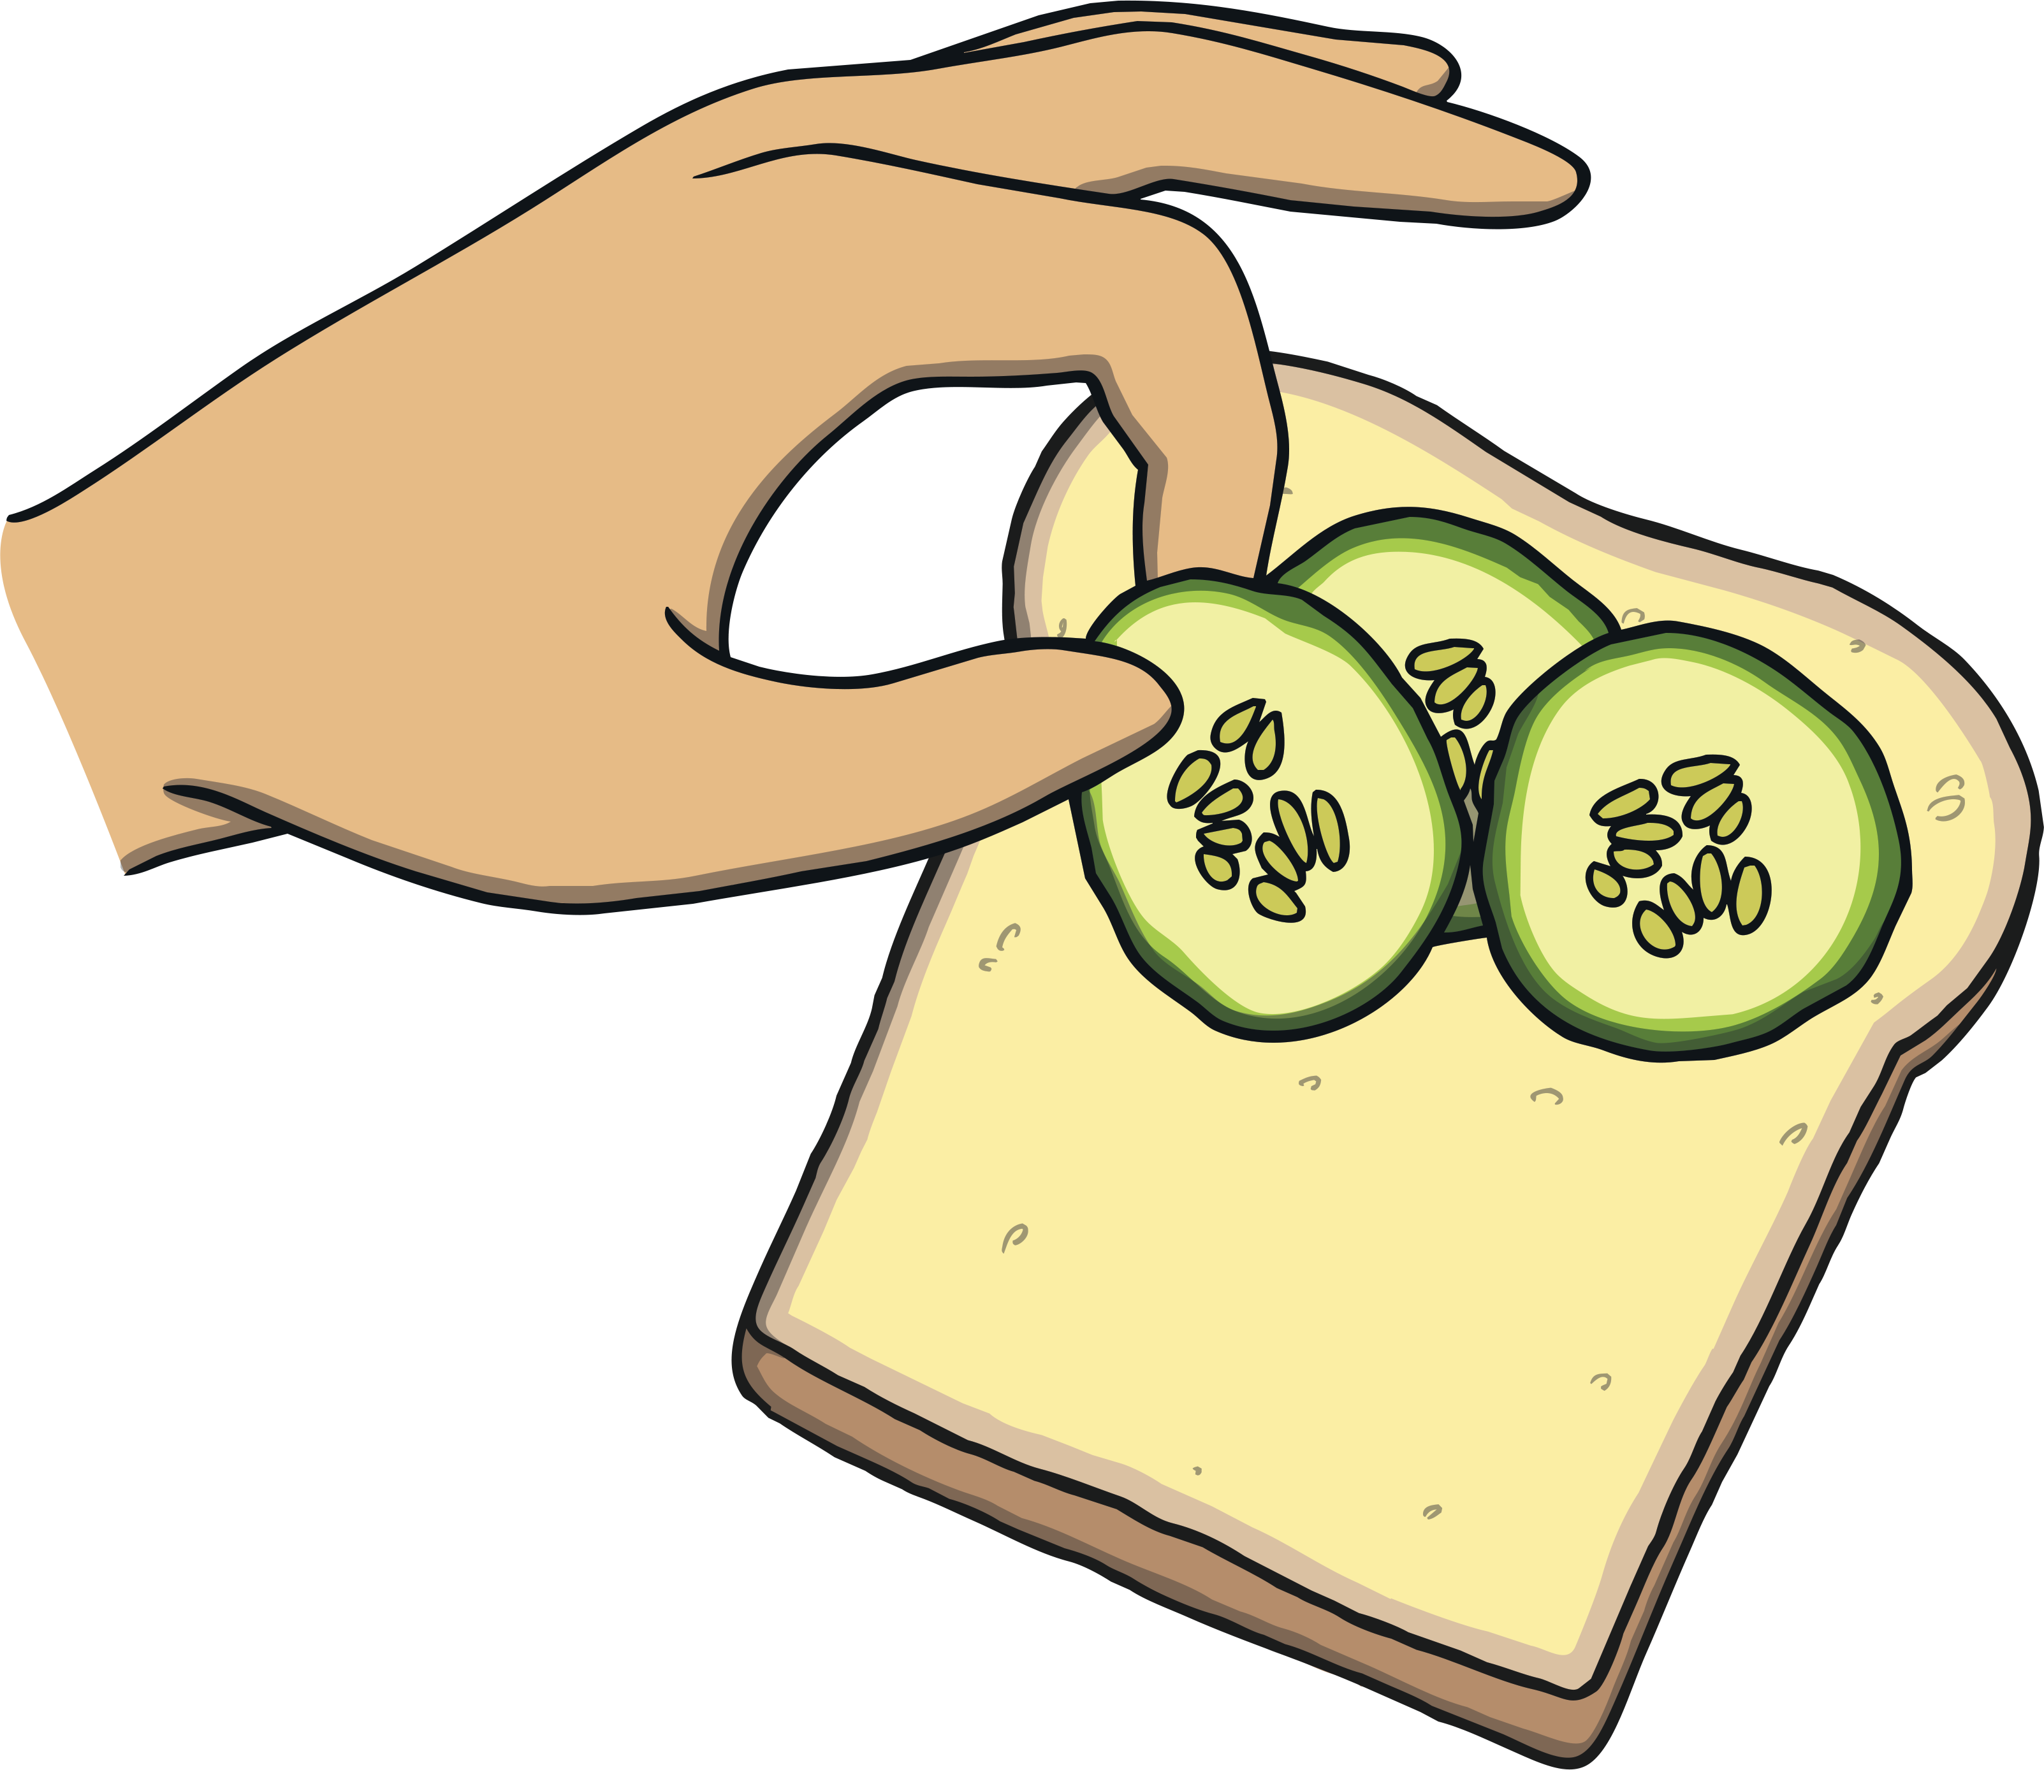
Practice
food
Check

Slide 18
Practice
hoof
Check

Slide 19
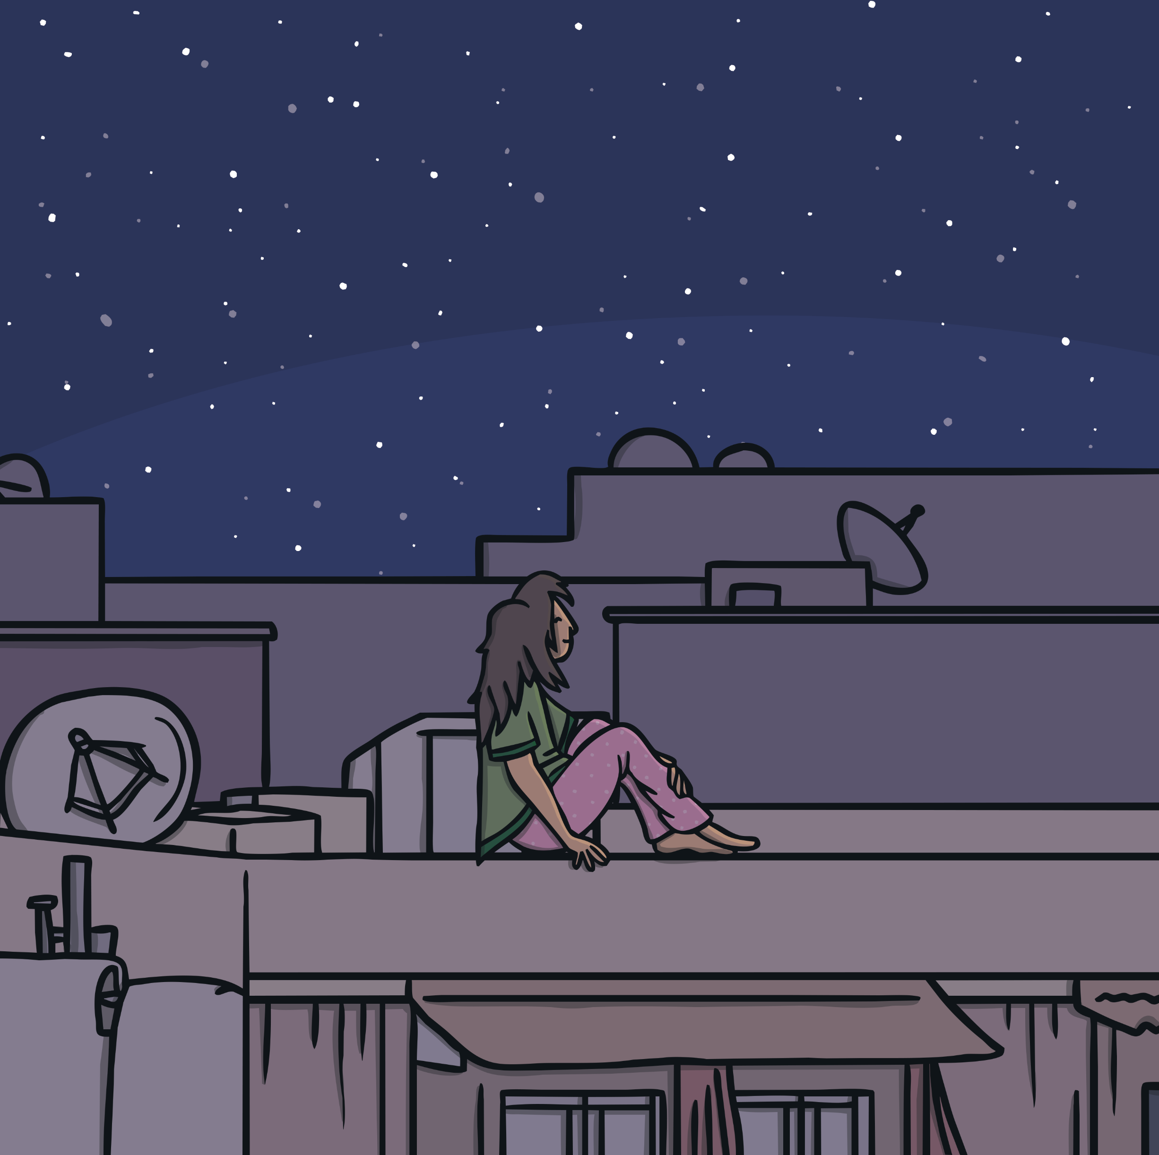
Practice
roof
Check

Slide 20
Practice
tool
Check

Slide 21
Apply
“Look at the stars as they shoot too. Let’s make a wish!” said Kit.
“Cool idea!” said Sam. They both closed their eyes and wished as hard as they could.

Slide 22
Sentence Time
Apply
What did Kit and Sam wish for? Read the sentence to find out.
X
Click ‘Sound Buttons On/Off’ to select whether you want to show sound buttons under the caption.
Click me for Kit’s teaching tips!

Slide 23
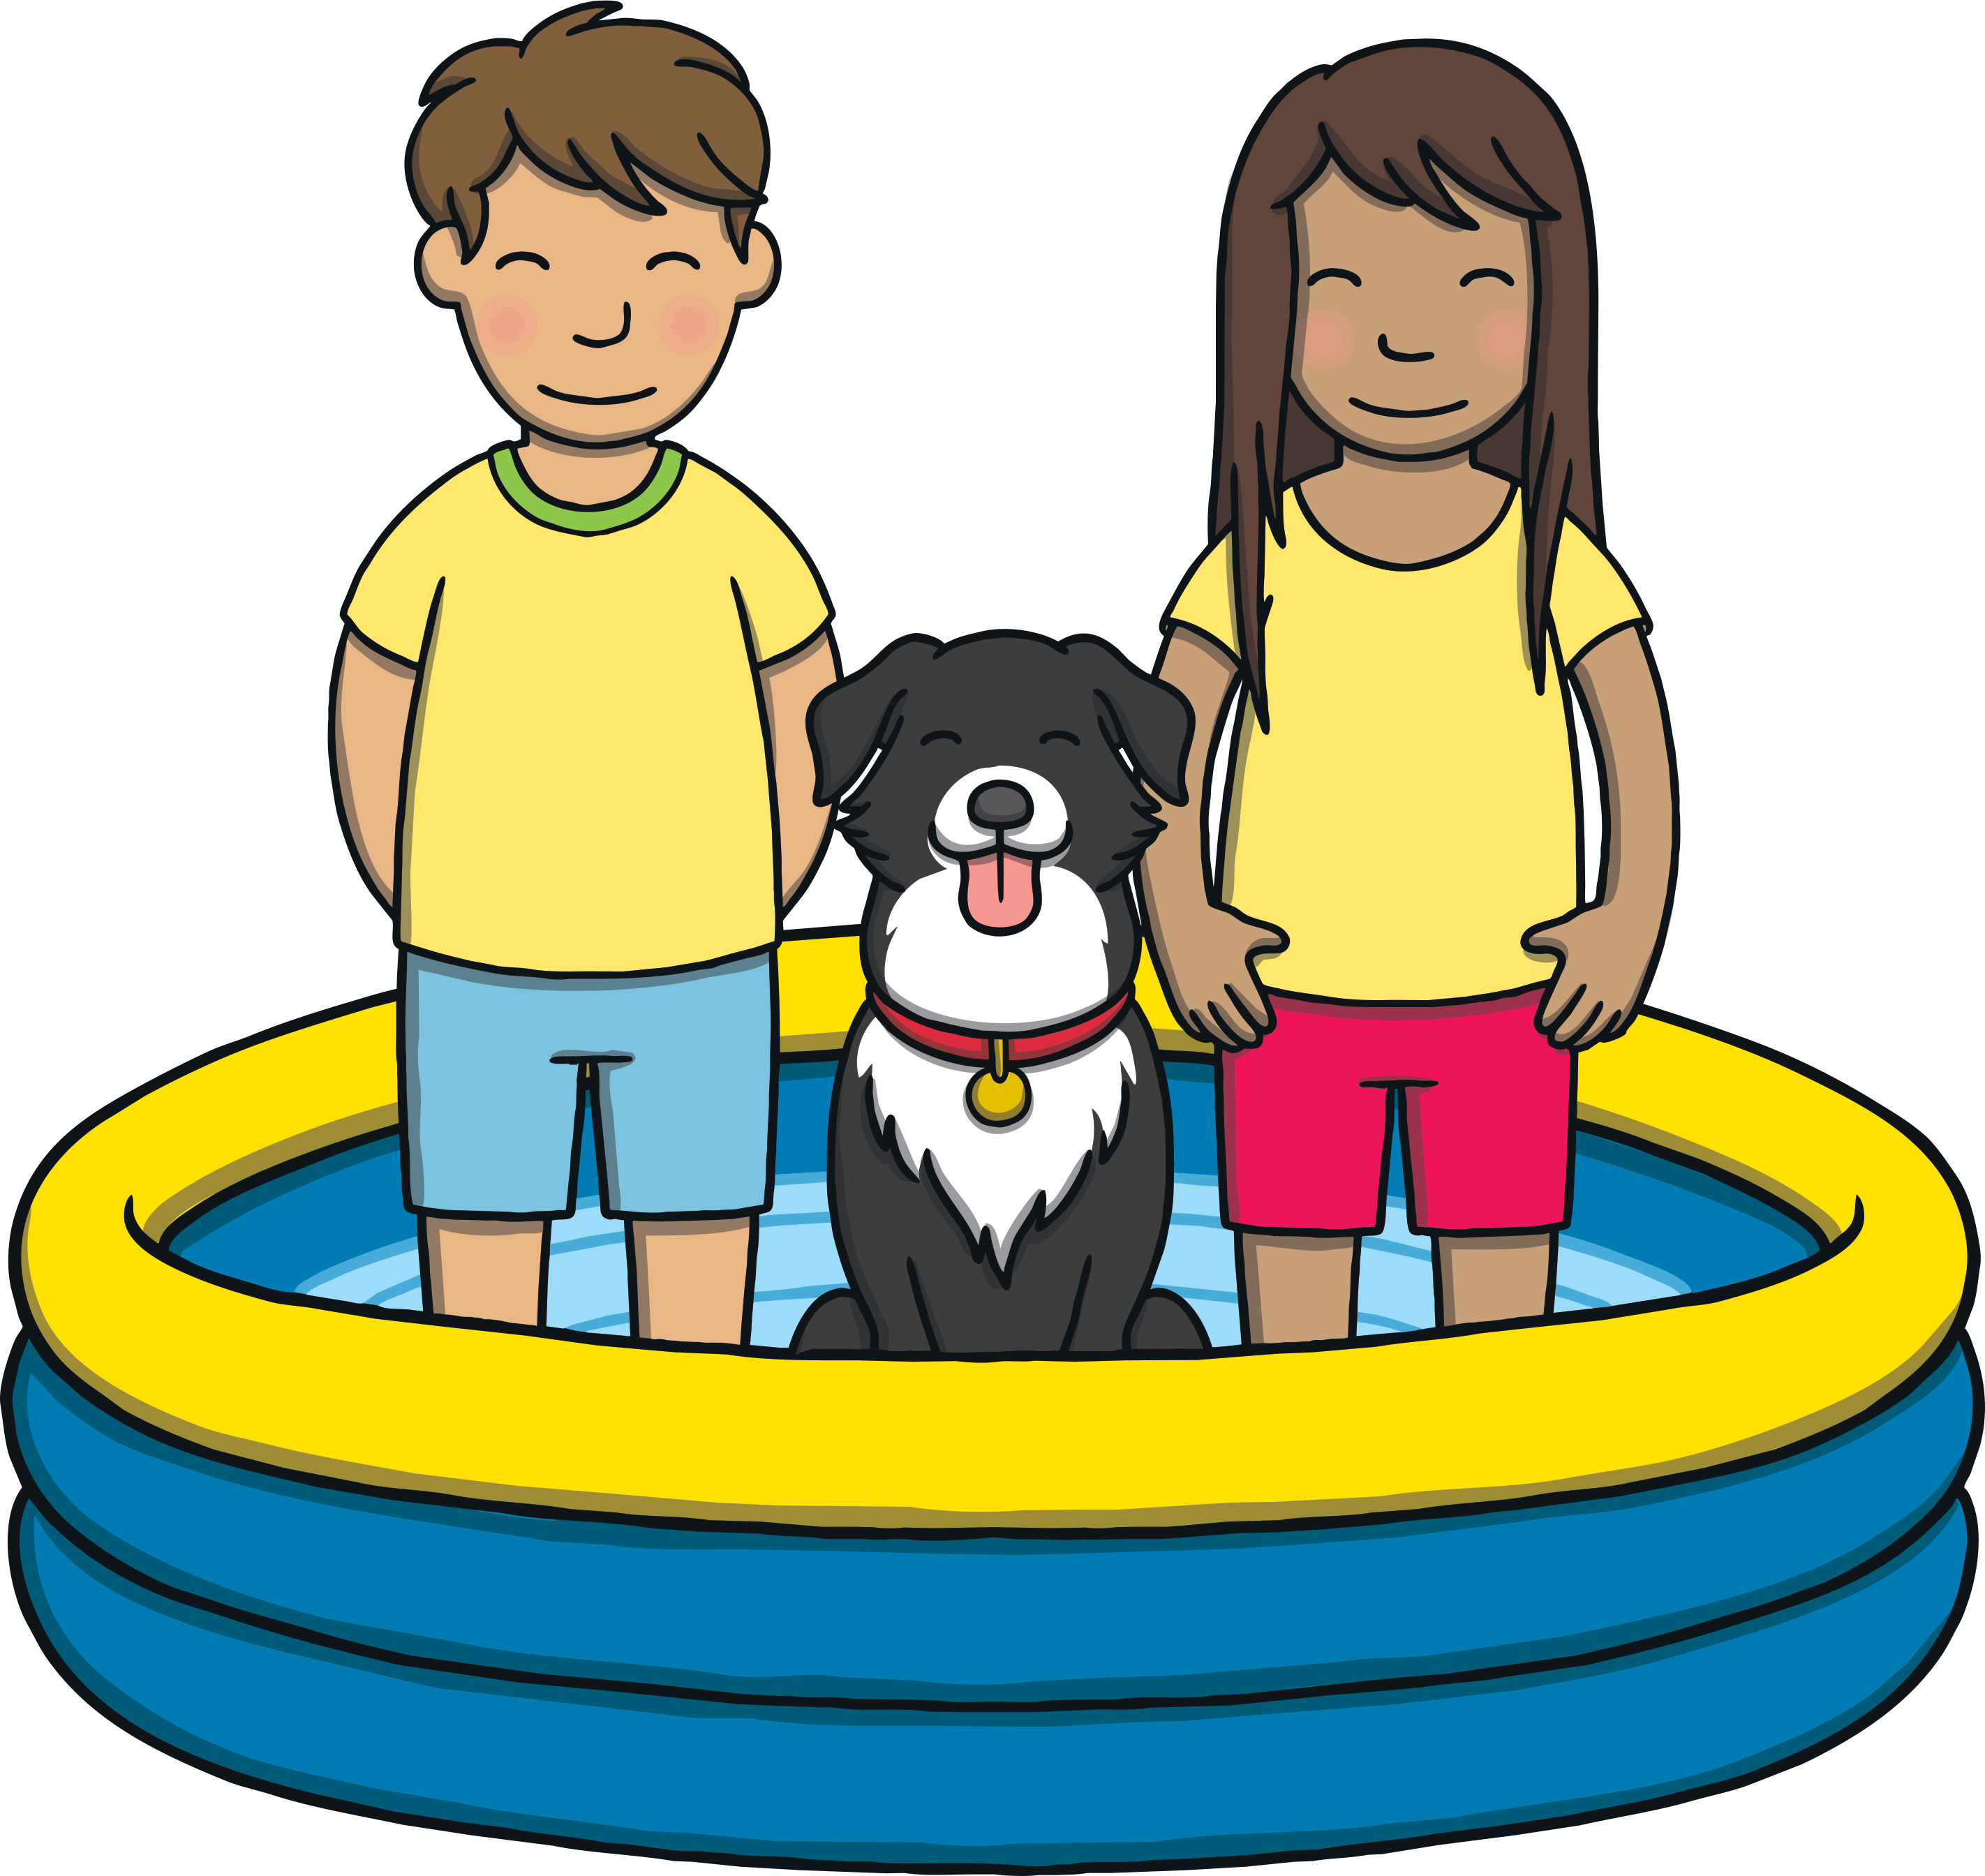
Apply
Sound Buttons On/Off
We wish we had a pool.
Show

Slide 24
Apply
The next day was a lovely, sunny day. Mum came home from the shop at noon with a surprise. It was a paddling pool for Kit and Sam!

Slide 25
Apply
“Our wish came true!” said Kit.
“I think Ben wished for a pool too!” laughed Sam.

Slide 26
Today, we have learnt…
oo
(long)

