Slide 1
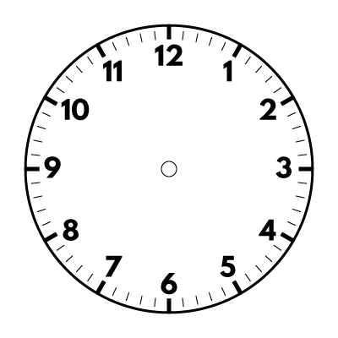
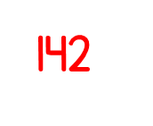
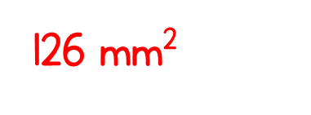
Year 5 | Week 3 | Day 3

Slide 2
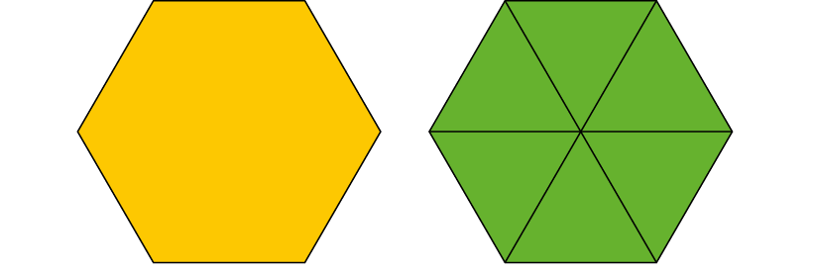
3.3 Non-unit fractions Step 1:2
Notes:
Show me one-sixth.
Now show me four lots of one-sixth.

Slide 3
3.3 Non-unit fractions Step 1:5
3 one-tenths = three-tenths
Notes:
I have three one-tenths. I have three-tenths.

Slide 4
3.3 Non-unit fractions Step 1:5
How many tenths of a metre?
Notes:
How many one-tenths of a metre does the ribbon measure?

Slide 5
3.3 Non-unit fractions Step 1:5
3 one-tenths of a kg = three-tenths of a kg
Notes:
Hannah has 1 kg of rice in total.
She has circled the amount of rice she needs for her recipe.
How many tenths of the whole kilogram does Hannah need?

Slide 6
3.3 Non-unit fractions Step 1:6
How many parts are shaded?
How many equal parts?
Notes:
There are eight equal parts in the whole.
There are three parts shaded.
Three-eighths is shaded.

Slide 7
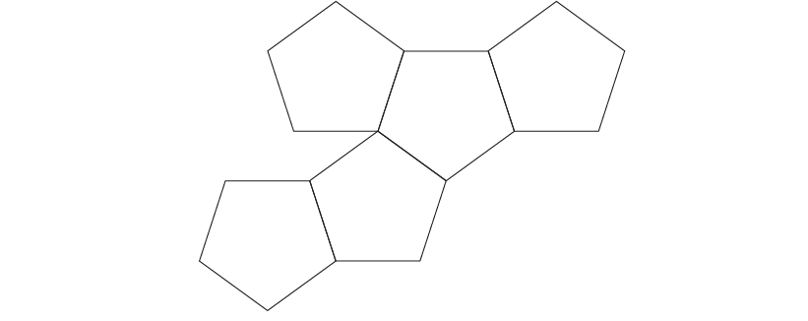
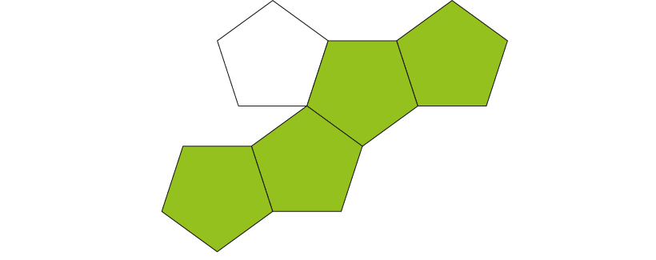
3.3 Non-unit fractions Step 1:6
How many parts are shaded?
How many equal parts?
Notes:
There are five equal parts in the whole.
There are four parts shaded.
Four-fifths is shaded.

Slide 8
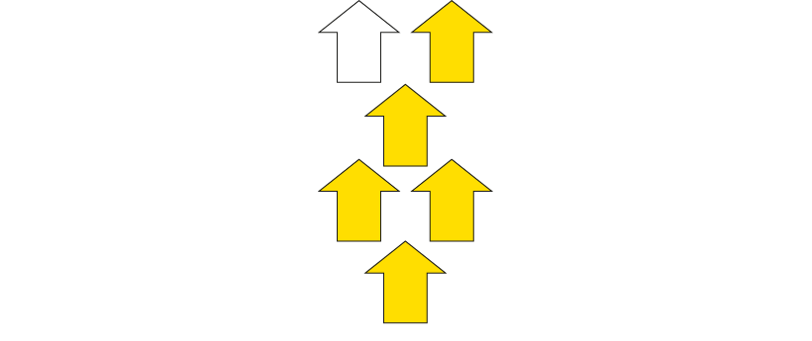
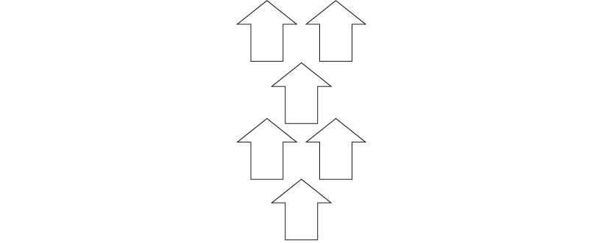
3.3 Non-unit fractions Step 1:6
Describe the fraction

Slide 9
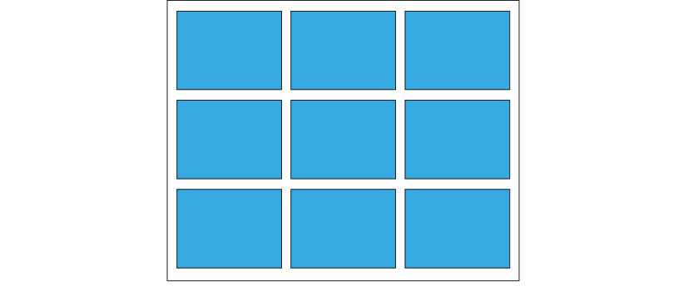
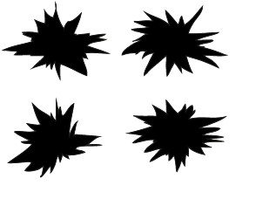
3.3 Non-unit fractions Step 1:6
What fraction of the whole window will need new window panes?
Notes:
Carly was playing football and accidentally broke some panes of glass in a window.
What fraction of the whole window will need new window panes?

Slide 10
3.3 Non-unit fractions Step 1:6
What fraction of the whole is orange?

Slide 11
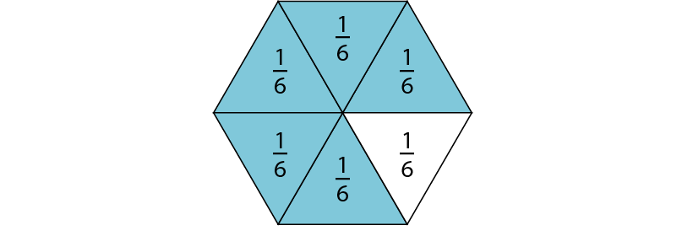
3.3 Non-unit fractions Step 2:1
Complete the stem sentence:
The whole has been divided into ____ equal parts.
____ of the whole parts are shaded; that is ____ of the whole.
Notes:
Complete the stem sentence:
The whole has been divided into ____ equal parts.
____ of the whole parts are shaded; that is ____ of the whole.
How do you think we could write five-sixths?

Slide 12
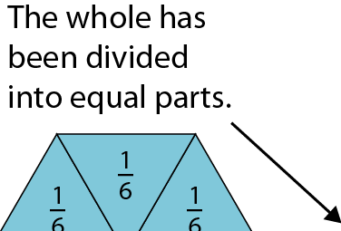
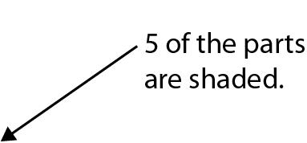
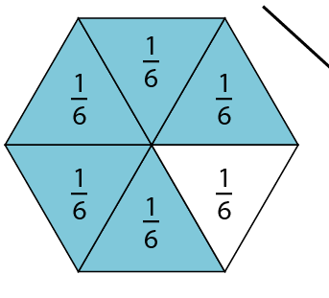
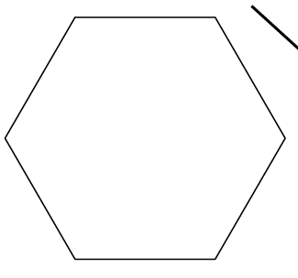
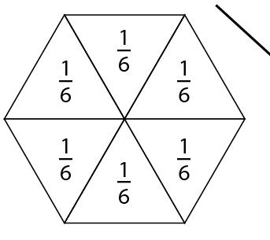
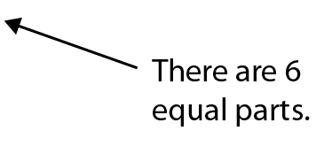
3.3 Non-unit fractions Step 2:1
Notes:
What does the ‘6’ represent?
What does the ‘5’ represent?
The whole has been divided into six equal parts.
Five of the parts are shaded.
This is five-sixths of the whole.

Slide 13
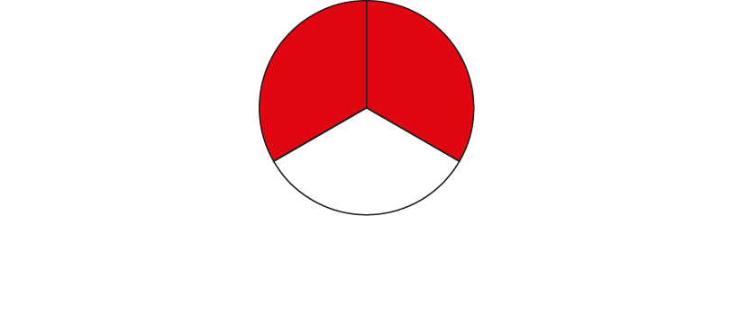
3.3 Non-unit fractions Step 2:2
The whole has been divided into 3 equal parts.
2 equal parts are shaded.
Notes:
What does the ‘3’ represent?
What does the ‘2’ represent?

Slide 14
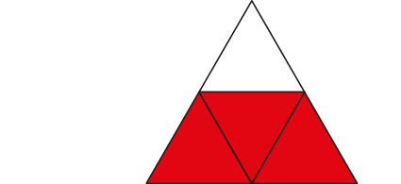
3.3 Non-unit fractions Step 2:2
The whole has been divided into four equal parts.
Three of the equal parts have been shaded.
What does the ‘4’ represent?
Notes:
The whole has been divided into four equal parts.
Three of the equal parts have been shaded.
What does the ‘4’ represent?
What does the ‘3’ represent?

Slide 15
3.3 Non-unit fractions Step 2:2
The whole has been divided into two equal parts.
Two of the equal parts have been shaded.
Notes:
The whole has been divided into two equal parts.
Two of the equal parts have been shaded.

Slide 16
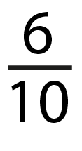
3.3 Non-unit fractions Step 2:2
Write the fraction of the whole that is shaded.
Notes:
Write the fraction of the whole that is shaded.

Slide 17
3.3 Non-unit fractions Step 2:2
Write the fraction of the whole that is shaded
Notes:
Write the fraction of the whole that is shaded.

Slide 18
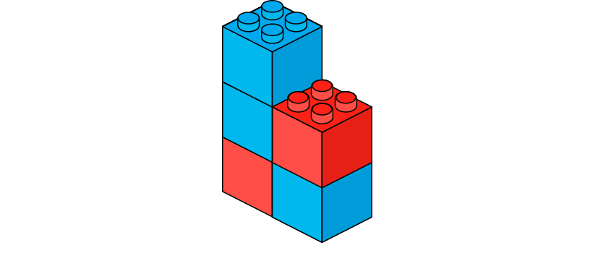
3.3 Non-unit fractions Step 2:2
5
3
2
Notes:
Sam has made this model using building bricks.
How many equal parts make up the whole?
What fraction of the whole is blue?
What fraction of the whole is red?

Slide 19
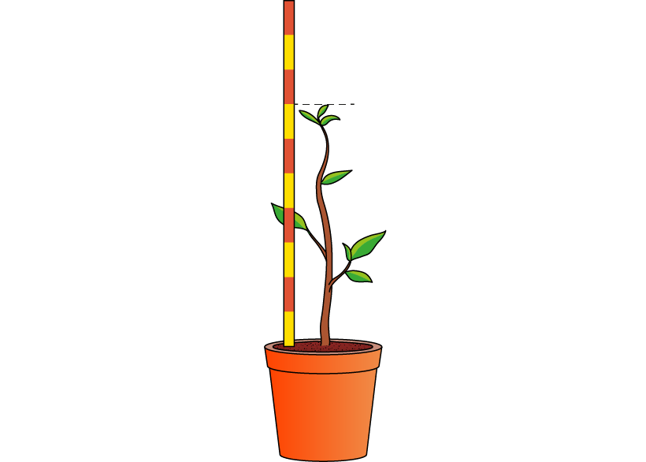
3.3 Non-unit fractions Step 2:2
Ameera is measuring a plant she has grown.
She uses a metre stick.
What fraction of one metre does the plant measure?
Notes:
Ameera is measuring a plant she has grown.
She uses a metre stick.
What fraction of one metre does the plant measure?

Slide 20
3.3 Non-unit fractions Step 2:2
Notes:
Pawel is sharing his orange with Dominika.
What fraction does Pawel have?
What fraction does Dominika have?

Slide 21
3.3 Non-unit fractions Step 2:3
Write each non-unit fraction that is shaded.
Notes:
Write each non-unit fraction that is shaded.

Slide 22
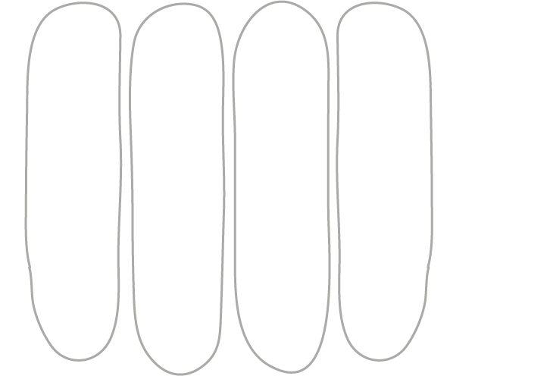
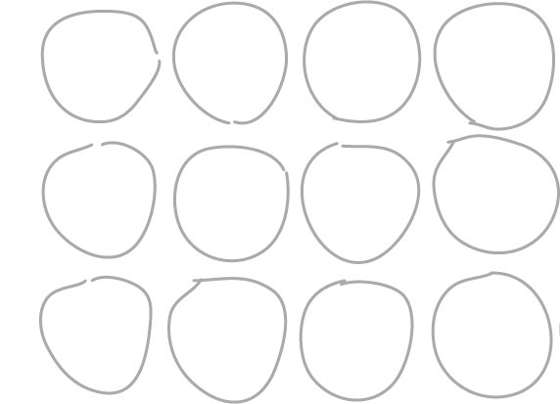
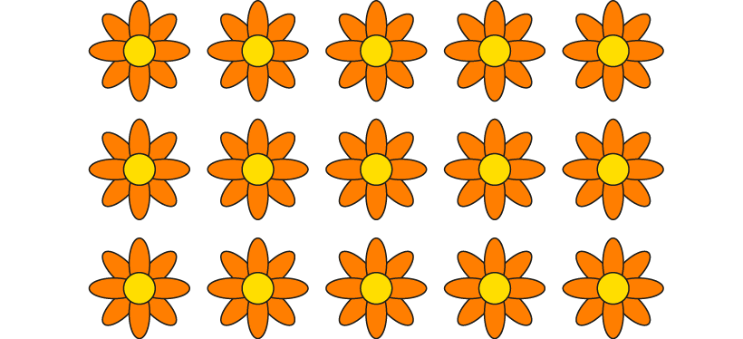
Step 2:6
How else can I express the fraction that I have circled?
Notes:
How else can I express the fraction that I have circled?

Slide 23
3.3 Non-unit fractions Step 2:6
or
Notes:
What fraction of the line is highlighted?

Slide 24
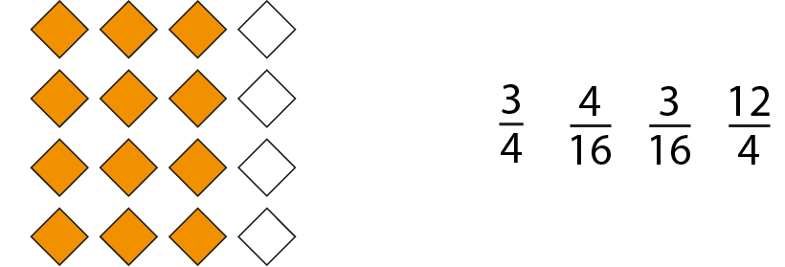
3.3 Non-unit fractions Step 2:6
Tick the matching fraction.
✓
✓

Slide 25
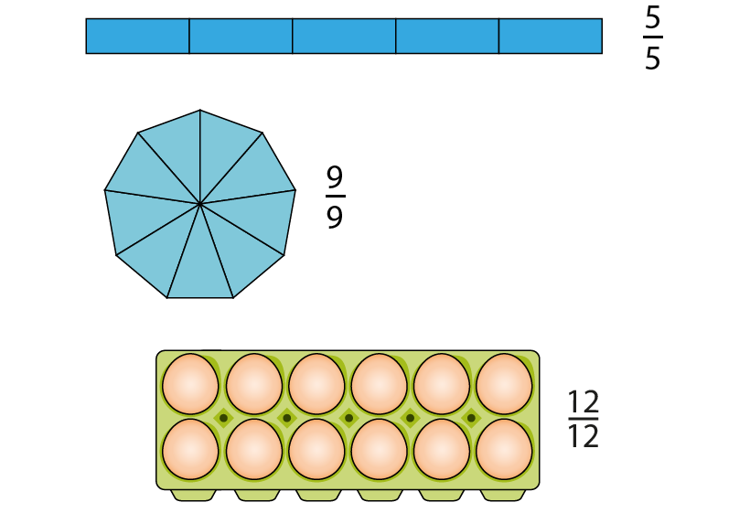
3.3 Non-unit fractions Step 3:3
Notes:
What do you notice about the numerators and the denominators?

Slide 26
3.3 Non-unit fractions Step 3:4
Fill in the missing numerators, so that each fraction is equivalent to one whole.
Notes:
Fill in the missing numerators, so that each fraction is equivalent to one whole.

Slide 27
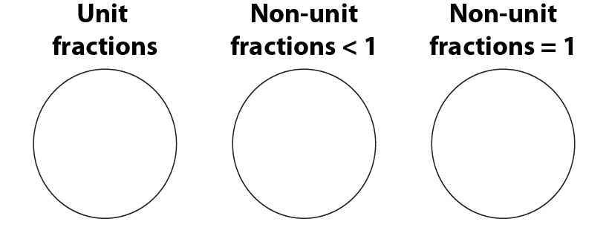
3.3 Non-unit fractions Step 6:4
Sort these numbers into the correct sorting circles:

Slide 28
3.3 Non-unit fractions Step 8:1
Notes:
Write the fraction that is represented, then use < or > to compare each pair.

Slide 29
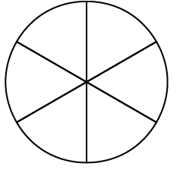
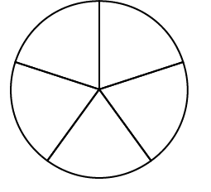
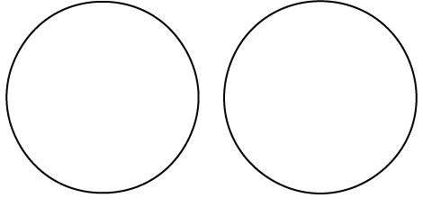
3.3 Non-unit fractions Step 8:8
Method 1 – on a diagram

Slide 30
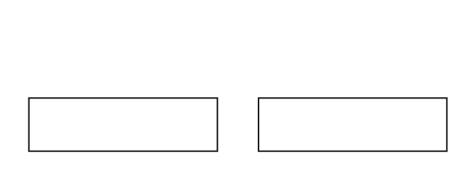
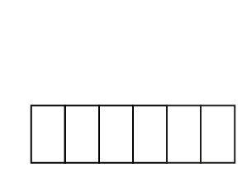
3.3 Non-unit fractions Step 8:8
Method 1 – on a diagram

Slide 31
3.3 Non-unit fractions Step 8:8
Method 2 – on a number line

Slide 32
3.3 Non-unit fractions Step 8:8
Method 3 – verbal reasoning

Slide 33
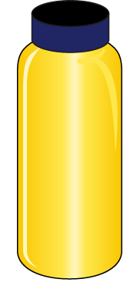
Extension answer
3.3 Non-unit fractions Step 8:13
Notes:
Sally has $\frac{1}{3}$ of her juice left.
Freddy has $\frac{1}{5}$ of his juice left.
$\frac{1}{3}$ > $\frac{1}{5}$ So, Sally has more juice left.

Slide 34
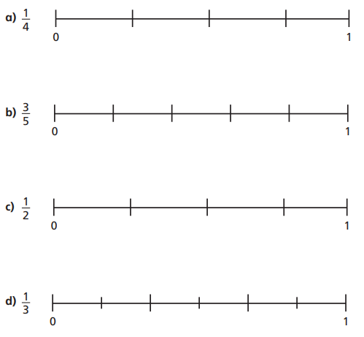
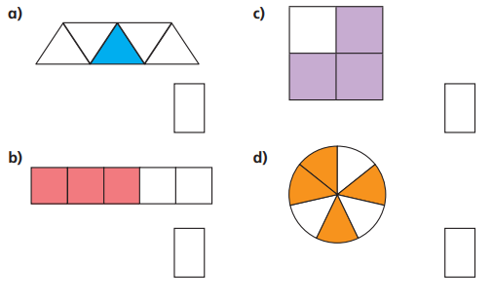
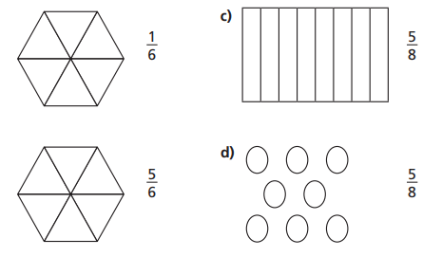
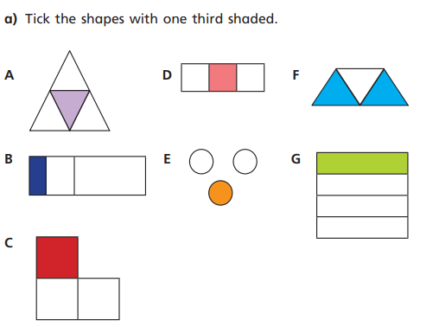
1. Write what fraction is shaded
3. Draw the number lines (ensure equal measure between divides) Draw an arrow to mark where the fraction would sit.
2. Copy the shapes then shade to match the fractions.
4. Write down the letters of the shapes with 1/3 shaded.

Slide 35
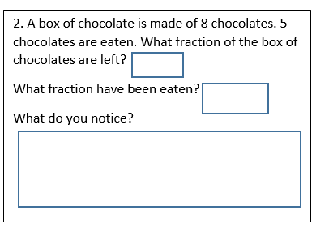
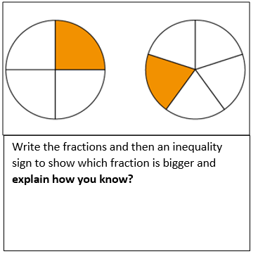
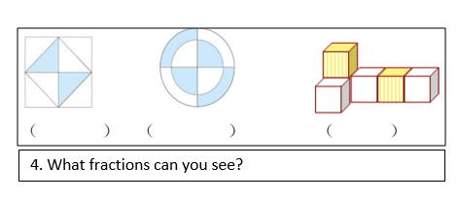
5
7
6. What fractions can you see? Write the fraction for each shape.

Slide 36
Extension

