Slide 1
10.02.21
Maths
WALT understand column multiplication

Slide 2
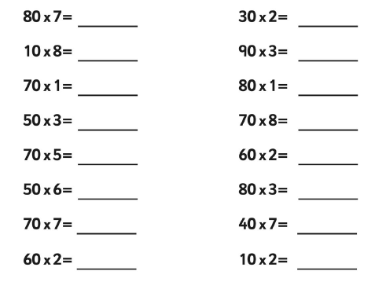
How quickly can you solve these calculations?

Slide 3
1. 43 x 2 =
2. 69 x 2 =
3. 87 x 2 =
4. 52 x 3 =
5. 63 x 3 =
6. 48 x 3 =
7. 39 x 4 =
8. 56 x 4 =
9. 85 x 4 =
10. 25 x 5 =
Mild
11. 37 x 5 =
12. 53 x 5 =
13. 76 x 5 =
14. 85 x 5 =
15. 92 x 5 =
Hot
Spicy

