Slide 1
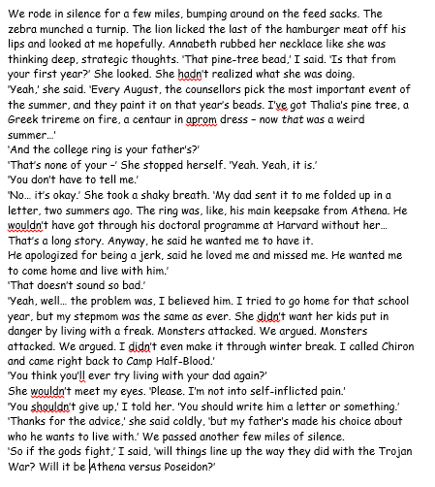
VIPERS
What were the Zebra and lion eating? ®
Who gave Annabeth the college ring? ®
Who did the ring originally belong to and how do you know? ®
What special things do the councillors do every August? ®
Why do you think the Lion looked at Percy ‘hopefully’ (I)
Why do you think Annabeth argued so much with her step-mother when she went back home for the school year? Explain using evidence form the text. (e)
What phrases from the text suggest that Annabeth will not be going to go back to live with her father anytime soon?
Find a word in the first paragraph that is similar in meaning to tactical. (V)
If the gods did line up and fight against each other as Athena’s team V Poseidon, why would that be awkward for Percy and Annabeth? (E)
Earlier in the paragraph where its states
Why do you think Athena took a shaky breath before telling Percy. How may this tell us about how she feels she was treated.
11. If you were Athena, give reasons using the text, why you would or wouldn’t want to go back to live with your father.

