Slide 2
Aim
I can compare materials according to their properties.
Success Criteria
I can describe a material’s properties.
I can explain the uses of different materials based on their properties.
I can sort and compare materials according to their properties.

Slide 3
Vocabulary
Material: the matter in which something is made of
Property: something that describes a material or substance
Magnetic: an ability to attract and repel certain metals
hard, solid: firm, and rigid; not easily broken, bent, or pierced
Transparent: allowing light to pass through so that objects behind can be distinctly seen
Flexible: capable of bending easily without breaking.
Permeable: will allow liquids or gases to pass through it.

Slide 4
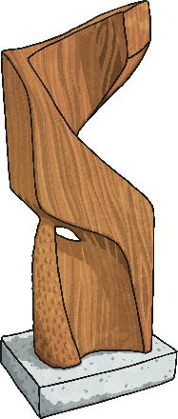
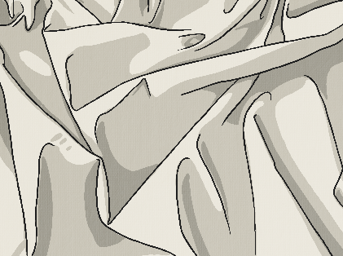
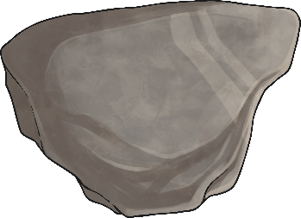
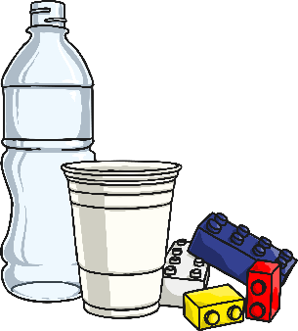
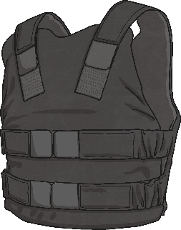
Describing Materials
Any substance that is used to make something is a material.
Natural materials such as stone, wood and cotton are used or worked with in the way they are found in nature.
Synthetic or human-made materials are made from natural materials, but are altered with the help of heat or chemicals. Some examples include plastics, polyester and Kevlar.
Natural
Human-made

Slide 5
Describing Materials
Around your home you should be able to find various materials

Slide 6
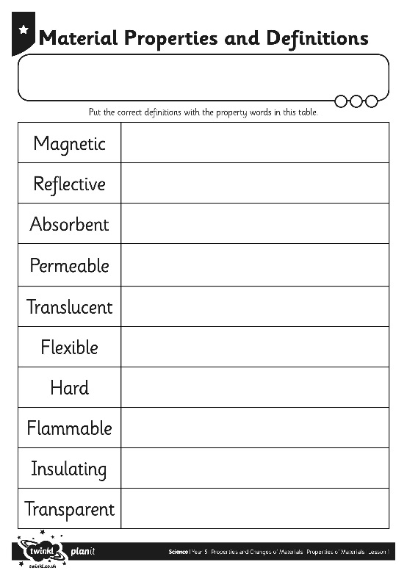
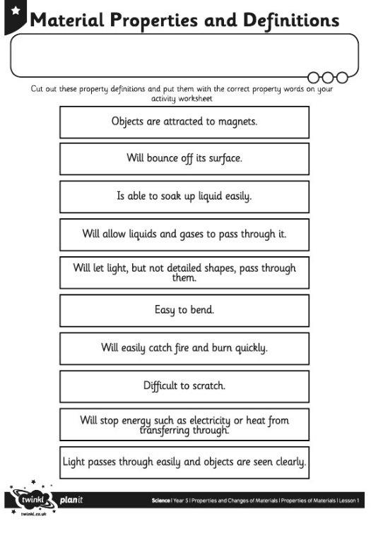
Properties
The words used to describe a material are known as its properties.
Each material has its own set of properties.
These properties make different materials useful for different purposes.
Can you match the properties with their definitions on your Material Properties Activity Sheet?

Slide 7
Using Materials
Why is it useful to know the properties of a material?
It is useful because if you know the properties of a material, you can then choose the best material for a purpose.
Look at objects around your house try to suggest reasons why they have been made using the material they have been made with.

Slide 8
Testing Properties
To find out which properties a material has, they have to be tested.
You are going to test several different materials that you found to find their properties.
You will test for:
magnetism;
hardness;
transparency;
flexibility;
permeability.

Slide 9
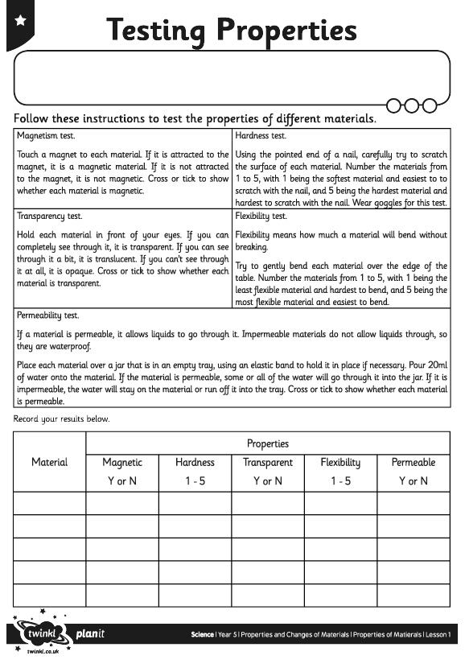
Testing Properties
Follow the instructions for each test, and try out each test with each material that you have in your home.
Complete your Testing Properties Activity Sheet with your results.

Slide 10
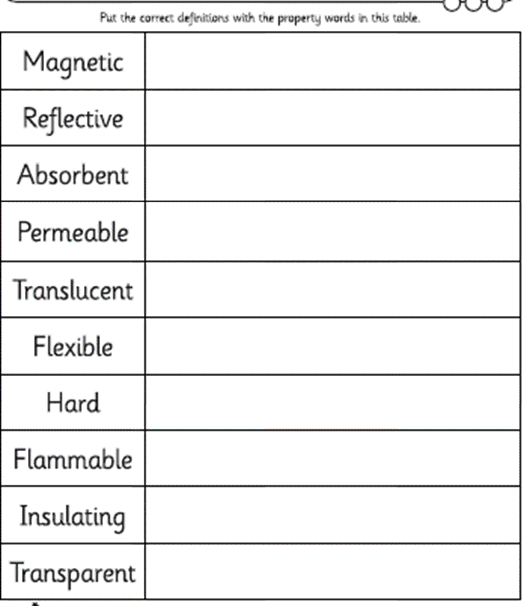

Slide 11
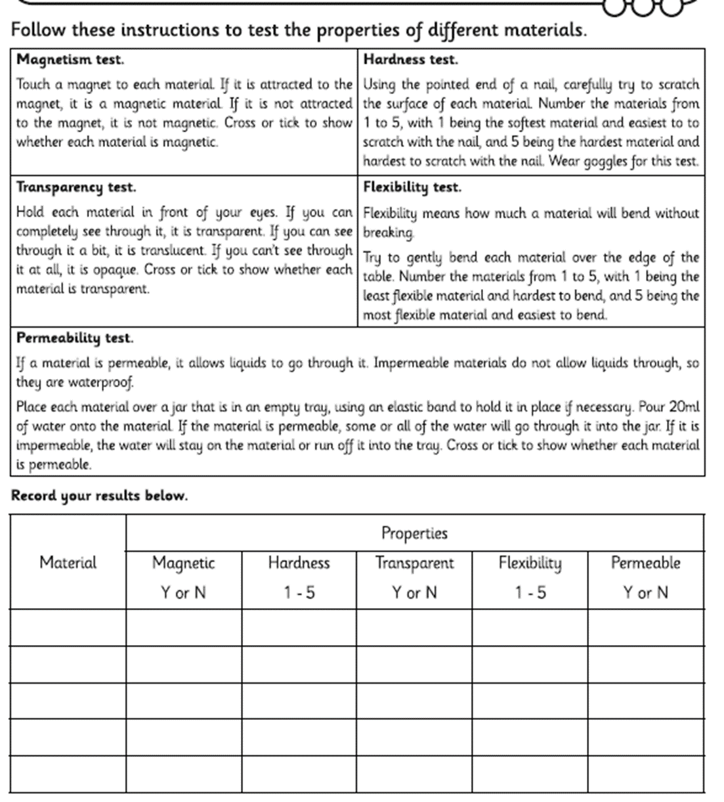
WALT use testing to understand the properties of materials
You will need the materials that you collected earlier including a magnet and a nail or something sharp.
Follow the instructions below to test each material for its properties and record the appropriate number for hardness and flexibility; or a yes or no to answer if it is transparent, magnetic or permeable.

