Slide 1
Thursday 4th February
English
WALT: Plan our non-chronological report

Slide 3
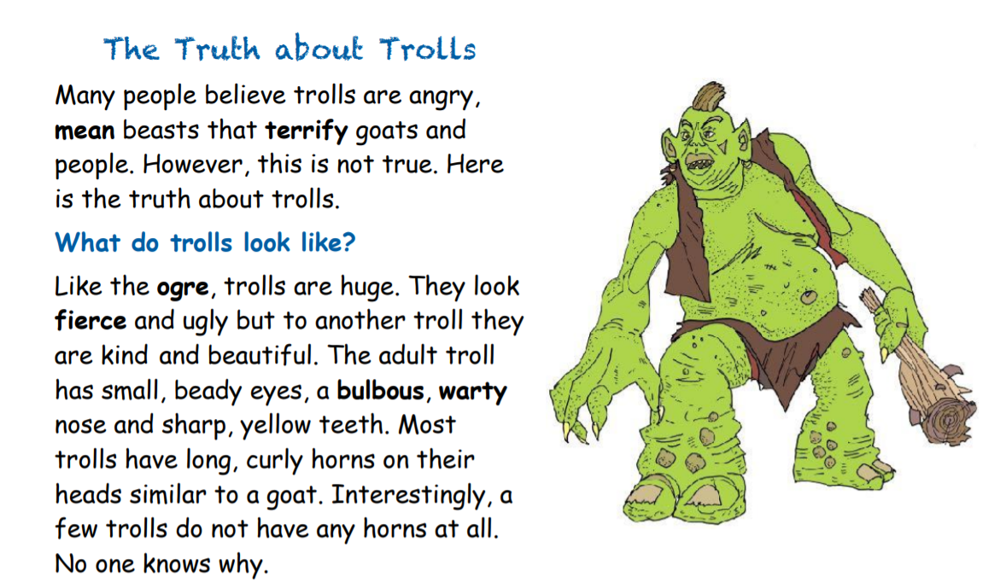

Slide 5
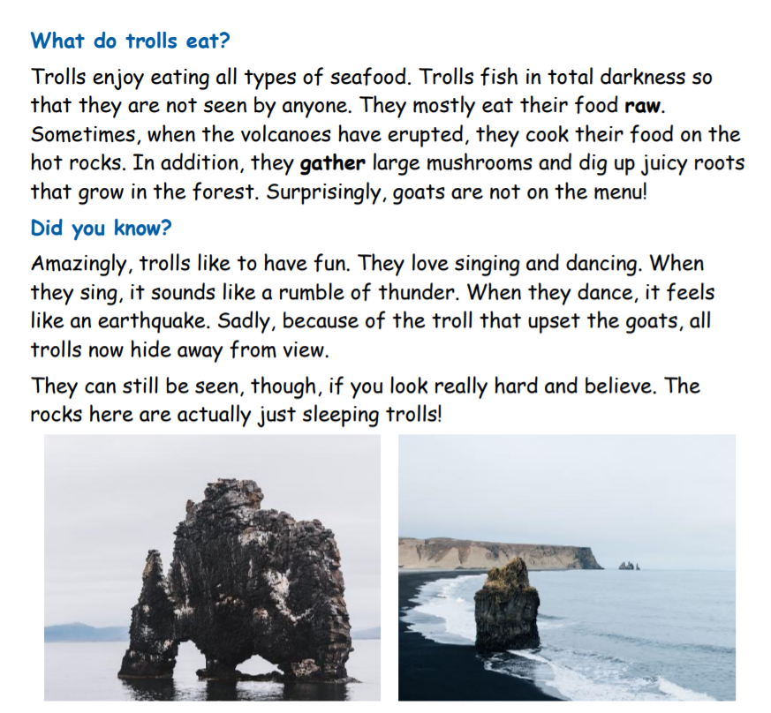

Slide 6
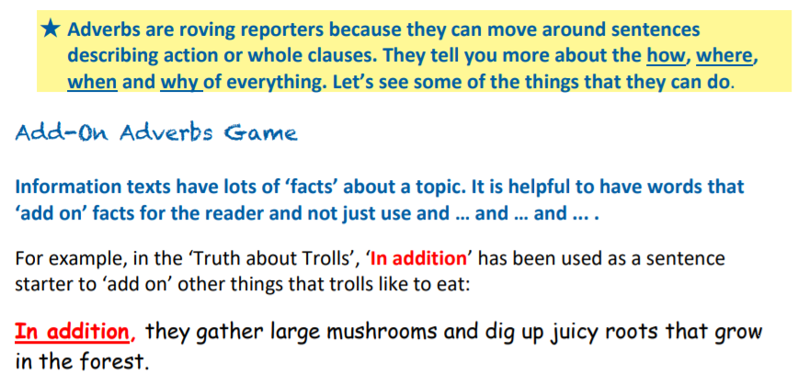
Game 1
Add on Adverbs
What else do you think trolls like to eat?
Think about food you really like or dislike. Tell me your sentence. Don’t forget to start with – In addition,… Furthermore,… or Additionally,…

Slide 7
The Truth about Lava Trolls
Many people believe that Lava Trolls are raging creatures that torment cattle and villagers. However, this is far from the truth. Here is the truth about Lava Monsters.
What do Lava Trolls Look like?
Like the Fire Beast, Lava Monsters are gigantic. The adult Lava Monster has colossal, crumbling boulders for legs, ape-like, amber arms and muscular, flaming shoulders.
Where do Lava Trolls live?
Lava Trolls are usually found near volcanic cities like Hekla and Laki in Iceland. Their habitat is underneath the earth’s crust where they bathe in the scorching lava. This environment allows their body to stay at the correct temperature and also allows them to drink the lava when thirsty.
What do Lava Trolls eat?
During the summer months, Lava Trolls enjoy eating all types of hot food. They mostly feast on a variety of hot objects. Sometimes, they eat coal from fire places. They reach down chimneys and scoop it up with their huge claws. Additionally, when there are fireworks they will catch them in mid-air and eat them like sweets. Furthermore, during the night they will search for metal parts especially oven parts in recycling centres.
Did you know?
Surprisingly, Lava Trolls like to dance. They especially enjoy rock music and like to stomp their feet in time to the music and play air guitar. Interestingly, they heat up with excitement and produce ash clouds from their ears. Sadly, the noise on the ground irritates those Lava Trolls playing chess underground.

Slide 8
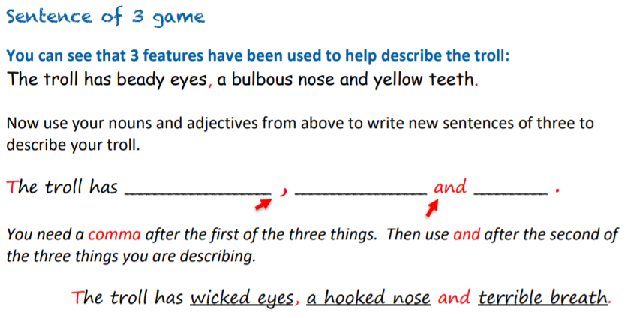
Game 2
Sentence of 3

Slide 9
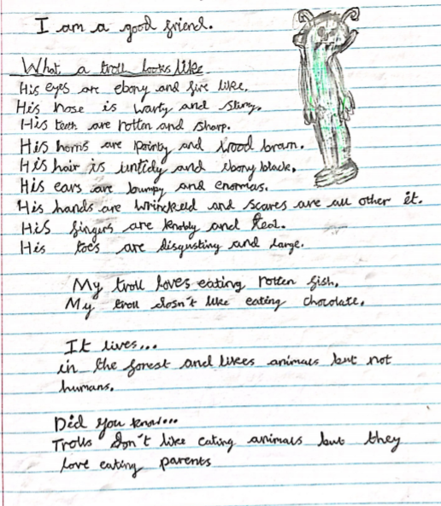
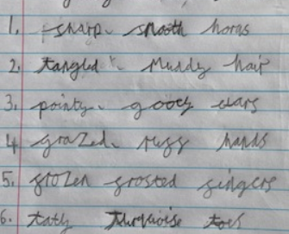
Let’s have a look at some of your adjectives from Tuesday. Does anyone recognise these?

Slide 10
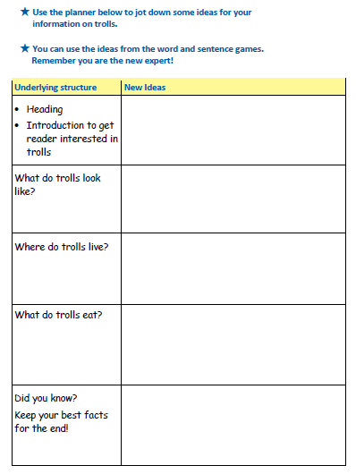
The Truth About Lava Trolls.
Raging creatures. Torment cattle. Here’s the truth.
Surprisingly, Gigantic, colossal, crumbling legs, ape-like amber arms.
Furthermore, Volcanic cities, underneath the earth’s crust – correct temperature. Drink lava.
All hot food. Coal from the fireplace. In addition to this, Fireworks, metal from ovens.
Finally, Dance to rock music and play air guitar. Ash clouds come from their ears

Slide 11
Toolkit
Adjectives with a comma between - colossal, crumbling legs Alliteration - bright, bulbous eyes huge, hairy ears Sentence of 3 - The troll has wicked eyes, a hooked nose and terrible breath.
Sometimes, Additionally, Furthermore, In addition, Also,
Interestingly, Surprisingly, Amazingly,

