Slide 2
Revisit and Review
Let’s practise Sam’s Sounds and Common Exception Words!
oy
ay
their
want
should
could
oh
would

Slide 3
Teach
This week we are learning to spell the common exception words come and some.
Watch the magic pencil write the words. Can you join in?

Slide 4
Teach
come
Play

Slide 5
Teach
some
Play

Slide 6
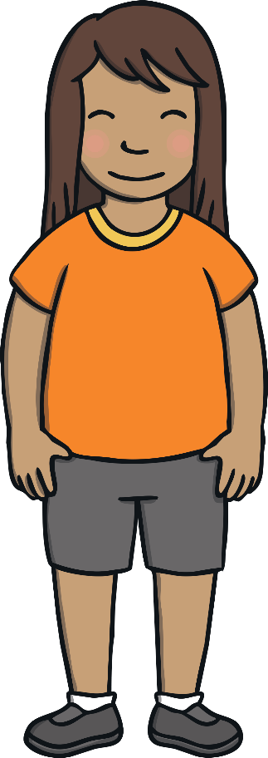
Teach
Today, we are learning to write words that contain ie.

Slide 7
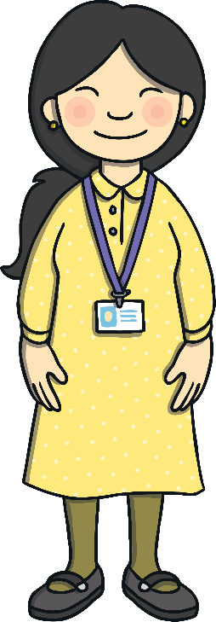
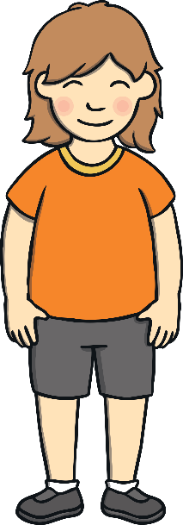
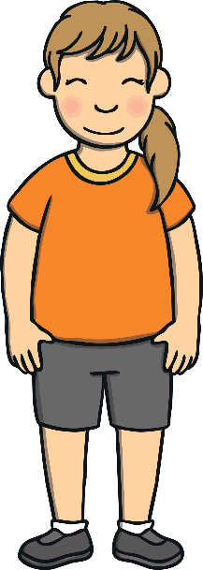
Teach
Kit, Sam and the other children in Mrs Tan’s class were enjoying Keeping Healthy Week. The next day, Mrs Tan took the class out to the school field.

Slide 8
Teach
“Today,” said Mrs Tan, “we are going to learn about keeping healthy by doing exercise. Who can tell me what exercise or sport you like to do?”

Slide 9
Teach
“Cricket!” shouted Sam.
“Ballet!” said Gabi.
“Football!” cheered Jake.
“All excellent,” smiled Mrs Tan. “Now, it is time for our first healthy game.”

Slide 10
Teach
Mr Adams has hidden some ie words around the school playground. Can you help the children to find them?
X
Children could draw a picture of the words as they find them.
Click me for Kit’s teaching tips!

Slide 11
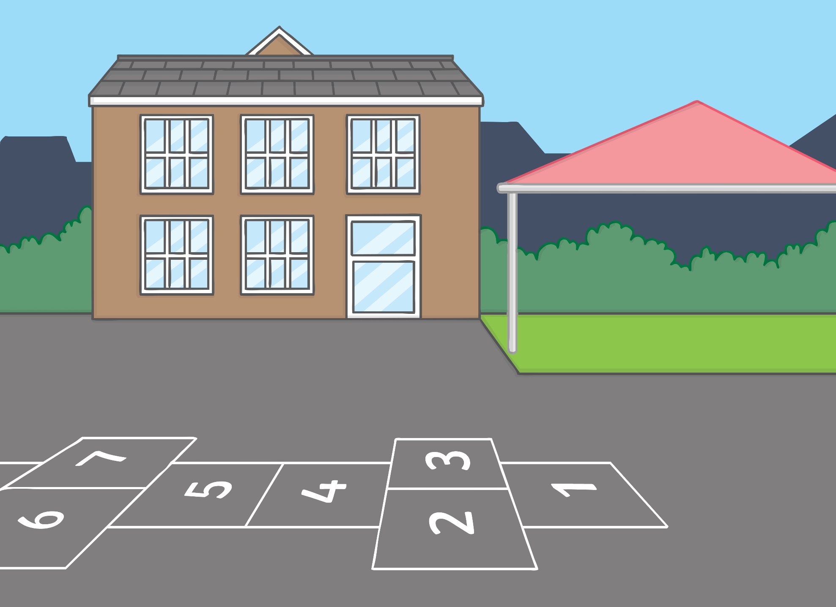
Teach
necktie
applied
pie
lied
skies
fried
supplies
flies

Slide 12
Practise
ie Letter Collect
The children are playing a game. They are racing to collect letters to make an ie word to match the picture. Can you help to find
the right letters?

Slide 13
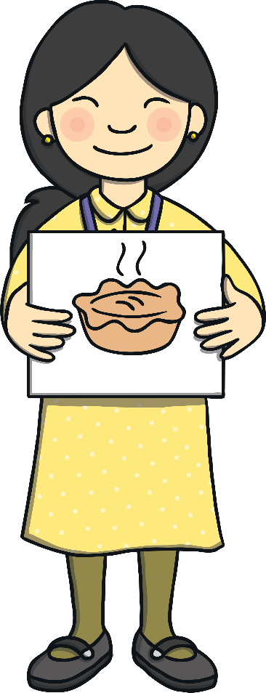
Teach
k
l
i
p
e
Check

Slide 14
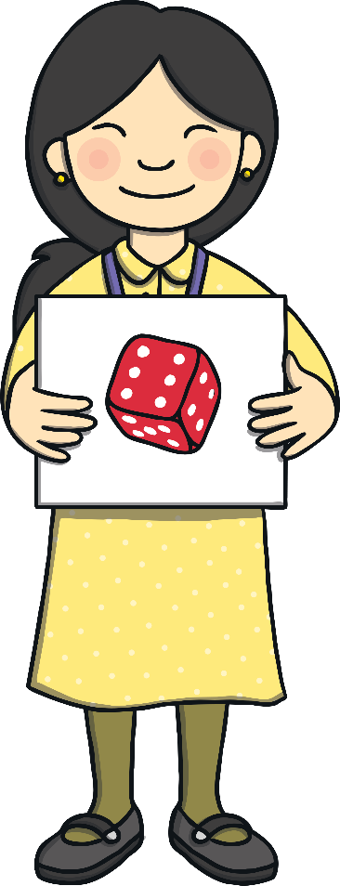
Practise
e
k
d
g
i
a
Check

Slide 15
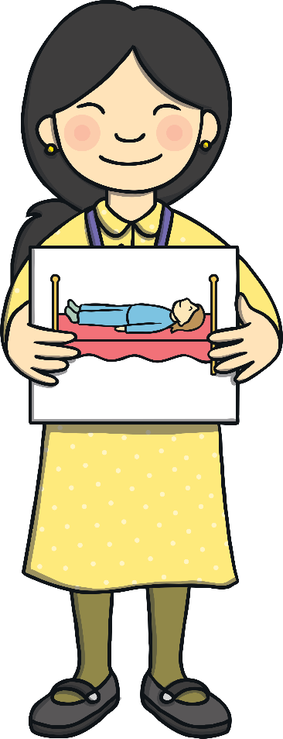
Practise
i
l
r
e
b
p
Check

Slide 16
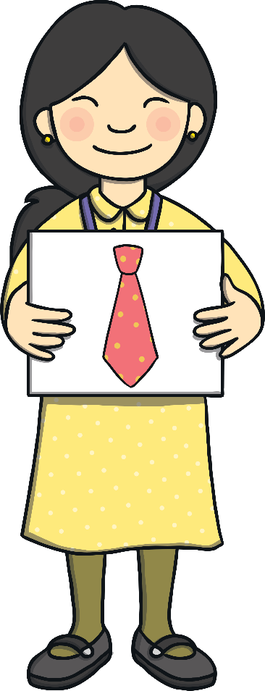
Practise
s
i
t
h
e
Check

Slide 17
Practise
s
i
r
q
t
m
e
f
Check

Slide 18
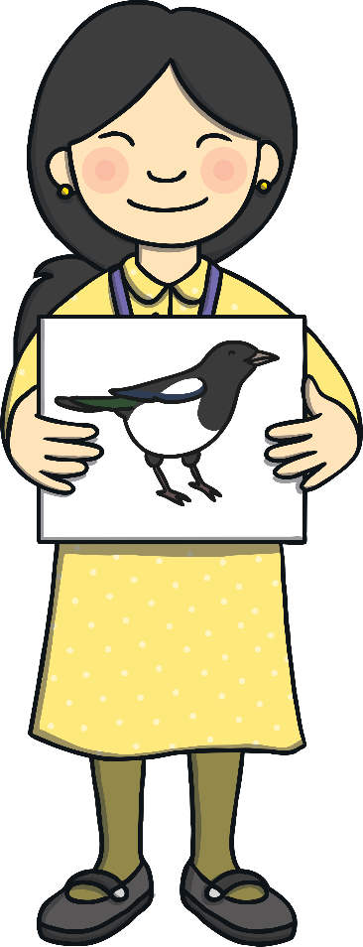
Practise
i
e
p
h
g
b
m
a
z
Check

Slide 19
Practise
The children collected the cards just in time before Mr Adams blew the whistle. They all stood where they were, huffing and puffing.

Slide 20
Sentence Time
Apply
What did Mrs Tan say to the children when she saw them looking so tired? Look at the picture and write a caption to match.
X
Click ‘Show Suggestion’ to see a suggested caption for the picture.
Click me for Kit’s teaching tips!

Slide 21
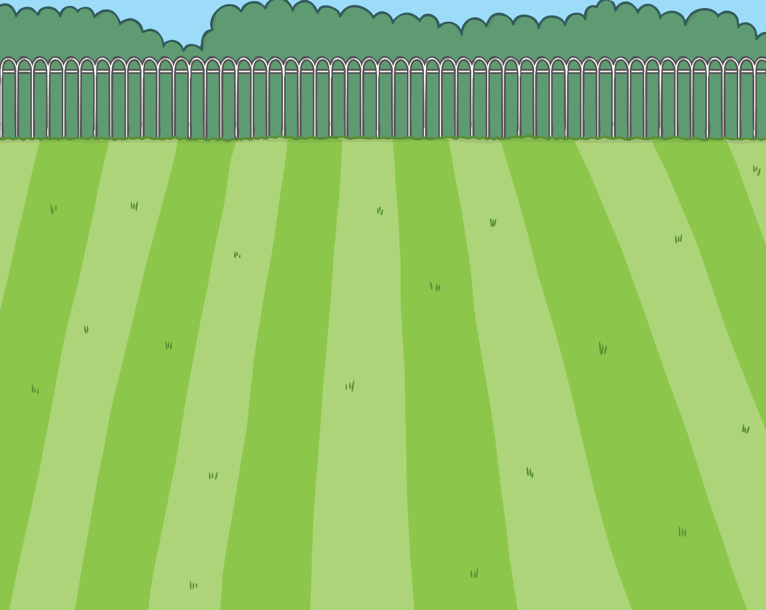
Apply
“Come and have a lie down children!” she cried.
Show Suggestion

Slide 22
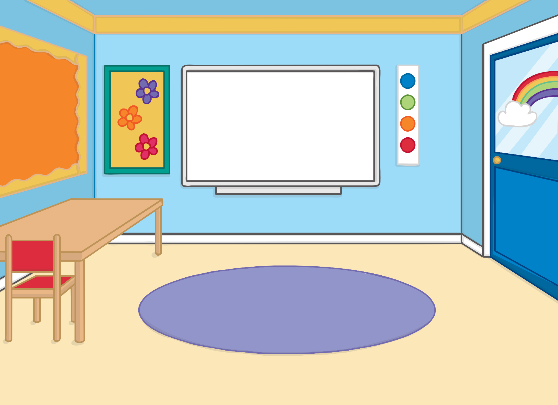
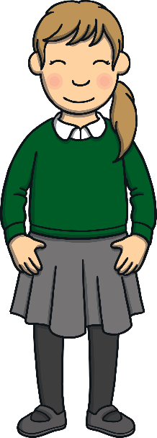
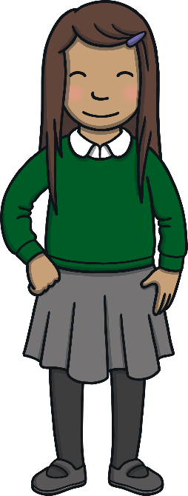
Practise
“So, what have we learnt today?” asked Mrs Tan when they were all back in the classroom.
“That keeping healthy is exhausting!” laughed Kit.

Slide 23
Today, we have learnt …
ie
saying /igh/
The story continues next lesson!

