Slide 1
Monday 25th January
English
WALT understand vocabulary

Slide 2
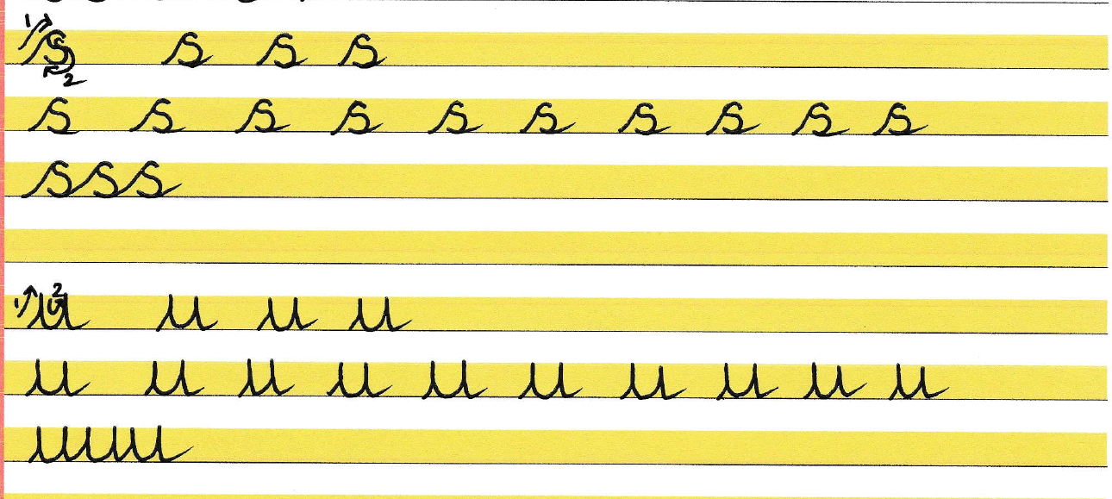

Slide 3
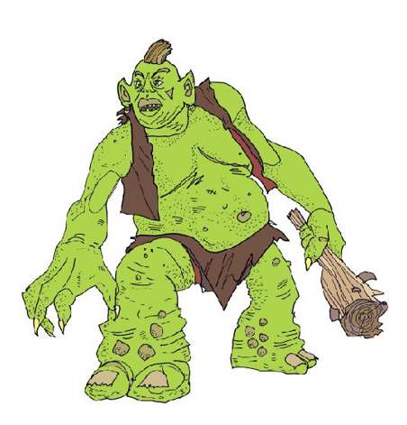
Trolls

Slide 5
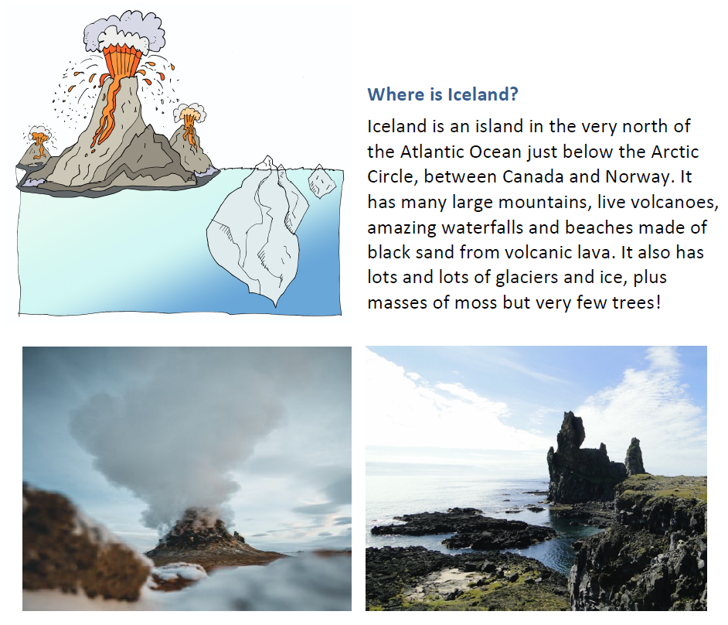
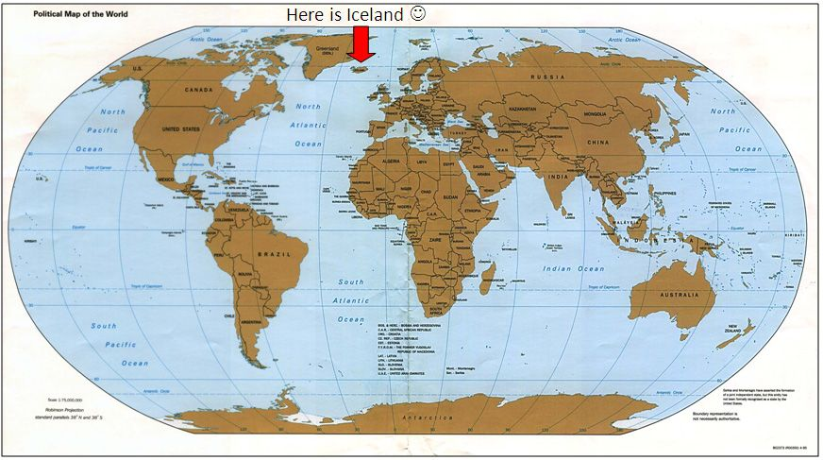

Slide 6
This is today’s focus

Slide 7
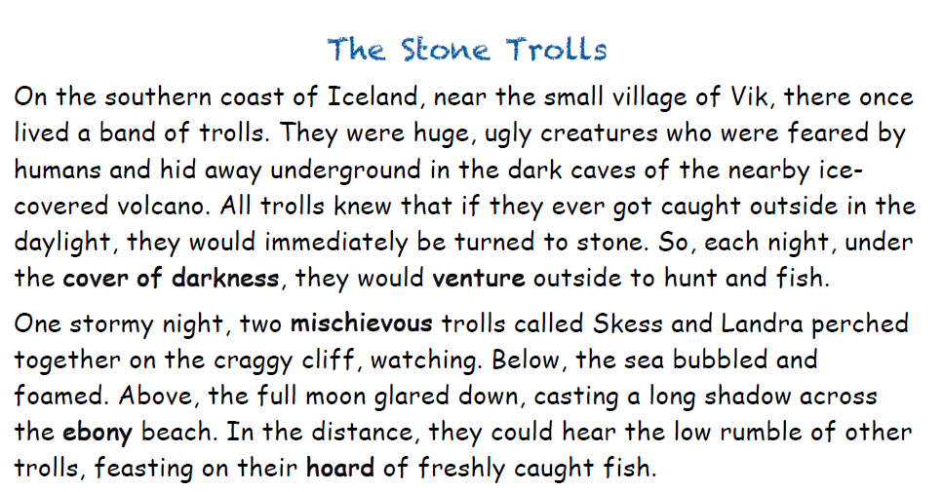

Slide 8
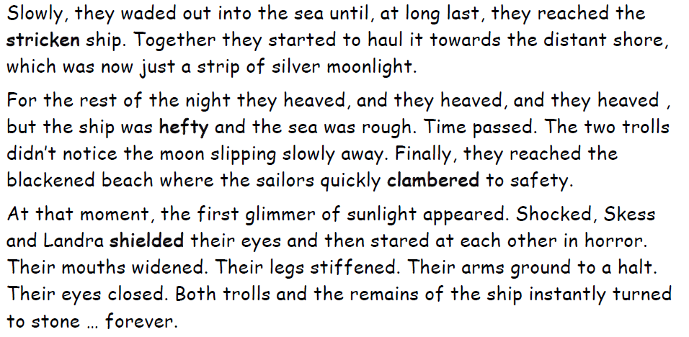

Slide 9
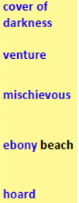
Can you match the words from our story to the ones below?
protected | paddle | risk or dare
naughty | climbed
heavy | wrecked
plunging | catch or supply
at night time | black

Slide 10
In your Home Learning Book write 5 sentences or more using any of our new words. You must use a fronted adverbial of time or place with a comma and you must underline the word with a ruler. I have done one for you:
1. Under the bridge, I spotted a naughty troll scratching his warty chin.

