Slide 1
Thursday 21st January
English
WALT use our publishing skills

Slide 2
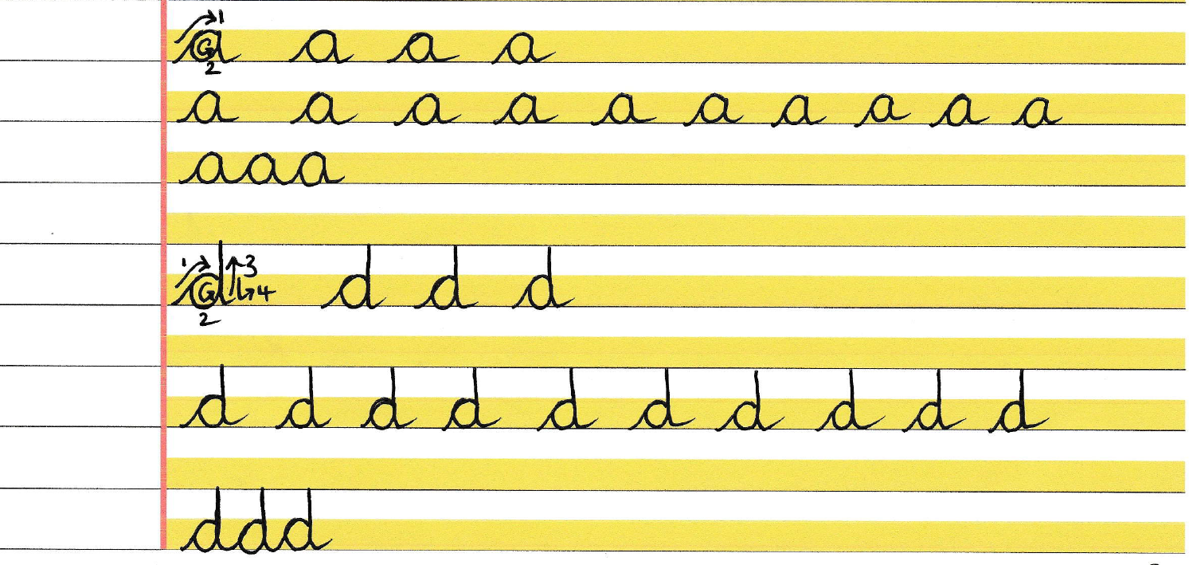
Here’s today’s joins to practise. Remember the direction you’re going in, clockwise or anti-clockwise, do one in the air first. Remember to have fleet flat on floor, paper tilted if you need to and warm up those fingers – play the piano in the air!

Slide 3
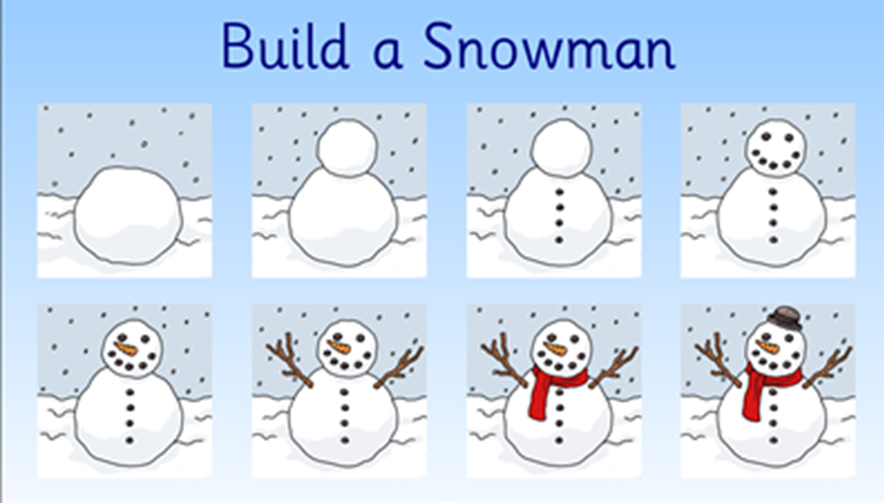
Are these instructions any good? Why? Why not? What’s missing? What has been left out? What is helpful though?

Slide 4
Example 1
Is this a good set of instructions? What ‘toolkit’ features can you spot?
What would improve it further?

Slide 5
Remember this was our order of your writing from yesterday. Remember, we were using ‘How to Catch a Dragon’ and ‘How to Catch a Soupee bird’ as our models. Hopefully you’ll be able to spot these features from our toolkit in your instructions?
Title
Introduction – question
What you will need list
What you do
1.
2.
3.
Warning

Slide 6
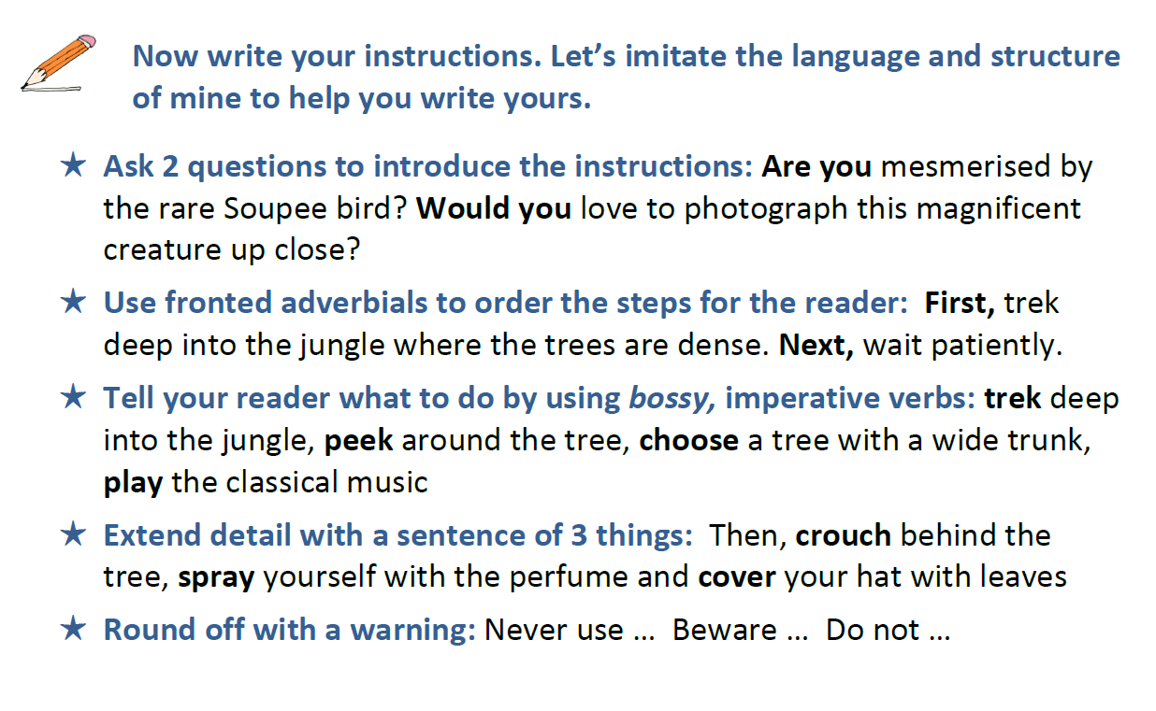
The Soupee bird example

Slide 7
Today’s Task
1. Check through your work from yesterday carefully. Purple Polish.
2. Use the checklist you can see on the next slide to make sure you’ve included everything. Check Mrs Thomas’s feedback from yesterday if you managed to send it to her to check.
3. Publish – write it out, consider your layout. You could type it up into neat or use a PowerPoint presentation if you like.
4. Use your neatest handwriting.
5. Add some beautifully drawn pictures to further illustrate your ‘How to Do It’ steps.
6. Send it to us to put on the website. Let’s celebrate!
Additional Information - You may even want to record yourself reading it! WeTransfer is a good way to send MP4 files if they are big.

Slide 8
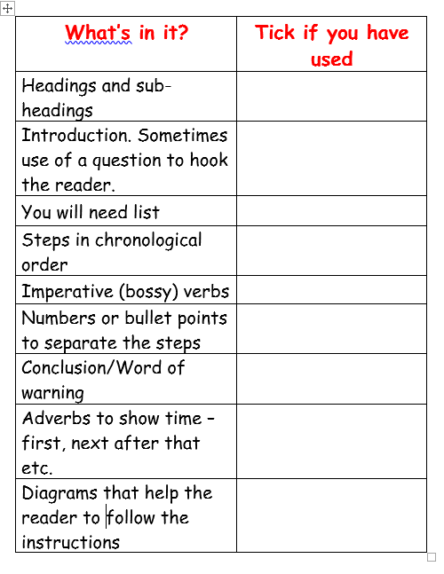
Your checklist

