Slide 1
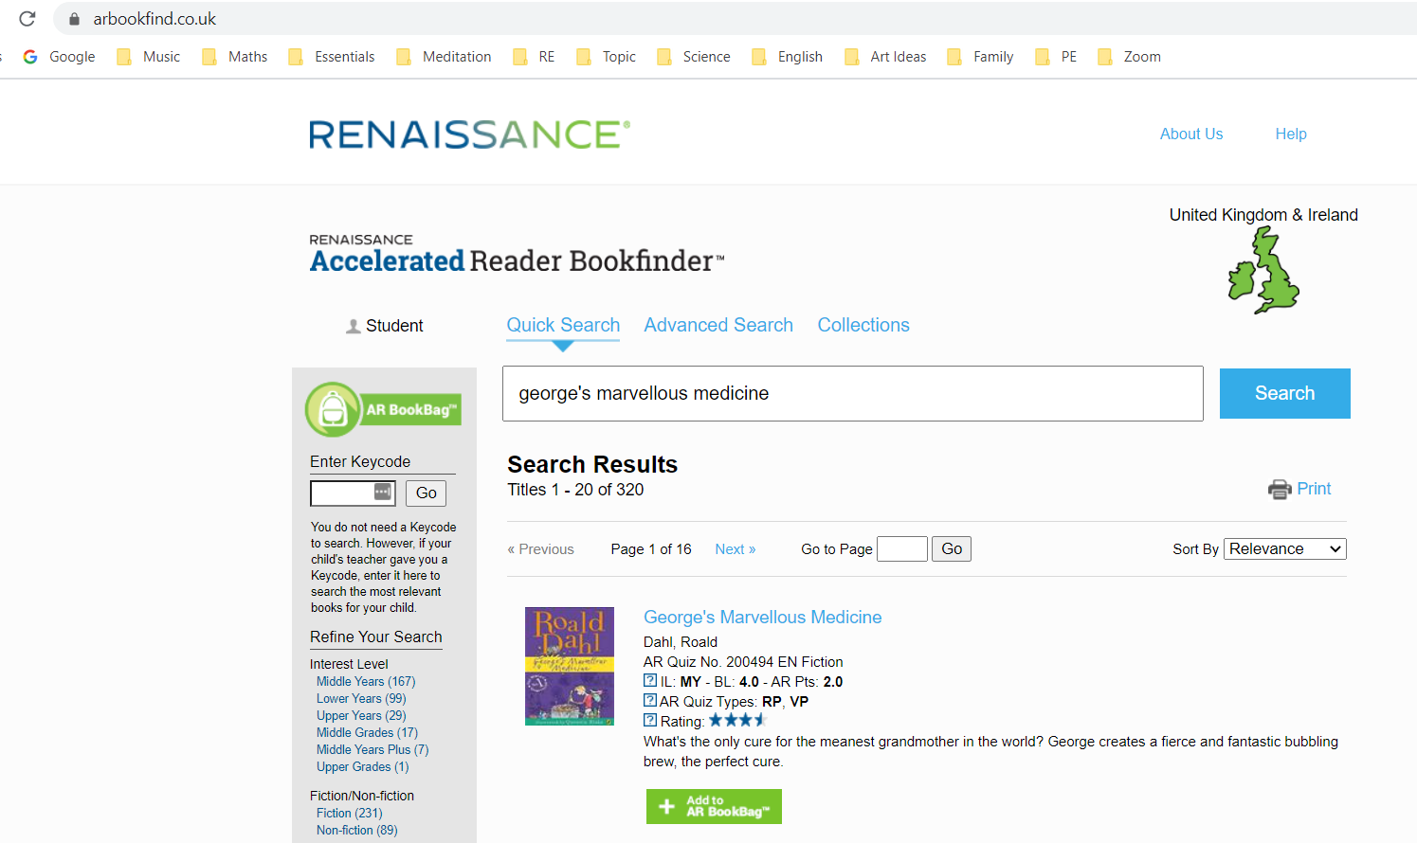
AR Bookfinder
AR Quiz No. 200494 EN Fiction

Slide 2
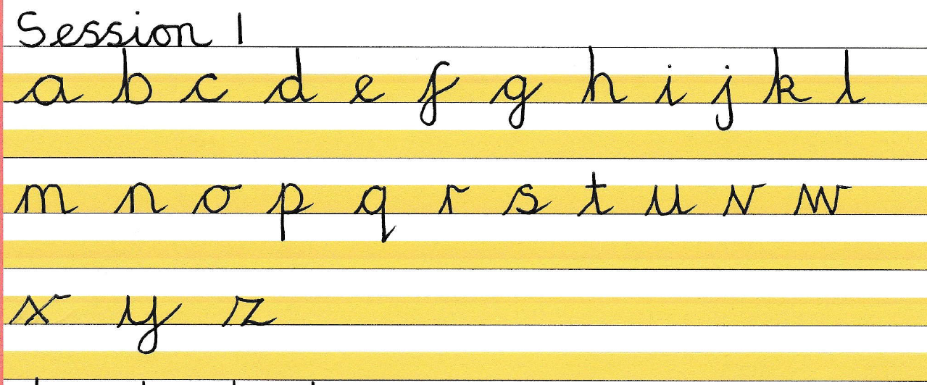
Please practise these letters in your book this morning. Circle your best letter. Which letters do you need to do a line of this morning?

Slide 3
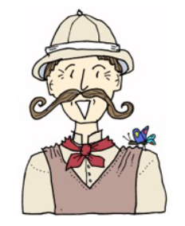
Monday 18th January
English
WALT use VIPERS

Slide 7
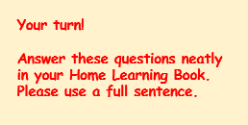
Which words in the text means ‘a way of hiding by covering yourself so you blend into your surroundings’? (Vocabulary)
The word that means a way of hiding by covering yourself so you blend into your surroundings is…
2. Why do you need to spray yourself with flowers? (Infer)
You need to spray yourself with flowers because…
What mysterious rare thing would you love to see up close and why?(Predict)
I would love to see a….. because…
Explain why you need to go to such efforts to catch a Soupee bird. (Explain)
You need to go to such efforts to catch a Soupee bird because…
List four things you need to uncover a Soupee bird. (Retrieve)
You will need;
6. Put these in the right order of what to do (Sequence)
A. Choose a tree with a wide trunk and loop your rope over the lowest branch .
B. Play the classical music.
C. Crouch behind the tree and cover yourself with perfume.
D. First, trek deep into the jungle.

