Slide 1
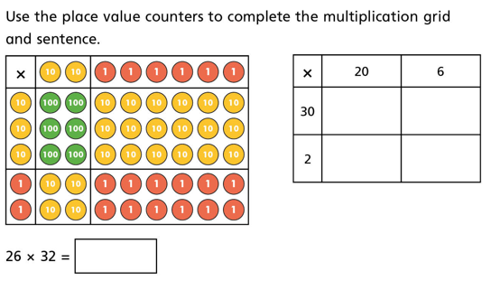
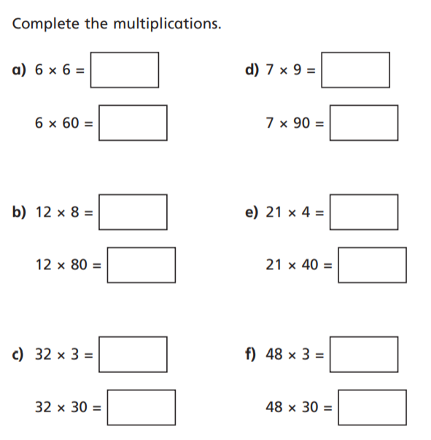
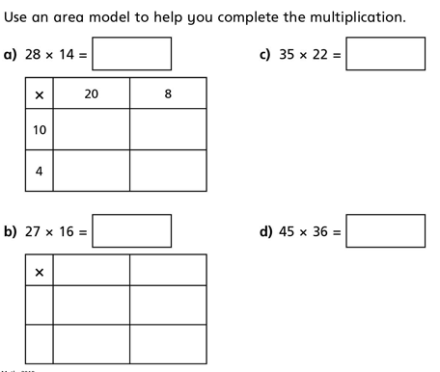
WALT understand how to multiply two digits by two digits. Using an area model
2.
1. Use mental methods to work out the answers below.
3.
4. A machine prints 92 labels every minute. How many label will it print in 3/4 of an hour?

