Slide 1
Separating Mixtures

Slide 2
Aim
I can use different processes to separate mixtures of materials.
Success Criteria
I can identify different ways materials can be mixed together.
I can use sieving, filtering, evaporating and other processes to separate mixtures of materials.
I know when to use which processes to separate mixtures.

Slide 3
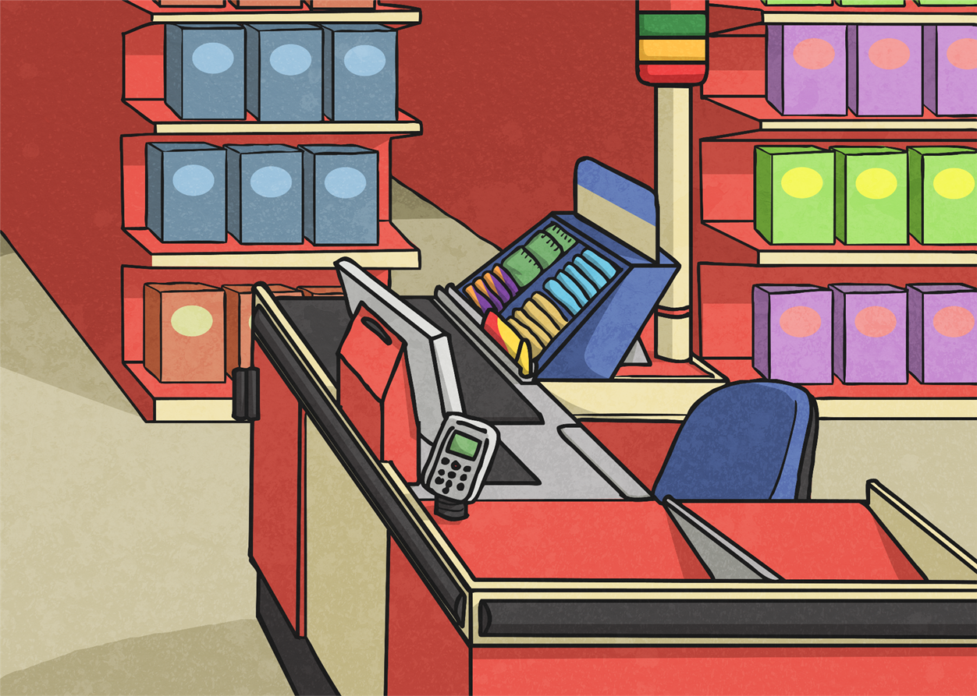
Supermarket Chaos!
A local supermarket has had a disaster!
Lots of their goods have got mixed up after a delivery truck was loaded up incorrectly.
The manager of the supermarket has asked for your help in separating all the items so that they can be put out on the shelves.
Have a look at the jumbled up materials and think about how they have been mixed together.

Slide 4
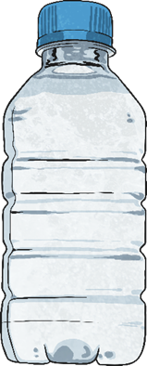
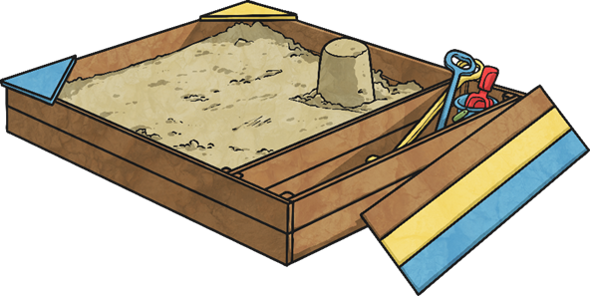
Mixed Materials – Sand and Water
Several water bottles have leaked into a bag of play sand.

Slide 5
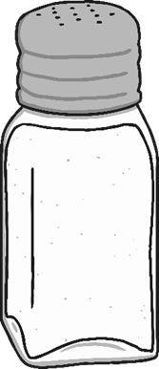
Mixed Materials – Salt and Water
A bag of salt has split open and the salt has mixed with some water from the water bottles.

Slide 6
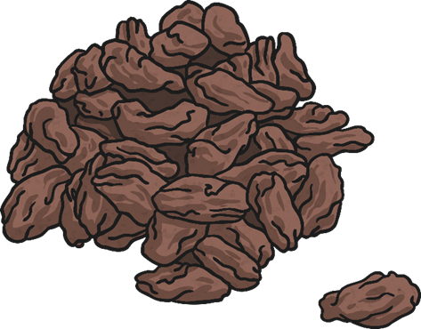
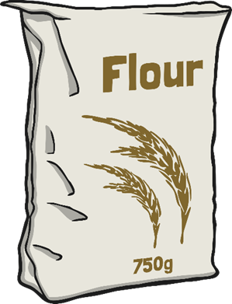
Mixed Materials – Raisins and Flour
Raisins have poured out of their boxes into the bags of flour.

Slide 7
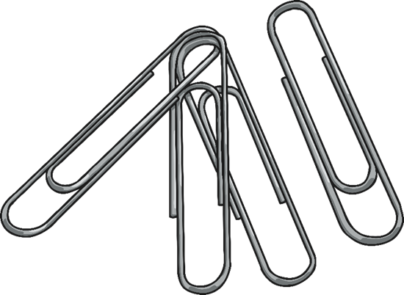
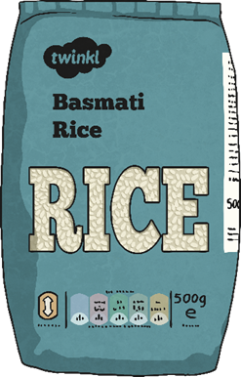
Mixed Materials – Paper clips and Rice
Some boxes of paper clips have spilled into the bags of rice.

Slide 8
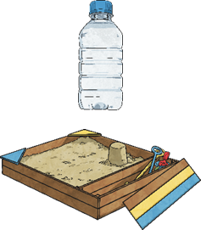
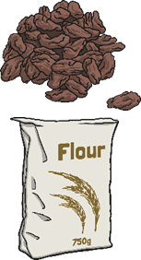
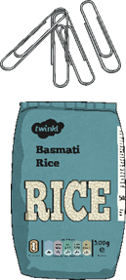
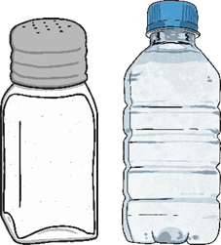
Mixed Materials
1. A suspension - a mixture of a liquid and solid particles that will not dissolve.
2. A mixture of two solids.
3. A solution - a solid dissolved in a liquid.
4. A mixture of two solids.
A. Sand and water.
B. Raisins and flour.
C. Paper clips and rice.
D. Salt and water.

Slide 9
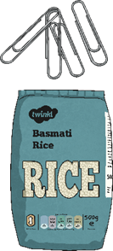
Mixed Materials
How did you do?
1. A suspension - a mixture of a liquid and solid particles that will not dissolve.
2. A mixture of two solids.
3. A solution - a solid dissolved in a liquid.
4. A mixture of two solids.
A. Sand and water.
B. Raisins and flour.
D. Salt and water.
C. Paper clips and rice.

Slide 10
Mixed Materials
Since each of these mixtures of materials has been mixed differently, you will need to use different processes to separate them.
Think about how you may be able to separate them.
1. A suspension - a mixture of a liquid and solid particles that will not dissolve.
2. A mixture of two solids.
3. A solution - a solid dissolved in a liquid.
4. A mixture of two solids.
A. Sand and water.
B. Raisins and flour.
D. Salt and water.
C. Paper clips and rice.

Slide 11
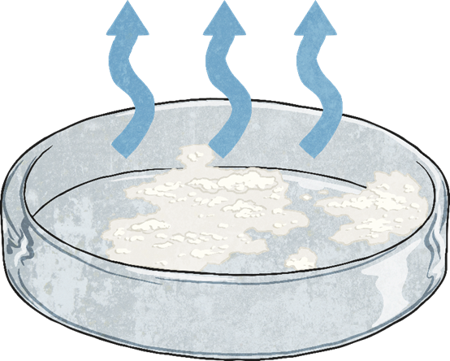
Separating Processes - Evaporation
How?
Boil the mixture, or leave it for a few days, so the liquid evaporates leaving the solid behind.
This process is best used to separate the salt and water solution.
As the salt has dissolved in the water, filtering would not separate the two materials. The salt particles would go through the filter paper along with the water.
When the salt water solution is evaporated, the water will turn into water vapour and leave the salt behind.

Slide 12
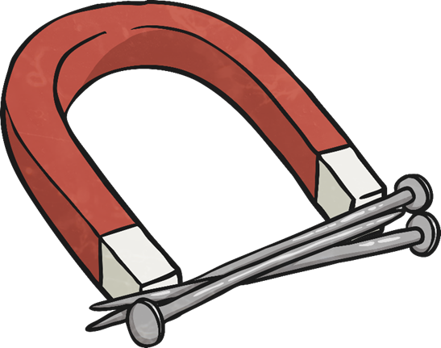
Separating Processes – Magnetic Attraction
How?
Use a magnet to attract any magnetic materials and remove them from the mixture.
Use this process to separate the paper clips from the rice.
The paper clips are made of steel and will be attracted to the magnet.
The rice is not magnetic so will stay in the bowl.

Slide 13
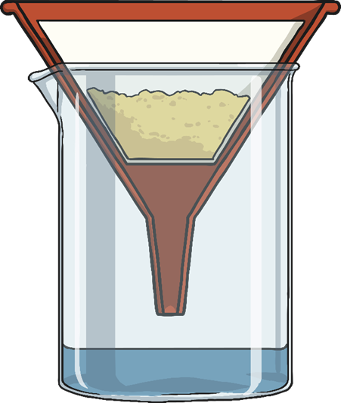
Separating Processes - Filtration
How?
Line a funnel with filter paper and place it over a beaker. Pour the mixture slowly into the filter paper. The liquid will get through and any insoluble solids will be caught in the filter paper.
This process should be used to separate the mixture of sand and water.
Sand is insoluble, so it has not dissolved in the water. The sand particles will not be able to get through the tiny holes in the filter paper, but the water particles will.
The sand will be caught in the filter paper while the water will get through to the bowl.

Slide 14
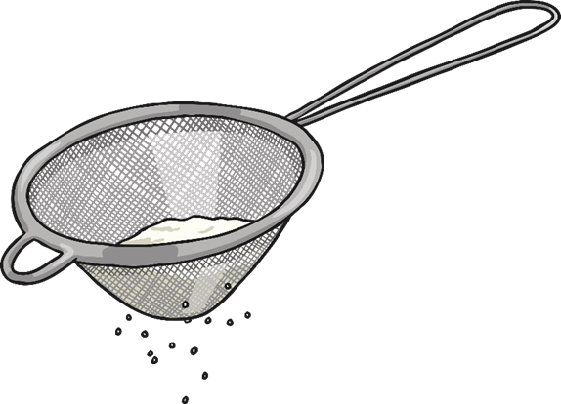
Separating Processes - Sieving
How?
Pour the mixture through a sieve held over a bowl. The smaller particles will get through it into the bowl and the larger particles will be caught in the sieve.
Use this process to separate the mixture of raisins and flour.
The grains of flour are much smaller than the raisins, so they will be able to go through the sieve into the bowl below.
The raisins are much bigger, and will get caught in the sieve.

Slide 15
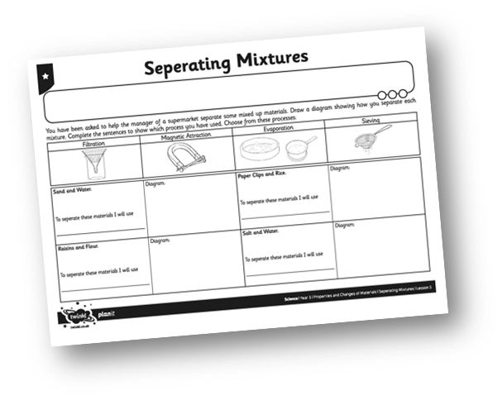
Separating the Mixtures
If you are ablr to day any of these practical experiments at home that would be great but if not, try to fill in the TASK sheets attached.

Slide 16
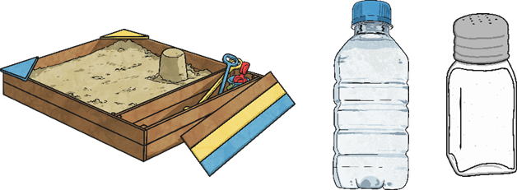
A Message from the Manager
Thank you for separating the mixed up materials!
Unfortunately, we found one more mixture in the delivery truck. Some of the sand and some of the salt have both mixed with a spilt bottle of water. How can we separate both the sand and the salt from the water?

Slide 17
To find the answer to the previous slide listen to the sound file below

Slide 18
Aim
I can use different processes to separate mixtures of materials.
Success Criteria
I can identify different ways materials can be mixed together.
I can use sieving, filtering, evaporating and other processes to separate mixtures of materials.
I know when to use which processes to separate mixtures.

