Slide 1
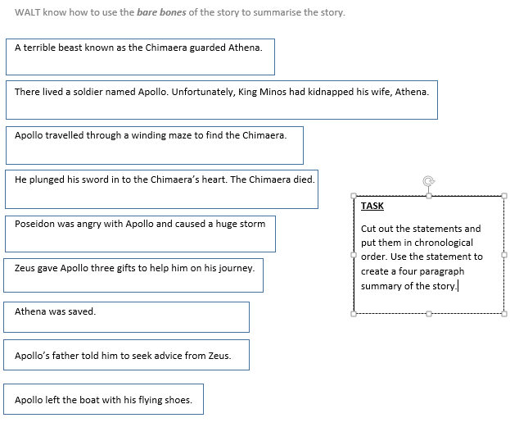
Lesson 8 WALT use the story to create a four paragraphed summary

Slide 2
WALT use the story to summarise it in to 4 paragraphs.
E.g.
Paragraph 1 – Beginning and build up and quest
King Minos had kidnapped Apollo’s wife Athena and she was guarded by the ferocious beast known as the Chimaera. Father told Apollo to go to Zeus for help.

Slide 3
Paragraph 2 – The gifts
What gifts were he given…

Slide 4
Paragraph 3 -the journey and annoying Zeus

Slide 5
Paragraph 4 Fighting the Chimaera

Slide 6
WALT use the story to create a four paragraphed summary
Now use the sheet with the bare bones to create your four paragraphs to summarise the story. Remember, you are not changing anything at this point and it is supposed to be a summary of the original story.
WILF
Well punctuated sentences
Enough relevant detail (bare bones) to tell the story
Only four paragraphs – it should be a summary.

