Slide 2
https://www.youtube.com/watch?v=ubDS1gk096Q&safe=active
Why is this programme called EastEnders?

Slide 3
Roman London. AD 47 – 410 AD
Anglo-Saxon London AD 410 – 1066AD
Romans built the first city. Londinium. Initially very small – smaller than the size of Mylor.
Romans added a business centre known as a Basilica. A wall was built around the city to stop invasion. – this area is now known as the Square mile and is the business area of the city.
In the 7 and 8th Century London was invaded regularly by the Vikings and they almost took full control over the Anglo-Saxons.
The Anglo Saxons continued to rule until the battle of Hasting 1066 which led to a Norman rule.

Slide 4
From Anglo Saxon to the beginning of the Tudor reign.
The Tower of London was built and had many different uses over time – a castle, a palace, a zoo and a weapons store, a mint (where coins are made) and a prison.
Through this time, London grew inside of the walls. Lots of trades and shops were developed over this time.

Slide 5
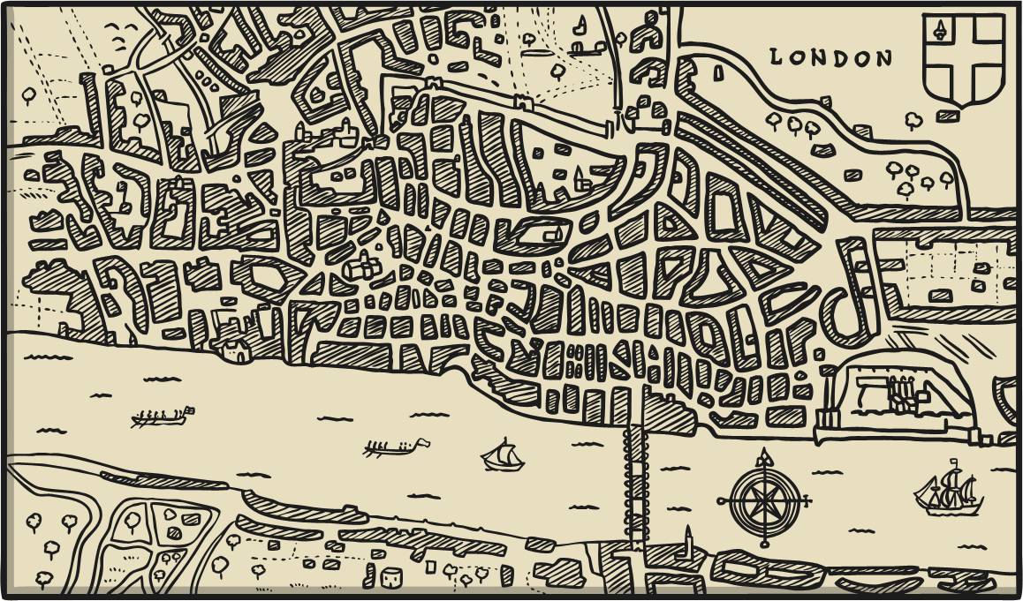
500 years ago… The 1500s
Tudor London, Population 50 000 – 100 000

Slide 6
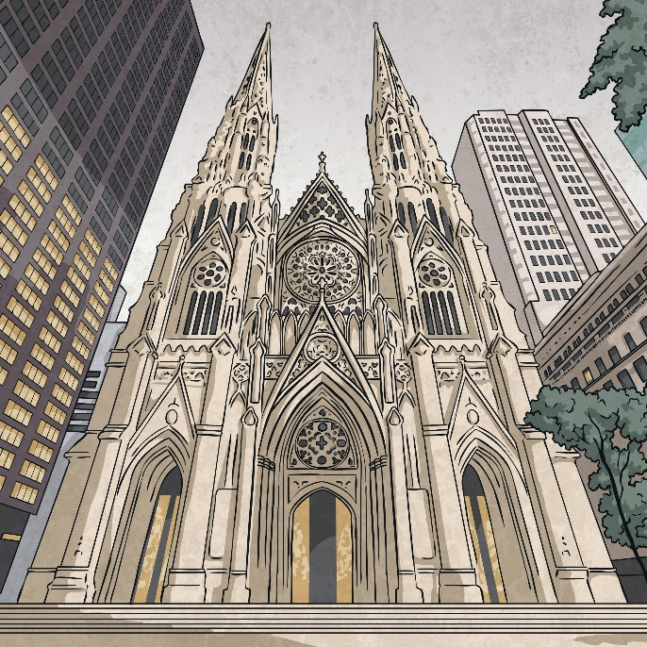
500 years ago… The 1500s
At the beginning of the 1500s, around half of all London properties were religious properties such as churches, but this all changed with Henry VIII’s Dissolution of the Monasteries.
London was rising in popularity as a commercial and trading centre for Europe. This was also the time of Shakespeare when drama and theatre in London was growing.

Slide 7
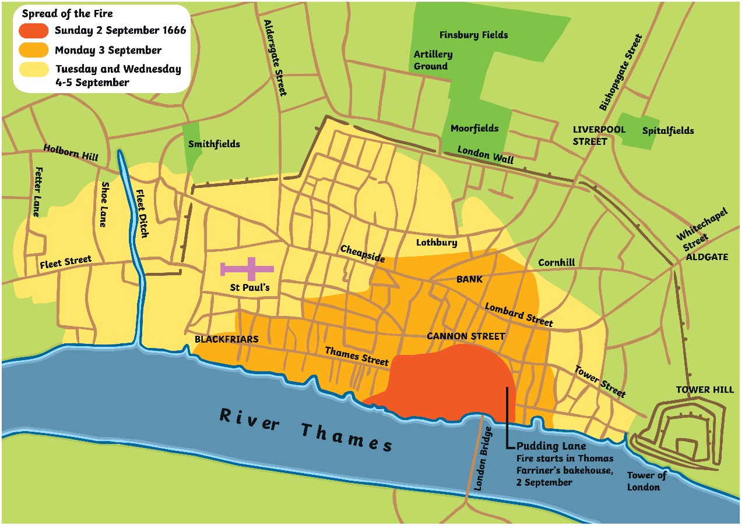
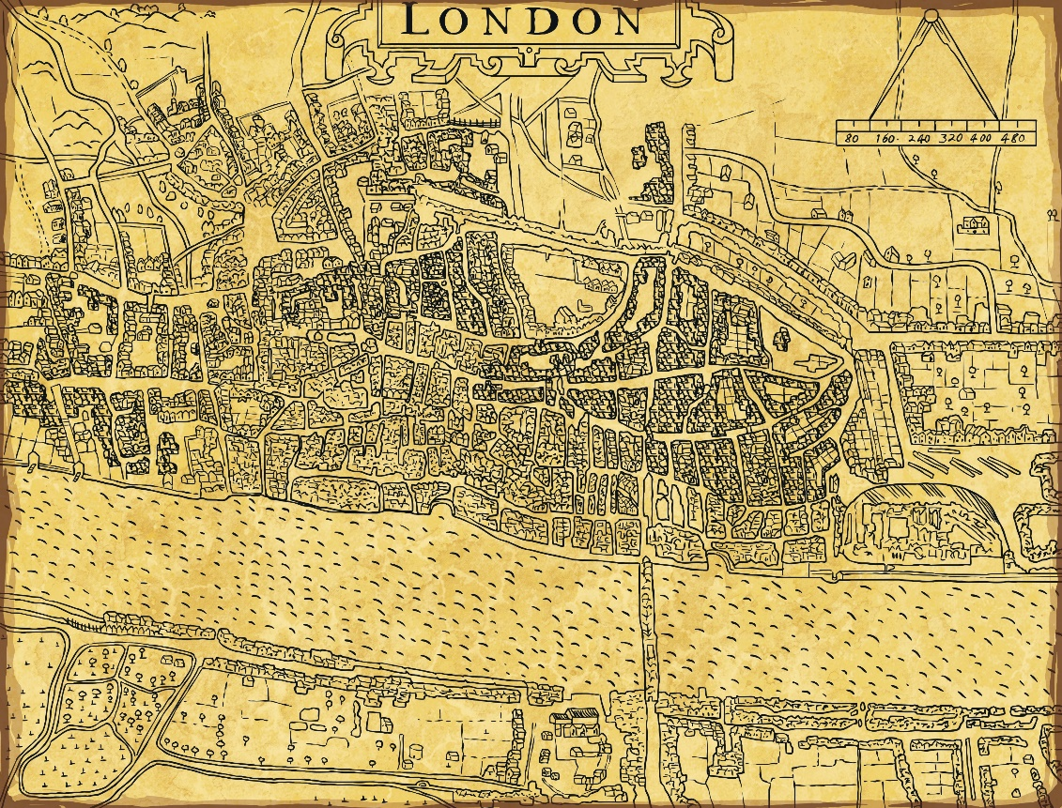
400 years ago… The 1600s
Stuart London, Population 200 000

Slide 8
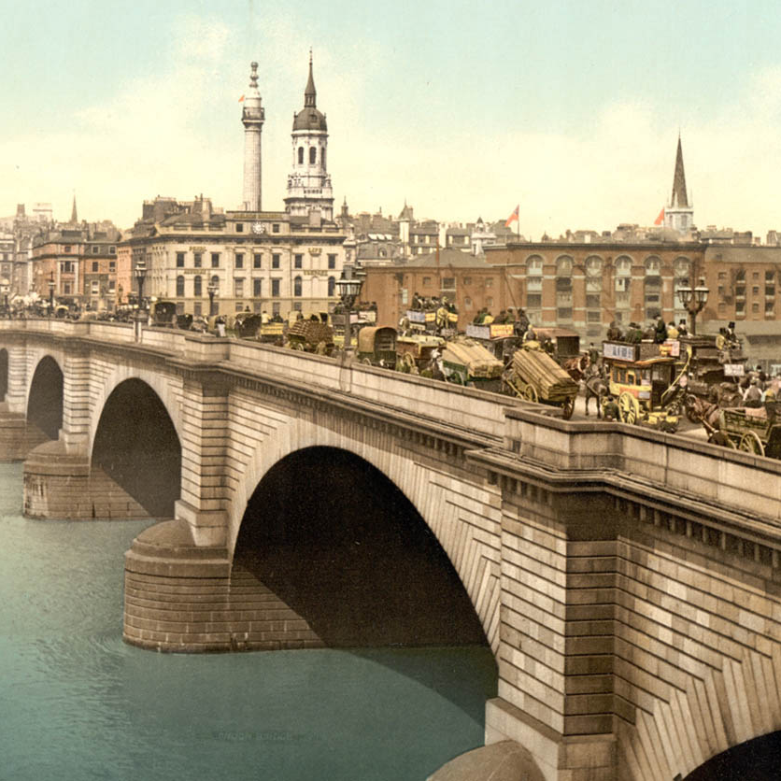
400 years ago… The 1600s
In the 1600s London was very crowded…even London Bridge (the only crossing over the River Thames) had many buildings on it. Most buildings were made from wood. Covent Garden and The West End were growing and the Bank of England opened in 1694.
The 1600s saw 30 000 Londoners die from The Great Plague and many more suffer in The Great Fire of London of 1666, although it did end The Great Plague..

Slide 9
300 years ago… The 1600s
Georgian London, Population 550 000 – 600 000
George III acquired Buckingham Place, then known as Buckingham House, for his wife in 1761.
1750 saw the second crossing over the River Thames with the opening of Westminster Bridge.

Slide 10
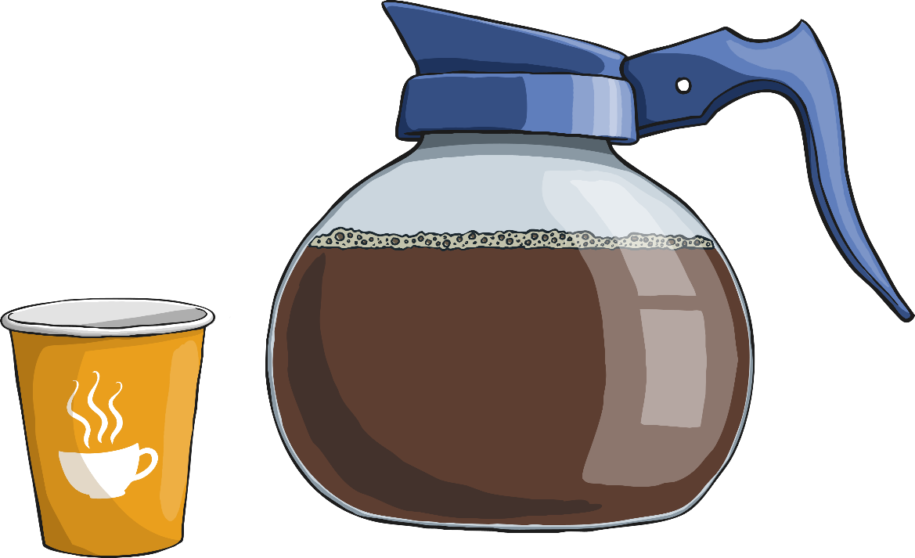
300 years ago… The 1700s
After The Great Fire of London, there were a lot of new buildings constructed, this time from brick or stone.
London grew rapidly as the centre of the British Empire.
Coffee Houses were popular meeting places, the printing press gave rise to the might of Fleet Street for news and the high crime led to the creation of the first police: The Bow Street Runners.

Slide 11
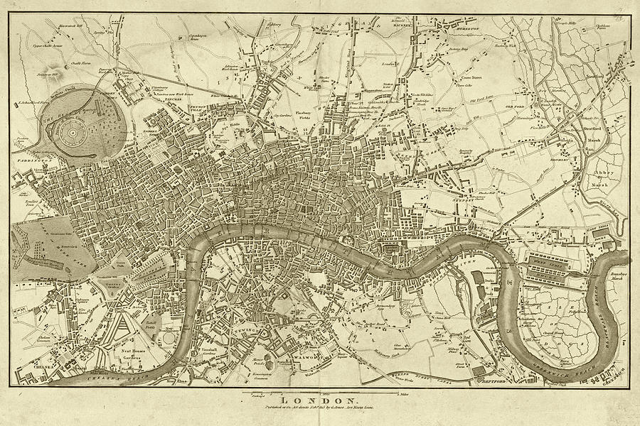
200 years ago… The 1800s
Victorian London, Population reaching 1 million.
In this century, we see the arrival of: Trafalgar Square, Big Ben, The Houses of Parliament, the Royal Albert Hall, The Victoria and Albert Museum and Tower Bridge.

Slide 12
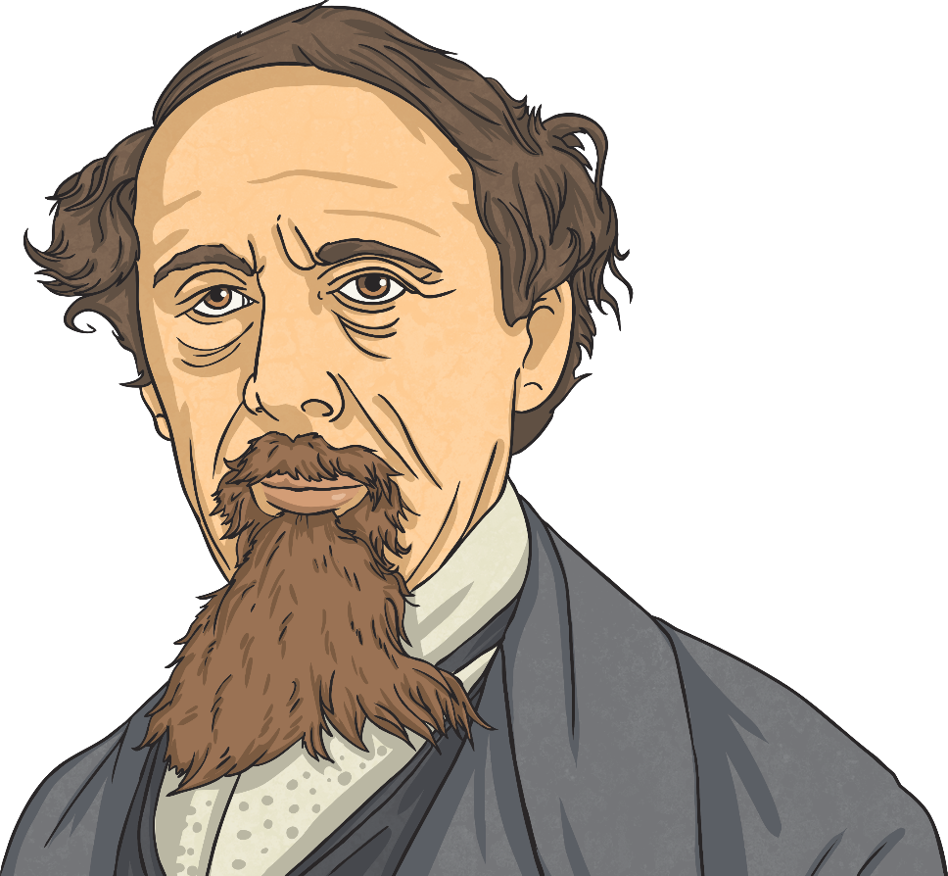
200 years ago… The 1800s
There was a lot of rapid growth and London was become a global capital for trade, politics and finance. The Metropolitan Police was established.
In 1863, the London Underground was opened and the overground railways caused London to spread to the suburbs. There were still a lot of poor people which was reflected in novels such as Oliver Twist written by Charles Dickens.

Slide 13
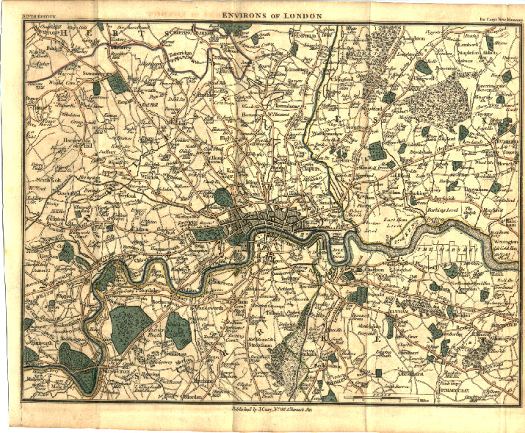
100 years ago… The 1900s
Windsor London, Population 6.5 million.
During the Blitz alone, there were over 30 000 tonnes of bombs dropped on London killing over 40 000 people.

Slide 14
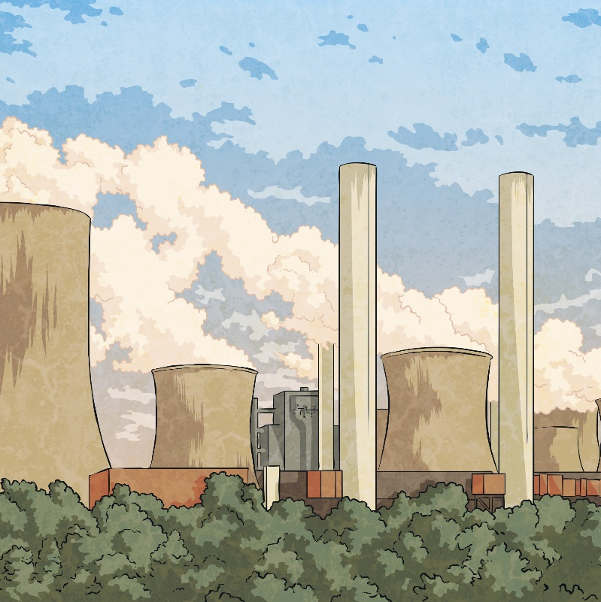
100 years ago… The 1900s
Overshadowed in the first half of the century by the first and second World wars, including the Blitz in 1940-1941 when a lot of London was destroyed, especially in the Docklands area.
London was nicknamed ‘The Smoke’ because of all the pollution caused by coal fires and the Great Smog of 1952 which killed 4000 people.
The second half of the 1900s saw more positive events with the 1948 Summer Olympics and a focus for the Swinging 60s. The M25 was also completed in 1986.

Slide 15
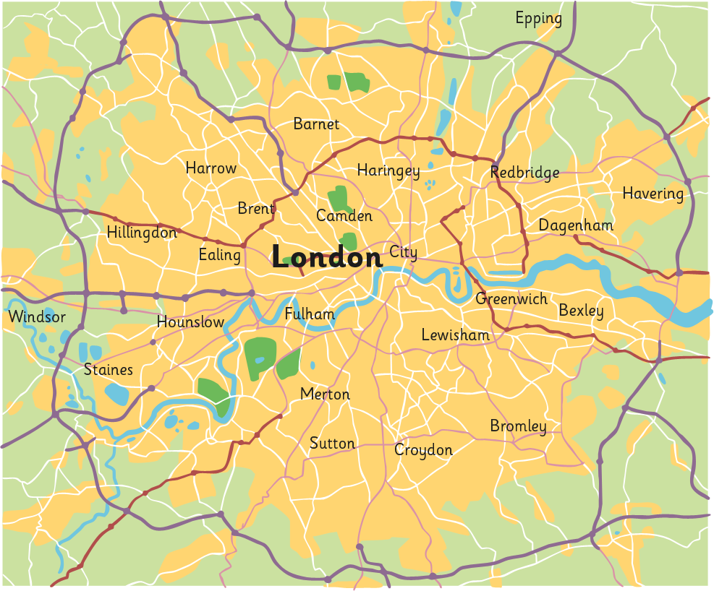
Modern Times…2000s Onwards
Modern London, Population 7 million and rising…

Slide 16
Hand drawn map on London 2020

Slide 17
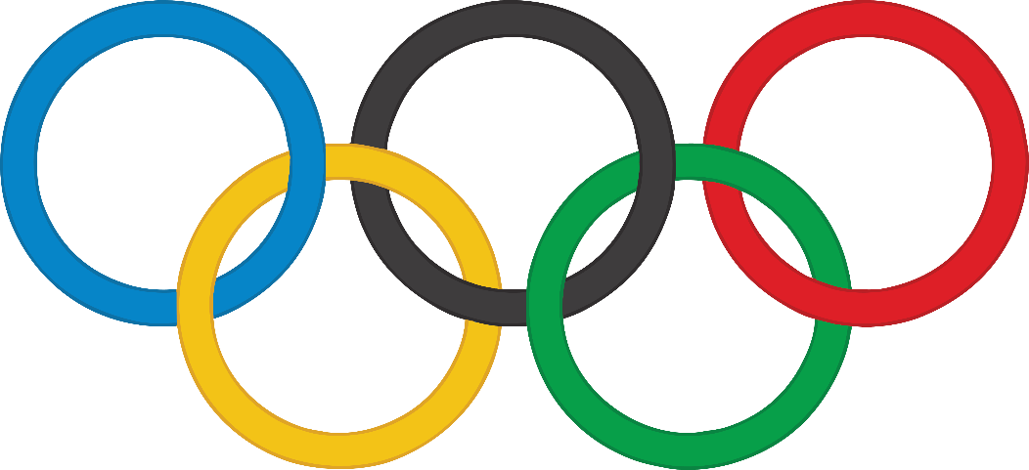
Modern Times… 2000s Onwards
The new millennium saw new iconic buildings including the Millennium Dome, The Gherkin and the London Eye.
London hosted the 2012 Olympics..

Slide 18
Questions
Between each century and now, can you see the differences in population, area and issues?
Which of the things mentioned interests you?
What would you like to find out more about?
What do you think that the London of the 2100s will look like and why?

