Slide 1
WALT understand how to multiply 3 digits by 2 digit numbers.

Slide 2

1) 12 $×$ 4 $=$
2) 12 $×$ 40 $=$
3) 206 $×$ 3 $=$
4) 206 $×$ 300 $=$

Slide 3
1) 12 $×$ 4 $=$
2) 12 $×$ 40 $=$
3) 206 $×$ 3 $=$
4) 206 $×$ 300 $=$
48
480
618
61,800

Slide 4
132 $×$ 23
Th | H | T | O
 | 1 | 3 | 2
 |  | 2 | 3
$$×$$
3
3
9
6
$($132 $×$ 3$)$
$$+$$

Slide 5
132 $×$ 23
Th | H | T | O
 | 1 | 3 | 2
 |  | 2 | 3
$$×$$
2
3
9
6
$($132 $×$ 3$)$
2
6
4
0
$($132 $×$ 20$)$
$$+$$
3
0
3
6
1
1

Slide 6
326 $×$ 32
Have a think
Th | H | T | O
 | 3 | 2 | 6
 |  | 3 | 2
$$×$$
6
5
2
$($326 $×$ 2$)$
1
$$+$$

Slide 7
326 $×$ 32
$=$ 10,432
Th | H | T | O
 | 3 | 2 | 6
 |  | 3 | 2
$$×$$
6
5
2
$($326 $×$ 2$)$
1
9
7
8
0
$($326 $×$ 30$)$
$$+$$
1
1
0
4
3
2
1
1

Slide 8
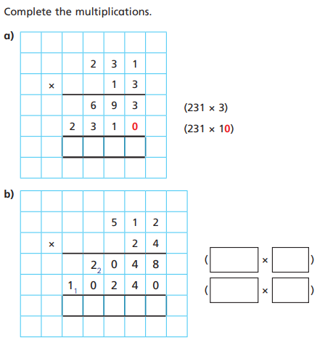
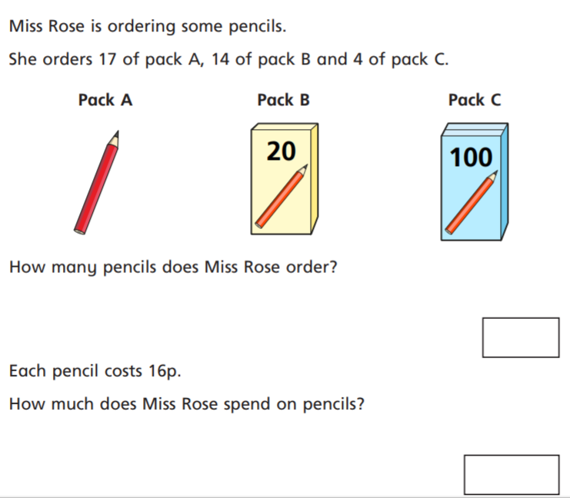
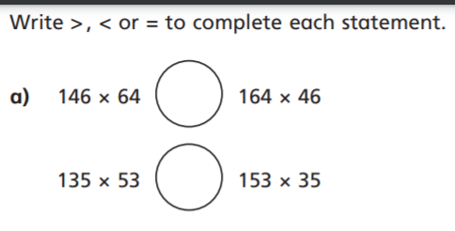
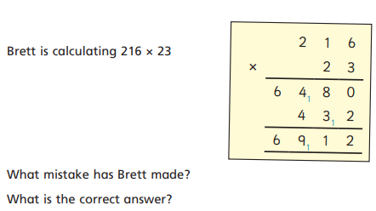
1
3. Complete these multiplications:
142 X 31 =
337 X 46 =
214 X 53 =
24 X 183 =
476 X 69 =
4. A football pitch is 128 m long and 52 m wide. What is the area of the pitch?
5
6
2
B What do you notice above? Does this always happen?

Slide 9
1
3. Complete these multiplications:
142 X 31 = 4402
337 X 46 = 15 502
214 X 53 = 11 342
24 X 183 = 4 392
476 X 69 = 32 844
4. A football pitch is 128 m long and 52 m wide. What is the area of the pitch? 6656 m²
3 0 0 4
5
6
512
2
512
20
1 2 2 8 8
2
X 216 by 30 not 3 and by 2 not 20
697
B What do you notice above? Does this always happen?
11 152p
Or
£111.52
4968 = answer

Slide 10
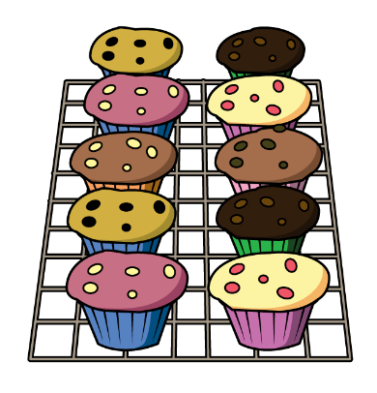
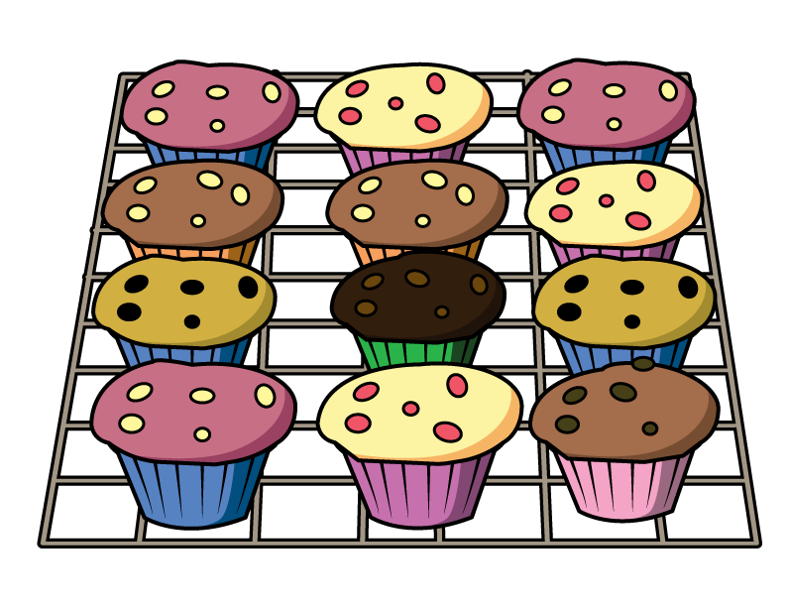
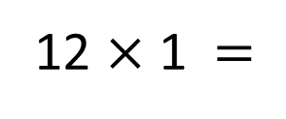
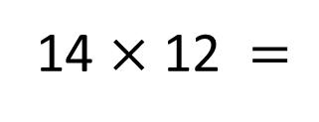
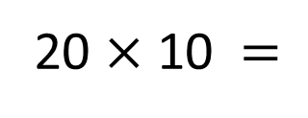
Mo orders muffins for a party.
He orders 12 of box A,
20 of box B
and 14 of box C.
How many muffins does Mo order?
Have a think
Box A
Box B
Box C
12 $×$ 1 $=$
12
20 $×$ 10 $=$
200
14 $×$ 12 $=$
168
14 $×$ 2 $=$ 28
200 $+$ 168 $+$ 12 $=$
380
14 $×$ 10 $=$ 140

Slide 11
380
How many muffins does Mo order?
Each muffin costs 24p. How much does Mo spend on muffins?
Th | H | T | O
 | 3 | 8 | 0
 |  | 2 | 4
9,120p
Have a think
$$×$$
1
5
2
0
$($380 $×$ 4$)$
3
7
6
0
0
$($380 $×$ 20$)$
$$+$$
1
9
1
2
0
1

Slide 12
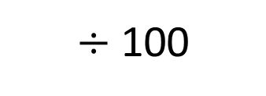
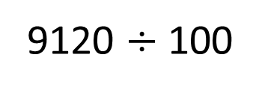
380
How many muffins does Mo order?
Each muffin costs 24p. How much does Mo spend on muffins?
9,120p
$÷$ 100
100p $=$ £1.00
9120 $÷$ 100
TTh | Th | H | T | O | tth | hth
9
1
2
0
£91.20

