Slide 1
How to use Adobe Acrobat Reader DC
On a windows laptop

Slide 2
In your start menu – see if you have Acrobat Reader DC. If you do… great. If you don’t perhaps ask a parent to download the app for you – I believe that it is free.
Go to the school website – download your maths sheet for today.

Slide 3
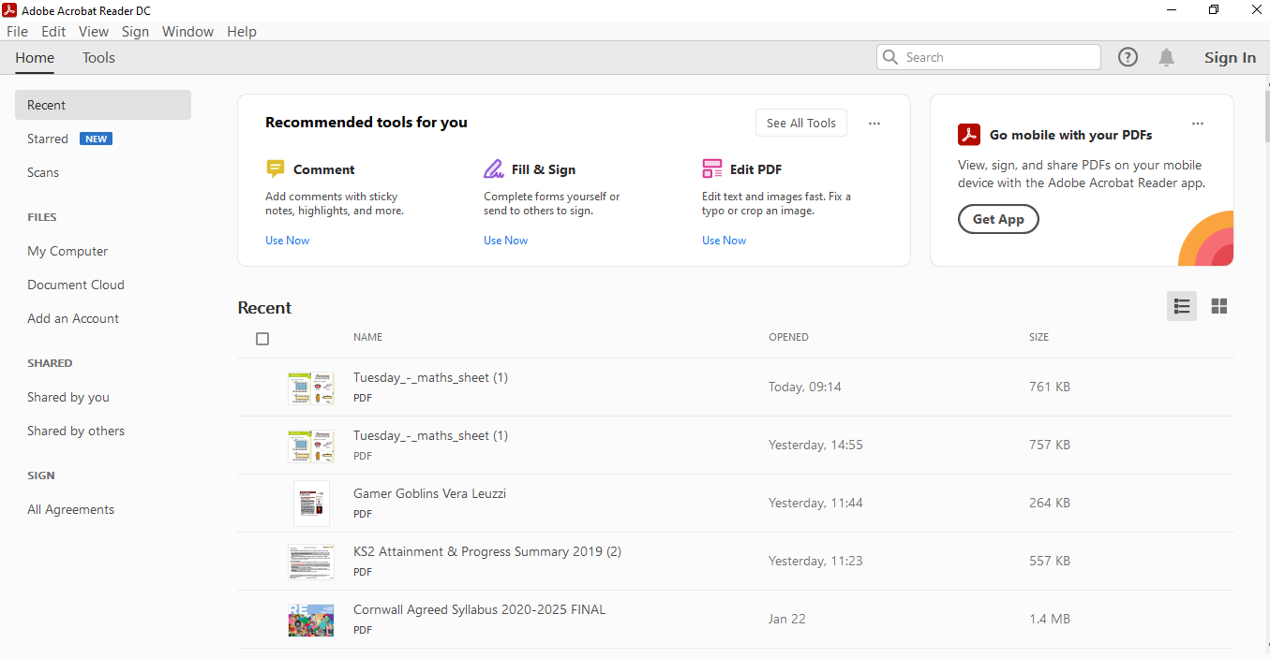
Go to file, open and select your sheet from the downloads tab.
Open Adobe Acrobat Reader DC – it’ll look like this

Slide 4
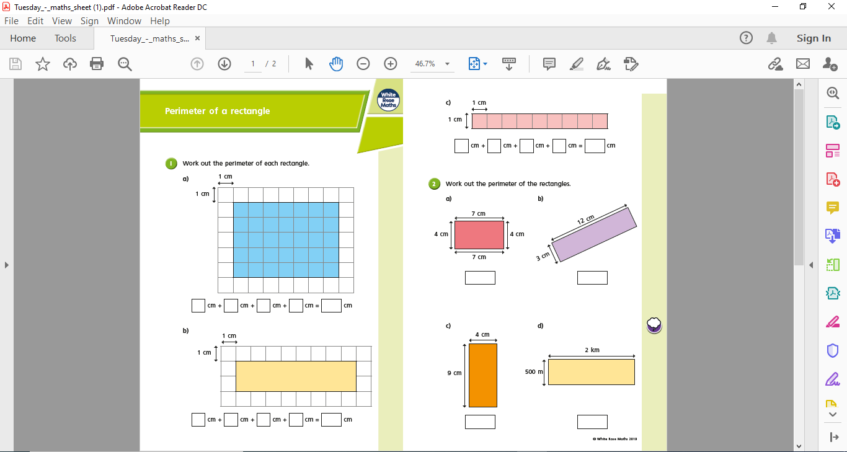
It’ll look like this. It might have a slightly different screen here that asks you to pay monthly, just use the slid bar to move passed that it’s an added feature that we won’t need.
Then you can use the comments box to add your answers to the sheet.

Slide 5
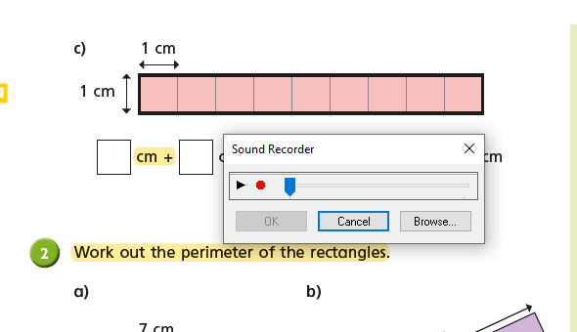
That will open up this tab .. Have a play with what all of the options do.
This one seems to be the most useful as it allows you to write directly onto the sheet.
You can even record a message to explain how you completed this work – rather than writing it!

Slide 6
Resave and then open your emails and send in as an attachment – or if it’s easier, take a photo (audio obviously won’t work in this case ☺ )

