Slide 1
Wednesday 6th January 2021 English WALT use inference

Slide 2
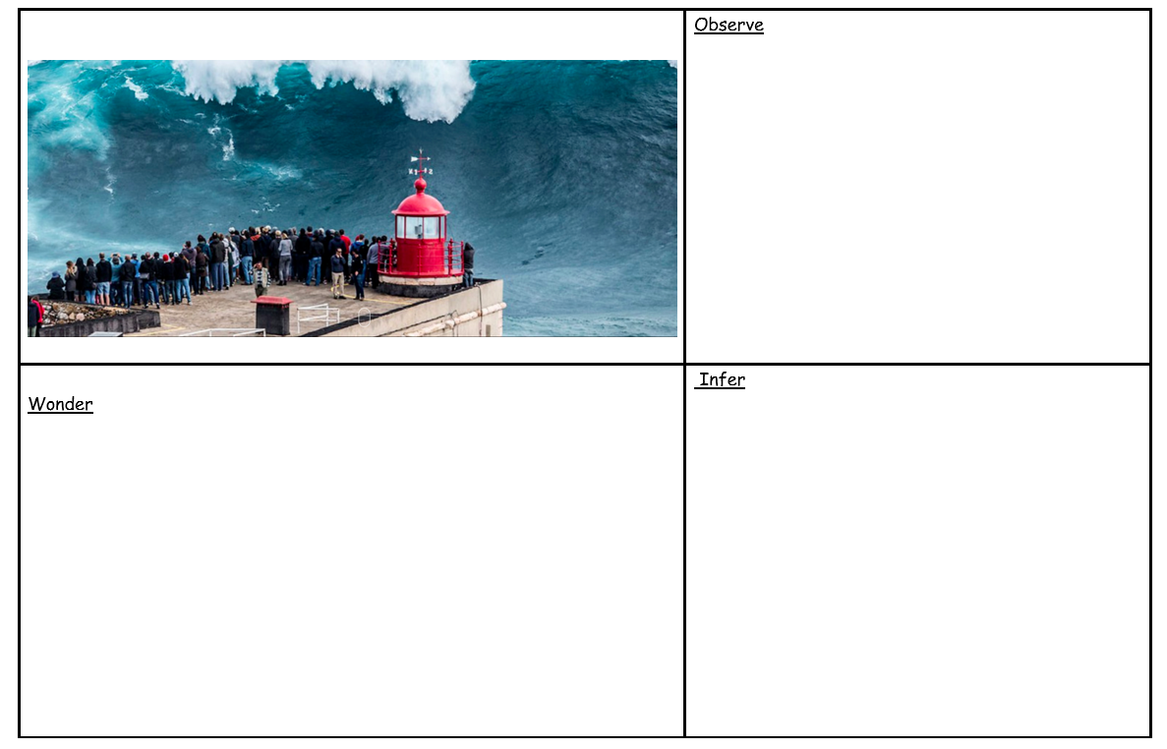
1.
I can see
We do
2.
3.
I think
I wonder how
I wonder if
I wonder where

Slide 3
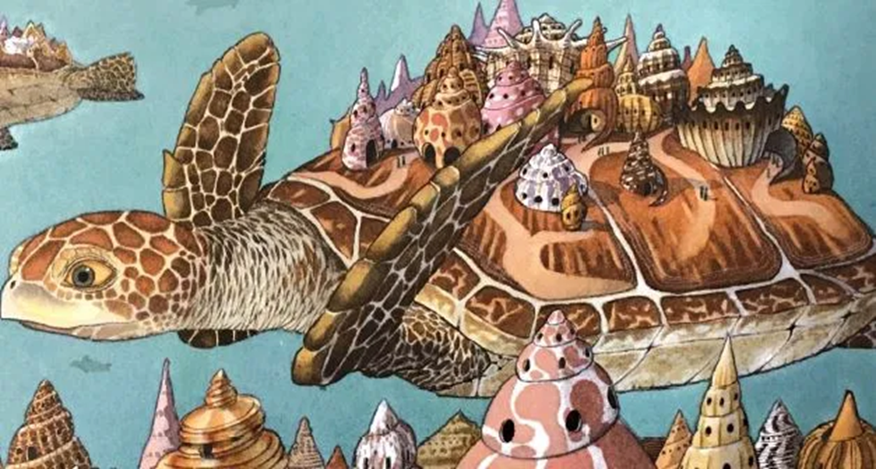
You do
Observe – I can see
Wonder – I wonder
Infer – I think
Please write a sentence for each number using the picture. Do more if you finish

