Slide 2
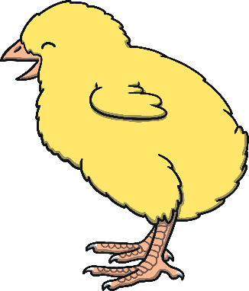
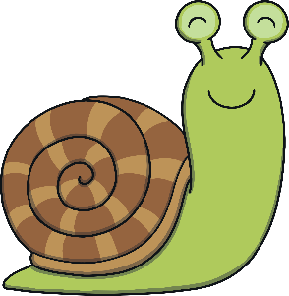
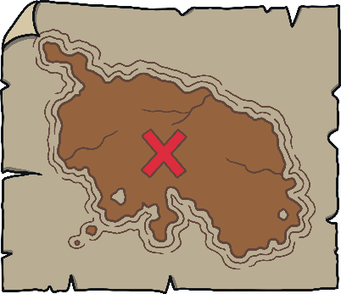
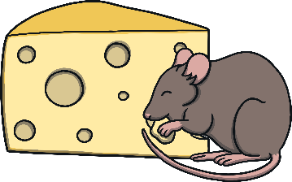
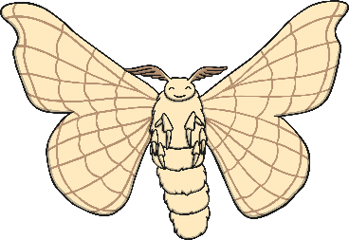
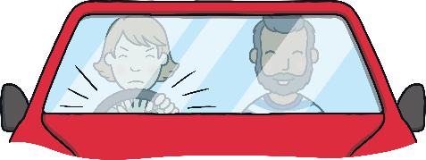
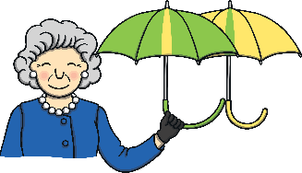
Revisit and Review
Let’s practise Sam’s Sounds and Common Exception Words!
er
y
j
ch
z
ee
air
ai
ear
ng
oi
oa
qu
th
ur
oo
x
v
ar
igh
ow
or
ure
ay
w
oo
th
sh
when
one
out
some
were
should
so
like
there
have
little
come
said
what
do
could

Slide 3
Teach
Today, we are learning to read and spell words that contain ay.
X
Grapheme ‘ay’ makes the same sound as Level 3 grapheme ‘ai’. It is used when the /ai/ sound comes at the end of a word (except where you would have 3 vowels together or in a compound word, e.g. we write ‘crayon’ instead of ‘craion’).
Click me for Kit’s teaching tips!

Slide 4
Teach
Let’s practise reading some of this week’s focus words that contain the ay sound.
day
tray
play
clay

Slide 5
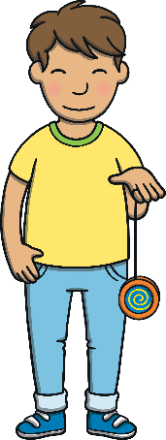
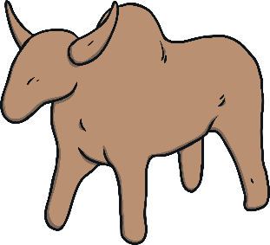
Teach
Can you write the words on a whiteboard or piece of paper?
clay
play
tray
day

Slide 6
Teach
Kit and Sam had used their magic book to bring Jay, the alien, to Earth. They had promised to take him for an adventure at school.

Slide 7
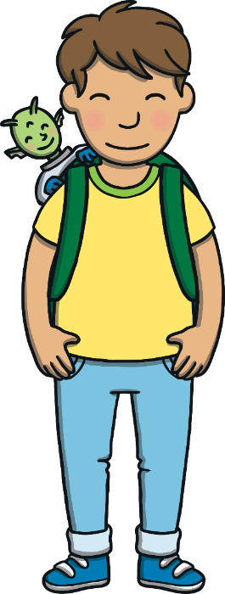
Teach
“Jump into my rucksack, Jay,” said Kit. “You should stay very quiet.”
Jay nodded excitedly and jumped in.
“Are you ready?” called Mum from downstairs.
“We’re on our way!” they said.

Slide 8
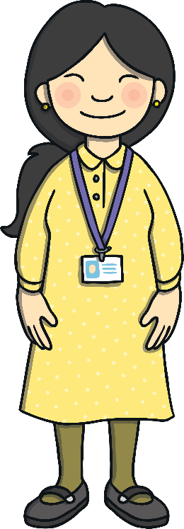
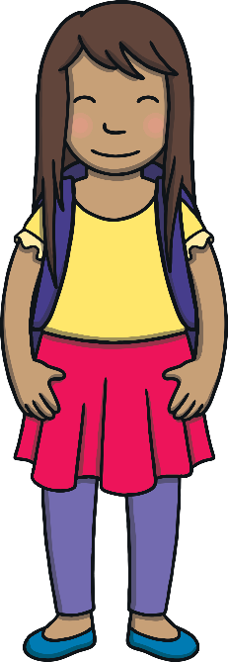
Teach
Kit and Sam arrived at school. “This is where we play,” Sam quietly told Jay as they walked through the playground. The children’s new teacher, Mrs Tan, took them inside.

Slide 9
Display Play
Teach
Kit and Sam are showing Jay the display in the school hallway. Can you spot any objects that have the ay sound in their name and read their labels?

Slide 10
Teach

Slide 11
Classroom Hunt
Practise
Mrs Tan has given the class a morning activity to do. Can you go on a sound hunt around the classroom with Kit and Sam to spot as many ay words as you can?

Slide 12
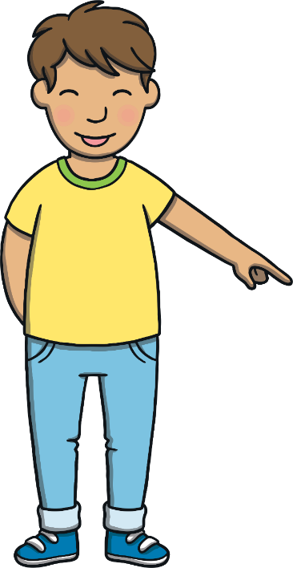
Practise
say
away
display
clay
tray
crayons
May
day
play

Slide 13
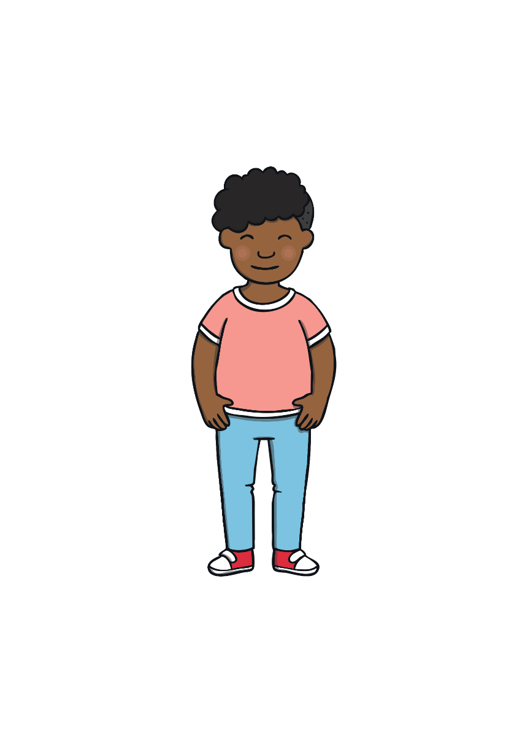
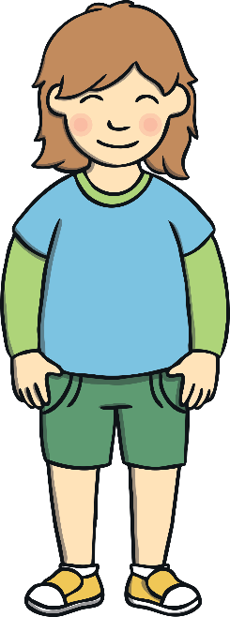
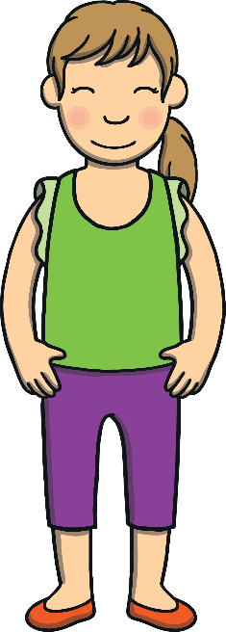
Apply
As they finished their morning activity, Kit and Sam realised that they had lost Jay! They looked at each other in dismay. Where could he be?

Slide 14
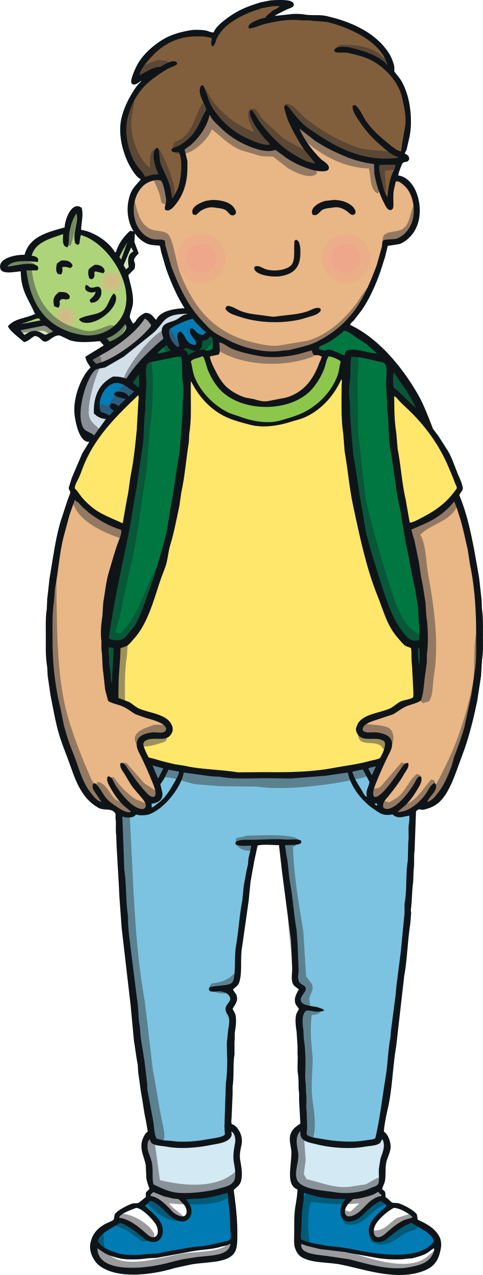
Sentence Time
Apply
Where did Kit and Sam find Jay? Read the sentence to find out.

Slide 15
Apply
He was having so much fun
playing on the display.
Sound Buttons On/Off
Show

Slide 16
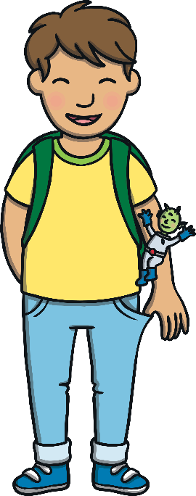
Apply
“There you are!” whispered Kit, relieved to see him.
“This is so much fun!” exclaimed Jay.
“We are glad you are enjoying your adventure,” smiled Kit, “but you should stay hidden.”
“Oops, sorry!” said Jay.

Slide 17
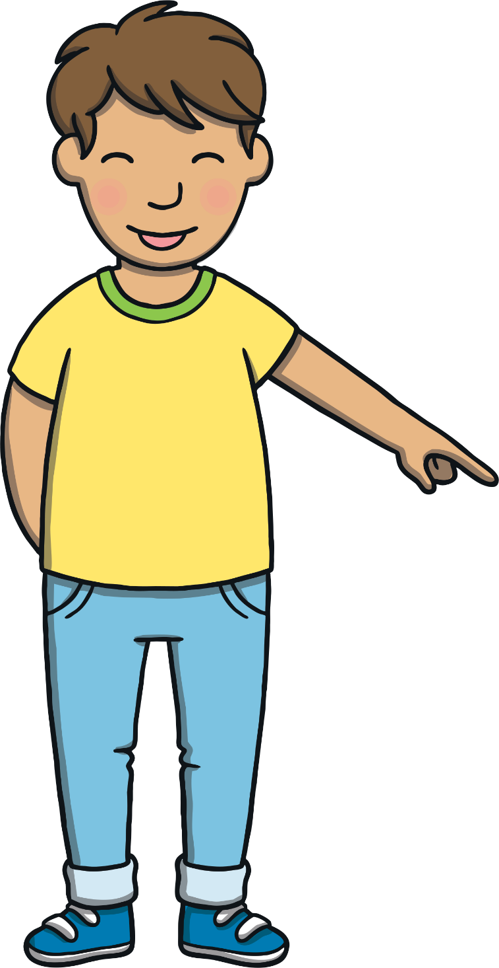
Today, we have learnt…
ay
saying /ai/
The adventure continues next lesson!

