Slide 1
2.02.21
Maths
WALT understand related calculations

Slide 2


Varied Fluency 1
Complete the multiplications:
2 x 4 = |  | 20 x 4 =
3 x 5 = |  | 5 x 30 =
4 x 4 = |  | 40 x 4 =
8 x 3 = |  | 3 x 80 =
© Classroom Secrets Limited 2018

Slide 3

Related Calculations
Diving
Complete the calculation for each set of place value counters.
1
1
1
1
1
1
1
1
1
1
1
1
1
5 × 3 = 15
1
1
1
1
1
3 × 5 = 15
4 × 2 = 8
1
1
1
1
1
2 × 4 = 8
10
10
10
10
10
10
10
10
10
10
10
10
10
3 × 50 = 150
50 × 3 = 150
10
10
10
10
10
or
40 × 2 = 80
2 × 40 = 80
10
10
10
10
10
5 × 30 = 150
30 × 5 = 150
or
20 × 4 = 80
4 × 20 = 80

Slide 4
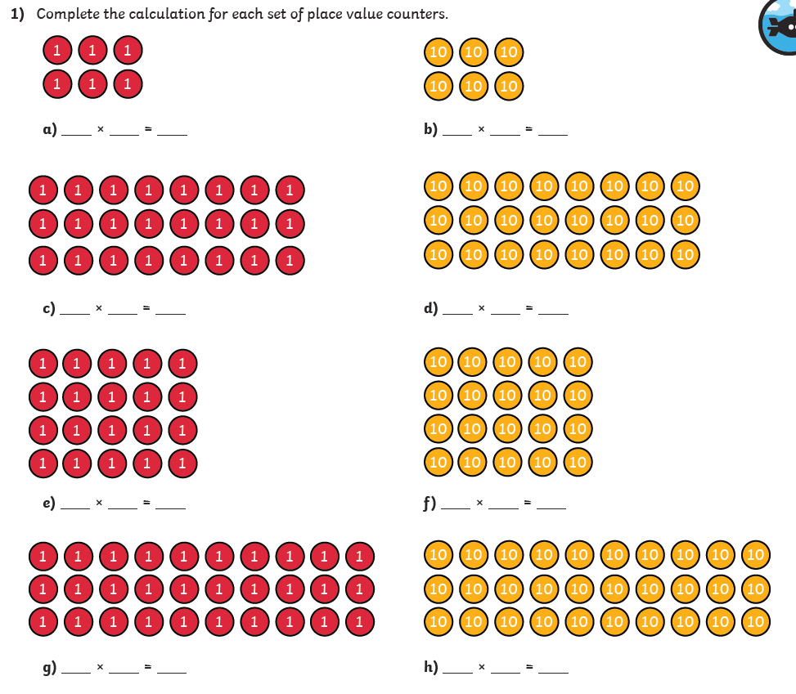

Slide 5


Related Calculations
Diving
Each bag contains 10 footballs.
There are 3 columns of 4 bags.
There are 3 columns of 40 balls.
3 × 4 = 12
4 × 3 = 12
3 × 40 = 120
40 × 3 = 120
There are 12 bags altogether.
There are 120 balls altogether.

Slide 6
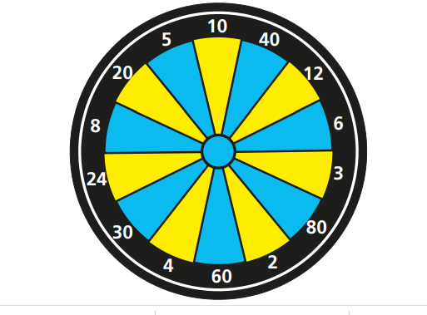



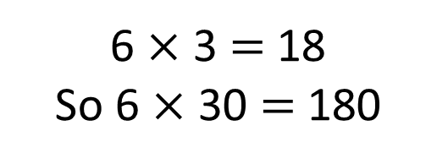
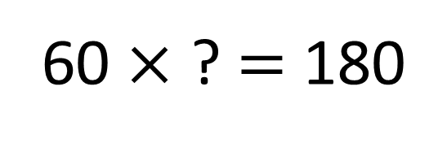
Where does Whitney’s counter need to land?
What was Annie’s score?
Have a think
180
60 $×$ ? $=$ 180
6 $×$ 3 $=$ 18
So 6 $×$ 30 $=$ 180
I wonder if I can score the same?

Slide 7
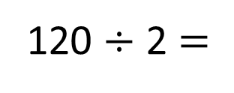
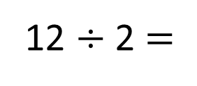
Complete the divisions.
12 $÷$ 2 $=$
6
120 $÷$ 2 $=$
60

Slide 8


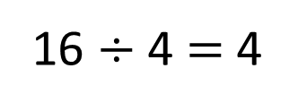
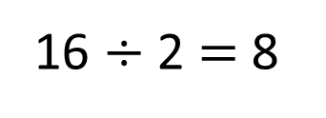
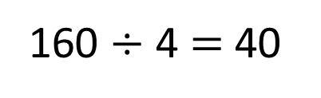
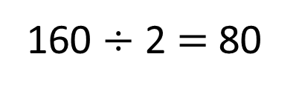
16 $÷$ 2 $=$ 8
16 $÷$ 4 $=$ 4
160 $÷$ 2 $=$ 80
160 $÷$ 4 $=$ 40

Slide 9
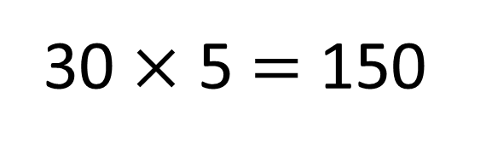
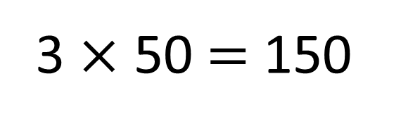
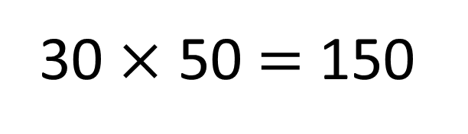
True
False
3 $×$ 50 $=$ 150
30 $×$ 5 $=$ 150
30 $×$ 50 $=$ 150

Slide 10
Varied Fluency 3
True or false?
If 4 x 80 = 320, then 320 divided by 80 = 40.
© Classroom Secrets Limited 2018

Slide 11
Varied Fluency 3
True or false?
False. 320 divided by 80 = 4.
If 4 x 80 = 320, then 320 divided by 80 = 40.
© Classroom Secrets Limited 2018

Slide 12
Reasoning 1
Erica has written some number sentences about a fact family, but she’s made a mistake.
Find and explain her mistake.
2 x 8 = 16 | 20 x 8 = 160
8 x 2 = 16 | 80 x 2 = 16
16 ÷ 8 = 2 | 160 ÷ 80 = 2
16 ÷ 2 = 8 | 160 ÷ 2 = 80
© Classroom Secrets Limited 2018

Slide 13
Reasoning 1
Erica has written some number sentences about a fact family, but she’s made a mistake.
Find and explain her mistake.
Erica has made a mistake because…
2 x 8 = 16 | 20 x 8 = 160
8 x 2 = 16 | 80 x 2 = 16
16 ÷ 8 = 2 | 160 ÷ 80 = 2
16 ÷ 2 = 8 | 160 ÷ 2 = 80
© Classroom Secrets Limited 2018

Slide 14
Have a go at the questions on the next slide

Slide 15
