Slide 1
12.1.21
Maths
WALT understand arrays

Slide 2
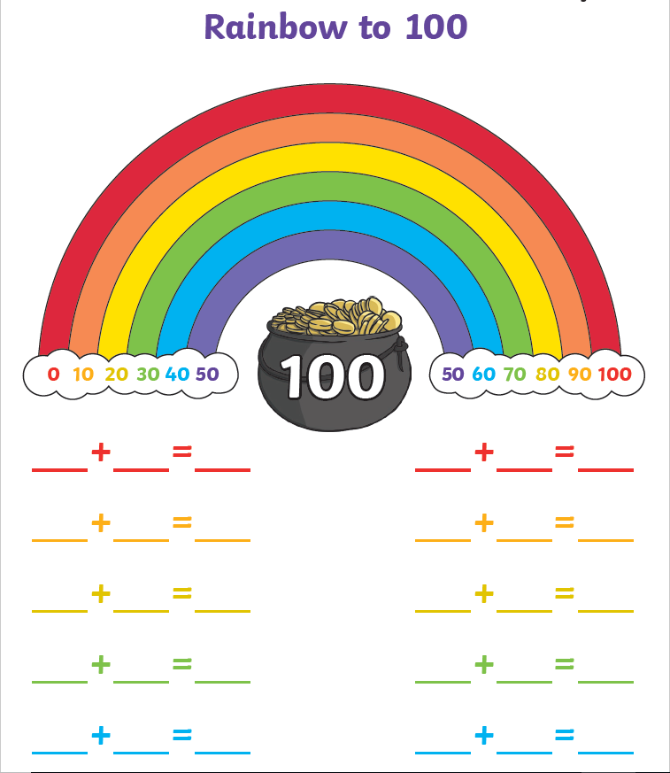
Use your number bonds to 10 to help you answer these number bonds to 100
Maybe you can answer without the rainbow to help you?

Slide 3
What does multiply mean?
What other words for multiply can you think of?

Slide 4
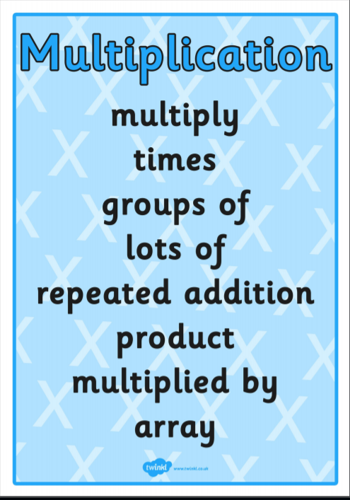

Slide 6
1) How many counters?
2) How many counters?
3) Which representations show 6?

Slide 7
1) How many counters?
2) How many counters?
3) Which representations show 6?
5
10

Slide 8
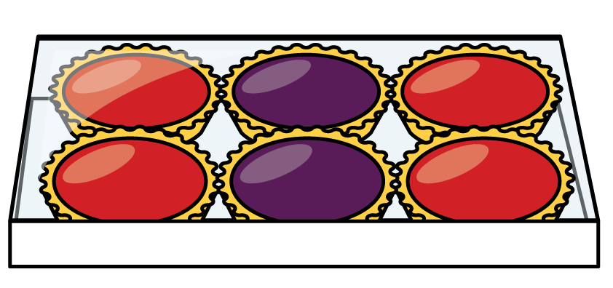
How many tarts?
3
3
2 2 2

Slide 9
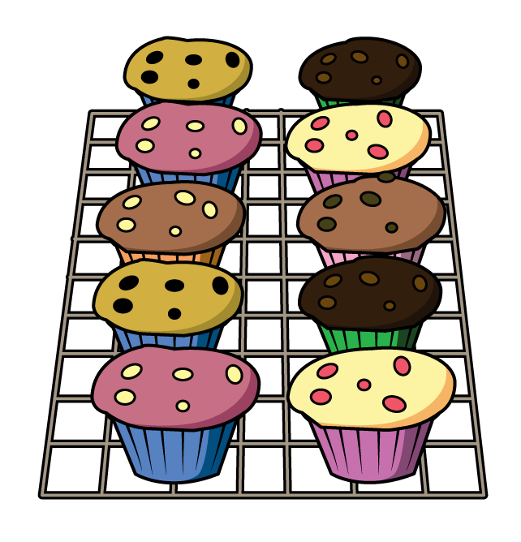
How many cakes?
2
2
2
2
2
5 5

Slide 10
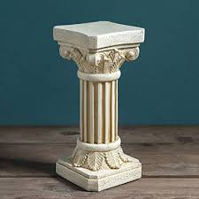
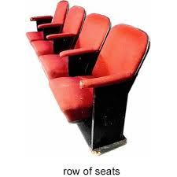
What is an array?
6 columns
2 rows
6 $+$ 6 $=$ 12
2 $×$ 6 $=$12
2 $+$ 2 $+$ 2 $+$ 2 $+$ 2 $+$ 2 $=$ 12
6 $×$ 2 $=$12
An array in maths is an arrangement of objects, numbers or pictures in columns or rows. The purpose of an array is to help us understand multiplication

Slide 11
Have a think
4 $+$ 4 $=$ 8
2 $×$ 4 $=$8
2 $+$ 2 $+$ 2 $+$ 2 $=$ 8
4 $×$ 2 $=$ 8

Slide 12
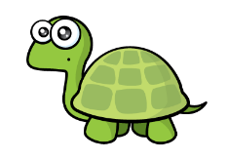
Have a think
You can’t make an array because 9 is an odd number
3 $+$ 3 $+$ 3 $=$ 9
3 $×$ 3 $=\text{9}$

Slide 13
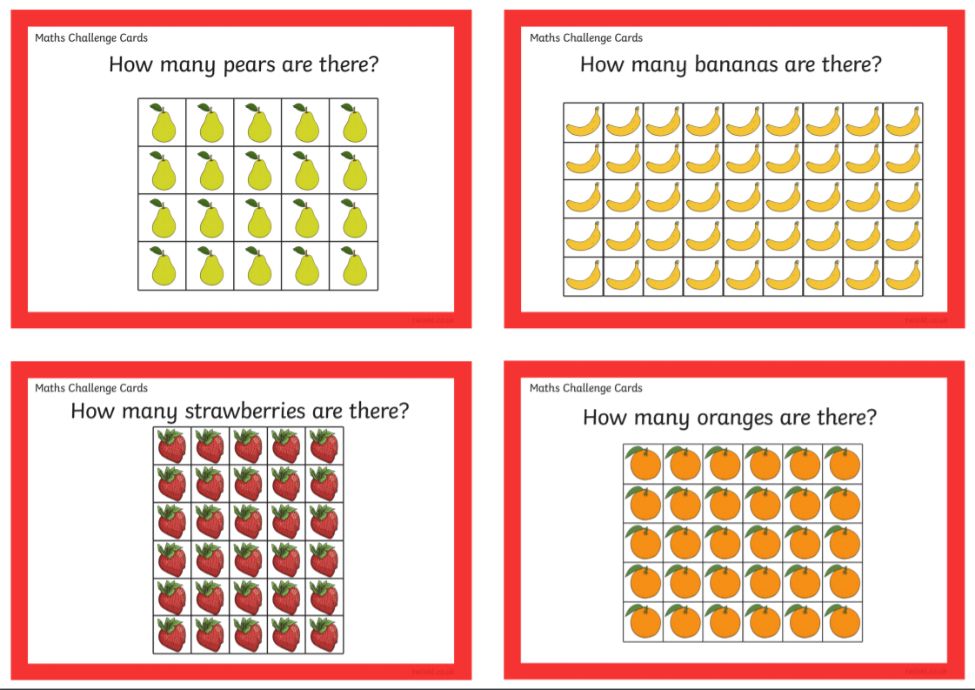

Slide 14
Have a go at the questions on the next page

Slide 15
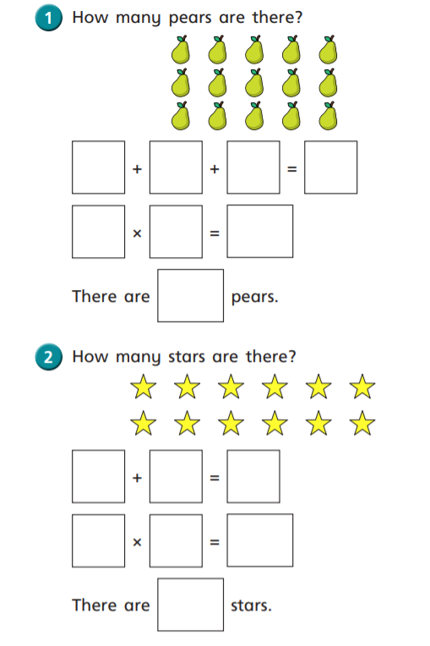
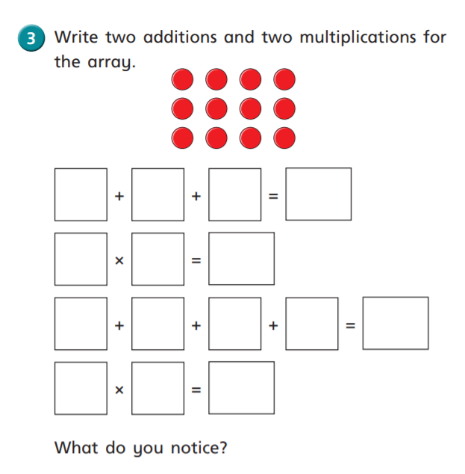
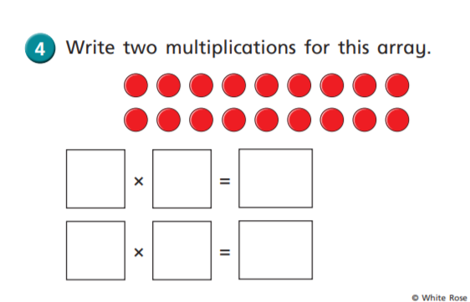

Slide 16
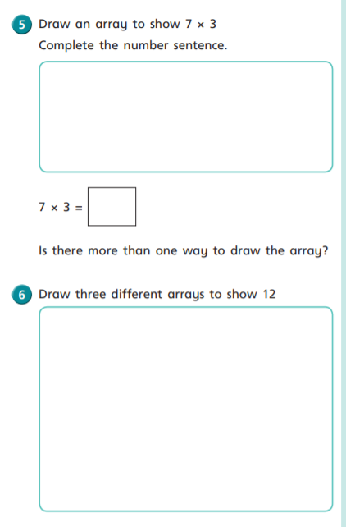
You will need 16 counters, dried pasta shapes, buttons
Don’t forget to email how you got on! Well done!

Slide 17
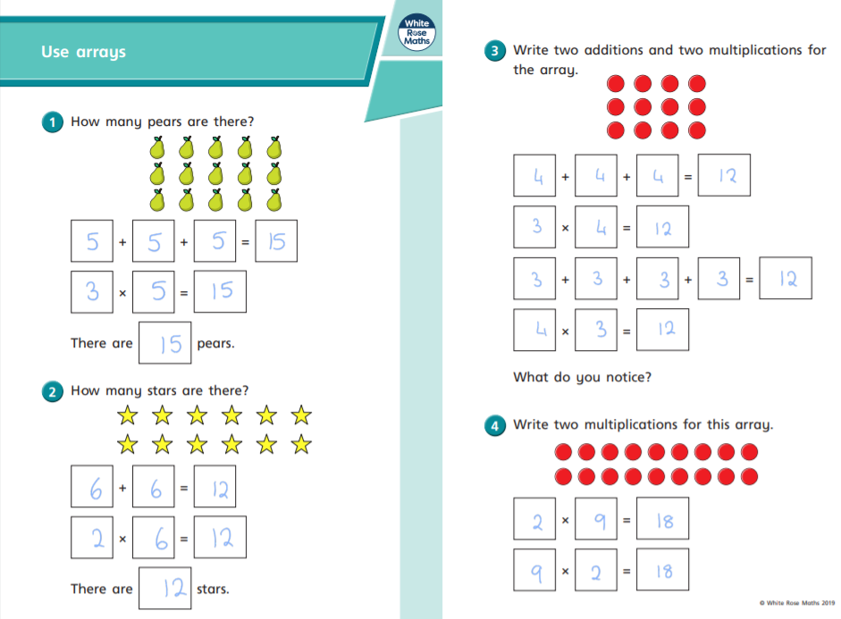
Answers

Slide 18
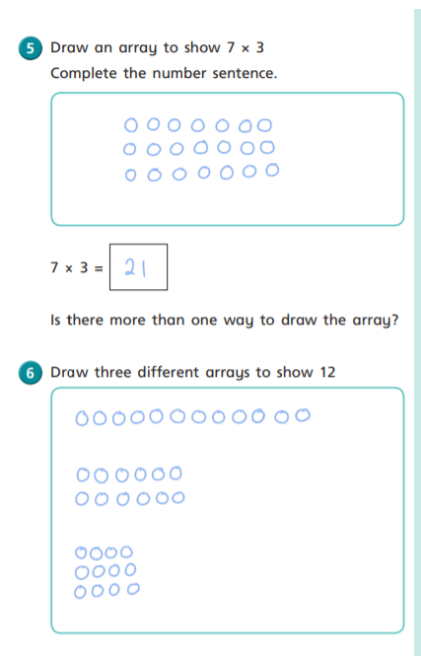
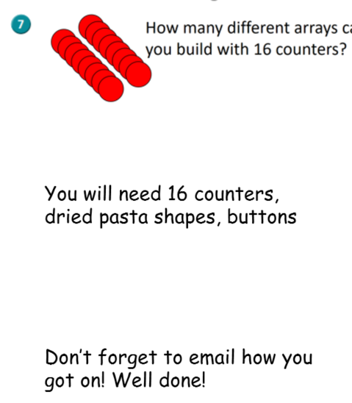
Various answers – please take a snap and email me

Slide 19
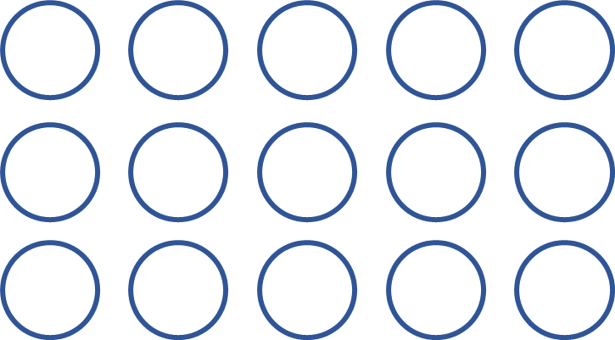
Draw an array to represent 5 $×$ 3
Have a think

