Slide 2
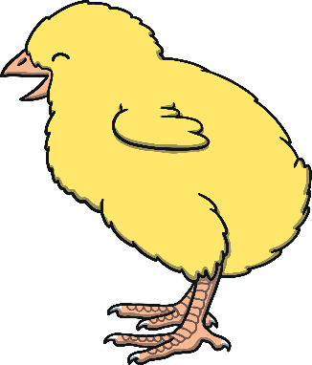
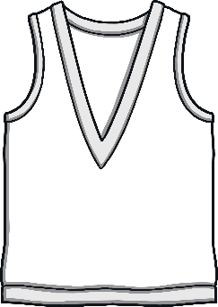
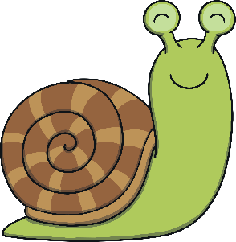
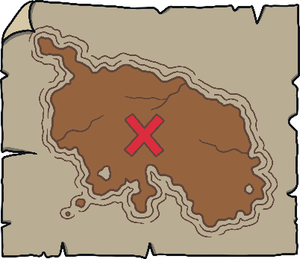
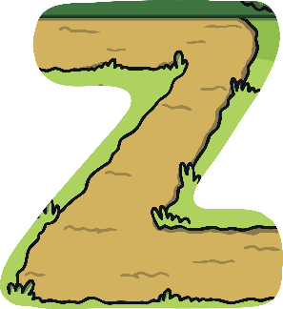
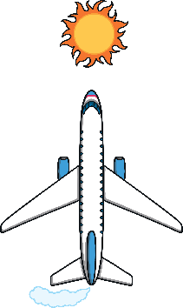
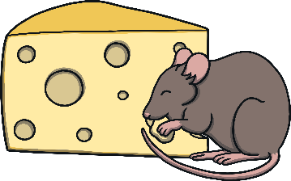
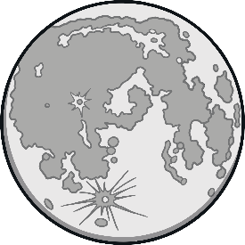
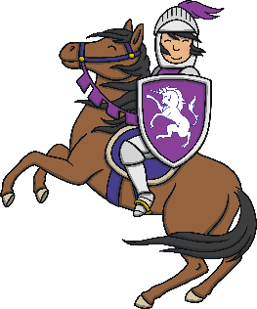
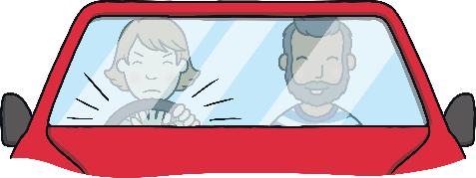
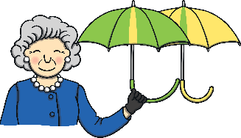
Revisit and Review
Let’s practise Sam’s Sounds and Common Exception Words!
er
y
j
ch
z
ee
air
ai
ear
ng
oi
oa
qu
th
ur
oo
x
v
ar
igh
ow
or
ure
ay
w
sh
when
one
out
some
were
should
so
like
there
have
little
come
said
what
do
could

Slide 3
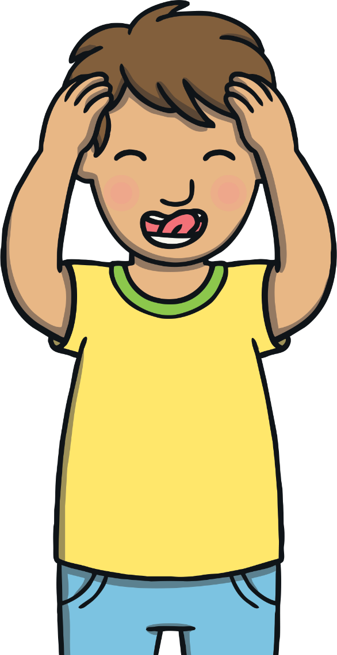
Teach
Today, we are learning to read and write words that contain ay.

Slide 4
Teach
Let’s practise reading some of this week’s focus words that contain the ay sound.
day
may
spray
tray
play
say
clay
crayon

Slide 5
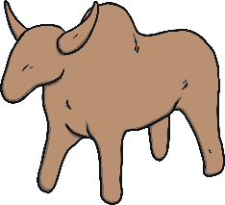
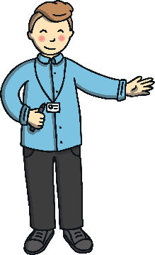
Teach
Can you write the words on a whiteboard or piece of paper?
day
play
spray
clay
may
crayon
tray
say

Slide 6
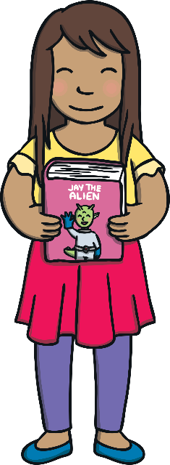
Teach
Kit and Sam had just said goodbye to Jay. Sam closed the magic book carefully. “I’m glad Jay enjoyed his adventure here,” she said.

Slide 7
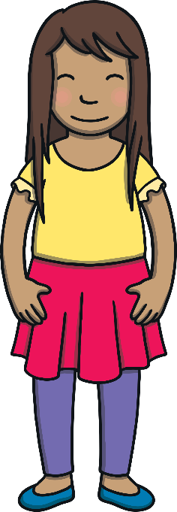
Teach
“Me too. It was so lovely to meet him in real life,” he said as he put the book about Jay back on the bookshelf.

Slide 8
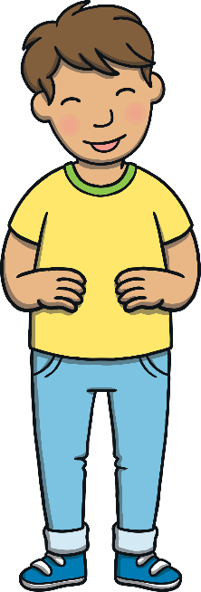
Teach
“I wonder what he is doing now that he is back home again,” wondered Sam.
“He might be making toad in the hole for his family!” laughed Kit.

Slide 9
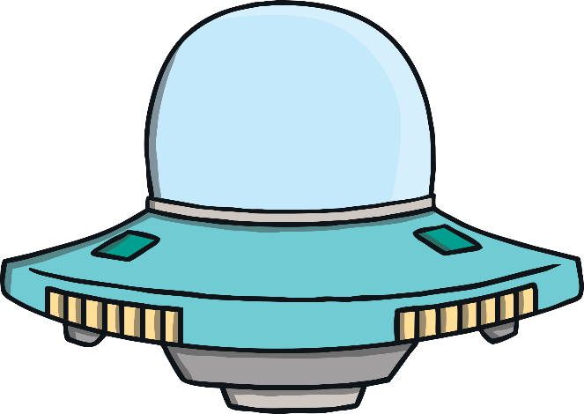
Spaceship Surprises
Practise
Jay is telling his family all about his exciting adventure to planet Earth. He has brought lots of things with him on his spaceship. Can you read the ay words to find out what the surprises are?

Slide 10
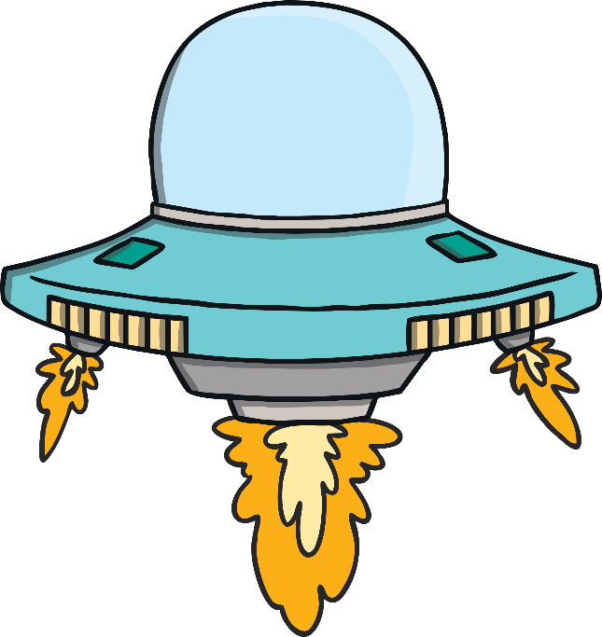
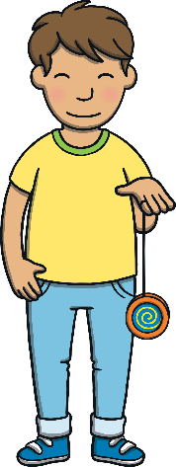
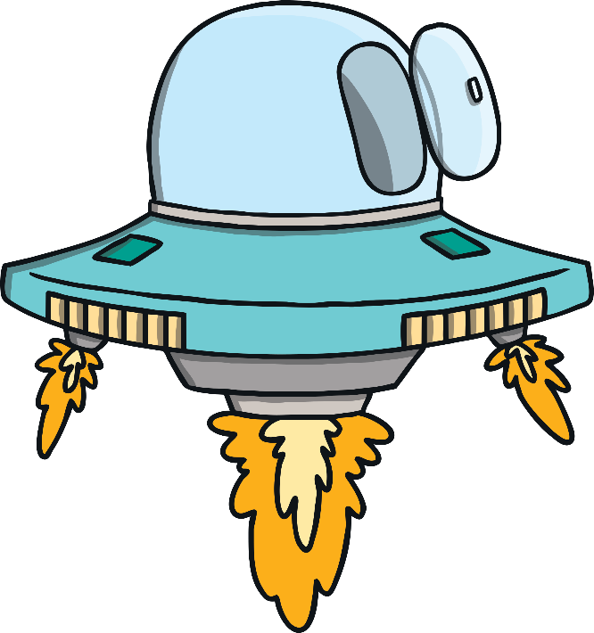
Practise
tray
tray
play
play
spray
spray
clay
clay
Show

Slide 11
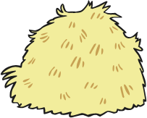
crayon
crayon
pay
hay
hay
pay
Show

Slide 12
Apply
“I hope he remembers to not add a toad!” laughed Sam.
“Why don’t we make a book all about Jay’s adventure here with us on planet Earth?” said Kit.

Slide 13
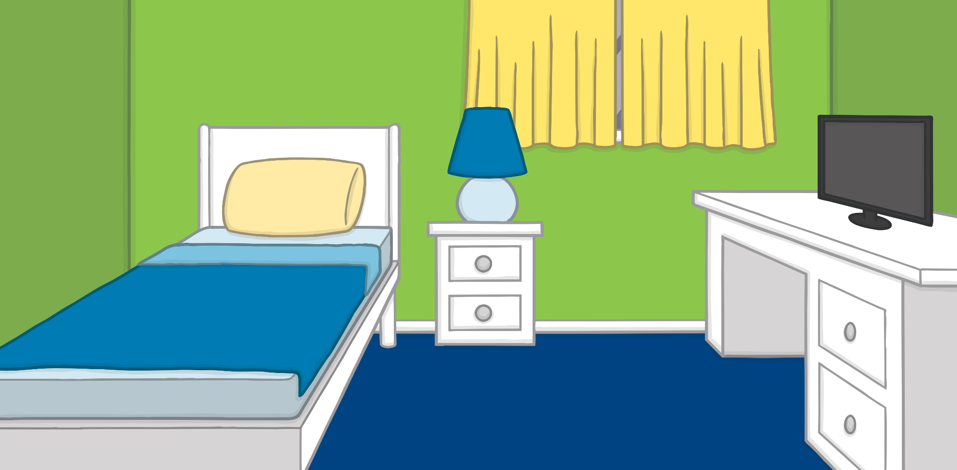
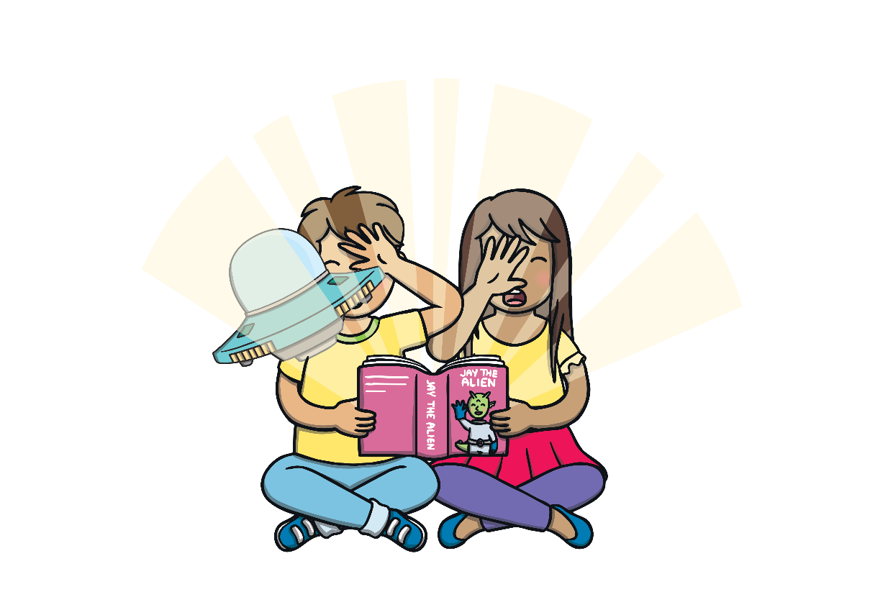
Apply
Fun With Jay
A ‘Let’s Read Together!’ Book

Slide 14
Apply
Kit and Sam had a book. They got Jay to visit so he could play.

Slide 15
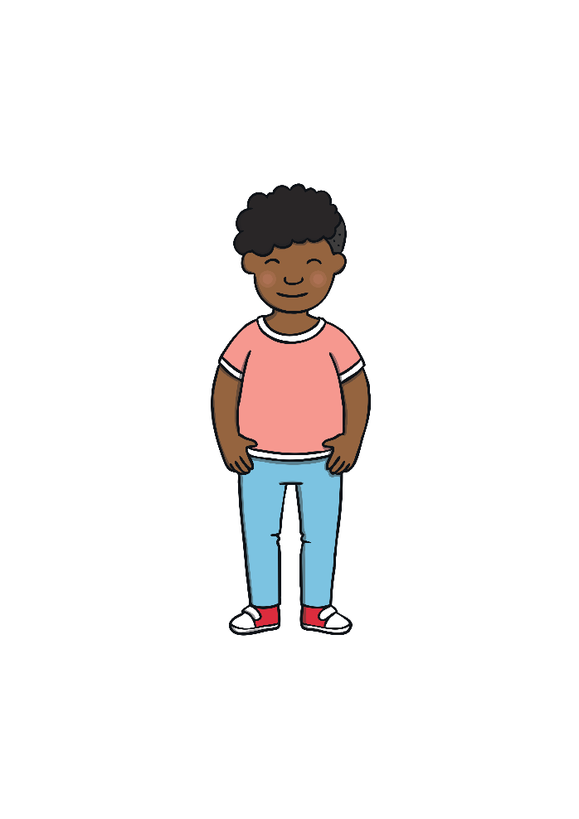
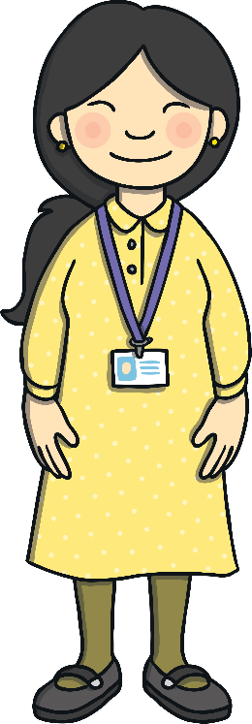
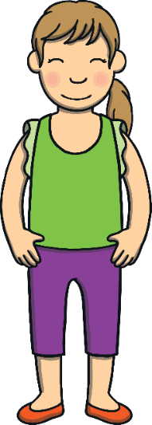
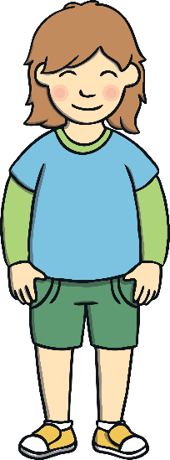
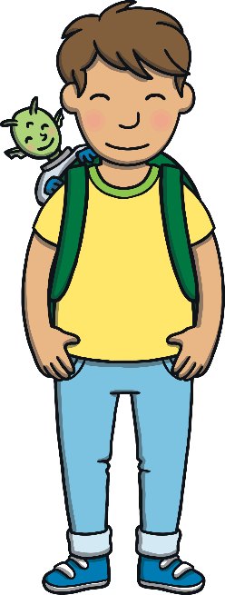
Apply
It was the end of the holidays. The next day, they took him to class.

Slide 16
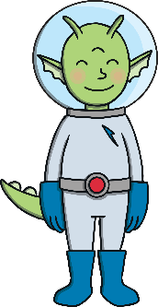
Apply
Apply
They lost him on the display. He should stay hidden!

Slide 17
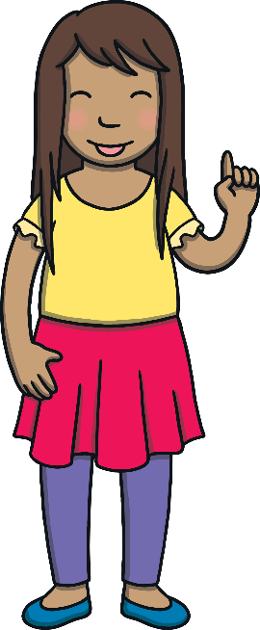
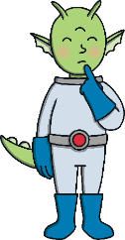
Apply
At midday, they went for dinner. They had to tell Jay there were
no toads.

Slide 18
Apply
After dinner, it was Kit and Sam’s art lesson. Jay got stuck with the crayons.

Slide 19
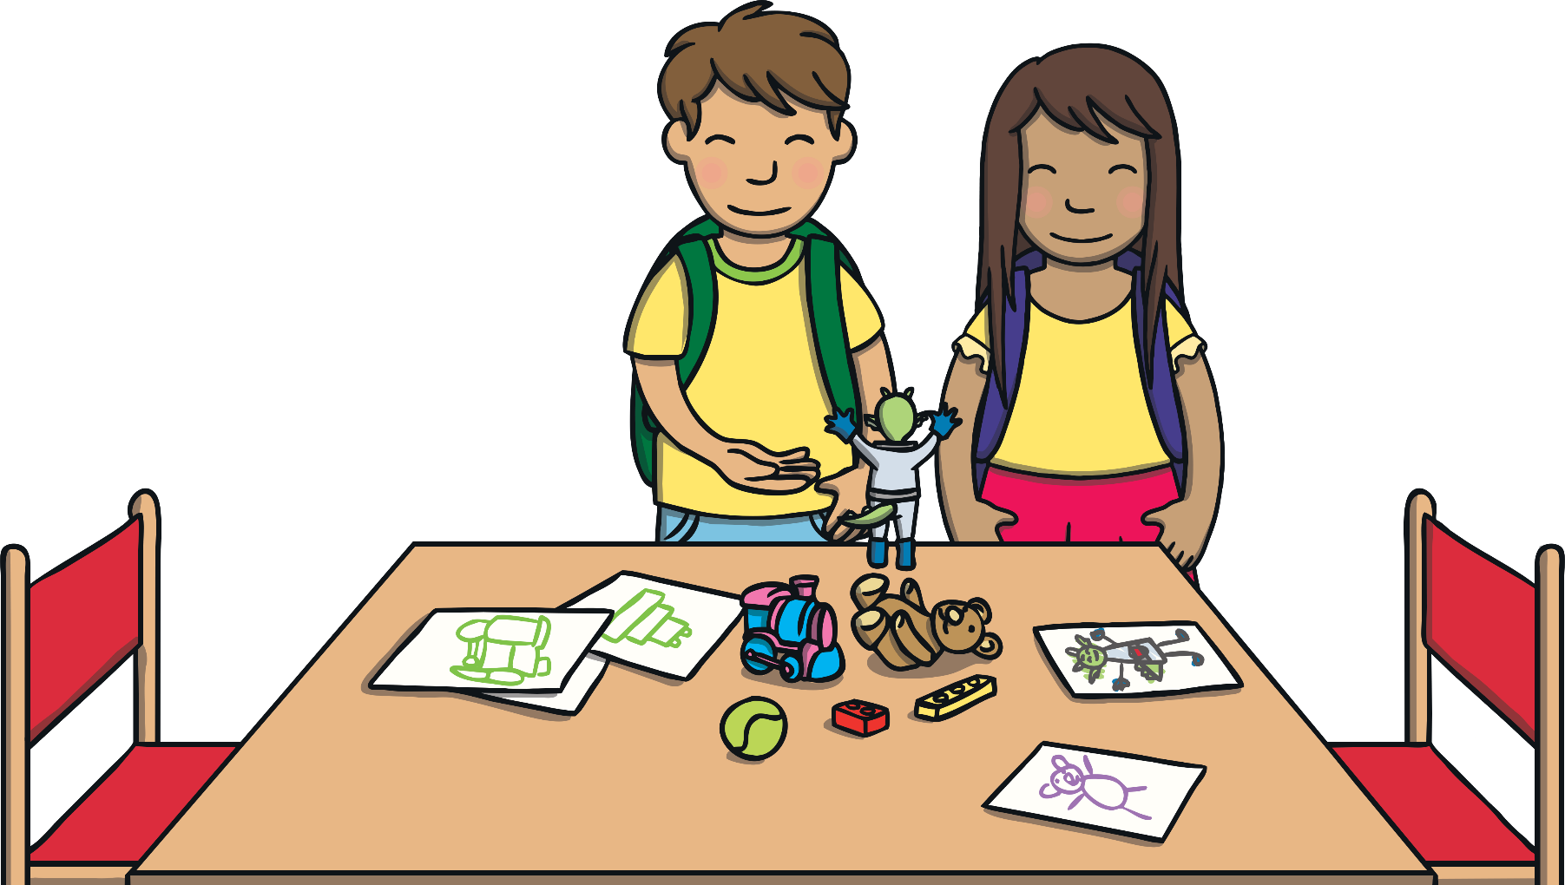
Apply
He had so much fun but he could not stay. “I must go back to my planet,” said Jay.

Slide 20
Apply
“Do you think we’ll see Jay again?” said Kit.
“I hope so,” said Sam. “It would be lovely to travel to his planet and visit him one day!”

Slide 21
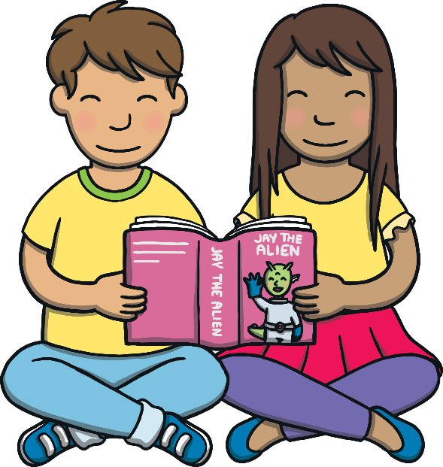
Today, we have read ‘Fun with Jay’ containing ay words.

