Slide 1
Friday 26th February
English
WALT understand the features of a poem
WALT know how to write a shape poem

Slide 2
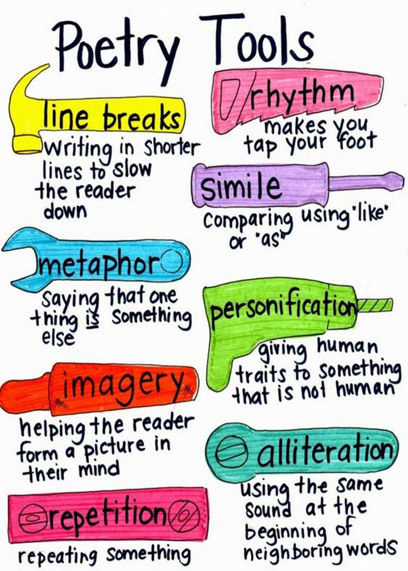
+ Rhyme
rhyme

Slide 3
Poem 10
Poem 11

Slide 4
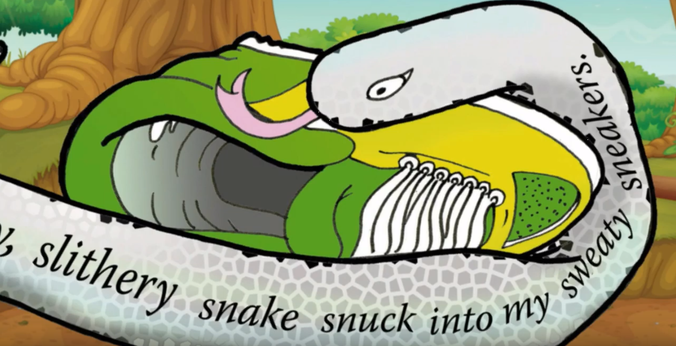
WALT know how to write a shape poem
Let's have a look at these animal shape poems

Slide 5
Let's watch this film clip to find out more about writing a shape poem!

Slide 6
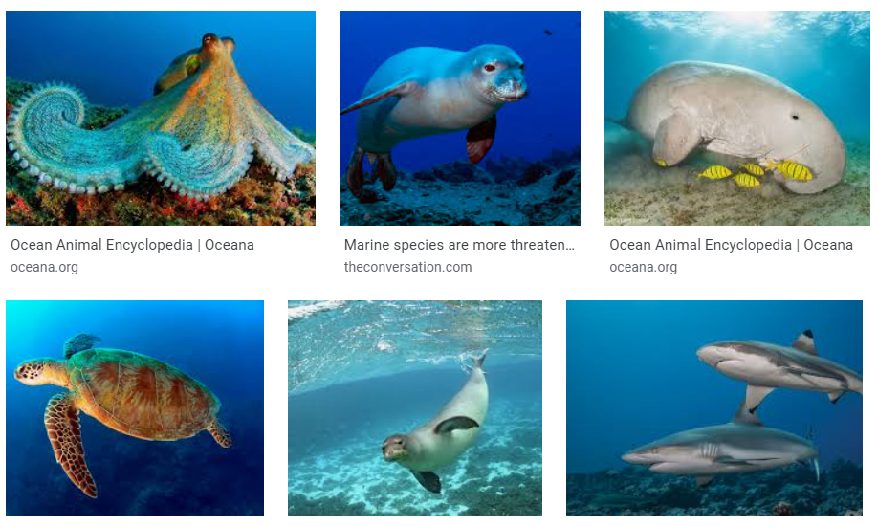
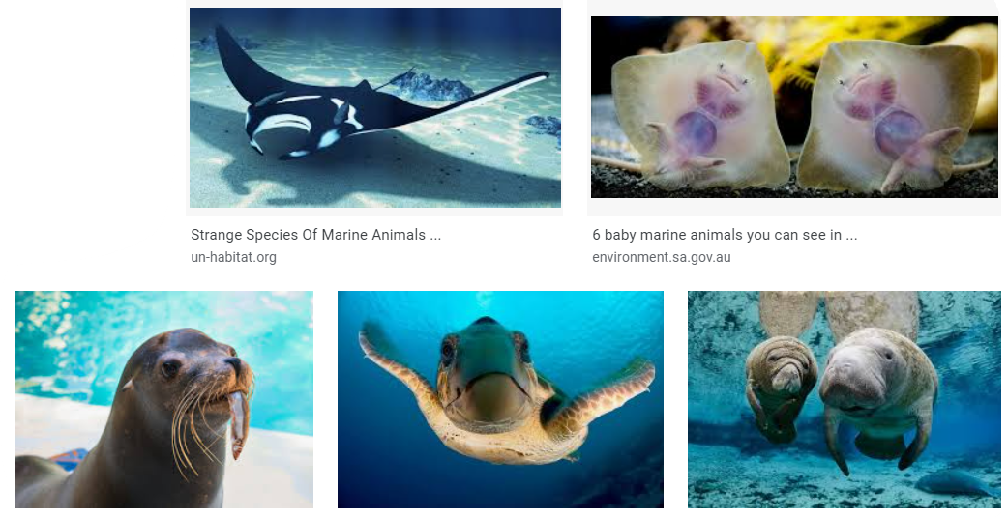

Slide 7
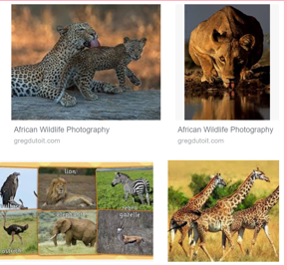
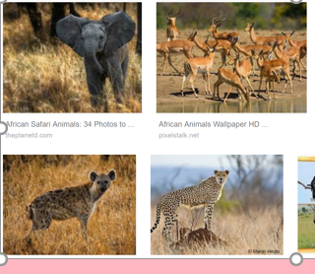

Slide 8
