Slide 1
3.2.21
Maths
WALT understand how to multiply 2 digits by 1 digit (no exchange)

Slide 2
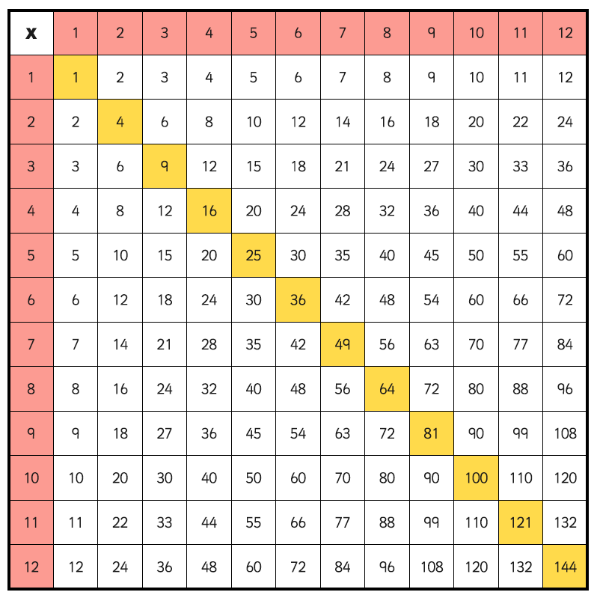
On the ‘Useful tab’ on our home page you will find this multiplication square, really good if your tables are not yet secure in your head!

Slide 3
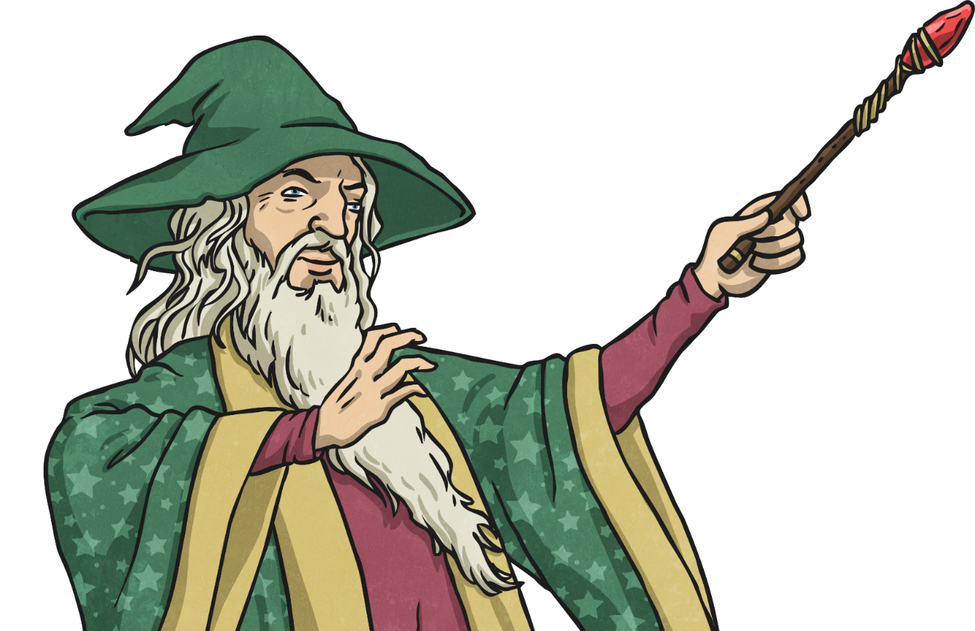
Multiplication Magic
Multiplication Magic is special trick that makes multiplying numbers in the 10× table really easy.

Slide 4
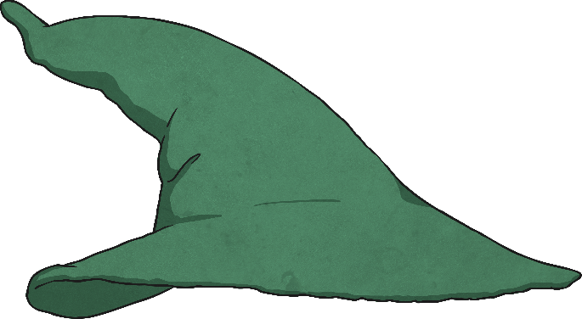

Draw the Hat to Find the Fact
It’s Magic!

Slide 5

Multiplication Magic
60 × 4 =
60 × 4 =
Draw the wizard’s hat to find the facts to calculate.

Slide 6
Multiplication Magic
60 × 4 =
6 × 4 = 24
Use your multiplication facts to calculate.

Slide 7
Multiplication Magic
60 × 4 =
If we know 6 × 4
…then we know
60 × 4!
Use your multiplication facts to calculate.

Slide 8
The Maths Behind the Magic
How does Multiplication Magic work?
40 × 3 =
We look for the facts and ignore the tens, so we calculate:
4 × 3 = 12
However, 4 really means 40, not 4. Therefore, we need to move the digits one place to the left and add a zero as a place holder.
So 40 × 3 = 120
H | T | O
1
0
2

Slide 9
Multiplication Magic
40 × 5 =
4 × 5 = 20
When we calculate 4 × 5, the answer already ends in a zero.
Does this change anything?

Slide 10
Multiplication Magic
40 × 5 =
4 × 5 = 20
40 × 5 = 200
H
T
O
40 × 5 =
20
0

Slide 11

Complete the calculations
3 $×$ 2 $=$ 3 $×$ 20 $=$
Complete the calculations
1 $×$ 4 $=$ 1 $×$ 40 $=$
2 $×$ 4 $=$ 2 $×$ 40 $=$
3 $×$ 4 $=$ 3 $×$ 40 $=$

Slide 12
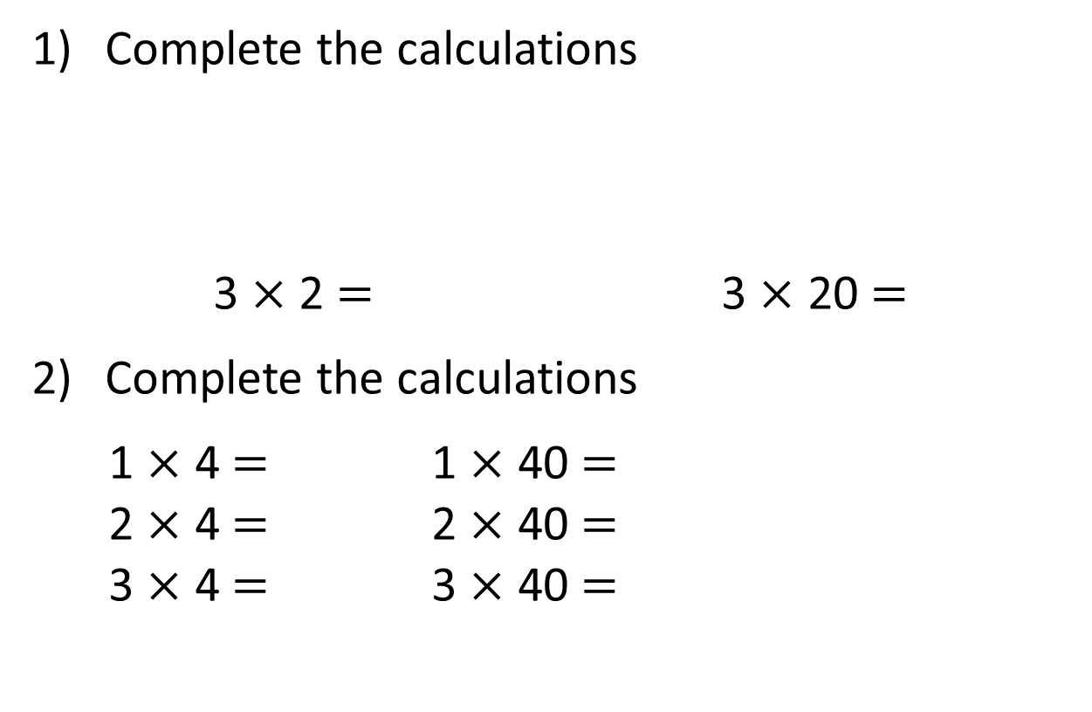
Complete the calculations
3 $×$ 2 $=$ 3 $×$ 20 $=$
Complete the calculations
1 $×$ 4 $=$ 1 $×$ 40 $=$
2 $×$ 4 $=$ 2 $×$ 40 $=$
3 $×$ 4 $=$ 3 $×$ 40 $=$
6
60
4
40
8
80
12
120

Slide 13


Now It’s Your Turn To Use
Multiplication Magic
Now you try:
50 × 8 = ?
3 × 60 = ?
70 × 4 = ?
Challenge:
30 × 40 = ?
20 × 80 = ?
90 × 30 = ?
Remember
Draw the wizard’s hat.
Use your multiplication facts to calculate.
5 × 8 = 40
50 × 8 = 400
50 × 80 = 4000
500 × 80 = 40000

Slide 14


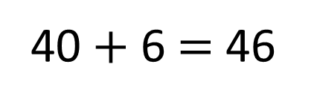
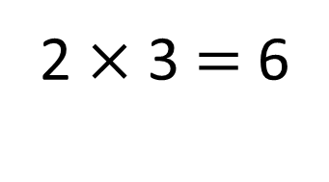
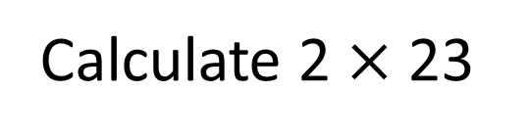
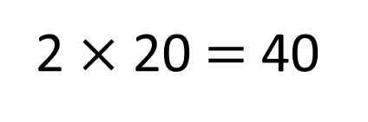
Calculate 2 $×$ 23
46
23
40 $+$ 6 $=$ 46
20
3
2 $×$ 20 $=$ 40
2 $×$ 3 $=$ 6

Slide 15

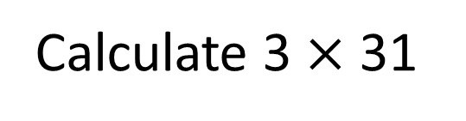
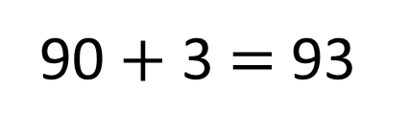
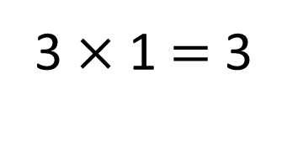
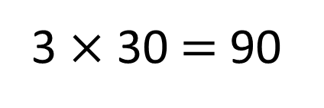
Calculate 3 $×$ 31
Have a think
93
31
90 $+$ 3 $=$ 93
30
1
3 $×$ 30 $=$ 90
3 $×$ 1 $=$ 3

Slide 16
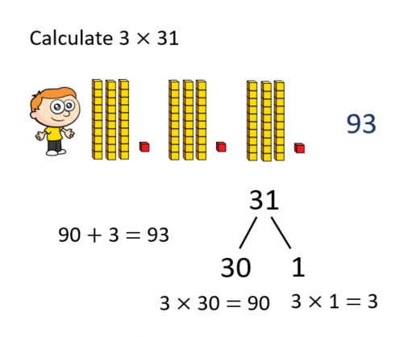
You’re going to demonstrate both methods in your book today
Draw your amount using Base 10
Partition into Tens and Ones
Do your two multiplications
Add together
Record calculation
Mild Spicy
3 x 21
4 x 22
34 x 2
13 x 3
WAGOLL
33 x 3
42 X 3
51 x 3
44 x 4
24 x 3
22 x 4
Hot – Have a go at challenge

