Slide 1
Day 1 - Comprehension
Read through the extract and answer the VIPERS questions in your book.

Slide 2
Extract taken from Tilly and the Time Machine by Adrian Edmondson

Slide 3
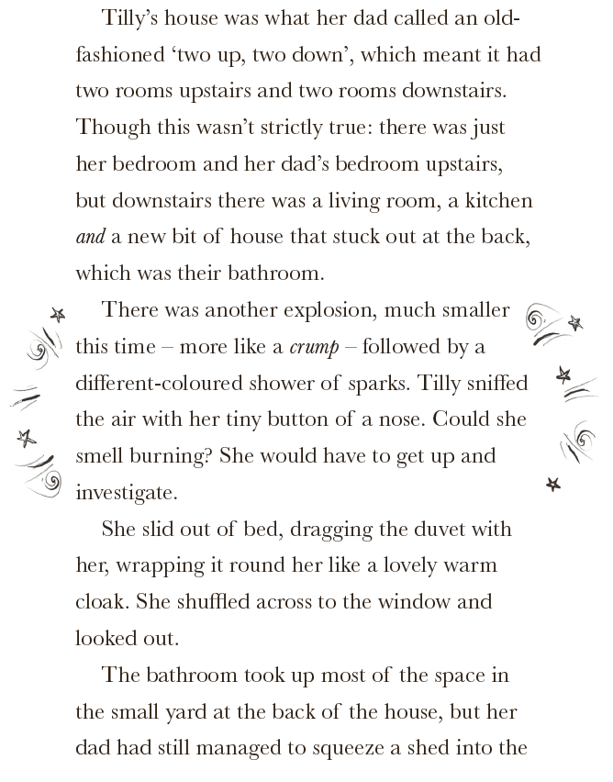
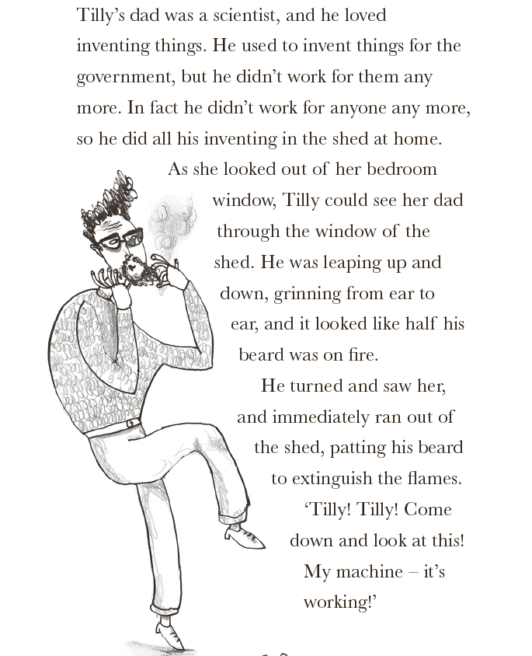

Slide 4
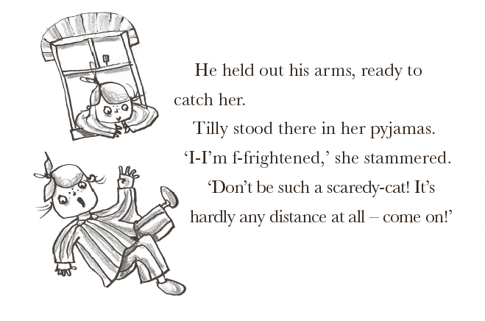

Slide 5
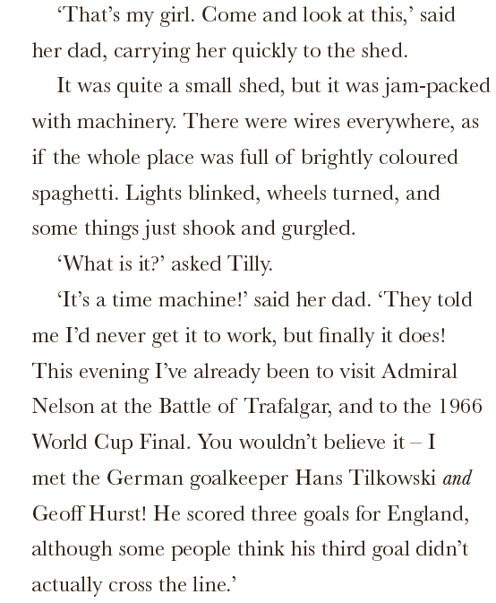

Slide 7
What impression do you get of Tilly’s dad? What words and phrases tell you this?

Slide 8
Predict what you think will happen next.

Slide 9
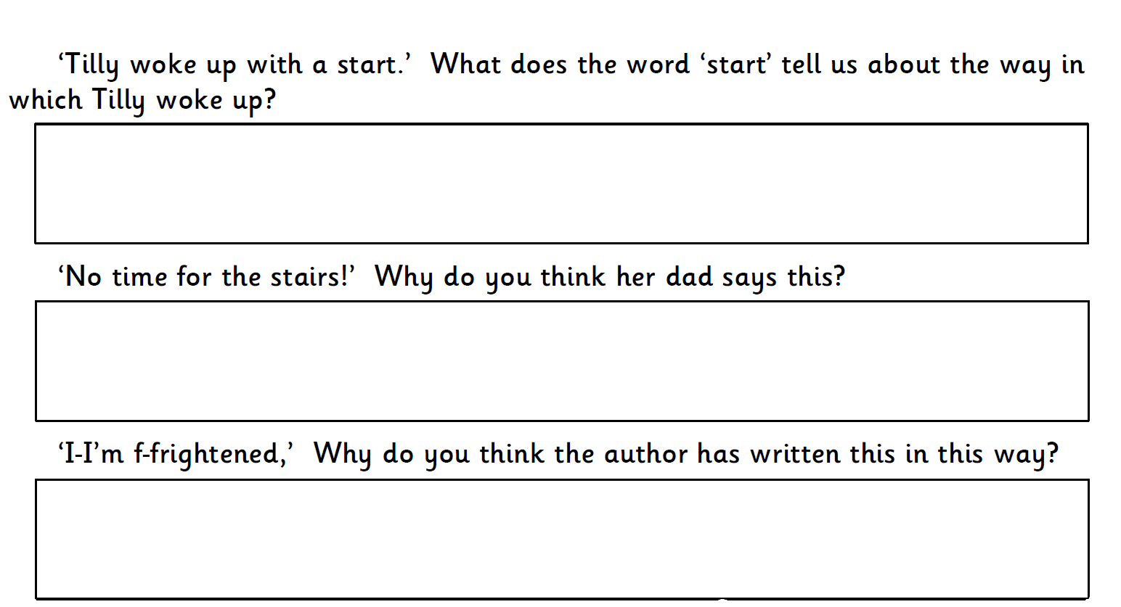

Slide 10
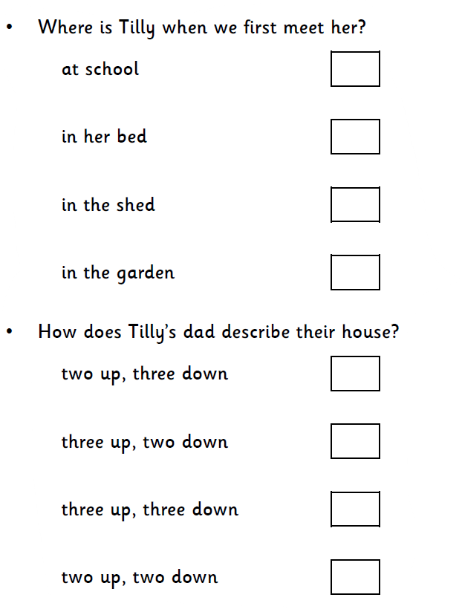
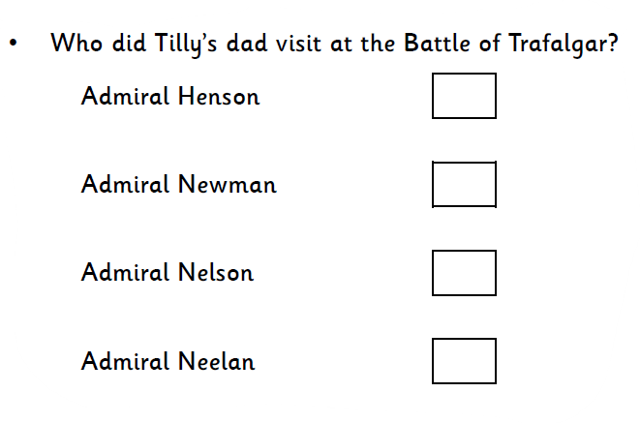
Choose one answer from each question

Slide 12
Day 2 - SPaG
Today’s SPaG is causal conjunctions

Slide 13
What is the conjunction in the sentence?

Slide 14
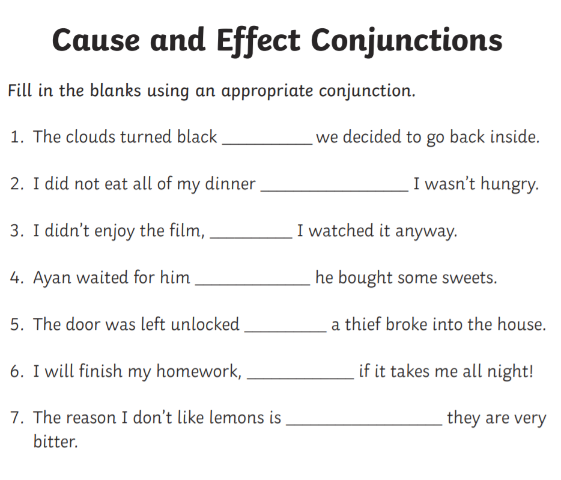

Slide 15
Day 3 & 4 – Planning and Writing

Slide 16
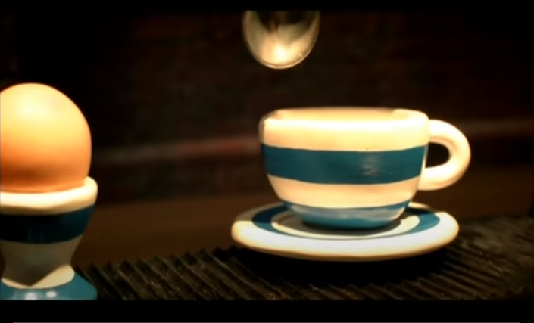
Wallace & Gromit Cracking Contraptions - The Snoozatron
Enjoy this short animation from Wallace and Gromit

Slide 17
The Snoozatron WAGOLL
The ‘Snoozatron’ is a device invented by Wallace, from ‘Wallace and Gromit’. Wallace made this device to help him get to sleep. It is a series of machines that helps him count sheep.
When Wallace pulls a lever, a loud bell rings in Gromit’s room, this causes him to wake up as he has a job to do as part of the snoozatron. First, some robot hands descend from the ceiling and fluff up Wallace’s pillows and mattress. After that, a mechanical claw drops a hot water bottle into Wallace’s lap. Another claw enters from side and produces a teddy bear for Wallace to cuddle. When the picture of the wall opens, a gramaphone (an old fashioned record player) starts playing a lullaby.
Once all this has occurred, Wallace calls out to Gromit. Gromit (who is now in his sheep outfit) stands downstairs under Wallace’s room, ready to be projected through a trapdoor into Wallace’s room. As Gromit bounces on a spring, Wallace counts him as a sheep. This continues until Wallace falls asleep.
Unluckily for Gromit, he cannot escape the ‘Snoozatron’ until the dial on the sheep counting lever returns to zero!

Slide 18
Day 3 & 4 – Planning and writing
Your Task
‘Magpie’ some of the red words to help you with your explanations
It could also be a machine for everyday activities.
Draw and label your machine. Don’t forget to use a ruler for your labels.

Slide 20
Day 5 - Publishing
Time to publish your explanation of how your machine works. You must either;
Type up on the computer using Word or Powerpoint
or
Copy up in your best handwriting.
You must do differently to what you did last week so that you are practising your writing skills. There is handwriting paper available on your child’s class page.

