Slide 1
Monday 7th February
English
WALT use VIPERS to help us understand the poem

Slide 3
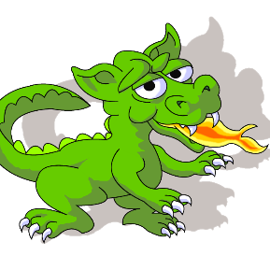
The Magic Box
I will put into the box
The swish of a silk sari on a summer night,
Fire from the nostrils of a Chinese dragon,
The tip of a tongue touching a tooth.
I will put into the box
A snowman with a rumbling belly,
A sip of the bluest water from Lake
Lucerene,
A leaping spark from an electric fish.
I will put into the box
Three violet wishes spoken in Gujarati,
The last joke of an ancient uncle,
And the first smile of a baby.
I will put into the box
A fifth season and a black sun,
A cowboy on a broomstick,
And a witch on a white horse.
My box is fashioned from ice and gold and steel
With stars on the lid and secrets in the corners.
Its hinges are the toe joints of dinosaurs.
I shall surf in my box
On the great high-rolling breakers of the wild Atlantic
Then wash ashore on a yellow beach,
The colour of the sun.

Slide 4
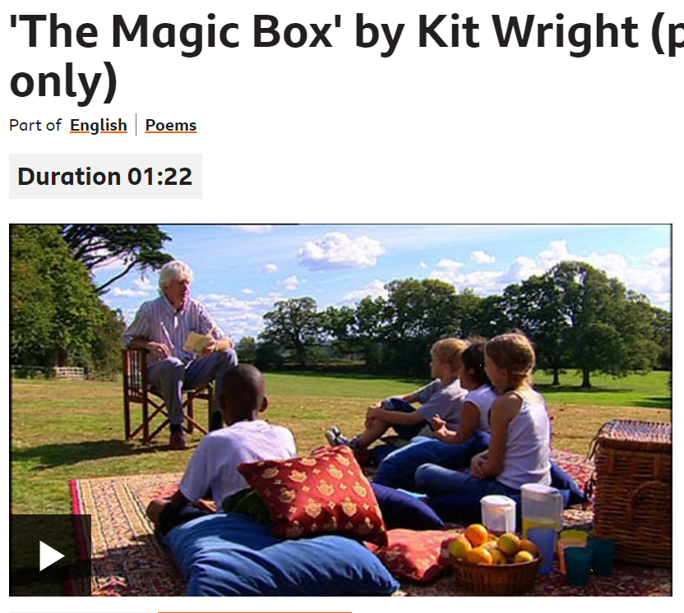

Slide 5
The author writes ‘the swish of a silk sari’. Say these words aloud. What is special about the
sounds these words make? (Vocabulary)
What is special about these sounds is that…
2. Why do you think the author wants to put ‘the first smile of a baby into the box’? (Infer)
I think the author wants to put a ‘the first smile of a baby into the box’ because….
3. What would your magic box be made of? (Predict)
My box would be made of…
4. Can you find two impossible things in verse four of the poem? (Explain)
The impossible things in verse four are…..
5. What is on the lid and in the corners of the box? (Retrieve)
On the lid of the box are… and in the corners are…
6. What is your favourite idea in the poem, and why? (Summarise)
My favourite idea in the poem is…because…

