Slide 1
WALT understand how to use the short method to multiply 4 digit by 2 digits

Slide 2
1) 1 × 415 =
2) 100 × 415 =
3) 200 × 415 =
4) 415 × 201 =

Slide 3
415
1) 1 × 415 =
2) 100 × 415 =
3) 200 × 415 =
4) 415 × 201 =
41,500
83,000
83,415
415 × 200 + 415 × 1

Slide 4
2,313 $×$ 32 =
Have a think
TTh | Th | H | T | O
 | 2 | 3 | 1 | 3
 |  |  | 3 | 2
$$×$$
4
6
2
6
2,313
2
$($_____ $×$ __$\text{_})$
$$+$$
$($_____ $×$ __$\text{_})$

Slide 5
2,313 $×$ 32 =
74,016
TTh | Th | H | T | O
 | 2 | 3 | 1 | 3
 |  |  | 3 | 2
$$×$$
4
6
2
6
2,313
2
$($_____ $×$ __$\text{_})$
6
9
3
9
0
2,313
30
$$+$$
$($_____ $×$ __$\text{_})$
7
4
0
1
6
1
1
1

Slide 6
2,313 $×$ 32 =
$$×$$
2,000
300
10
3
30
60,000
9,000
300
90
2
4,000
600
20
6
60,000 + 9,000 + 4,000 + 300 + 90 + 20 + 6 =
74,016

Slide 7
6,324 $×$ 33 =
208,692
Have a think
 | TTh | Th | H | T | O
 |  | 6 | 3 | 2 | 4
 |  |  |  | 3 | 3
$$×$$
1
8
9
7
2
6,324
3
$($_____ $×$ __$\text{_})$
1
1
$$+$$
1
8
9
7
2
0
6,324
30
$($_____ $×$ __$\text{_})$
1
1
2
0
8
6
9
2
1
1
1

Slide 8
4,145 $×$ 52 =
215,540
Have a think
 | TTh | Th | H | T | O
 |  | 4 | 1 | 4 | 5
 |  |  |  | 5 | 2
$$×$$
2
0
4,145
2
8
9
$($_____ $×$ __$\text{_})$
1
2
0
7
2
5
0
4,145
50
$$+$$
$($_____ $×$ __$\text{_})$
2
2
2
2
1
5
5
4
0
1
1

Slide 9
Can you spot the three errors?
Have a think
 | TTh | Th | H | T | O
 |  | 5 | 4 | 0 | 2
 |  |  |  | 2 | 4
 | 2 | 1 | 6 |  | 8
$$×$$
4
0
5,402
4
$($_____ $×$ __$\text{_})$
2
1
0
0
2
4
$$+$$
1
0
8
5,402
20
$($_____ $×$ __$\text{_})$
1
3
2
4
7
2
2
9
6
4
8

Slide 10
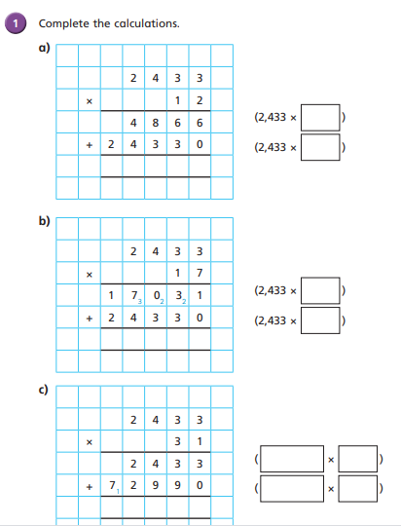
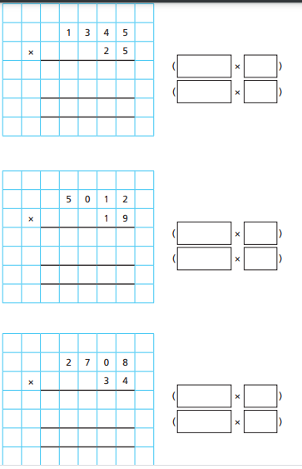
Work out the following multiplications
4511 X 23
5037 X 15
74 X 1156
8001 X 26
9261 X 11
49 X 3860
Find the product of 5604 and 81
d
e
f
c

Slide 11
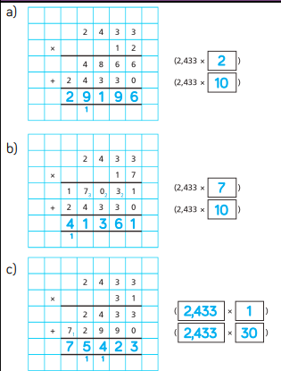
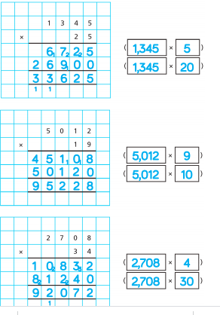
Work out the following multiplications
4511 X 23 = 103 753
5037 X 15 = 75 555
74 X 1156 = 85 444
8001 X 26 = 208 026
9261 X 11 = 101 871
49 X 3860 = 180 320
Find the product of 5604 and 81 = 453 681

