Slide 1
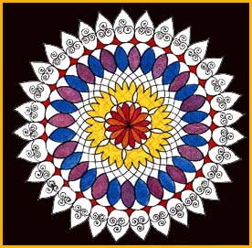
Hindu Rangoli Patterns

Slide 2
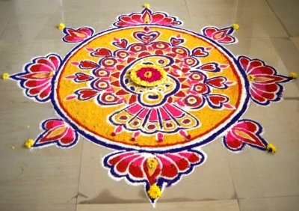
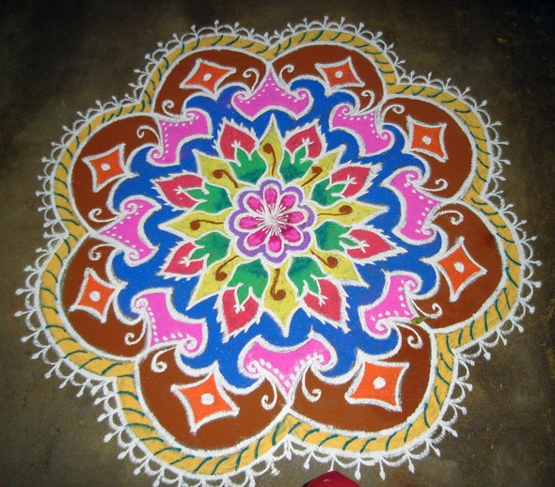
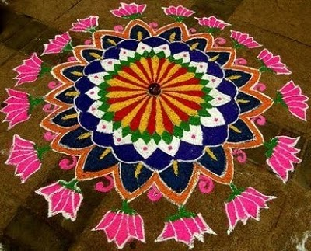
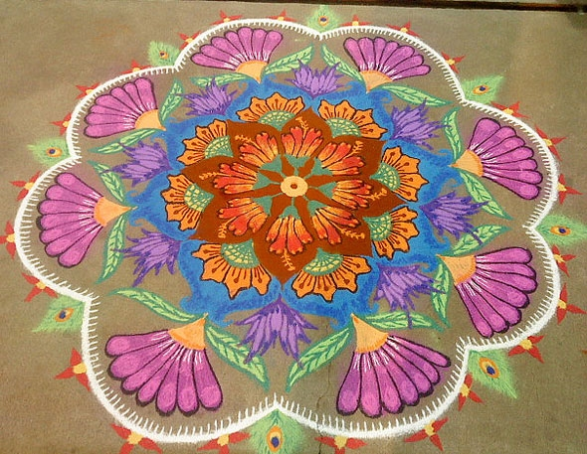
A Rangoli pattern is a colourful pattern which is drawn on the floor near the entrance to a house to welcome guests.

Slide 3
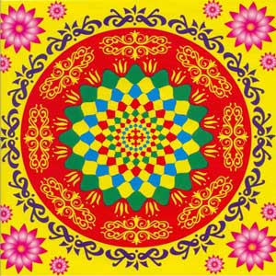
During Diwali people draw bright Rangoli patterns to encourage their goddess to enter their homes.

Slide 4
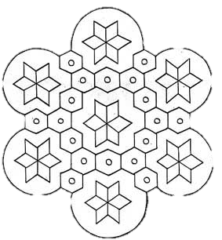
Rangoli patterns can be made up from lots of different shapes,
what shapes can you see?

Slide 5
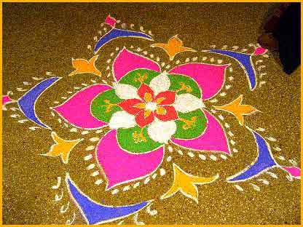
Rangoli patterns are traditionally drawn using rice, flour, sand and chalk.

Slide 6
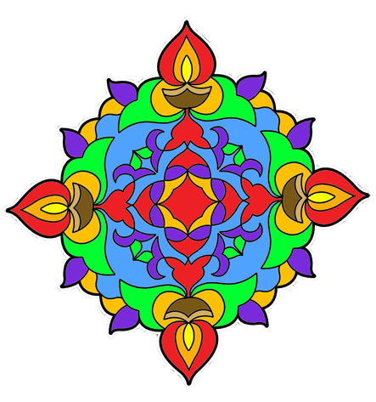
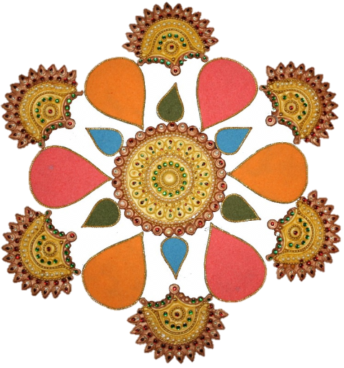
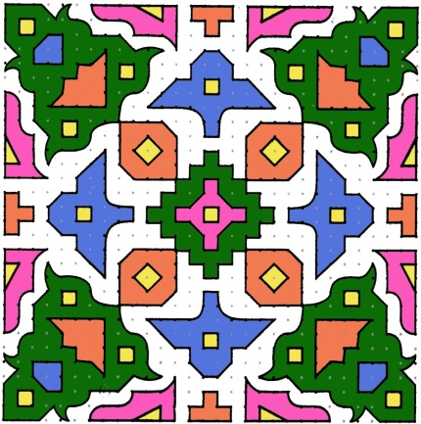
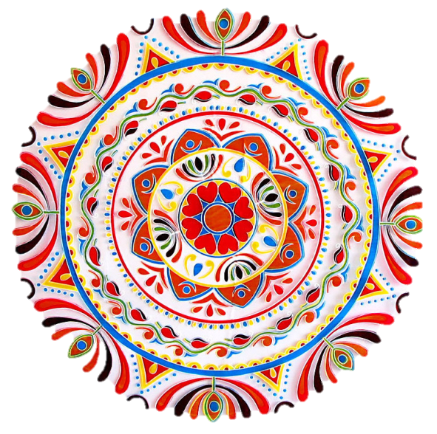
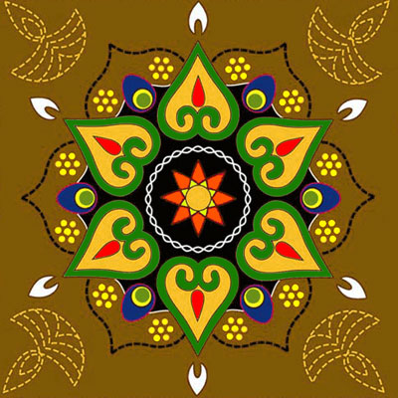
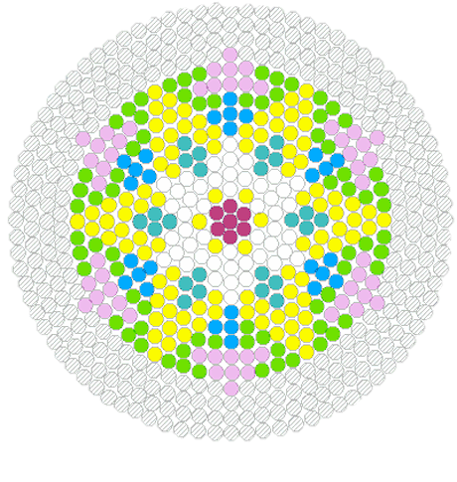
Rangoli patterns come in lots of different shapes and sizes.

Slide 7
YOUR TASK
Can you create your own Rangoli pattern design?
Remember the patterns are repeating and can contain a variety of shapes and they are usually colourful. You can use the images on this sheet for help.
Remember, when you add colour there has to be a repeating pattern here too.

