Slide 1
Thursday 4th February 2020

Slide 2
Thursday 4th February 2021
ENGLISH
WALT: Use similes to describe.

Slide 4
Aim
To revise adjectives and similes
Success Criteria
To be able to explain and give examples of simile and adjectives
To be able to improve sentences using adjectives and similes
To be able to create similes and choose adjectives

Slide 5
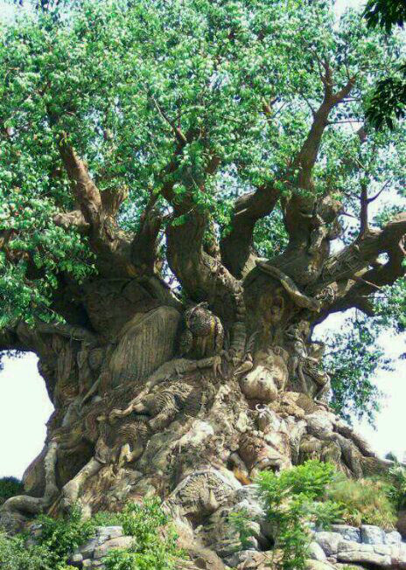
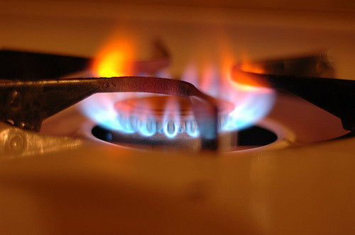
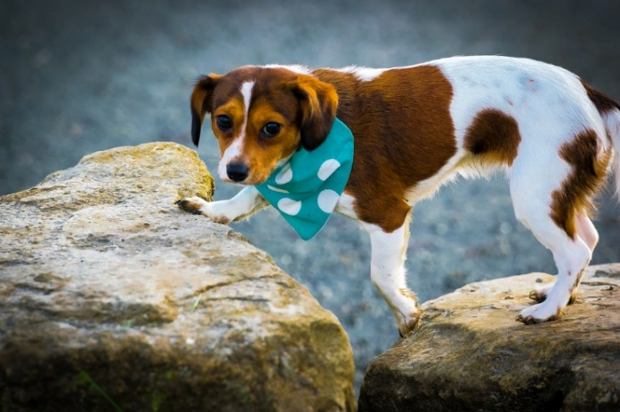
Starter
Can you think of any similes for the pictures?
Can you think of any adjectives to describe the pictures?

Slide 6
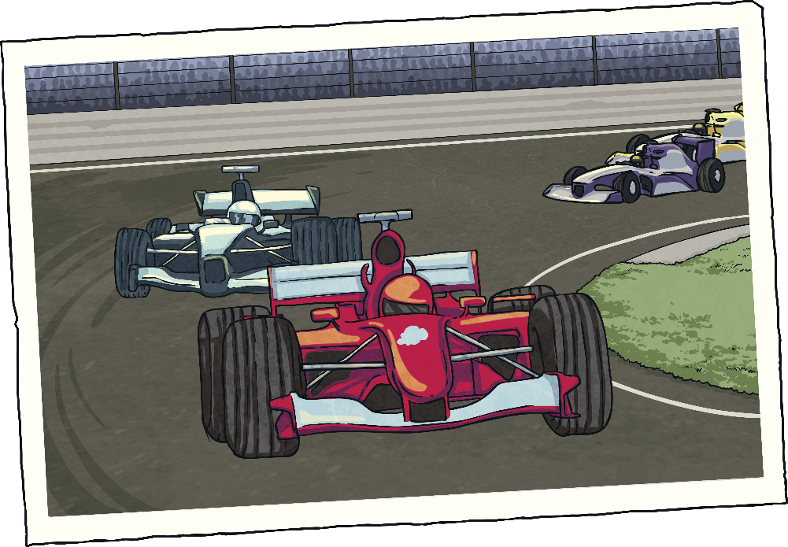
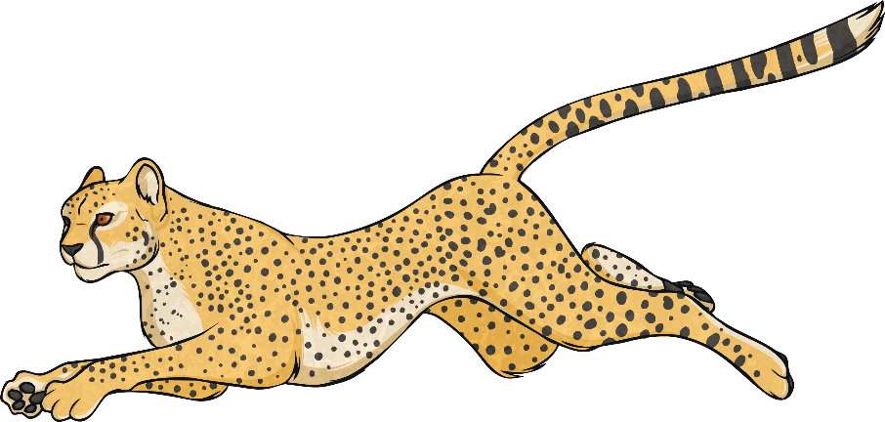
Simile Reminder
A simile is a way of describing something by comparing it to something else using ‘like’ or ‘as’.
Her eyes are like stars and her lips are like roses.
The car was as fast as a cheetah

Slide 7
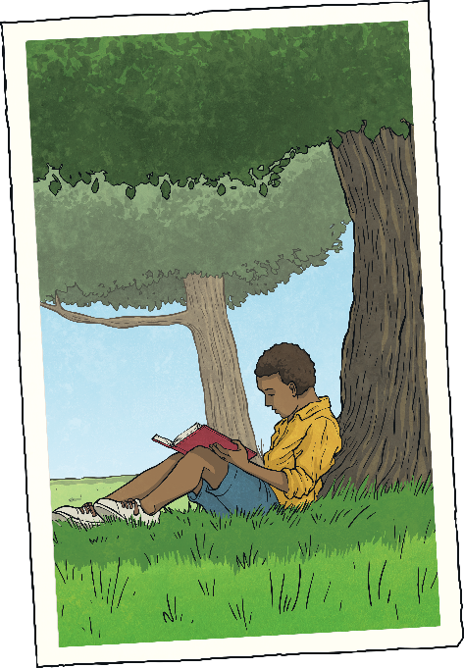
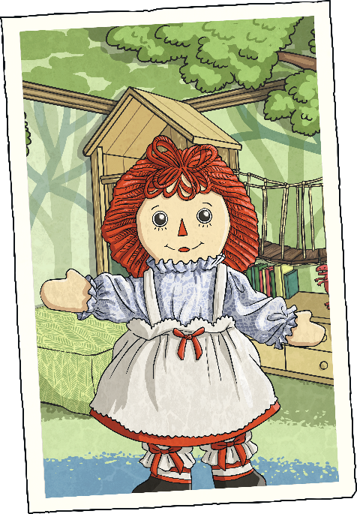
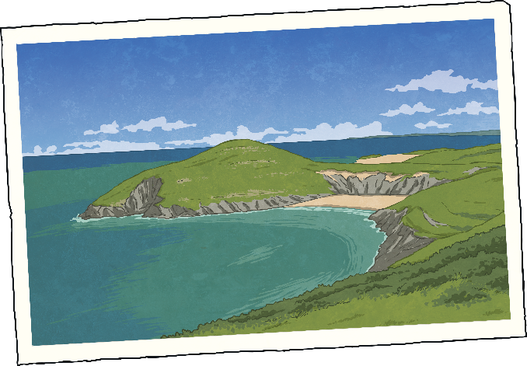
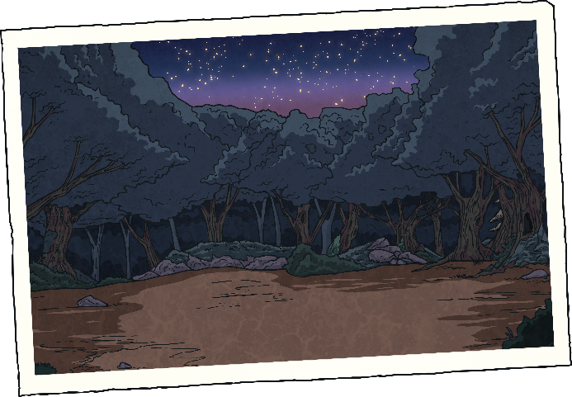
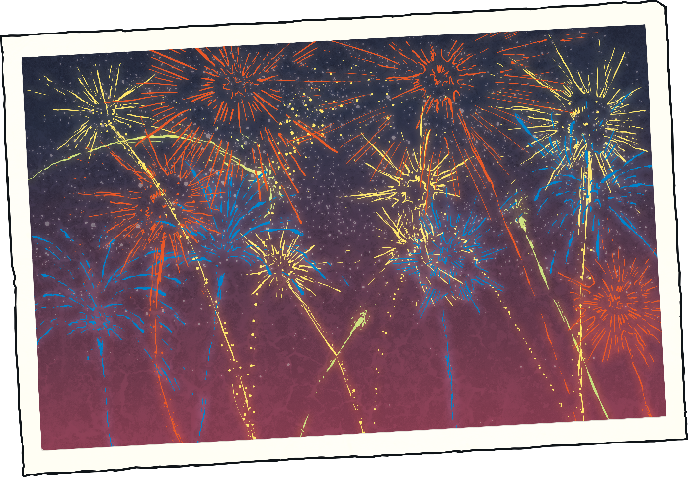
Now you try…
Finish the similes:
?
?
?
Greece was hot like…
The doll’s face was as smooth as…
The book was as exciting as…
?
?
The night was as black as…
The fireworks were colourful like…

Slide 8
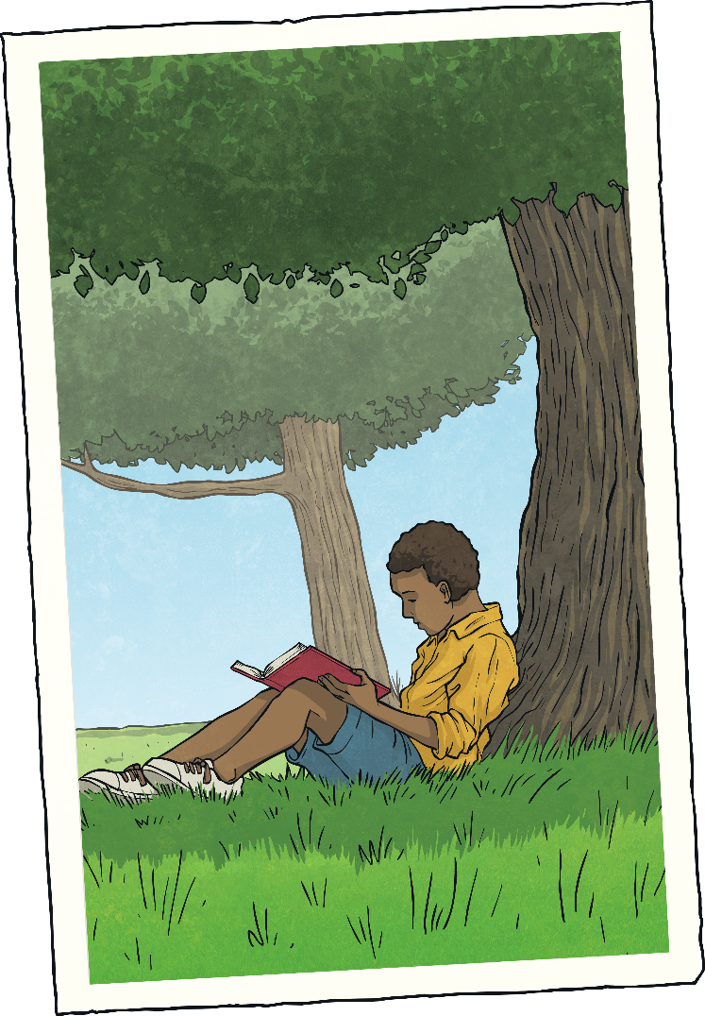
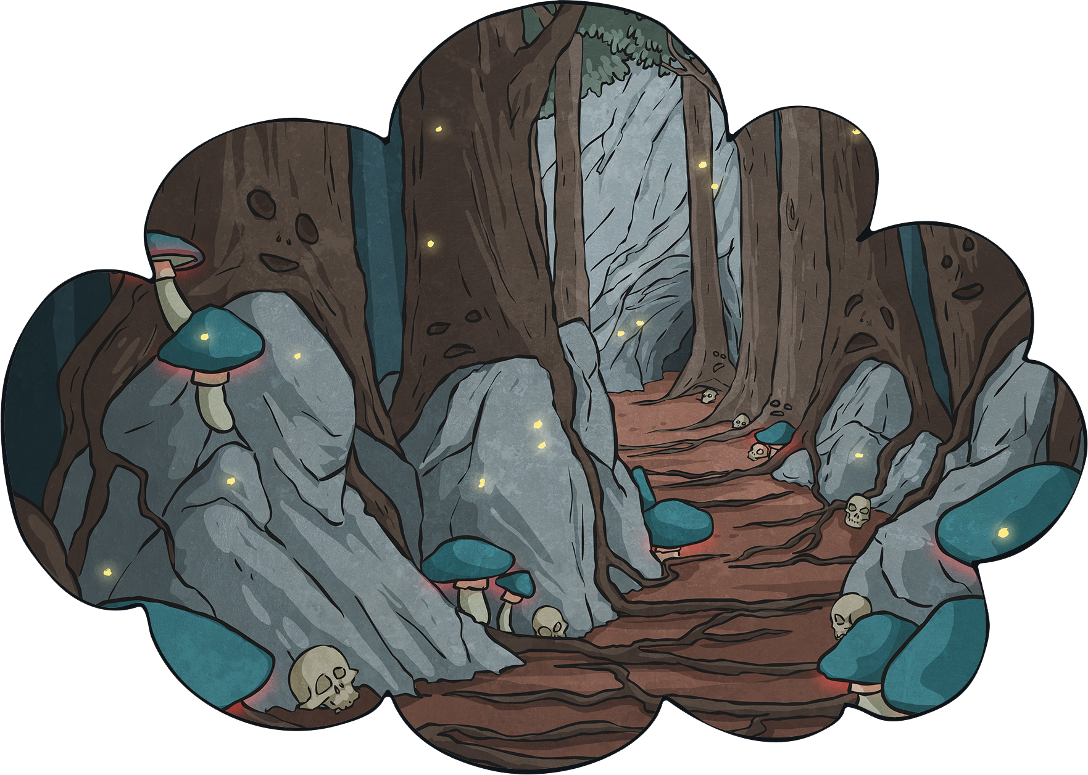
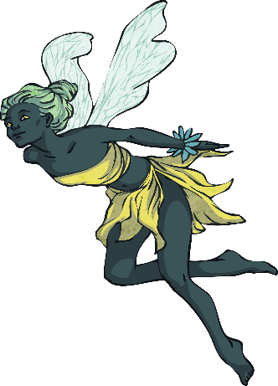
Why?
Why do we use similes and adjectives?
When you are describing something, you are trying to create a picture in the reader’s mind. Similes can help you to do this.
They are most often used in stories and poems.

Slide 9
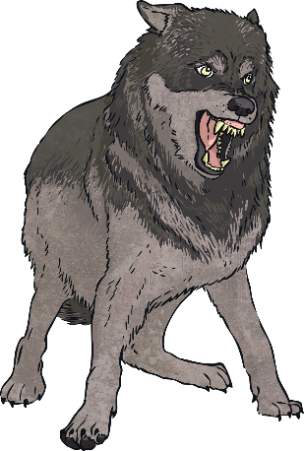
See How It Works
Why do we use similes and adjectives?
The dog was big and fierce.
Now if we add adjectives and similes…
The house was beautiful.
Now if we add adjectives and similes…
The black, scruffy dog was as big as a wolf and fierce like a very angry bear.
The ancient house was beautiful like an old fashioned painting.
Isn’t that better?

Slide 11
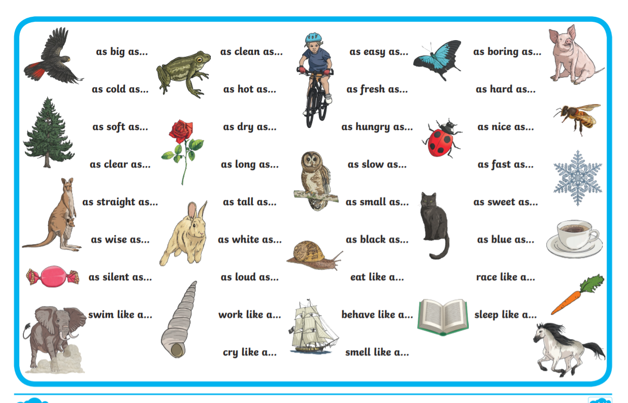

Slide 12
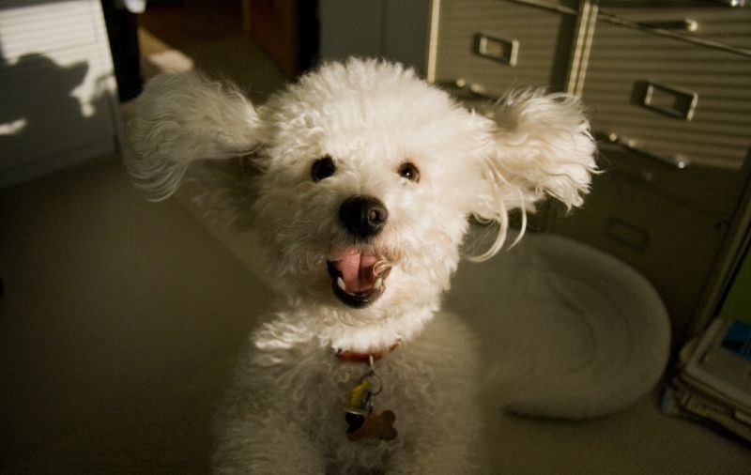
Share!
Volunteer to share your ideas!

Slide 13
Quiz!
Which of these words is an adjective?
A
B
jumping
palace
D
C
happily
amazing

Slide 14
Quiz!
Why do we use similes?
A
B
To make our writing sound good.
To create a picture for the reader.
C
D
Because our teacher wants to make our life difficult.
Because we get better marks for it.

Slide 15
Quiz!
Why do we use similes?
A
B
The moon was a pale, silver coin in the sky.
The sky was as blue as the sea
C
D
The angry waves climbed the sea wall.
The howling, wolf-like baby was driving me mad.

Slide 16
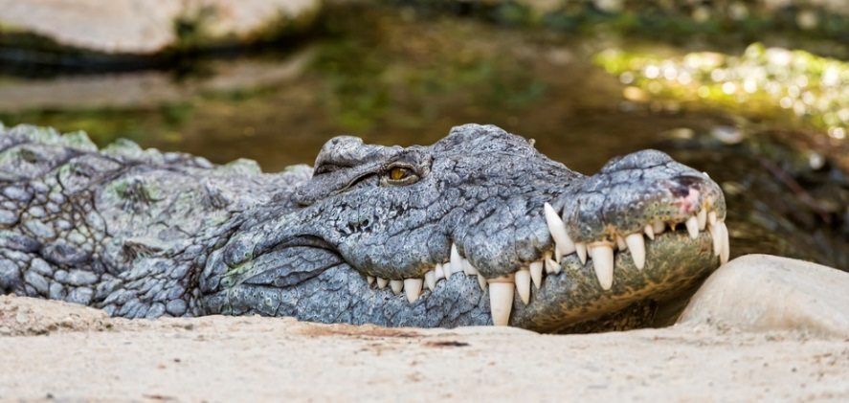
Quiz!
Pick the best adjective to describe the teeth in the picture. Give reasons.
A
B
nasty
razor-sharp
D
C
pointy
awful

Slide 17
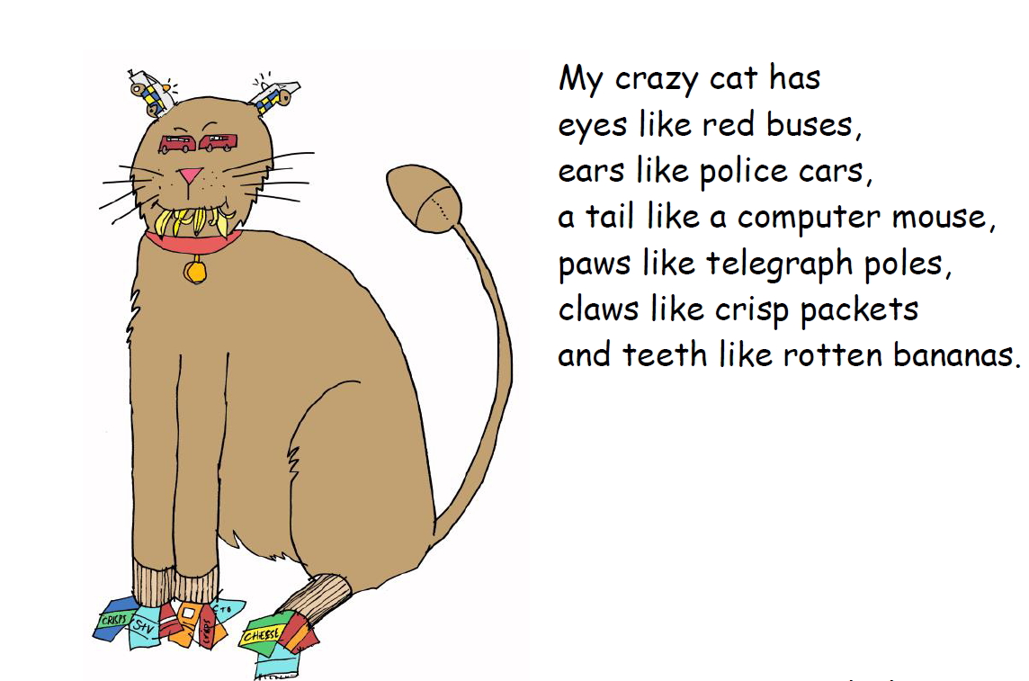

Slide 18
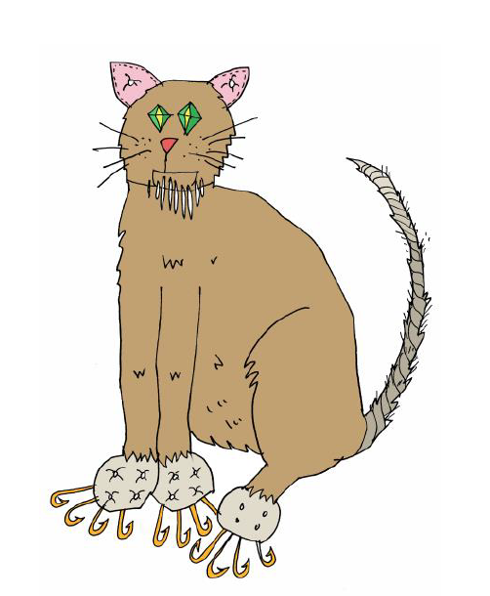

Slide 19
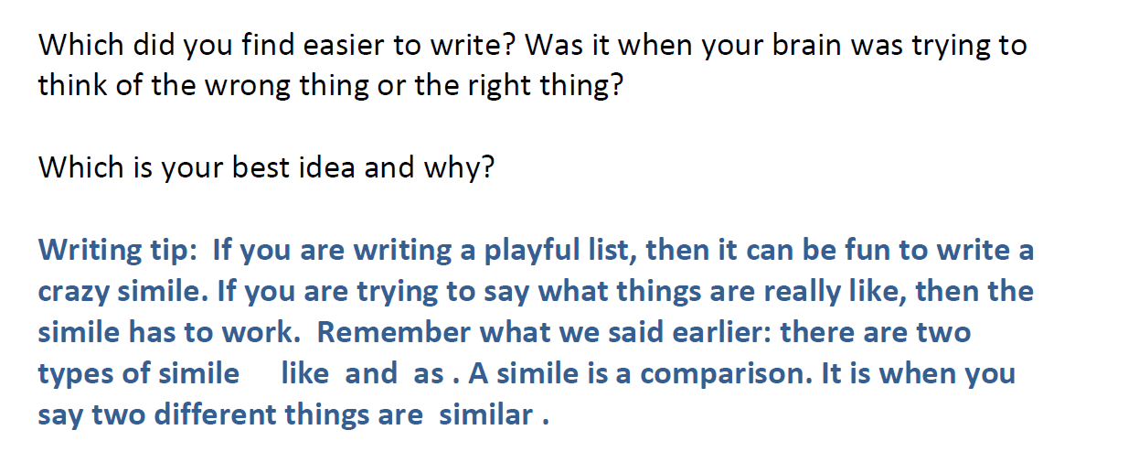

Slide 20
Write your poem about your pet, your teddy, your brother/sister
Anything you wish!
Toolkit:
use similes
Ambitious adjectives
Keep to list format
If writing a playful list, make sure you have a crazy simile!
Draw a picture to match your poem

