Slide 1
Thursday 25thFebruary 2021

Slide 2
Thursday 25th February 2021
English
WALT: Use a plan to draft poem

Slide 5
We are going to have a go at writing a list poem to describe a different
favourite place or activity
and how lockdown has changed it.
Pick a place that you want to write about. There are hundreds of possibilities.
Here are just a few:
Classroom, school playground, sport’s club, park, grandparents house,
picnic, birthday party, swimming pool, football club

Slide 6
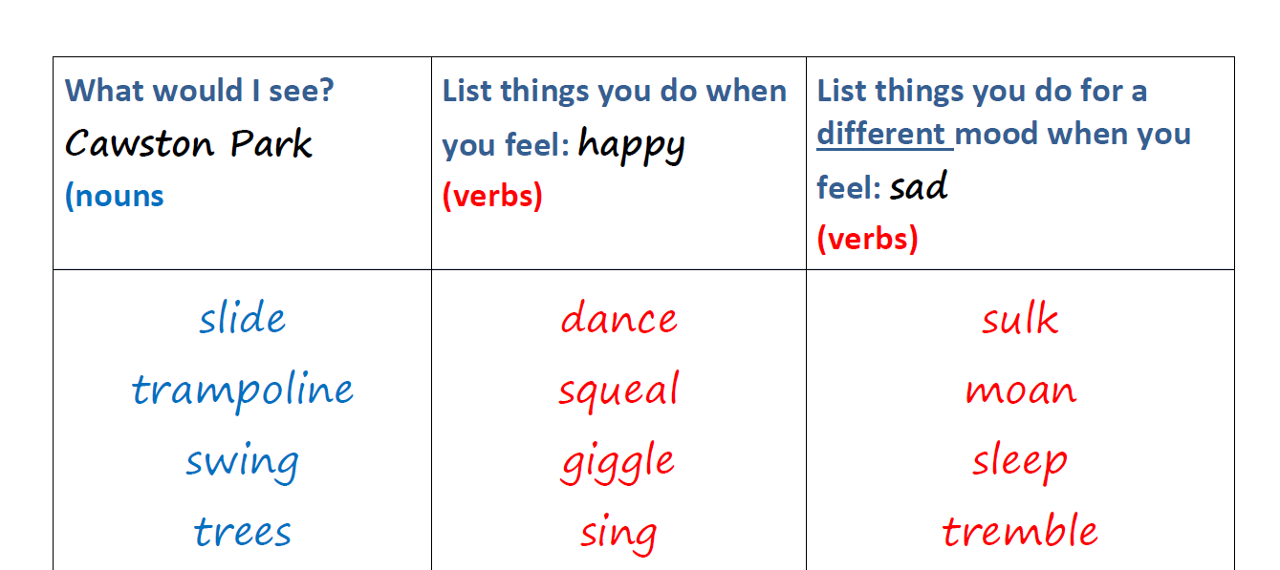
Decide upon a place.
Think about how you felt about the place before and after the
lockdown:
I felt happy then sad.
3. Complete the table below:

Slide 7
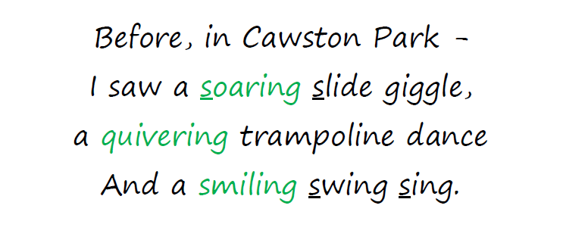
Here is a first verse of poem- what features can you see?
What will I want to see you include with your poem?

Slide 8
Use of antonyms (opposite words)
Use of year 4 grammar and punctuation –
? ! ‘ , ()
Ambitious adjectives and verbs
Alliteration
Personification

Slide 9
