Slide 1
Year 4 - Autumn - Block 2
Addition & Subtraction

Slide 2
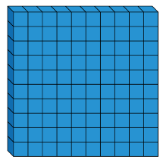
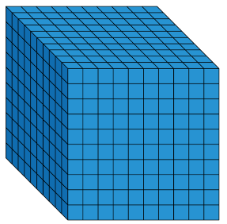
Which questions are easy?
Which questions are hard?
8,273 $+$ 4 $=$ ____
8,273 $+$ 4 tens $=$ ____
8,273 $−$ 500 $=$ ____
8,273 $−$ 5 thousands $=$ ____
Why are some easier than others?

Slide 3
Mo says,
Is Mo correct? Explain your answer.
When I add hundreds to a number, only the hundreds column will change.

Slide 4
Rosie adds 2 numbers together that total 4,444
What could the numbers be?
Prove it.
How many ways can you find?
Both numbers have 4 digits.
All the digits in both numbers are even.

Slide 5
Two children completed the following calculation:
1,234 $+$ 345
Dora
Alex
Both of the children have made a mistake in their
calculations.
Calculate the actual answer to the question.
What mistakes did they make?
My answer is 1,589
My answer is 4,684

Slide 6
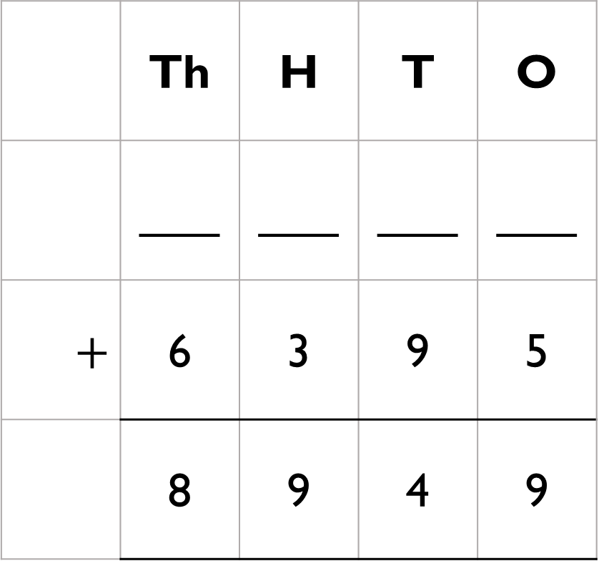
What is the missing 4-digit number?
 | Th | H | T | O
 | ___ | ___ | ___ | ___
$$+$$ | 6 | 3 | 9 | 5
 | 8 | 9 | 4 | 9

Slide 7
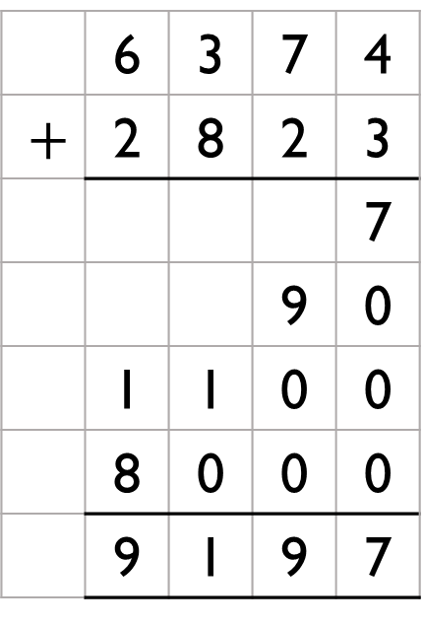
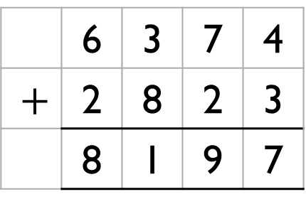
Annie, Mo and Alex are working out the solution to the calculation 6,374 $+$ 2,823
Annie’s Strategy Alex’s Strategy
6,000 $+$ 2,000 $=$ 8,000
300 $+$ 800 $=$ 110
70 $+$ 20 $=$ 90
4 $+$ 3 $=$ 7
8,000 $+$ 110 $+$ 90 $+$ 7 $=$ 8,207
Mo’s Strategy
Who is correct?
 | 6 | 3 | 7 | 4
$$+$$ | 2 | 8 | 2 | 3
 |  |  |  | 7
 |  |  | 9 | 0
 | 1 | 1 | 0 | 0
 | 8 | 0 | 0 | 0
 | 9 | 1 | 9 | 7
 | 6 | 3 | 7 | 4
$$+$$ | 2 | 8 | 2 | 3
 | 8 | 1 | 9 | 7

Slide 8
Jack says,
Do you agree?
Explain your reasoning.
When I add two numbers together I will only ever make up to one exchange in each column.

Slide 9
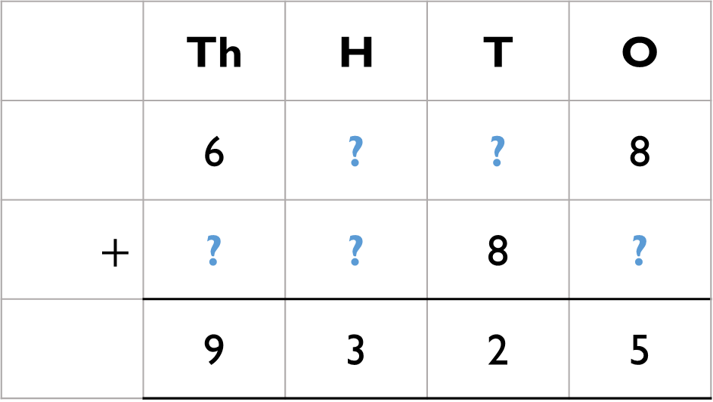
Complete:
Mo says that there is more than one possible answer for the missing numbers in the hundreds column.
Is he correct? Explain your answer.
 | Th | H | T | O
 | 6 | ? | ? | 8
$$+$$ | ? | ? | 8 | ?
 | 9 | 3 | 2 | 5

Slide 10
Eva is performing a column subtraction with two four digit numbers.
The larger number has a digit total of 35
The smaller number has a digit total of 2
Use cards to help you find the numbers.
What could Eva’s subtraction be?
How many different options can you find?

Slide 11
There are counters to the value of 3,470 on the table but some have been covered by the splat.
What is the total of the counters covered?
How many different ways can you make the missing total?

Slide 12
1,235 people go on a school trip.
There are 1,179 children and 27 teachers.
The rest are parents.
How many parents are there?
Explain your method to a friend.

Slide 13
Find the missing numbers that could go into the spaces.
Give reasons for your answers.
____ $−$ 1,345 $=$ 4__6
What is the greatest number that could go in the first space?
What is the smallest?
How many possible answers could you have?
What is the pattern between the numbers?
What method did you use?

Slide 14
Amir and Tommy solve a problem.
Amir
Tommy
Who is correct?
Explain your reasoning.
Why is one of the answers wrong?
When I subtract 546 from 3,232 my answer is 2,714
When I subtract 546 from 3,232 my answer is 2,686

Slide 15
There were 2,114 visitors to the museum on Saturday.
650 more people visited the museum on Saturday than on Sunday.
Altogether how many people visited the museum over the two days?
What do you need to do first to solve this problem?

Slide 16
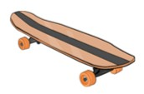
Amir has £1,000
He buys a scooter for £345 and a skateboard for £110
How much money does he have left?
Show 3 different methods of finding the answer.
Explain how you completed each one.
Which is the most effective method?

Slide 17
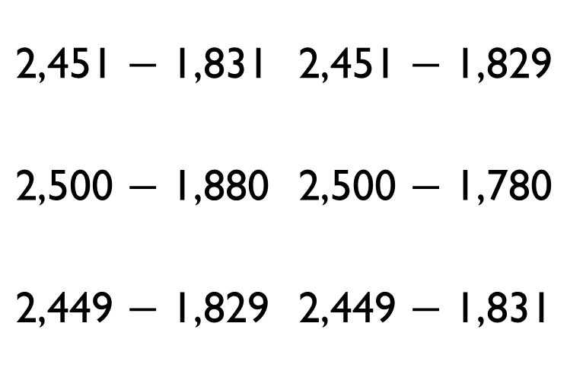
Look at each pair of calculations.
Which one out of each pair has the same difference as 2,450 $−$ 1,830?
When is it useful to use difference to solve subtractions?
2,451 $−$ 1,831 | 2,451 $−$ 1,829
2,500 $−$ 1,880 | 2,500 $−$ 1,780
2,449 $−$ 1,829 | 2,449 $−$ 1,831

Slide 18
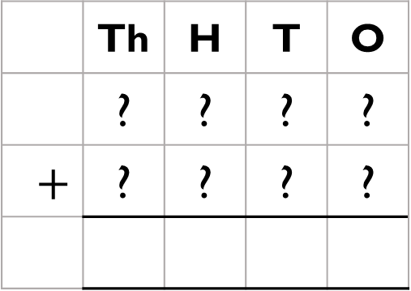
Game
The aim of the game is to get a number as close to 5,000 as possible.
Each child rolls a 1-6 die and chooses where to put the number on their grid.
Once they have each filled
their grid, they add up their
totals to see who is the
closest.
 | Th | H | T | O
 | ? | ? | ? | ?
$$+$$ | ? | ? | ? | ?

Slide 19
The estimated answer to a calculation is 3,400
The numbers in the calculation were rounded to the nearest 100 to find an estimate.
What could the numbers be in the original calculation?

Slide 20
Use the number cards and $+$ or $−$ to make three calculations with an estimated answer of 2,500
1,295
1,120
4,002
1,489
3,812
1,449

Slide 21
Here is a number sentence.
350 $+$ 278 $+$ 250
Add the numbers in different orders to find the answer.
Is one order of adding easier? Why?
Create a rule when adding more than one number of what to look for in a number.

Slide 22
I completed an addition and then used the inverse to check my calculation.
When I checked my calculation, the answer was 3,800
One of the other numbers was 5,200
What could the calculation be?
____ $+$ ____ $=$ ____
____ $−$ ____ $=$ 3,800

Slide 23
In the number square below, each horizontal row and vertical column adds up to 1,200
Find the missing numbers.
Is there more than one option?
Check the rows and columns using the inverse and adding the numbers in different orders.
897
 |  | 832
 | 762

