Slide 2
Revisit and Review
Let’s practise Sam’s Sounds and Common Exception Words!
oy
ay
could
would
should
want

Slide 3
Teach
Today, we are learning to read and spell words that contain oy saying /oi/.

Slide 4
Teach
Let’s practise reading some of this week’s focus words that contain oy.
annoy
employ
destroy
royal

Slide 5
Teach
Now, let’s write them with the magic pencil…

Slide 6
Teach
annoy
Play

Slide 7
Teach
employ
Play

Slide 8
Teach
destroy
Play

Slide 9
Teach
royal
Play

Slide 10
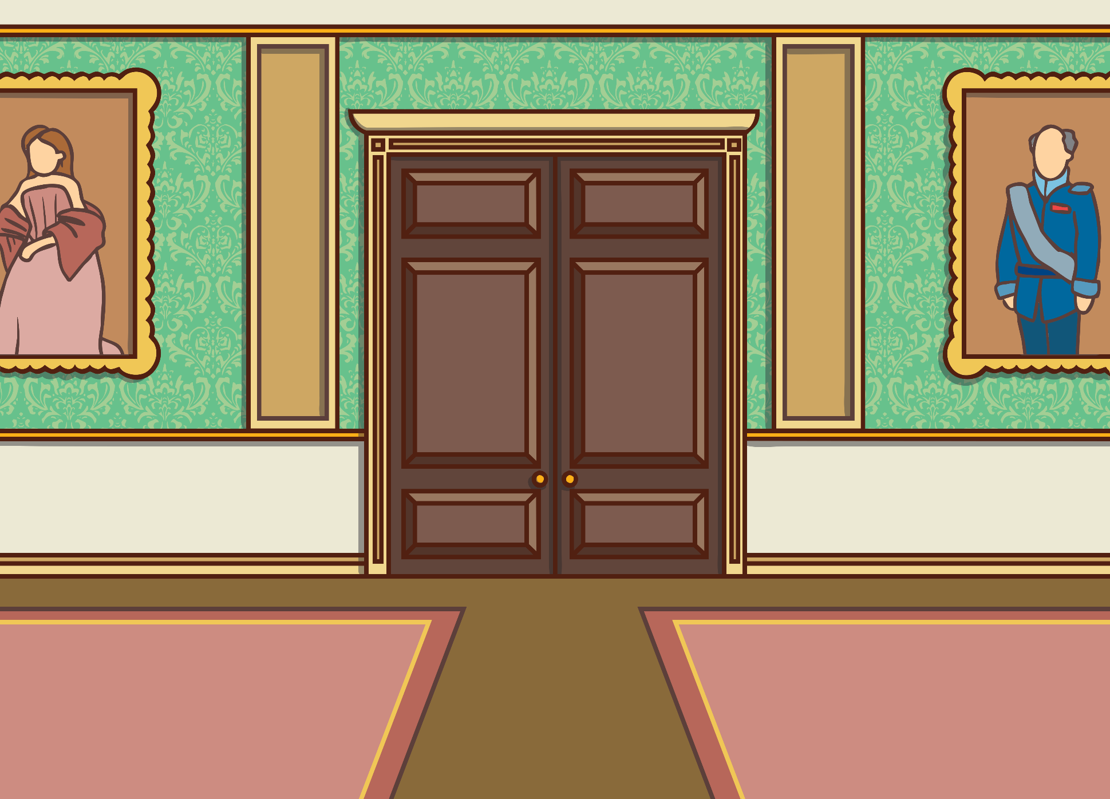
Teach
Kit and Sam are lost in Buckingham Palace. The royal children have had to go for afternoon tea and Kit and Sam still can’t find the queen.

Slide 11
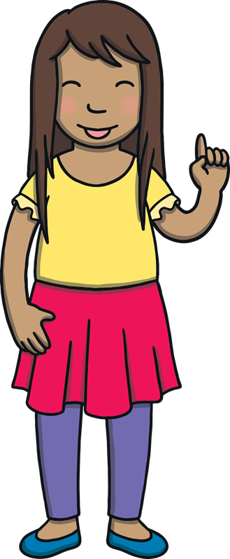
Teach
But Sam has had a good idea. “The Queen is famous for having loyal dogs,” she said.
“Right…” said Kit, confused.
“Well, in my bag, I just happen to have some of the treats that Ben enjoys,” said Sam, reaching inside.

Slide 12
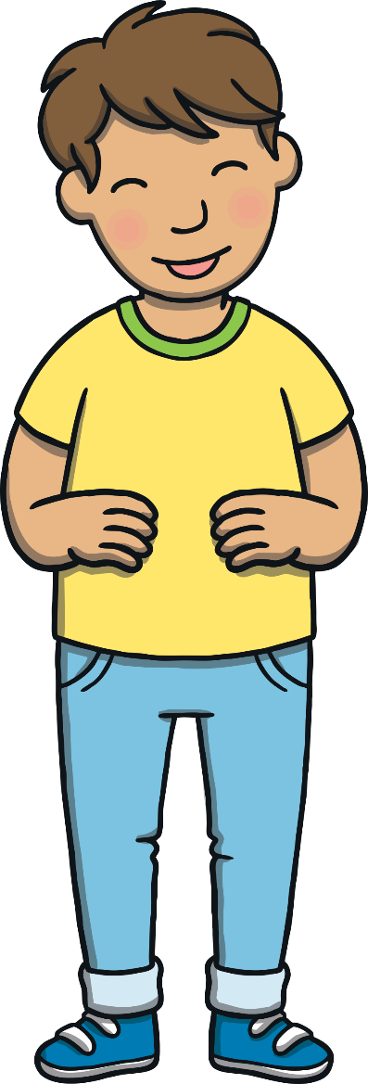
Teach
“Ha ha,” laughed Kit. “That’s fantastic! Ben would destroy the kitchen to get at those! The dogs will make such a racket when they smell them, that someone the Queen employs will come to find us. Let’s find those dogs!”

Slide 13
Find the Dogs
Teach
On each palace door is a sign but some of them are damaged. Can you help Kit and Sam work out what is behind each door? Write what you think the sign should say.

Slide 14
Teach
r__al
royal
check

Slide 15
Teach
toys
t__s
check

Slide 16
Teach
boys
b__s
check

Slide 17
Teach
employees
em_l__ees
check

Slide 18
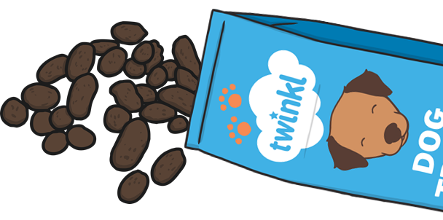
A Royal Apology
Practise
The dogs have made such a mess trying to get the treats that Kit and Sam think that they should write an apology to the Queen. Can you help them to finish the letter?

Slide 19
Practise
To Her R____ Highness, The Queen,
We do not wish to _____ you, but the dogs smelt the food and began to _______ the room. However, they did _____ the food!
From Kit and Sam
To Her Royal Highness, The Queen,
We do not wish to annoy you, but the dogs smelt the food and began to destroy the room. However, they did enjoy the food!
From Kit and Sam
Show

Slide 20
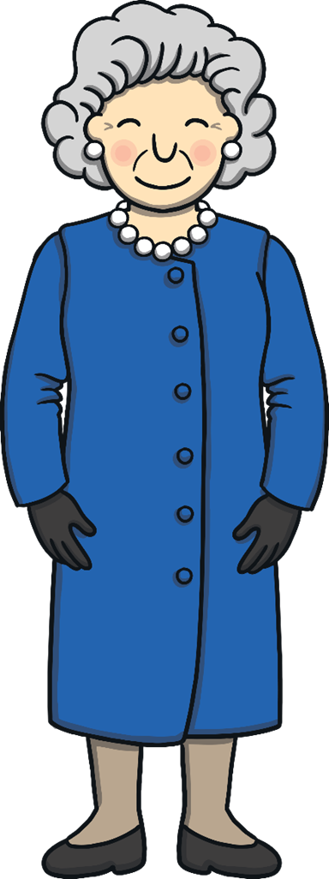
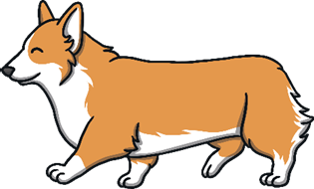
Teach
Luckily, Sam’s plan worked. The Queen heard the din and found Sam and Kit in a very messy room. “Come with me,” she smiled, patting her loyal dogs, “I have something to show you.”

Slide 21
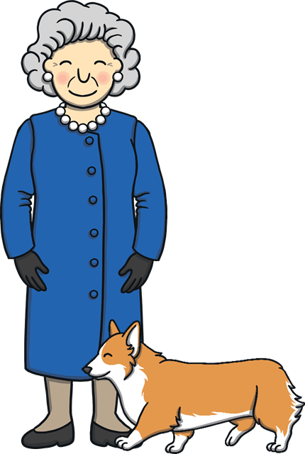
Sentence Time
Apply
What did the Queen show Kit and Sam? Write a sentence about what she showed them.

Slide 22
Apply
In the toy box, you will see a dustpan and brush.
Sound Buttons On/Off
Show

Slide 23
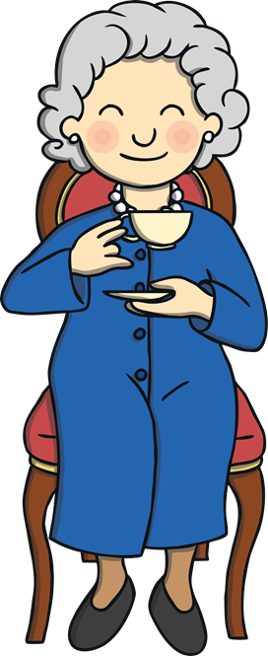
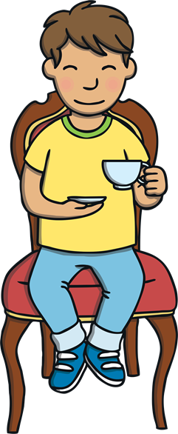
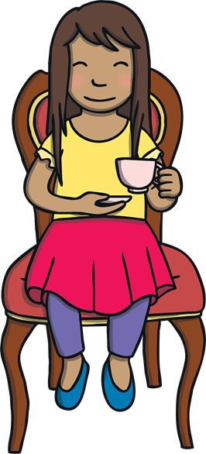
Apply
Kit and Sam cleaned up the mess that the Queen’s dogs had made and sat with her for a cup of tea. “You are just like I was at your age,” laughed the Queen. “I still sometimes annoy my husband when I wander off, even now!” she said, with a wink.

Slide 24
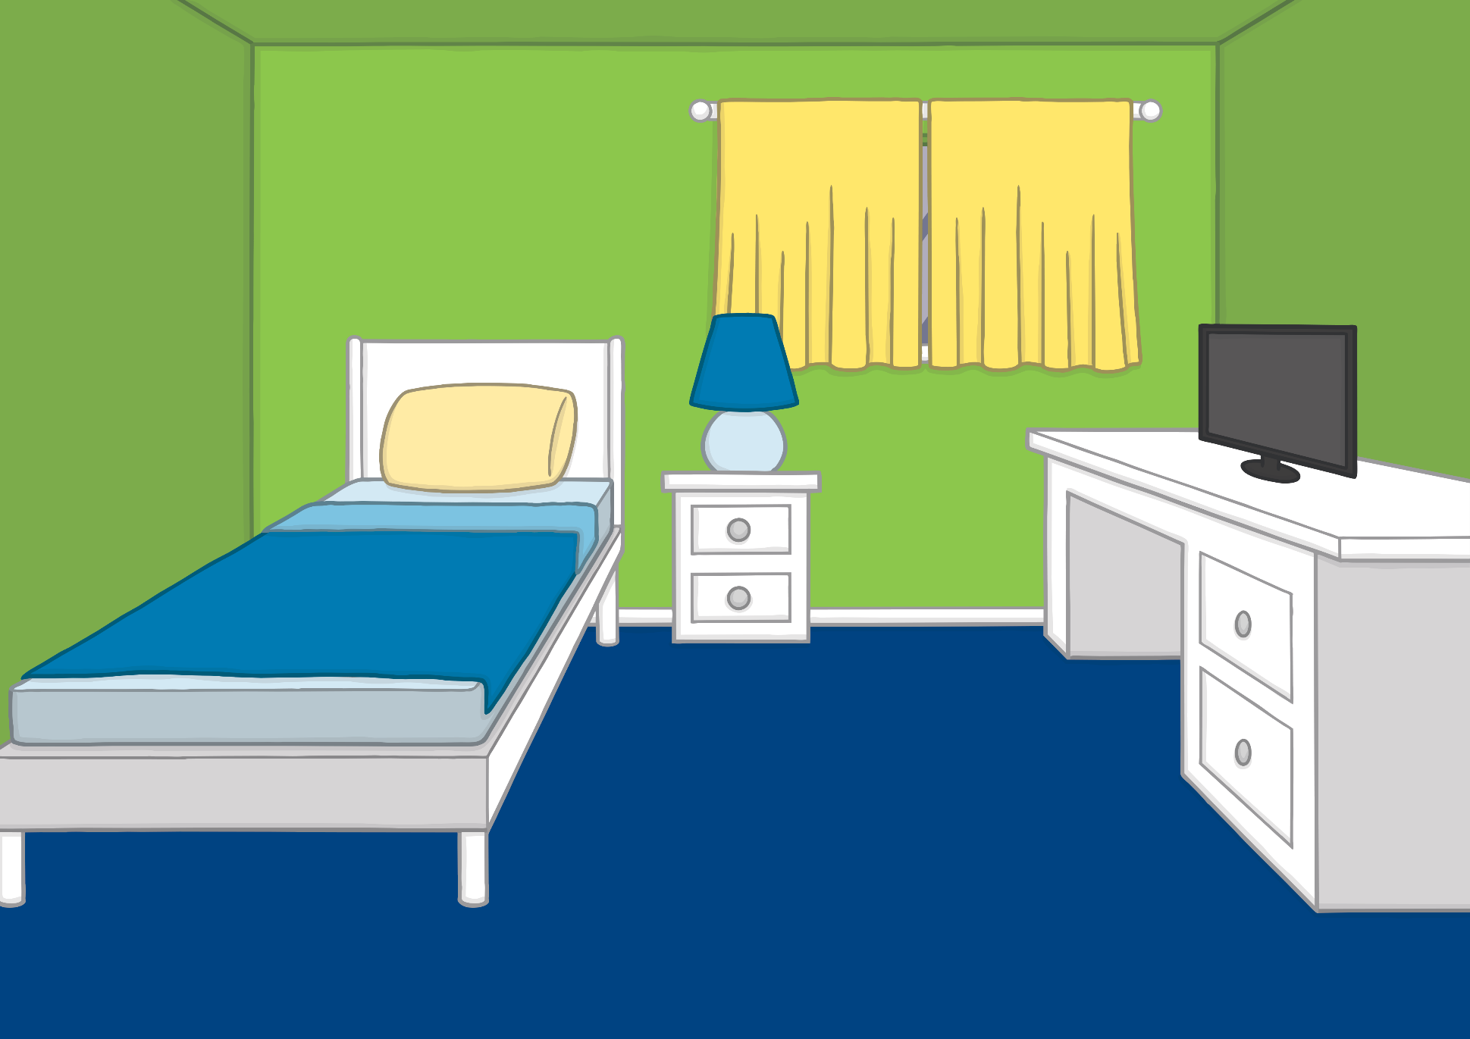
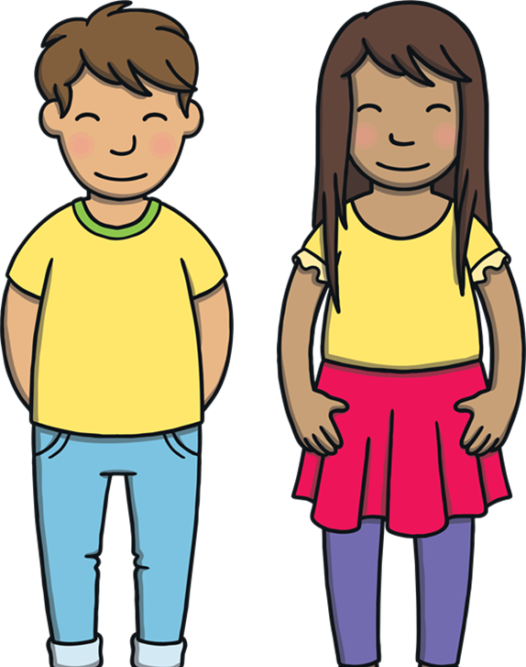
Apply
Kit and Sam thanked the Queen for a wonderful day, and the room began to fade. They found themselves back in Kit’s bedroom. “That was fun,” said Sam, “but let’s be careful where we wander off in future!”

Slide 25
Today, we have learnt…
oy
saying /oi/
The adventure continues next lesson!

