Slide 1
Wednesday 6th January 2020

Slide 2
Today we are going to:
Expectations for home learning.
Equipment you will need
What a typical week will look like – at the moment! (show timetable)
Spellings
Live Zoom inputs- morning @9 am, @10.30 @ 1pm
How to access support materials or sheets
Recorded zoom story
homework

Slide 3
Daily Timetable:
9am: Maths live zoom input
10.-10.30 Breaktime
10.30: English Live zoom input
11.30 am : Spellings/focussed phonics
12-1.00: LUNCH!
1pm: live zoom input for topic ( not Monday afternoons)
2.30pm audio story

Slide 4
Expectations for home learning:
Please read the zoom agreement with your parents.
Home learning is expected from 9-3 Monday- Friday. Monday afternoons will be my planning time- there will be no live zoom and topic lesson set. There will be a link on the class webpage for a P.E activity.
Spelling lesson and TT rockstars at least 3times a week.
BE READY WITH ALL EQUIPMENT! Logged on, computer is ready, and you are suitably dressed.
Best learning behaviours at the ready!
I will deliver an input for English, Maths and topic. Activities will be independent with parent support.
Once you have completed your work, please photograph and email to me for feedback.
Homework- at least 20 minutes a day and AR quizzing.
Be resilient and try our best at all times!

Slide 5
Presentation: you will be expected to write the date. In maths, we write the short date. In English, we write the long date. (it will be on screen for you to copy).
Draw a line underneath each completed piece of work.
Good handwriting is expected at all times, please complete 3 handwriting sessions a week from the handwriting booklet on the class webpage. Complete sessions on each sheet if you have a printer, if not, do your best into your home learning books.

Slide 6
Equipment- what will you need?
Pencils
Ruler
Rubber
Home learning book
Afternoon sessions: may need some other resources, at times- such as gluesticks, scissors, felt tips, coloured pencils.
If something specific, I will email to parents in plenty of time – for example, next week you will be needing some chocolate!
Printing: If you want to print out resources, please do. However, I have tried my best to ensure activities set can be copied from the screen into your home learning books. Please note, each subject session powerpoint will be accessible after the zoom lesson on the class page.

Slide 7
What a typical week will look like?
Daily Live zoom- @9am @1030 @ 1pm
Please understand and respect that this way of working is new to us and is subject to change. We welcome any feedback – please email Mrs Sanderson.
Spellings: Daily spelling lessons will be available on the class page. Please complete lessons by the end of the week. Some children will be provided with alterative phonics lessons.
Stories to listen to:
Every day there will be a audio story to listen to, either read by myself or from a online link- see section on the class webpage.
Homework: at least 20 minutes reading at least 4x a week, book quizzes can be completed:
Ukhosted36.renlearn.co.uk/2234869 – type into the address bar

Slide 8
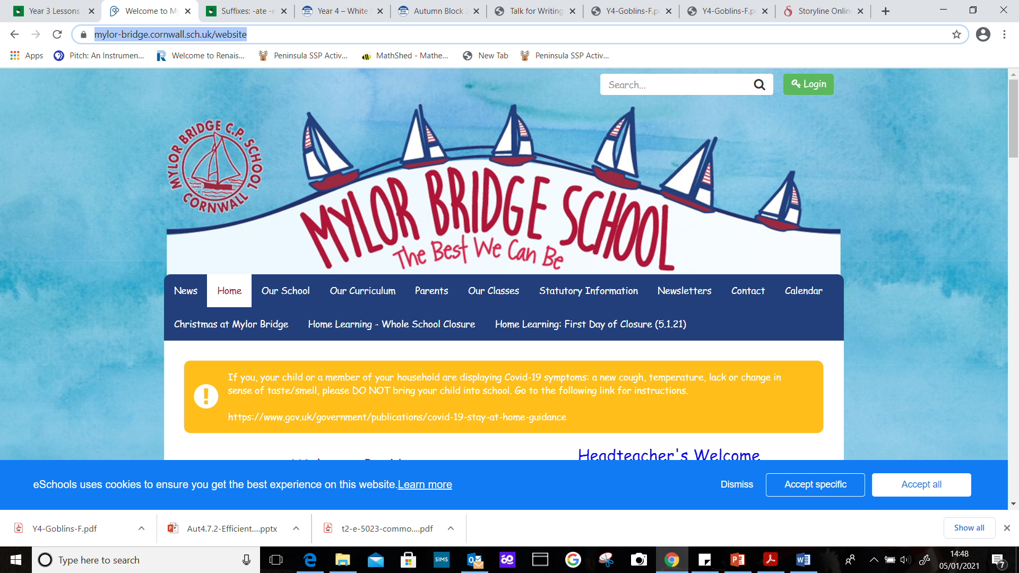
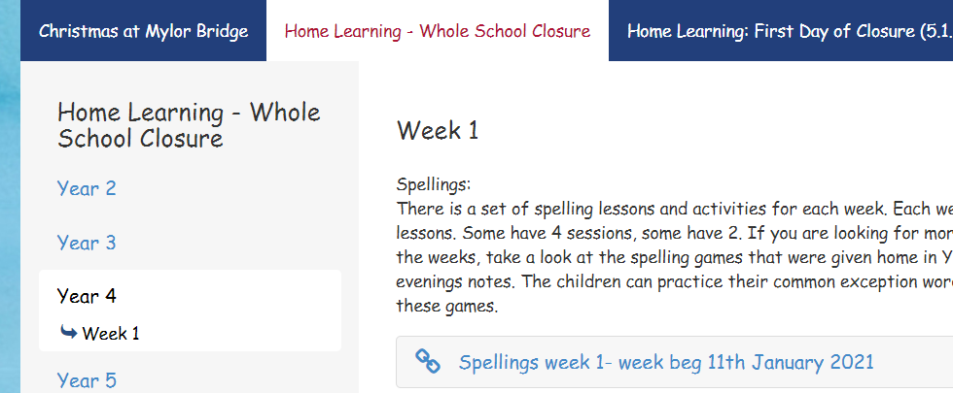
How to access support materials:
https://www.mylor-bridge.cornwall.sch.uk/website

Slide 9
Wednesday 6th January 2021
English
WALT: Use inference

Slide 10
1. Observe.
I can see
3. Infer.
2. Wonder.
I wonder if
I think
I wonder how
I think that
I wonder where

Slide 11
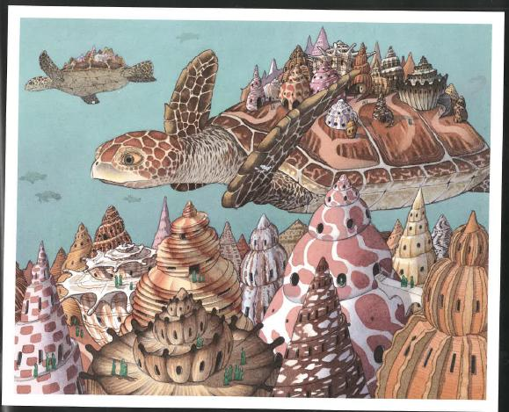
1. Observe: (I can see)
2. Wonder ( I wonder if, how, where)
3. Infer (I think)

Slide 12
6.01.2021 Maths
WALT: Use column subtraction

Slide 15
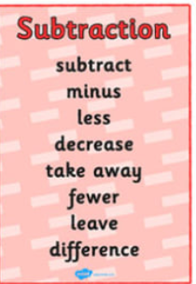

Slide 16
3,008 $−$ 2,990 $=$
18
Th | H | T | O
3 | 0 | 0 | 8
2 | 9 | 9 | 0
2
9
1
1
$$−$$
0
0
1
8

Slide 17
Set A:
229 2. 363
153 - 259
3. 647 4. 452
361 -139
5. 716 6. 548
- 572 - 129
Set B:
2386 2. 4528
1571 - 1964
3. 5142 4. 6623
- 3650 - 5296
5. 7419 6. 3274
- 4835 - 1459
Set C:
23749 2. 15273
1357 - 2468
31485 4. 56358
12514 - 31773
5. 85861 6. 47632
- 28557 - 41980
I will now turn my camera and audio off. Screen share will be on for 20 minutes! Complete as many questions as you can in that time. Any questions, type them into the chat and I will try to answer them.

Slide 18
We made it!
Well done everybody!
Enjoy lunch, don’t forget to complete spellings, TT rockstars and your afternoon topic session.
See you in the morning!

