Slide 1

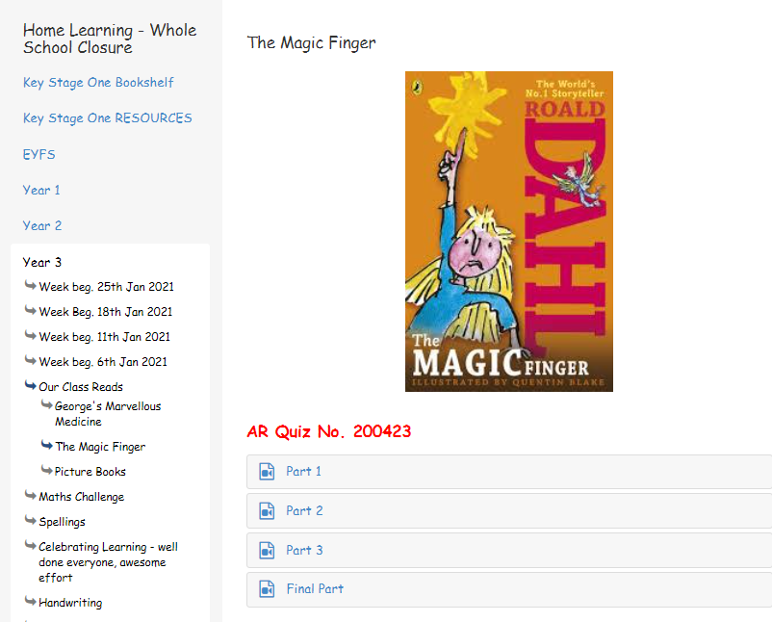
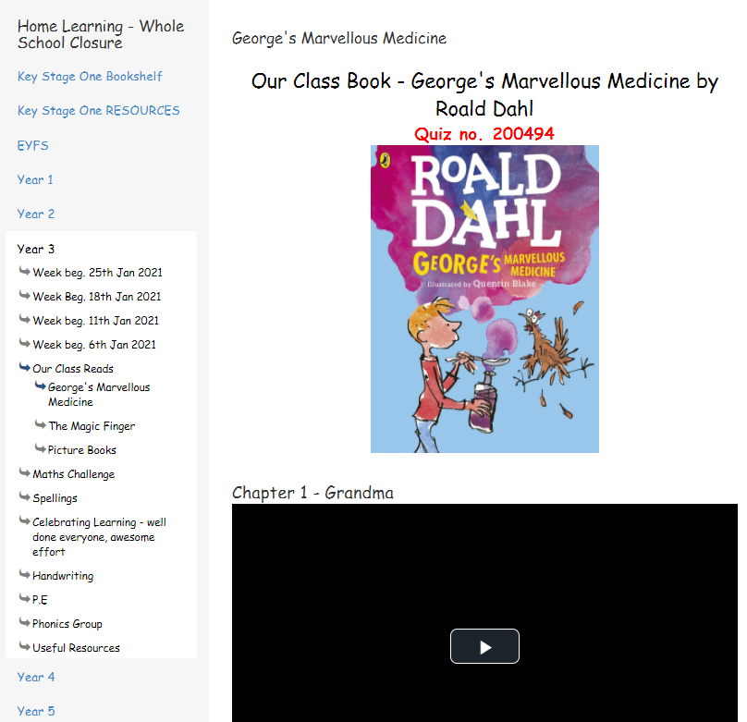
Look at all this quizzing you can do today!

Slide 2
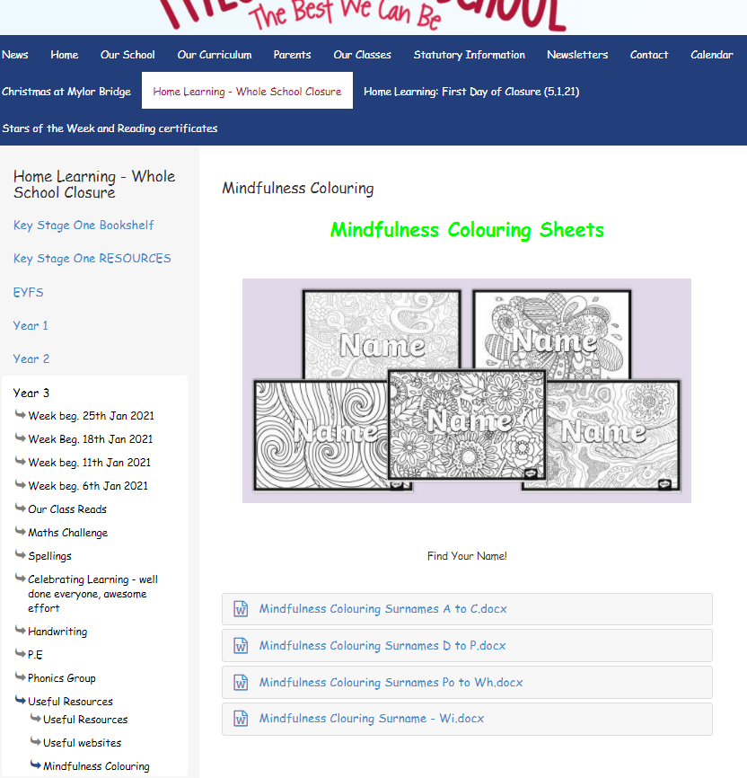
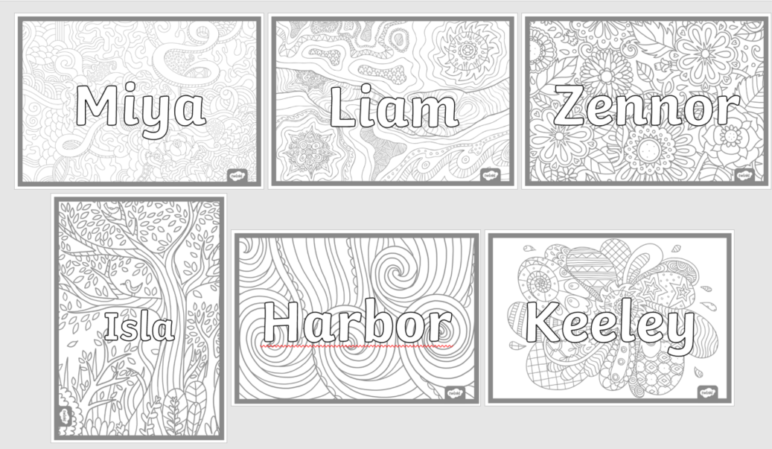

Slide 3
Wednesday 27th January
English
WALT understand adjectives

Slide 4
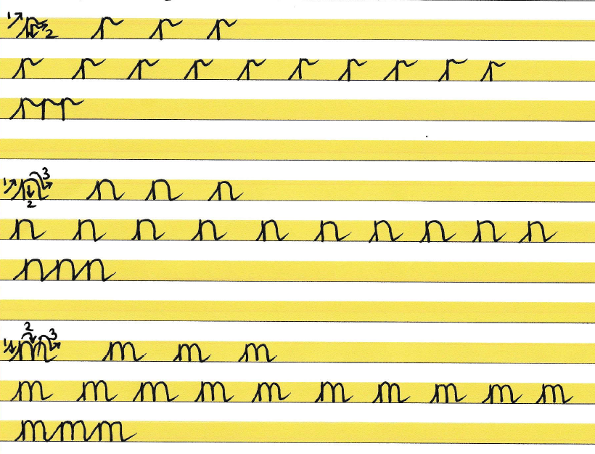
‘r’ at the top is one of the trickiest

Slide 5
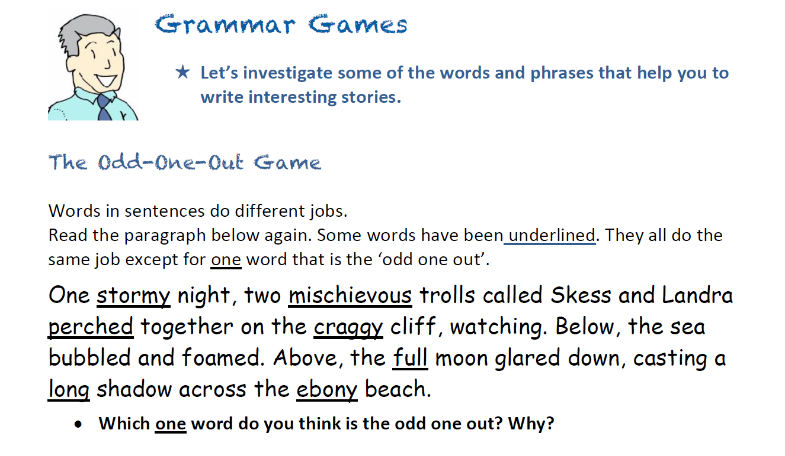

Slide 6
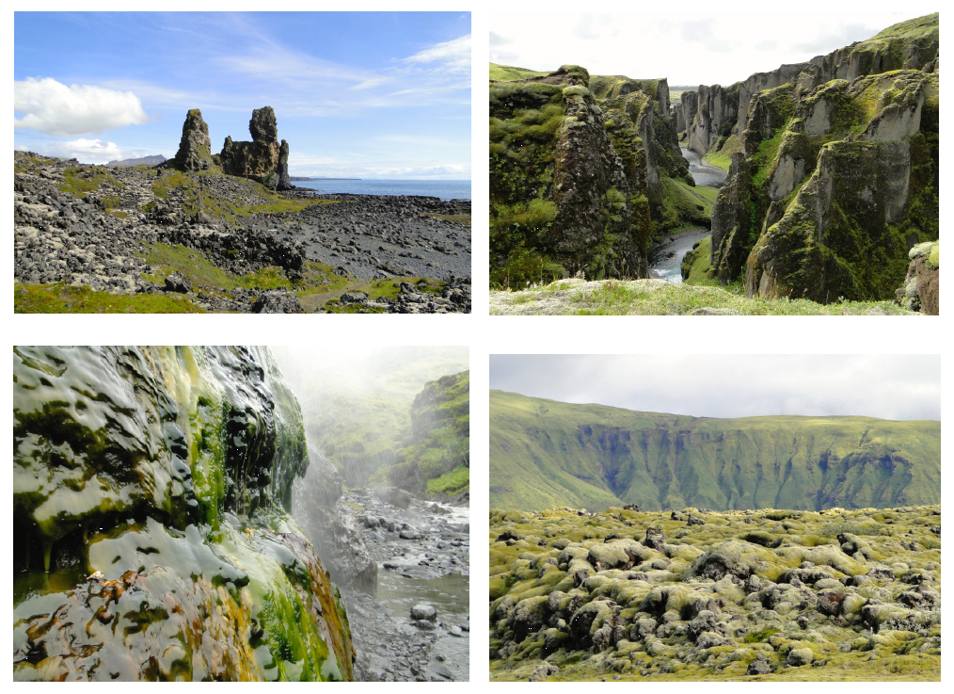
Adjectives are used to describe nouns. Let’s make a list of all the things (nouns) we can see in these pictures of Iceland.
I can see….

Slide 7
Adjectives are used to describe nouns. Let’s make a list of all the things (nouns) we can see in these pictures of Iceland.
I can see….
Let’s record your ideas below

Slide 8
Now we need to think of adjectives to describe our nouns.
Colour?
Size?
Shape?
Smell?
Taste?
Sound?
Mood?
The reflective sea
A huge expanse of unending ocean
The pinnacle shaped iceberg
The earthy smelling moss
The squeaky snow
The calm water
The lonely clouds
A terrifying crater
Calm sea – I’ve used this adjective twice, what can I do?

Slide 9
Now we need to think of adjectives to describe our nouns.
Colour?
Size?
Shape?
Smell?
Taste?
Sound?
Mood?
The reflective sea
A huge expanse of unending ocean
The pinnacle shaped iceberg
The earthy smelling moss
The squeaky snow
The calm water
The lonely clouds
A terrifying crater
Calm sea – I’ve used this adjective twice, what can I do?

Slide 10

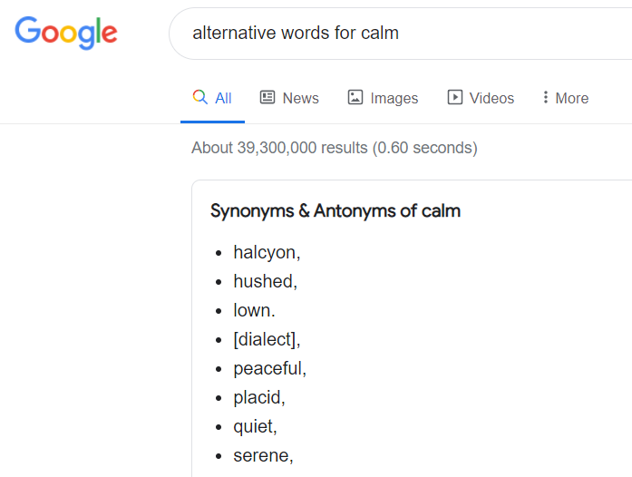
How to find ‘alternative’ or ‘better’ words
When I looked in my thesaurus (a book that gives you alternative words), I found some more alternative words (synonyms) that I could use to describe the sea.
You can also use the internet. Just type alternative word for xxxxx (insert your word here) online to
find some other words that are similar.
The placid sea.

Slide 11

Today’s Task
Choose a scene from Iceland. Cut it out and stick in your book if you want to. Describe the scene.
Use 2 adjectives with a comma to describe the nouns in the picture.
Use a prepositional phrase at the start. (Below…, Under…, Above…)
Make sure both adjectives work, and they are not just saying the same thing!
Use a thesaurus or the Internet to find even better adjectives.
Do at least 5 sentences.
Preposition or prepositional phrase
Below…
Above…
In the distance,
In front
Here’s one I’ve done for you.
Ahead, the colossal, glassy iceberg shimmered in the calm
sea.
Below, was a deep, mossy ravine.
Fronted adverbial of place, prepositional phrase
2 adjectives separated with a comma

