Slide 3

1) 48 $÷$ 4 $=$
2) 480 $÷$ 4 $=$
3) 72 $÷$ 9 $=$
4) $÷$ 9 $=$ 800

Slide 4
12
1) 48 $÷$ 4 $=$
2) 480 $÷$ 4 $=$
3) 72 $÷$ 9 $=$
4) $÷$ 9 $=$ 800
120
8
7,200
72 $×$ 100

Slide 6
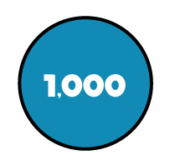
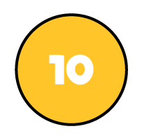
There are 4,884 crayons and they come
in packs of 4
How many packs are there?
1,221 packs
Thousands | Hundreds | Tens | Ones
4 | 4 | 8 | 8 | 4
1
2
2
1

Slide 7
9,306 $÷$ 3
Have a think
Thousands | Hundreds | Tens | Ones
3 | 9 | 3 | 0 | 6
3
1
0
2

Slide 8
4,324 $÷$ 2
Thousands | Hundreds | Tens | Ones
2 | 4 | 3 | 2 | 4
2
1
6
2
1

Slide 9
Have a think
6,115 $÷$ 5
Thousands | Hundreds | Tens | Ones
5 | 6 | 1 | 1 | 5
1
2
2
3
1
1
1

Slide 10
Have a go at the questions on the next slides.

Slide 11
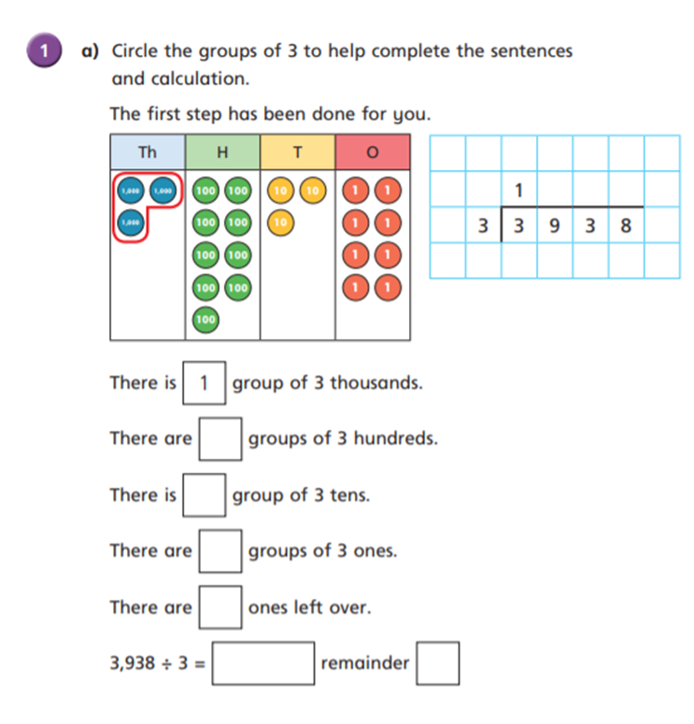
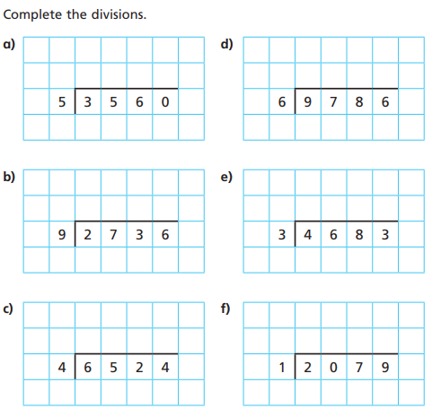
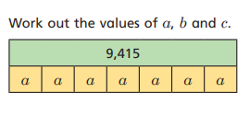
2
3

Slide 12
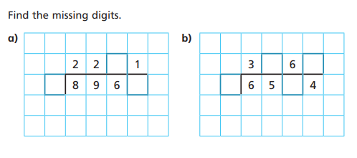
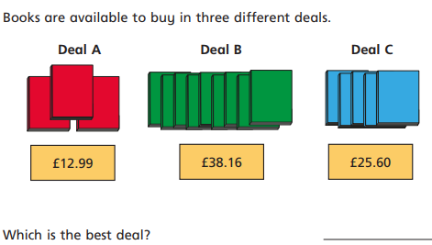
Extension

