Slide 1
Some places I have visited whilst travelling europe
Addison pedley-biggins

Slide 2
Paris, france
Climbed all 1665 steps of the Eiffel tower!

Slide 3
Crete, greece
Visited the cave of Zeus, where Zeus as a baby was kept hidden away from his father Cronus, until Zeus was old enough to battle him

Slide 4
Rome, italy
.
We saw many beautiful and amazing sites in
Rome such as,
The Collosseum
The Trevi fountain
The Pantheon
And St Peters Basilica
We also entered the Sistine Chapel in the Vatican City, where the pope lives.

Slide 5
SOME Other cities I VISITED in italy
Venice is built on 118 small islands that are separated by 150 canals.
People cross the canals by many small bridges.
You can also go across the city on rowing boats and motor boats.
We travelled the canals by Gondola, which you can see in this picture
Pisa
Some facts about the leaning tower of PISA
It is 56 metres from the ground
When the second floor was built in 1178 the tower began to lean
Venice

Slide 6
croatia
We visited many fortresses in the cities of Croatia, some of them were Dubrovnik, Split and Hvar.
We also swam in the Krka national park waterfalls

Slide 7
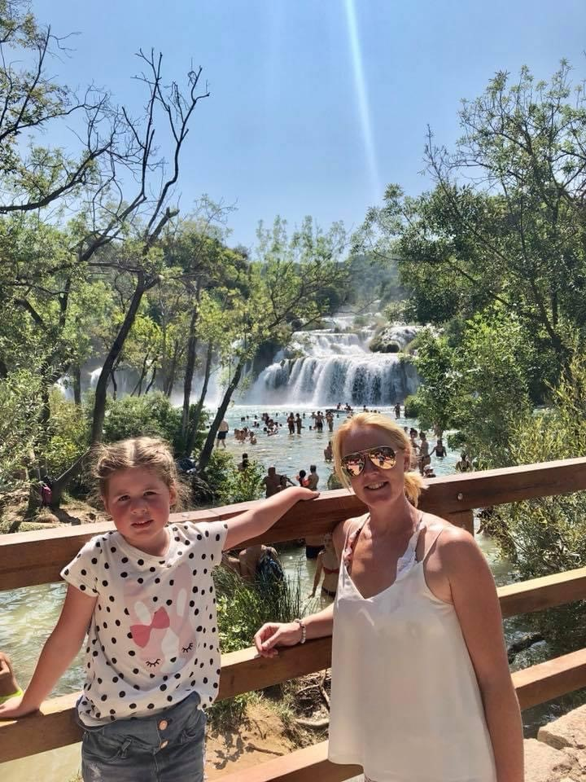
CROATIA KRKA FALLS

Slide 8
Switzerland
Llint chocolate factory
Rhine waterfalls
We saw how the chocolate was made
We got to taste it and saw many different flavors being made.
We went down hundreds of steps to a platform where we stood behind the waterfall. It was VERY loud!
.

Slide 9
SOME OTHER PLACES
NORWAY
Brussels, belgium
Monaco
MILAN, ITALy
We went husky sledding and also visited the venue of the winter olympics
There are lots of statues like this around Brussels, and some very important government buildings
We saw some very beautiful large yachts in Monaco that belong to some very rich and famous people.
We also walked around some of the roads that are the grand prix formula 1 race track
The people of Milan LOVE their football. They are football crazy! This is me with an AC Milan shirt when we visited their stadium.

