Slide 1
How to… …trap a baby molten goblin AKA Amare Cobalus
By Bodi Clark

Slide 2
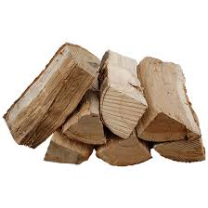
Are you…
Sounds like you’ve got a baby Amare Cobalus!!!
Fed up with your hot chocolate being stolen?
Annoyed with all the logs for your fire being taken?
Frustrated about another set of burnt car tyres?
Read this extremely helpful guide to rid your life of these PESKY creatures

Slide 3
WORD OF WARNING PRIOR TO THESE INSTRUCTIONS, BE AWARE THAT CUPBOARD GOBLINS HAVE SIMILAR ANNOYING TRAITS TO AMARE COBALUS, SO IF THE STEPS BELOW DON’T WORK, YOU MAY NEED TO READ OUR CUPBOARD GOBLIN GUIDE

Slide 4
What you will need
An iron cage; it’s the only metal that can hold them
Hot chocolate (Galaxy is their favourite)
Strong rope
A brick, extra hard as it needs to knock them out

Slide 5
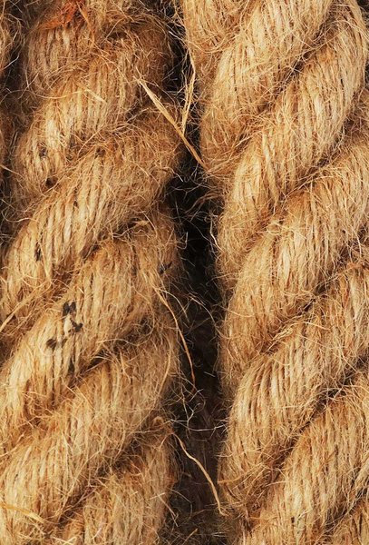
What to do
Firstly, put the hot chocolate in the cage and arrange it in a way so that when the goblin grabs it the rope will pull off the brick and it will fall on the goblin.
After that, hide behind an object big enough to conceal yourself fully.
WAIT, be patient.
Once the goblin smells the sweet chocolatey aroma it will be lured into the cage. Once it is inside, slam the door behind it.
Penultimately, wait for the thud and check it has been knocked out. If there is no movement, you will be safe to approach.
Finally, call the goblin removal company and they will come and collect your goblin.

Slide 6
Top tip
If the Goblin Removal Company take longer than expected to arrive, and you need to keep your goblin asleep for longer, Professor Goblin P.O.O from the University of Goblinton suggests grating some ginger close to the goblin cage, the aromas will ensure the Amare Cobalus doesn’t wake from its slumber.

Slide 7
conclusion
If you have followed these instructions carefully you will be able to enjoy a baby Amare Cobalus free day
WELL DONE!!

Slide 8
If molten goblins are not your problem, please refer to one of our other helpful instruction guides
How to Trap a Cloud Goblin
How to Trap a Lightening Goblin
How to Trap a Carpet Goblin
How to Trap a Cupboard Goblin
How to Trap a Rainbow Goblin
How to Trap a Tree Goblin

