Slide 1
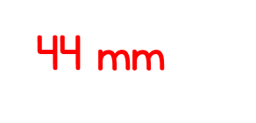
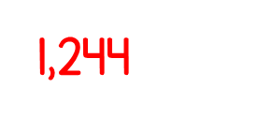
WALT know how to recognise equivalent fractions
37 X 89 =

Slide 2
Paper folding
Fold , , respectively with three circular sheets of the same size , then colour in the figures.

Slide 3
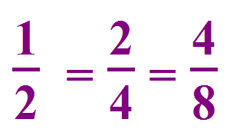
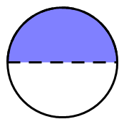
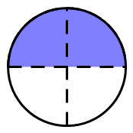
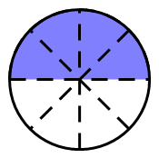
Thinking
What is the relationship of these fractions?
Their numerator and denominator are different, but they are equivalent fractions.

Slide 4
$$\frac{\text{1}}{\text{4}}$$
Numerator –
How many of the parts we are using
Denominator –
How many equal parts there are
$$\frac{\text{2}}{\text{8}}$$
$\frac{\text{1}}{\text{4}}$ is equivalent to $\frac{\text{2}}{\text{8}}$
$\frac{\text{2}}{\text{8}}$ is equivalent to $\frac{\text{1}}{\text{4}}$
What do you notice?

Slide 5
Is $\frac{\text{6}}{\text{9}}$ equivalent to $\frac{\text{2}}{\text{3}}$ ?
$\frac{\text{6}}{\text{9}}$ is equivalent to $\frac{\text{2}}{\text{3}}$
$\frac{\text{2}}{\text{3}}$ is equivalent to $\frac{\text{6}}{\text{9}}$

Slide 6
Have a think
Odd One Out
$$\frac{\text{4}}{\text{9}}$$
$$\frac{\text{6}}{\text{9}}$$
$$\frac{\text{4}}{\text{6}}$$

Slide 7
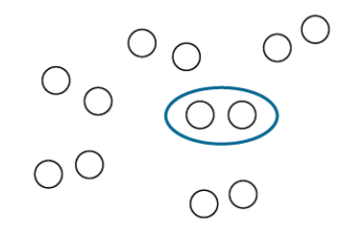
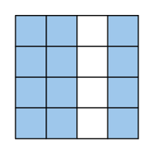
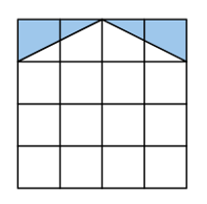
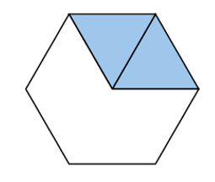
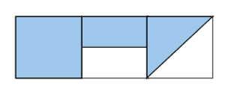
5F-2 Find equivalent fractions
Equivalent fractions can be written for each of the representations.
Can you see each of the pairs of equivalent fractions by looking at the whole in different ways?
Explain why they are equivalent fractions – why they represent the same value?

Slide 8
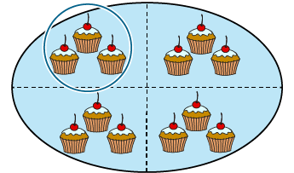
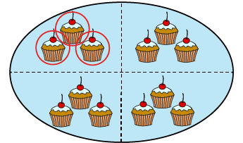
5F-2 Find equivalent fractions
Two friends were arguing who would eat more cake. Mimi will eat ¼ but Kitty will eat 3/12. Who eats more? What do you notice?
What do you notice about the two representations?
Explain why $\frac{1}{4}$ and $\frac{3}{12}$ are equivalent fractions.
The whole is divided into 4 equal parts and 1 of those parts is circled.
The whole is divided into 12 equal parts and 3 of those parts are circled.
1
3
4
12

Slide 9
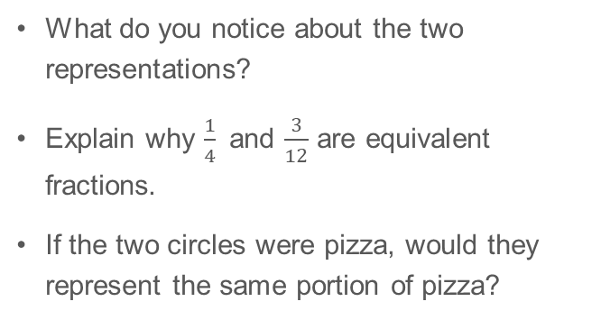
5F-2 Find equivalent fractions
What do you notice about the two representations?
Explain why $\frac{1}{4}$ and $\frac{3}{12}$ are equivalent fractions.
If the two circles were pizza, would they represent the same portion of pizza?
The whole is divided into 4 equal parts and 1 of those parts is shaded.
The whole is divided into 12 equal parts and 3 of those parts are shaded.
$\frac{1}{4}$and $\frac{3}{12}$ are equivalent because 1 is the same portion of 4 as 3 is of 12.

Slide 10
5F-2 Find equivalent fractions
What do you notice about where 0 and 1 are located on both number lines?
What is the same about both fractions shown in red on the number lines?
Why are the two fractions located at the same point on the number lines?
Identify other equivalent fractions on the number lines. Explain how you know that they are equivalent.
$\frac{1}{4}$and $\frac{3}{12}$ are equivalent because they are located at the same point on the number lines.

Slide 11
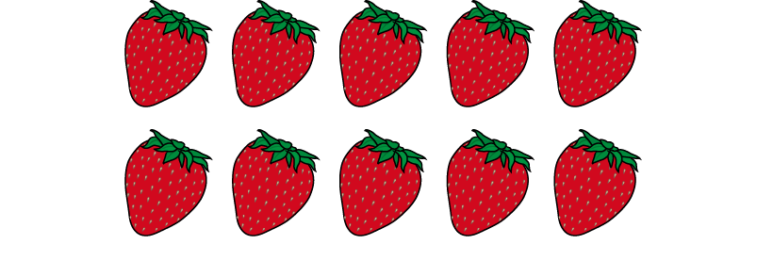
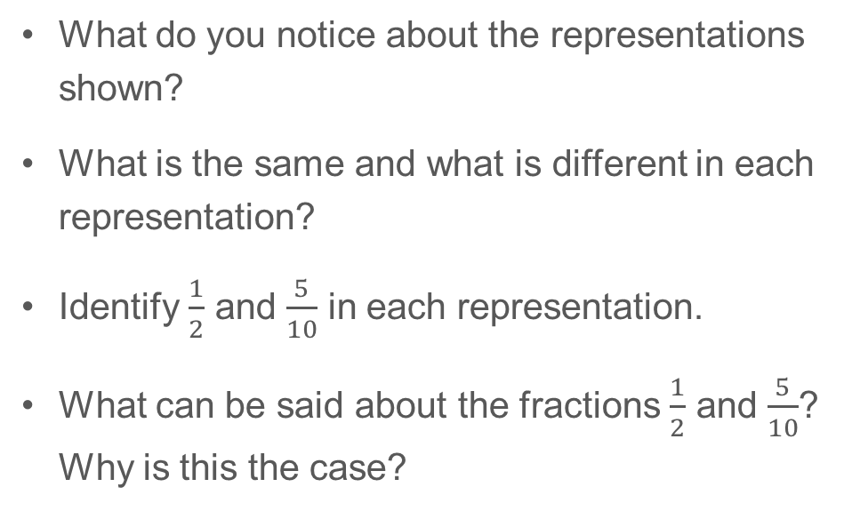
5F-2 Find equivalent fractions
What do you notice about the representations shown?
What is the same and what is different in each representation?
Identify $\frac{1}{2}$ and $\frac{5}{10}$ in each representation.
What can be said about the fractions $\frac{1}{2}$ and $\frac{5}{10}$? Why is this the case?
$\frac{1}{2}$ and $\frac{5}{10}$ are equivalent because 1 is the same portion of 2 as 5 is of 10.

Slide 12
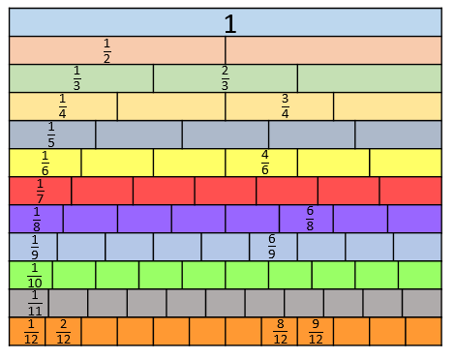
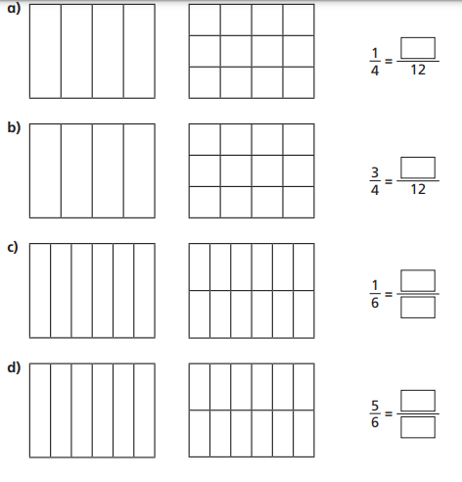
WALT understand equivalent fractions Independent practice
1) Either draw out the shapes, if you haven’t got them printed. Colour in the fractions and then write the equivalent fraction.
3) Use the fractions wall above to write as many equivalent fractions as you can.
4) 5/9 and 5/7 have the same numerator. This means that they must be equivalent fractions right? Explain why this statement is wrong?
5. Which fraction is larger, 8/8 or 4/4? Explain how you know.
2) Draw two rectangles to show that

Slide 13
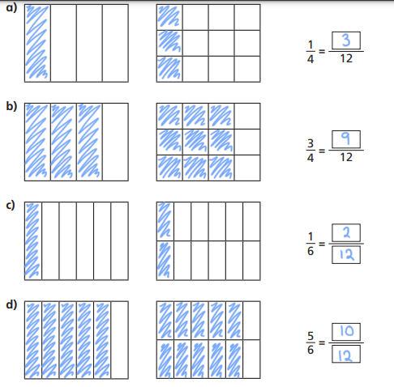
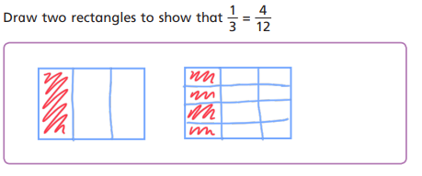
Question 3 various answers
4) 5/9 and 5/7 have the same numerator. This means that they must be equivalent fractions right? Explain why this statement is wrong?
No because they have been broken in to a different amount of parts. With 9 equal part, each equal part will be smaller than the 7 equal parts. Therefore 5/7 is a larger part of the whole.
5. Which fraction is larger, 8/8 or 4/4? Explain how you know. They are both wholes so are the same amount if the wholes were the same size

