Slide 1
Friday 5th February 2021

Slide 2
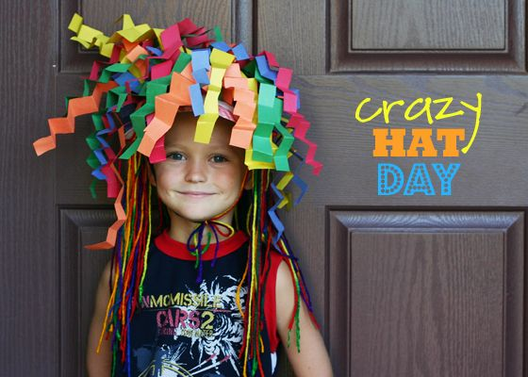

Slide 3
Reading and spellings: Remember to quiz your books using AR reader- https://ukhosted36.renlearn.co.uk/2234869/ https://www.mylor-bridge.cornwall.sch.uk/website/spellings/531079

Slide 4
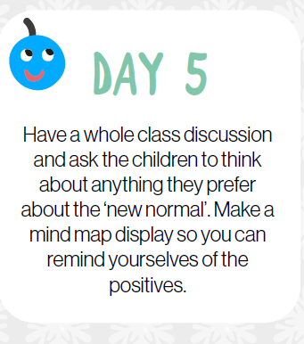

Slide 5
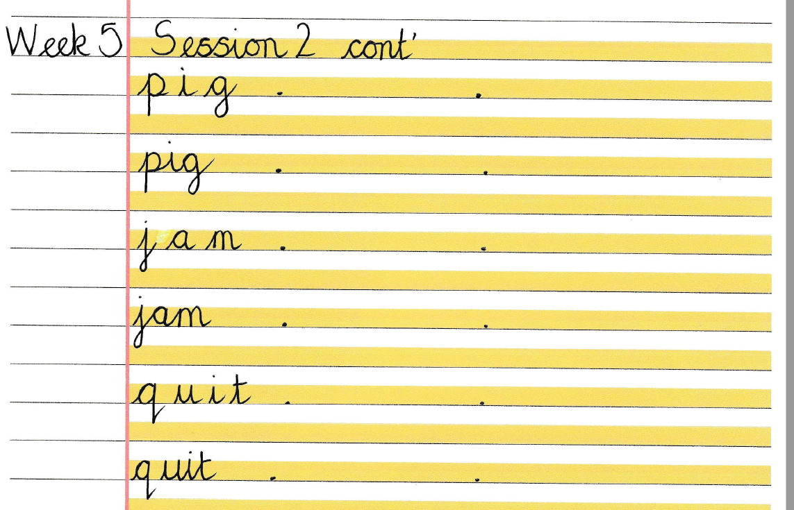

Slide 6
This week’s show and tell speakers are:
Bodi, Addi, Harriet and Jess!

