Slide 1
Talk It Solve It
I am a 2D shape.
I am an irregular shape.
I am have less than 5 sides.
I have 4 corners.
I have parallel sides.
I am enclosed on 4 sides.
I have 4 right angles.

Slide 2
Vocabulary:
Metre
Centimetre
Millimetre
Perimeter
area
Rectangle
Width
length
Height
Compound
Notes:
Overview of the lesson

Slide 3
If peri means around then…
Periodic : PERI odie (per ee od’ ik) adj.
Occurring at regular, stated times
Periodical : PERI odical (per ee od’ i k’l) n.
A publication which appears in regular intervals
Pericranium : PERI cranium (per i kray’ nee um) n.
Around the skull
Pericardium : PERI cardium (per i kard’ ee um) n.
Around the heart
Perigon : PERI gon (per’ i gon) n.
An angle that is round
Period : PERI od (per’ ee od) n.
A period of time ( a going around)

Slide 4
perimeter
A: A measuring device used to measure peri-peris (a unit or measurement smaller than a millimetre)
B: The distance around the edge of something, sometimes known as circumference
C: A fraction of a metre equal to one peri or 25cm

Slide 5
Perimeter
Conjecture: Doubling the length and doubling the width will always give me the perimeter.

Slide 7
What is perimeter?
Can you give some rules for creating a perimeter fence?
What should it be able to do?
What shape should it be?
How many lines do you need?

Slide 8
Use 12 lolly sticks/lines and create a perimeter.
Make another.
One that no one has thought of.
A non-example.

Slide 9
What is the length of the line segment?
What is the perimeter?
12 cm
What is the length of …?
What do you notice?
What do you notice?

Slide 10
How can we rebuild the original line?
2
4
4
2

Slide 11
What is perimeter?
The shape is enclosed by a continuous line.
The measurement all the way around the outside of a 2D shape, space or area.

Slide 12
The perimeter of a shape is the total length of its sides
length
Perimeter of a rectangle
= length + width
+ length + width
width
width
5 m
length
lawn
3 m
Perimeter of this lawn
m
= 16
= 5 + 3 + 5 + 3
Think about
Is there another way to find the perimeter?

Slide 13
2 x L + 2 x W
Can you find a quick way to calculate?
3 + 3 + 3 + 3 =
3cm
6cm
L
Length
6 + 6 + 3 + 3 =
L + L + W + W
W
W
3cm
Width
2 x Length + 2 x Width
L
(L + W) x 2

Slide 14
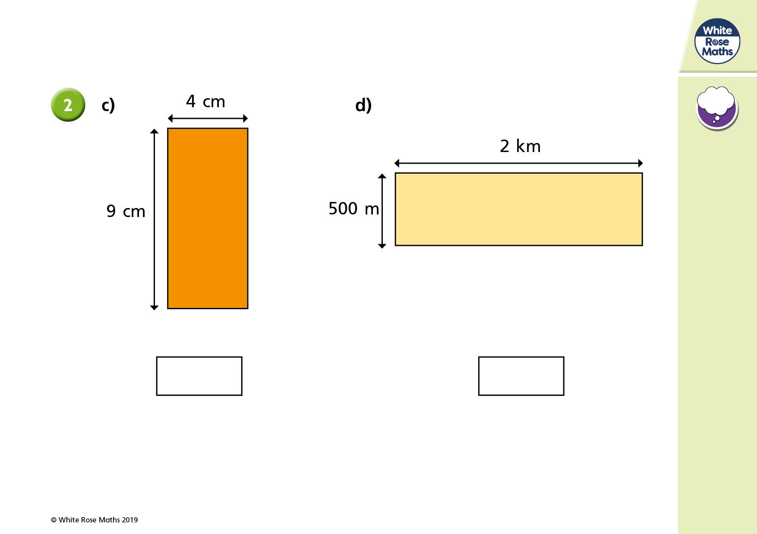
Talk: Can you say the stem sentence for these?
(L + W) x 2 = 2 x (L + W)

Slide 15
Conjecture: Doubling the length and doubling the width will always give me the perimeter.
Double the length added to double the width will always give me the perimeter of a rectangle.

Slide 16

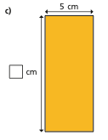


Independent work.
Find the perimeter of the rectangles on your sheet.

Slide 17
What changes? What stays the same? Why?
162 cm
21cm
26cm
162cm
60cm
55cm
162cm
25cm
162cm
22cm
56cm
59cm

Slide 18
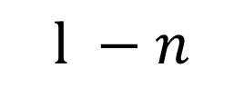

Find the perimeter of the rectangle…
Use the lolly sticks to help you.
$$l −n$$
$$w+n$$

Slide 19

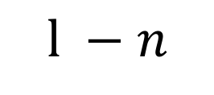


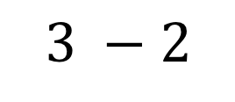
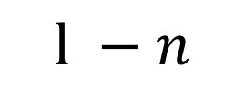

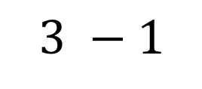
Find the perimeter of the rectangle…
What do you notice? What is happening?
$$3 −2$$
$$l −n$$
$$3 −1$$
$$l −n$$
$$3+2$$
$$w+n$$
$$w+n$$
$$3+1$$

Slide 20
Rank: Gold, silver, bronze
304cm
18cm
134cm
188cm
25cm
129cm
69cm
290cm
16cm

Slide 21
What is perimeter? Conjecture…
Perimeter is only the outside of rectangles.

