Slide 1
20.1.21
Maths
WALT: Understand Kilometers

Slide 3
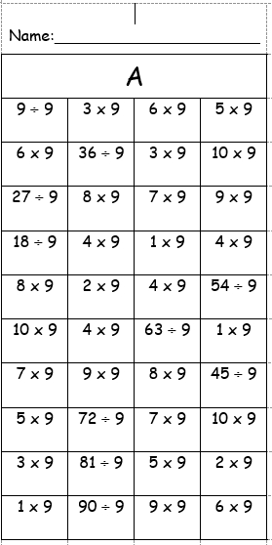

Slide 4
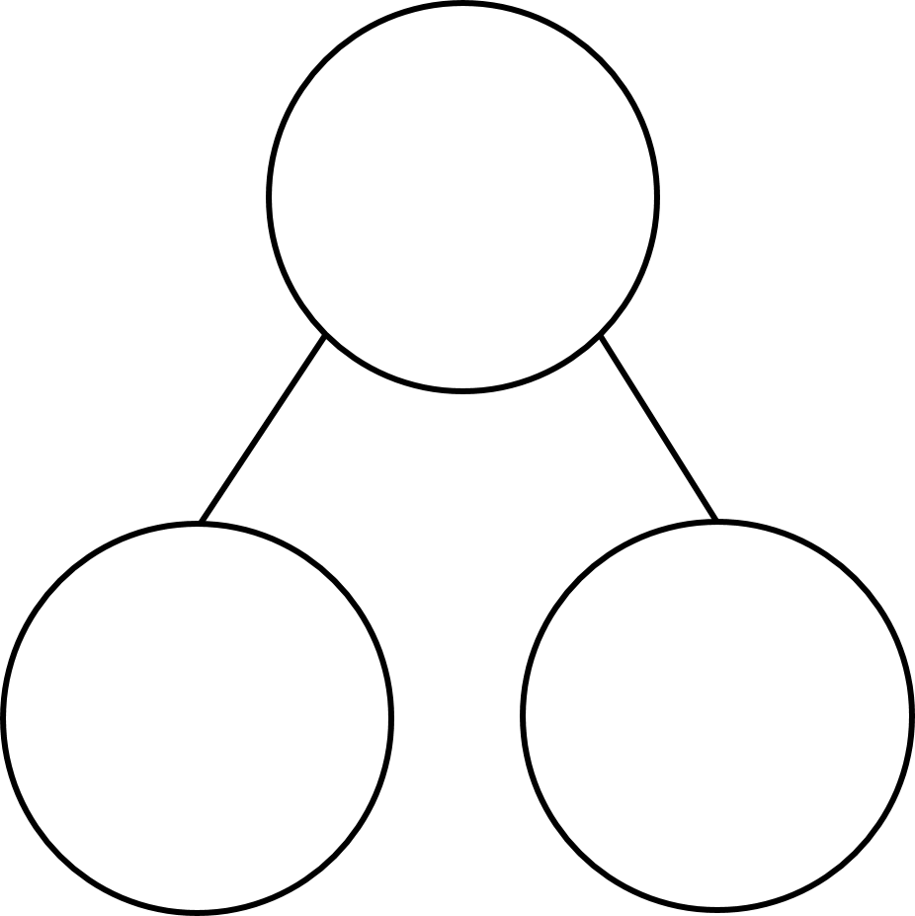
Complete the sequence.
1,000 2,000 3,000 _______ ______
2) How many thousands are in 4,832?
3) Complete the part-whole model.
9,931
931

Slide 5
Complete the sequence.
1,000 2,000 3,000 _______ ______
4,000
5,000
2) How many thousands are in 4,832?
4 thousands
3) Complete the part-whole model.
9,931
9,000
931

Slide 7
kilometres
0
1
2
3
4
5
6
7
8
9
10
0
1,000
2,000
3,000
4,000
5,000
6,000
7,000
8,000
9,000
10,000
metres
10 km = 10,000 m
5 km = 5,000 m
6 km = 6,000 m
7 km = 7,000 m
8 km = 8,000 m
9 km = 9,000 m
1 km = 1,000 m
2 km = 2,000 m
3 km = 3,000 m
4 km = 4,000 m
0 km = 0 m

Slide 8
4,250
4 km 250 m
4,200
4 km 200 m
4,150
4 km 150 m
4,100
4 km 100 m
4,050
4 km 50 m
4,100 m
4,050 m
m
4,000
4 km
km and m
4 km
100 m
4,000 m
50 m

Slide 9
1 km = 1,000 m
800 m
1,000 $−$ 800 =
200
1 km
2 km = 2,000 m
600 $+$ 200 $=$
800
200 m
2,000 $−$ 800 =
1,200
2 km
600 m | 200 m
1,200 m

Slide 10
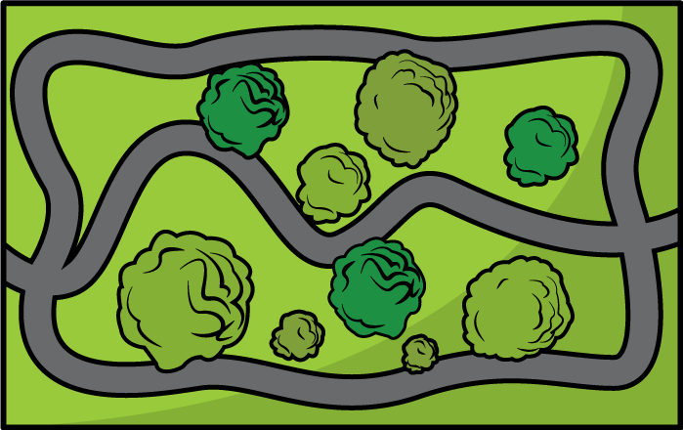
1 km
1$\frac{1}{2}$ km
2 km
$\frac{1}{2}$ km
2$\frac{1}{2}$ km
0 km
START
3 km
5 km
END
4$\frac{1}{2}$ km
4 km
3$\frac{1}{2}$ km

Slide 11
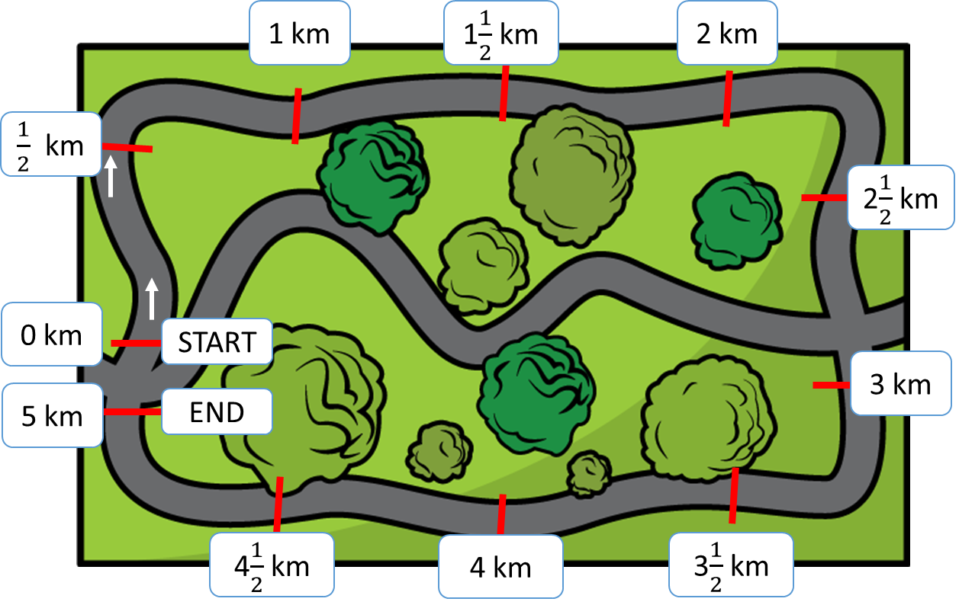
4 $\frac{1}{2}$ km
4,500 m
4,000 m
$\frac{1}{2}$ km
4 km
500 m
Annie has run 4 $\frac{1}{2}$ kilometres.
How many metres has she run?
4,500 m
$\frac{1}{2}$ of 1 km $=$
$\frac{1}{2}$ of 1,000 m $=$
1,000 m $÷$ 2 $=$
500 m

Slide 12
5,000 m
5 km
2$\frac{1}{4}$ km
?
2,250 m
2,750 m
Teddy has run 2 $\frac{1}{4}$ km.
How many metres does he have left to run?
2,000 m
2,250 m
2,500 m
2,750 m
3,000 m
5,000 $−$ 2,250 $=$
2,750
1,000 $÷$ 4 $=$
250
Teddy has 2,750 metres left to run.
2 km
2$\frac{1}{4}$ km
2$\frac{1}{2}$ km
2$\frac{3}{4}$ km
3 km

Slide 13
