Slide 1
Guidance for Video/Audio in PowerPoints
1. Open the folder and copy all the files.
2. Paste the copied files into a new folder.
3. Open the PowerPoint file, enable editing and enter presentation mode (start the slide show).
Please note the embedded audio may not be compatible with early versions of PowerPoint.
You may wish to delete this slide before beginning the presentation.

Slide 3
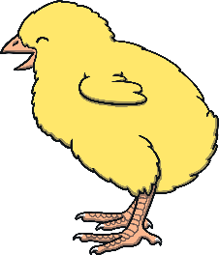
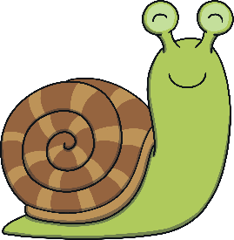
Revisit and Review
Let’s practise Sam’s Sounds and Tricky Words!
v
j
y
x
qu
ch
w
zz
z
ng
th
th
sh
ai
was
be
me
she
we
he

Slide 4
Sing the Alphabet
Revisit and Review
Can you sing this alphabet song along with Kit? (To the tune of the traditional alphabet song)
A, B, C, D, E, F, G,
Sing the alphabet with me.
H, I, J, K, L, M, N,
Have a rest and start again.
O, P, Q, R, S, T, U,
Come along and sing it too.
Sing V, W, X and Y,
Z is last so say goodbye.
Can you sing this alphabet song along with Kit? (To the tune of the traditional alphabet song)
A, B, C, D, E, F, G,
Sing the alphabet with me.
H, I, J, K, L, M, N,
Have a rest and start again.
O, P, Q, R, S, T, U,
Come along and sing it too.
Sing V, W, X and Y,
Z is last so say goodbye.
Play Song

Slide 5
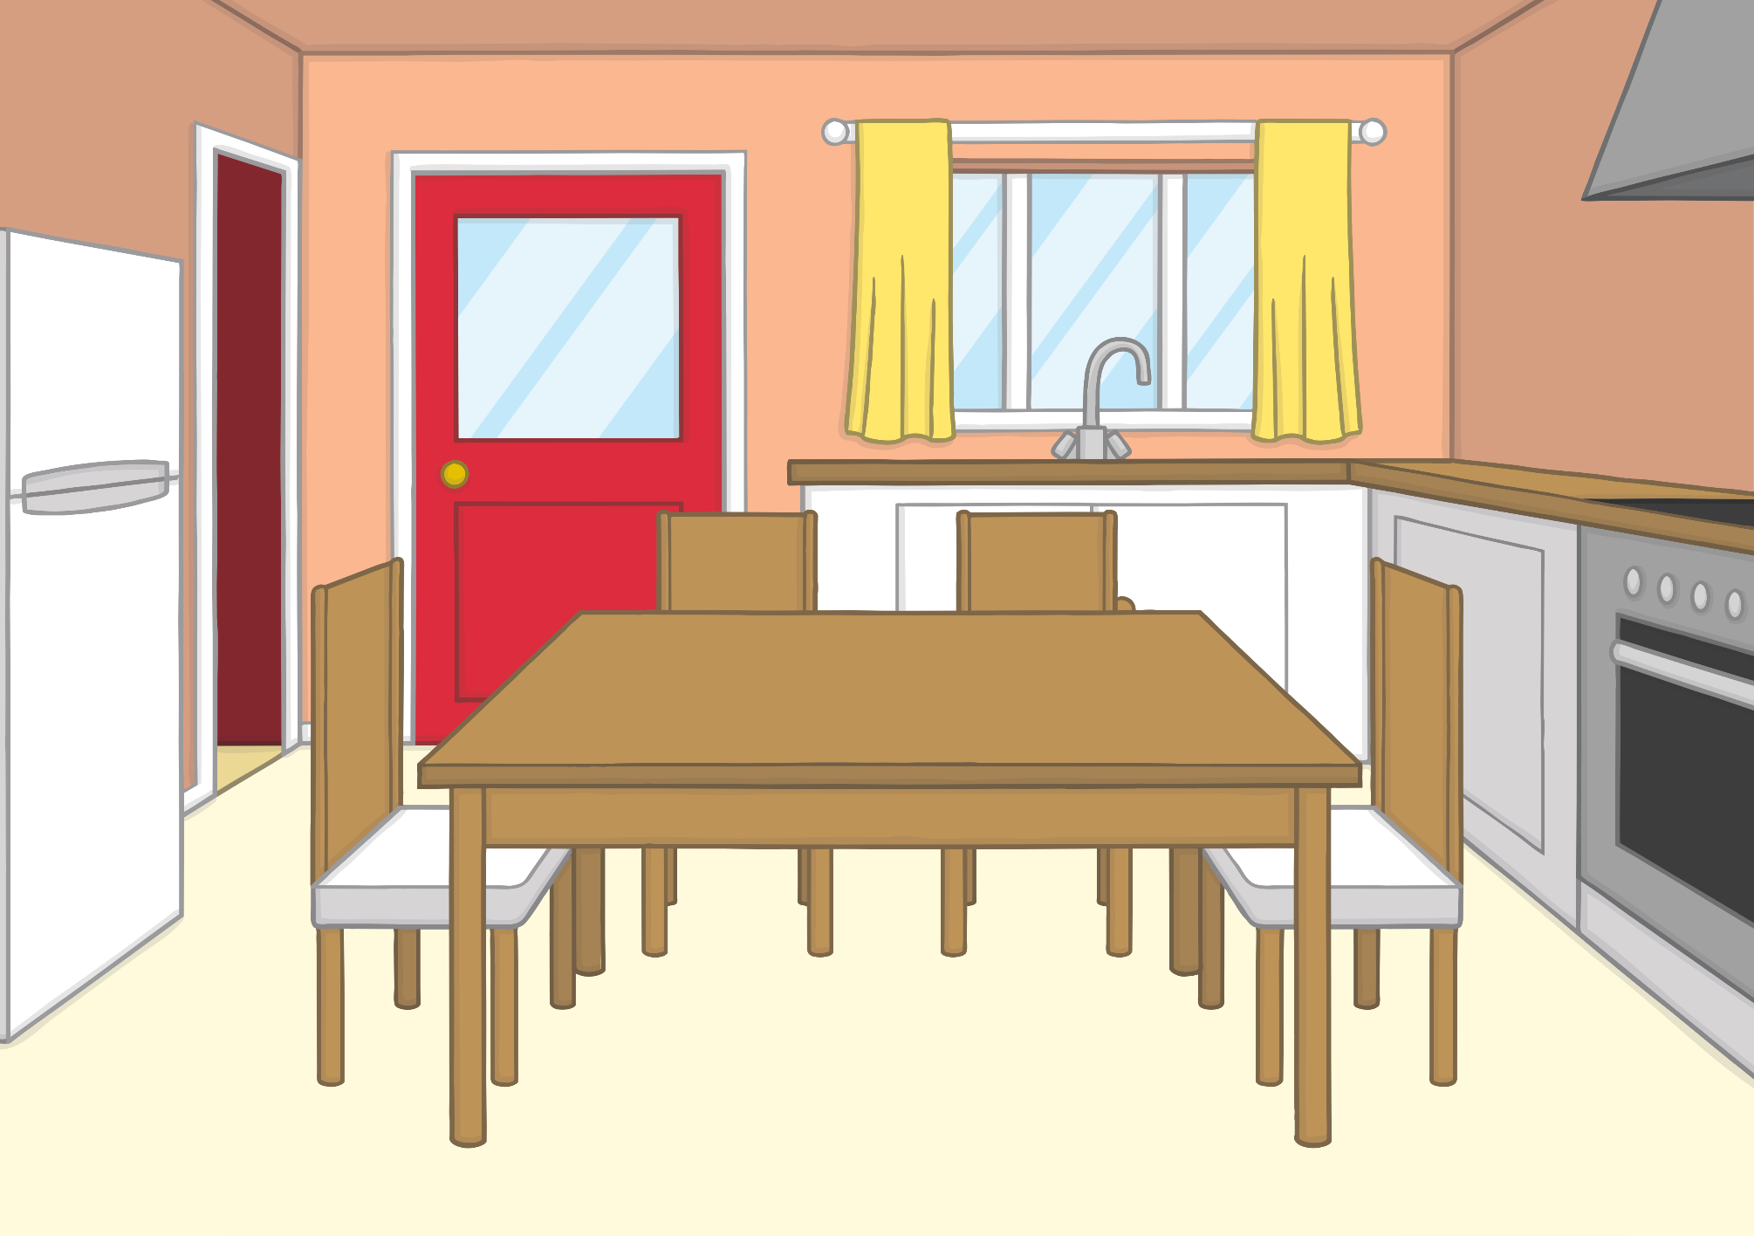
Teach
Sam had been at evening cricket practice and was hungry. She decided to make herself a cheese sandwich and a big drink of milk.

Slide 6
Teach
“Finish that quickly,” said Mum. “It’s time for bed.”
Sam quickly gobbled up the last of her sandwich and ran upstairs, forgetting to put the cheese away.

Slide 7
Teach
“Look at this!” said Dad, the following morning.
“Oh, no! I left the cheese out!” said Sam. “Eek! It has been nibbled by a cheeky mouse!”

Slide 8
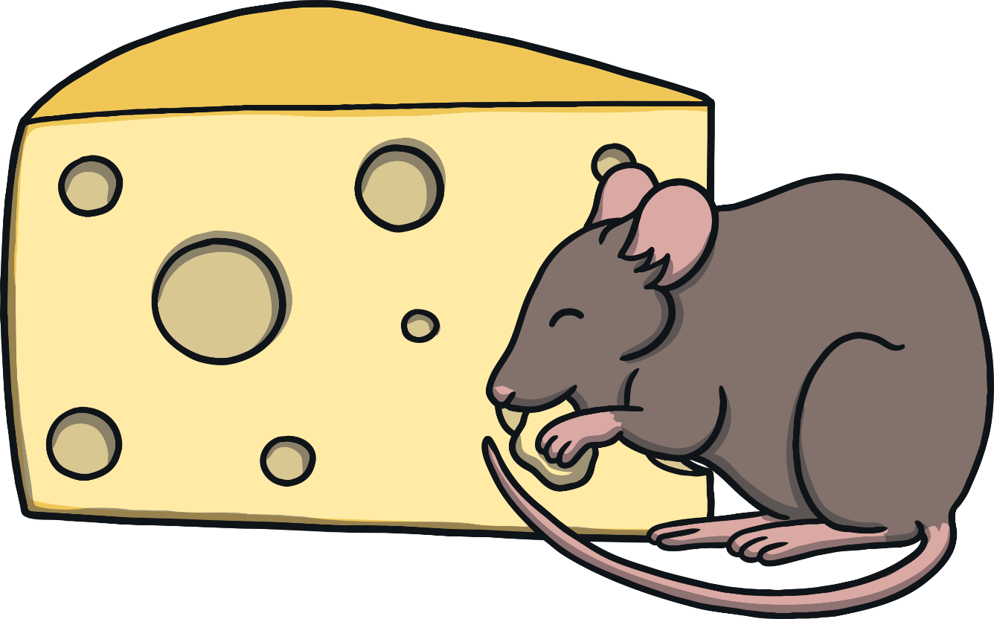
e
e
Teach
Sometimes, an e and another e partner up. They say ee.

Slide 9
Teach
Teach
ee
ee

Slide 10
Action
Teach
Teach
Make mouse whiskers.
Say ‘ee, ee, ee’.

Slide 11
Write the Letters
Teach
ee
Around the egg and under the cup.
Around the egg and under the cup..
Play

Slide 12
Let’s Sing!
Teach
(To the tune of ‘Do You Know the Muffin Man?’)
Cheeky mice have found the cheese,
ee - ee - ee
ee - ee - ee
Cheeky mice have found the cheese,
And nibbled all night long.
Play Song

Slide 13
Nibbled Cheese
Practise
The cheeky mice have nibbled at the cheese. Can you read the word they have revealed and match it to the correct picture?

Slide 14
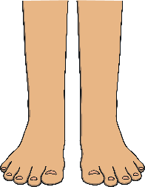
feet
Practise

Slide 15
see
Practise

Slide 16
weep
Practise

Slide 17
jeep
Practise

Slide 18
meet
Practise

Slide 19
week
Practise

Slide 20
Apply
“I think we should put the cheese back in the fridge,” said Dad. “We don’t want those little mice to eat any more of it. Oh! Where has it gone?”

Slide 21
Sentence Time
Apply
Where has the cheese gone? Read the sentence then click ‘Show’ to reveal the answer!
X
Click ‘Sound Buttons On/Off’ to select whether you want to show sound buttons under the caption.
Click me for Kit’s teaching tips!

Slide 22
Sentence Time
Apply
It was in Ben’s teeth.
Sound Buttons On/Off
Show

Slide 23
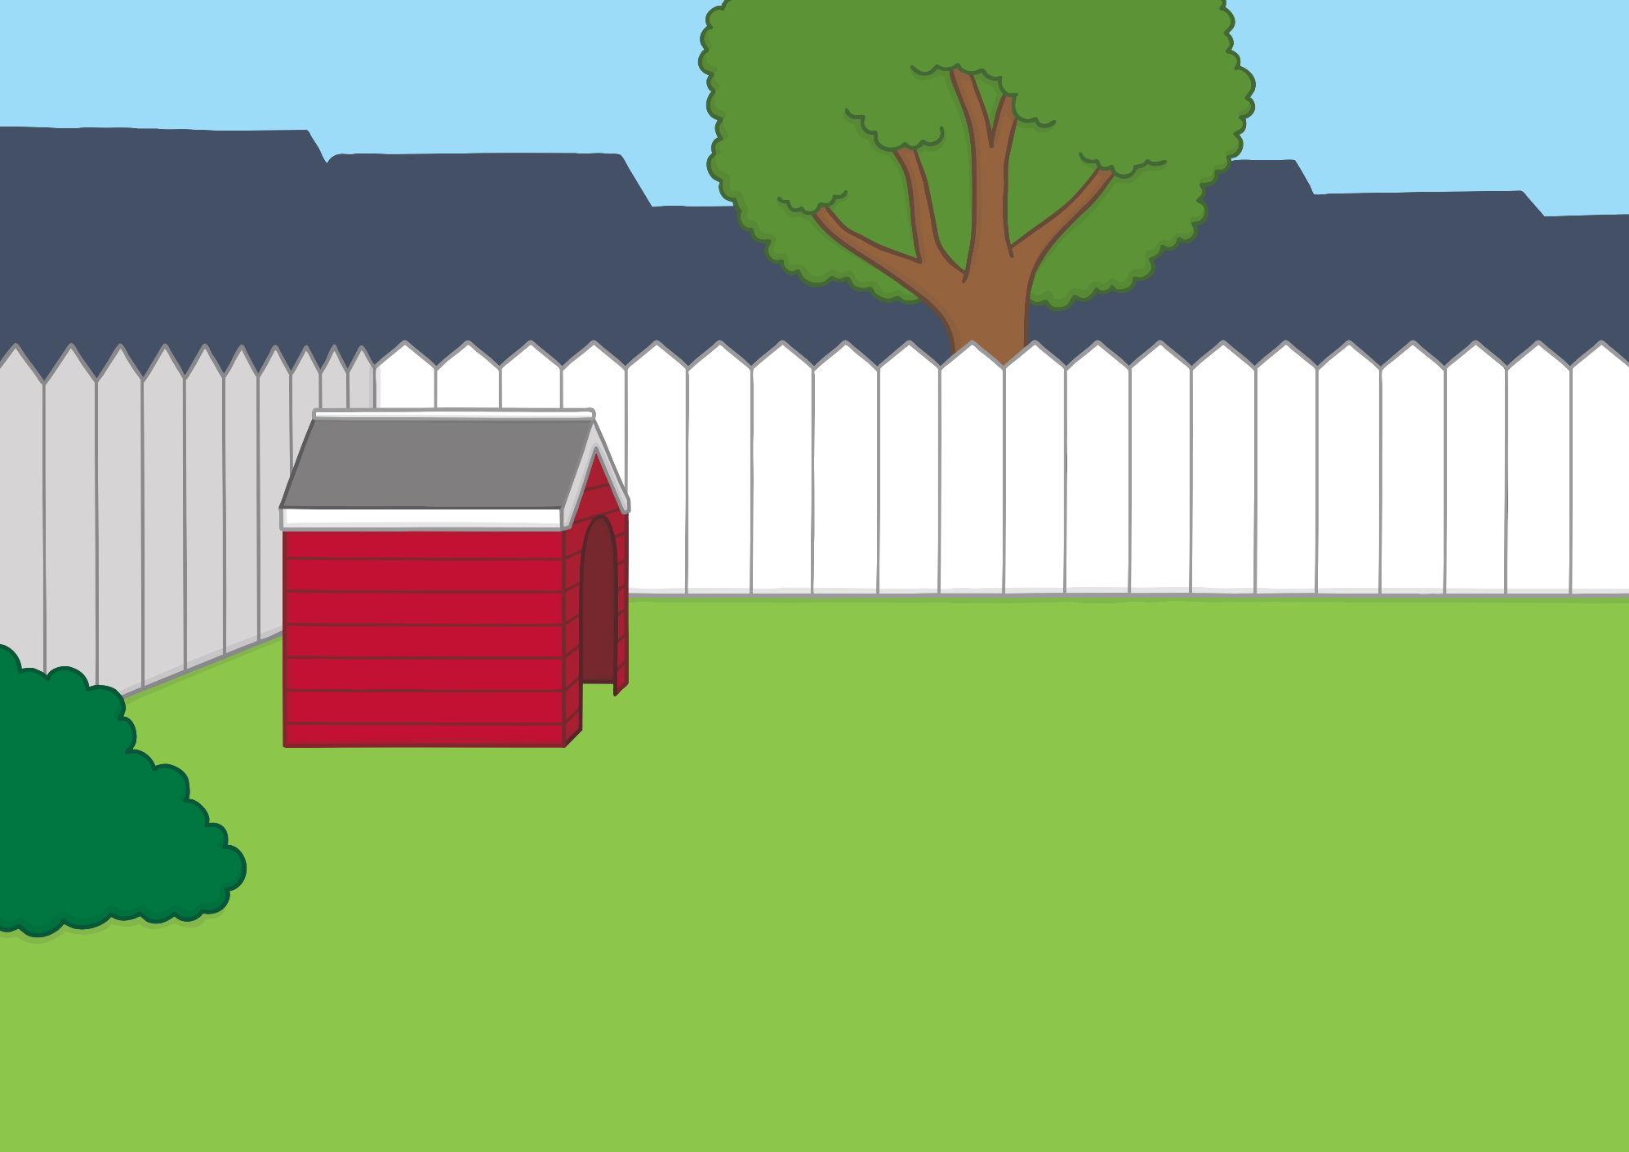
Apply
Kit and Sam found Ben out in the garden. “Ben, you are as cheeky as the mice!” said Sam, giving him a chew instead. Ben wagged his tail happily.

Slide 24
Today, we have learnt…
Apply
ee

