Slide 1
WALT understand the principles of division - part two - grouping.

Slide 2
Fluency 5
= missing number

Slide 3
Vocabulary
Product –
the value of two or more factors multiplied together.
Factor
a number that will divide in to another number equally with no remainder
Multiplication
adding groups of the same number together
Times
is how often the addition needs to be done.
Lots of
is the number in each equal group
Division –
making equal groups
Divisor
The number divided into another number
Dividend -
The quantity that is to be divided
Quotient –
The answer to a division calculation
Communitive Law
can calculate in any order and will provide the same result.

Slide 4
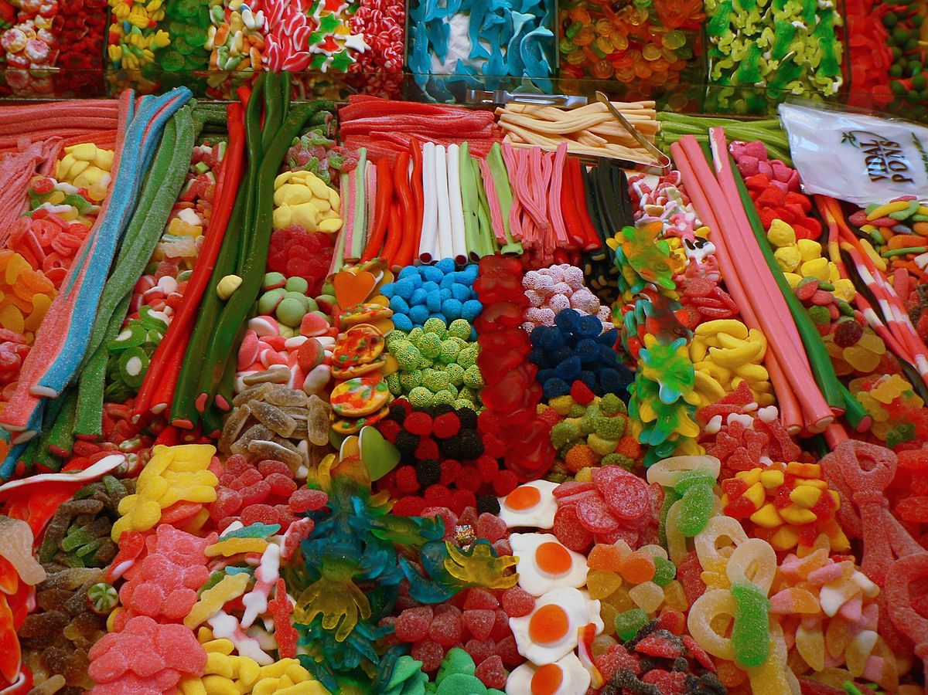
What is division
Division – making equal groups
When may you use division?
Organising teams
Sharing food or anything equally
Paying for things monthly
Home improvements

Slide 5
12 blue spots shared in to 3 yellow circles.
Will be sharing them in groups of three until you cant anymore.
Notes:
Partitive structure
This model of division links the two structures – it animates the partitive model on the Japanese text book page but links to the importance of the divisor as the key as it shows the removal of a group of 3 at each stage which is then distributed into the three sets.

Slide 6
One group of 3 – one each
Notes:
A group of 3 is identified as we are dividing by 3

Slide 7
Notes:
Each of the 3 is then assigned to a separate set

Slide 8
A second group of 3
Notes:
This process continues until all the groups of 3 have been identified and allocated to a set

Slide 9
A third group of 3

Slide 10
A fourth group of 3

Slide 11
A fourth group of 3 – four each

Slide 12
12 ÷ 3 = 4
There were 12 spots altogether.
There were 3 circles.
All the groups of 3 have been shared.
There are 4 in spots each set.

Slide 13
Twenty conkers are shared equally between five children. How many conkers will each child get?
Each child gets four conkers.
Notes:
Click to identify a new group of 5 then the rest of the animation is automatically timed!
Start with divisors as 2, 5 or 10 so that known facts can be used.
The next set of slides are hidden. They demonstrate when the divisor is 3 – you could use this when the children have learnt the three times table.

Slide 14
What about when you don’t know how many equal groups you have to share in to?
Mr. Mutsaers has 20 children in a class he needs teams of 5 for basketball. How can he group them equally?
Talk to your partner – how is he going to get them in to groups of 5 – how many equal groups will he have?

Slide 15
Use the equipment on the table to divide the numbers in to equal groups.
Use 30 counters/objects
I would like equal groups of 6
I would like equal groups of 5
I would like equal groups of 10
I would like equal groups of 15
I would like equal groups of 7
What do you notice with the last question?
Can I make equal groups of 7?
What would the equation look like?
30 ÷ 7 = 5 with two remaining.

Slide 16
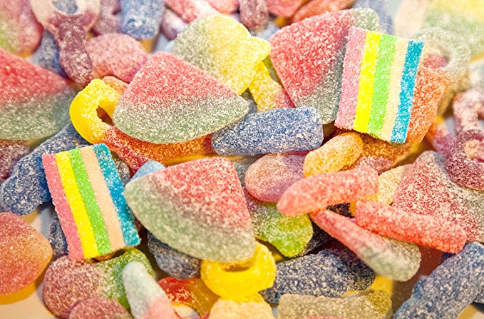
Can you compare these two questions?
I have 3 other siblings and we need to share a bag of sweets equally between us. There are 40 in the packet. How many will we receive each?
There are 40 sweets in a packet and I want to share them in to equal groups of 10. How many groups of 10 can I make?
What will the equations for each be?
40 ÷ 4 = 10
40 ÷ 10 = 4

Slide 17
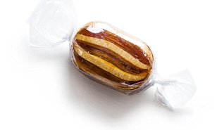
There are 40 sweets in a packet and I want to share them in to equal groups of 10. How many groups of 10 can I make?
I have 3 other siblings and we need to share a bag of sweets equally between us. There are 40 in the packet. How many will we receive each?
40 ÷ 4 =

Slide 18
Can you sort these questions in to those that require sharing in to equal groups when you know the total amount of groups and those that require dividing in to equal groups when you don’t know how many groups you may get.
Sharing when you know how many equal groups
Dividing when you don’t know how many equal groups
Emma has 24 biscuits to sell, she wants to put them into packs of 6. How many packets will she need?
Emma has 24 biscuits to sell, she wants to share them into 6 packets. How many biscuits will go in each packet?
Emma has sold 24 biscuits in packets of 6. How many packets has she sold?
Mr. Martin wants teams of 7 he has 56 players. How many teams can he make?
Bananas are sorting in to boxes of 20 there are 160 bananas. How many full boxes will there be?
There are six classes at Mylor Bridge School. There are 360 pencils to be shared out equally. How many pencils should each class receive?
There are 160 pens that need to go in to packets of 15. How many full packets of pens can we make?

Slide 19
Can you sort these questions in to those that require sharing in to equal groups when you know the total amount of groups and those that require dividing in to equal groups when you don’t know how many groups you may get.
Sharing when you know how many equal groups
Dividing when you don’t know how many equal groups
Emma has 24 biscuits to sell, she wants to share them into 6 packets. How many biscuits will go in each packet?
Emma has 24 biscuits to sell, she wants to put them into packs of 6. How many packets will she need?
Emma has sold 24 biscuits in packets of 6. How many packets has she sold?
There are six classes at Mylor Bridge School. There are 360 pencils to be shared out equally. How many pencils should each class receive?
Mr. Martin wants teams of 7 he has 56 players. How many teams can he make?
Bananas are sorting in to boxes of 20 there are 160 bananas. How many full boxes will there be?
There are 160 pens that need to go in to packets of 15. How many full packets of pens can we make?

Slide 20
Use equipment to solve the answers to the questions below. Remember to write the equation that goes with each question.
1. Emma has 24 biscuits to sell, she wants to put them into packs of 6 biscuits.. How many packets will she need?
6. Bananas are sorted in to boxes of 20. There are 160 bananas. How many full boxes will there be?
2. Emma has 24 biscuits to sell, she wants to share them into 6 packets. How many biscuits will go in each packet?
7. There are six classes at Mylor Bridge School. There are 360 pencils to be shared out equally. How many pencils should each class receive?
3. Emma has sold 24 biscuits in packets of 6. How many packets has she sold?
4. Mr. Martin wants teams of 7 he has 56 players. How many teams can he make?
8. There are 160 pens that need to go in to packets of 15. How many full packets of pens can we make?
5
NOW make up two grouping word problems and two sharing word problems of your own for your partner to solve.
What happens here? How can you tell that 28 isn’t a multiple of 3?

