Slide 1
Use the information below to help you write a postcard home from Greece, making comparisons with what it like back home,

Slide 2
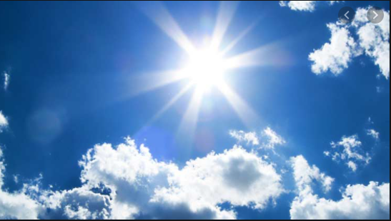
The slides below are about the climate in Greece

Slide 3
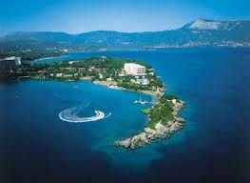
What is the weather like in Greece?
Greece has a warm, sunny climate with temperatures that peak at about 33 C in the summer months of June, July and August, lowering to between 13 C and 15 C from December to February. The climate is known as a Mediterranean climate – like the climate that is produced in the Mediterranean biome at the Eden project.
Rainfall in Greece peaks at about 65mm in December and January, but lowers to only 6mm in July and August.
The climate means that Greece can export lots of foods and is famous for its olives.

Slide 5
Average temperature and rainfall in Halkadiki
Month | Average temperature degrees
January | 13
February | 13
March | 15
April | 19
May | 24
June | 28
July | 31
August | 31
September | 28
October | 23
November | 18
December | 15
Month | Average rainfall mm
January | 55
February | 48
March | 44
April | 25
May | 18
June | 6
July | 6
August | 6
September | 10
October | 44
November | 48
December | 60
Use the data to plot a comparative line graph to show the average temperature for Greece – Halkadiki and Newquay in Cornwall. and then the average rain fall across the year.

Slide 6
Average temperature and rainfall in Newquay
Month | Average temperature degrees
January | 7
February | 9
March | 9
April | 11
May | 13
June | 15
July | 18
August | 17
September | 16
October | 13
November | 9
December | 8
Month | Average rainfall mm
January | 121
February | 114
March | 72
April | 63
May | 30
June | 35
July | 53
August | 40
September | 50
October | 90
November | 110
December | 108
Use the data to plot a comparative line graph to show the average temperature for Greece – Halkadiki and Newquay in Cornwall. and then the average rain fall across the year.

Slide 9
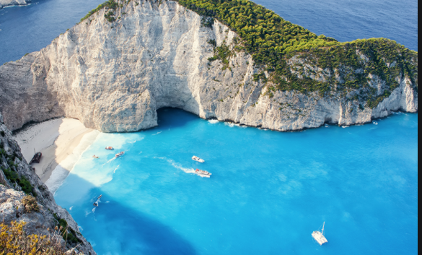
The slides below are about the landscape and coastline.

Slide 10
Greece has the longest coastline in Europe and is the southernmost country
In Europe. The mainland has rugged mountains, forests and lakes, but the country
is well known for the thousand of islands dotting the blue Aegean Sea to the east,
and the Ionian sea to the west.
The country is divided into 3 geographical regions: the mainland, the islands and the
Peloponese (the peninsula south to the mainland).
Mount Olympus is Greece’s highest mountain (2,917 m above sea level) Ancient Greeks
believed it was the home of the gods. This was also the first national park in Greece.
Greece has 10 national parks and marine parks. The marine parks help protect 2 of
Europe's most endangered sea creatures, the loggerhead turtle and the monk seal. Greece
has crystal clear seas and golden beaches.

Slide 11
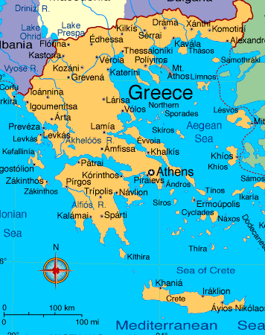
Capital:
Athens
Language:
Greek
Currency:
Euro
Population:
11,319,048

Slide 12
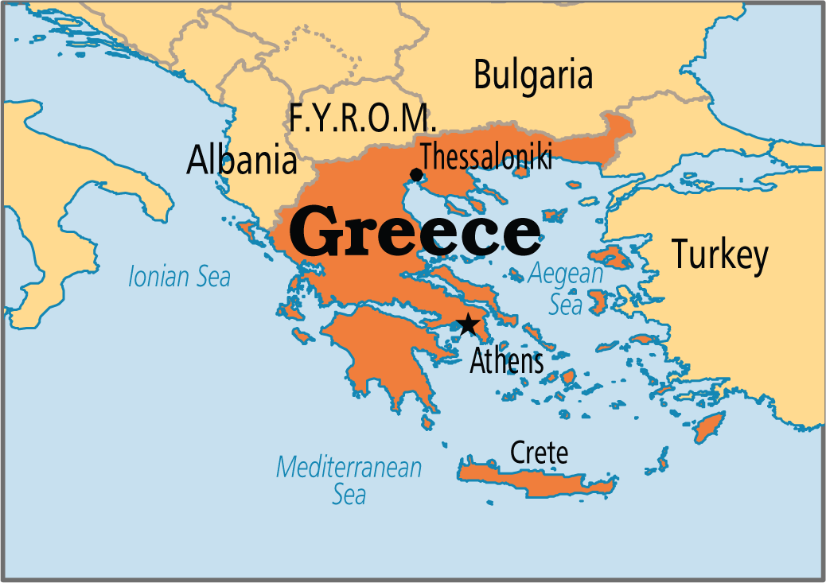
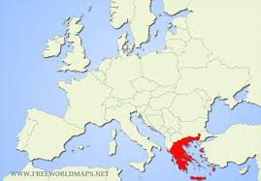
Where is modern-day Greece?
Greece is a peninsula.
It is made up of many islands

Slide 13
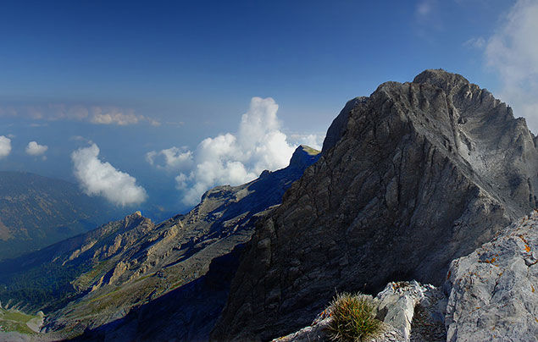
Greek Topography
The mainland has rugged mountains, dense forests and beautiful lakes – but the country is best known for the thousands of islands dotting the blue Aegean Sea to the east, the Mediterranean Sea to the south and the Ionian Sea to the west.
Mount Olympus is Greece’s highest mountain, standing a huge 2,917m above sea level. The Ancient Greeks believed this magnificent mountain was where the gods lived!

Slide 14
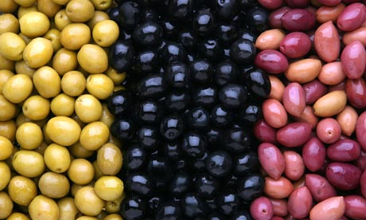
The Following slides are about Greek food
Greek cuisine

Slide 15
Greek food
Greek cuisine a Mediterranean cuisine. Greece has an ancient food traditions dating back several thousand years, and over the centuries Greek cuisine has evolved and absorbed numerous influences and influenced many foods itself.
Traditional Greek cookery makes wide use of olive oil, vegetables and herbs, grains and bread, wine, fish, and various meats, including poultry, rabbit and pork. Also important are olives, cheese, aubergine, courgette, and yoghurt.
Greek cuisine has a long tradition and its flavours change with the season and its geography.
Wine and olive oil have always been a central part of the Greek diet and the spread of grapes and olive trees in the Mediterranean. Greek olive oil and yoghurt is widely exported to countries across the world.
The most characteristic and ancient element of Greek cuisine is olive oil, which is frequently used in most dishes. It is produced from the olive trees prominent throughout the region, and adds to the distinctive taste of Greek food.
Important vegetables include tomato, aubergine , potato, green beans, okra, green peppers, and onions. Honey in Greece is mainly honey from the nectar of fruit trees and citrus trees: lemon, orange, trees, thyme honey, and pine honey from conifer trees. Greek cuisine uses some flavorings more often than other Mediterranean cuisines do, namely:
Due to the vast coastline, fish is a key part of the Greek diet.
Although fast food chains such as Mcdonalds are evident in Greece, most Greeks prefer to prepare fresh and traditional foods which can be attributed to why Greek people often live long, healthy lives.

Slide 16
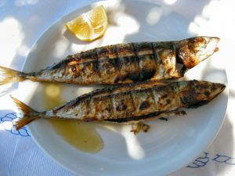
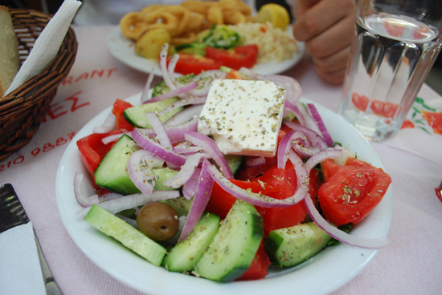
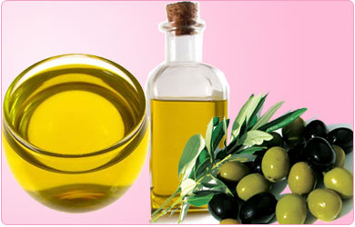
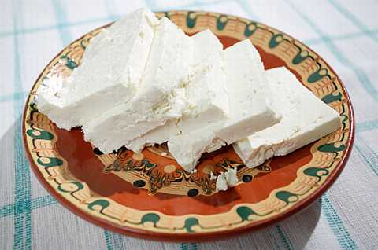
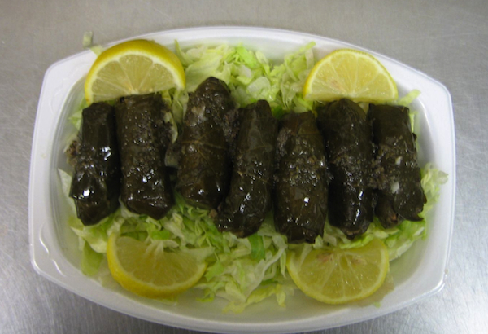
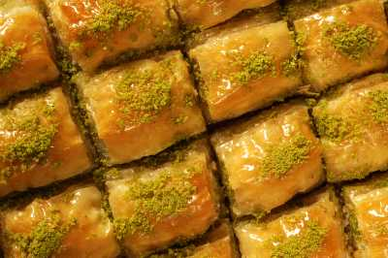
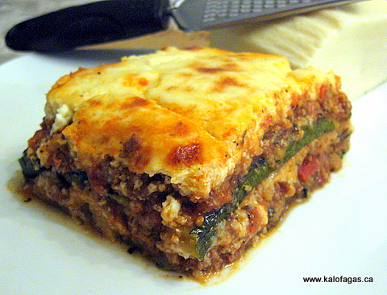
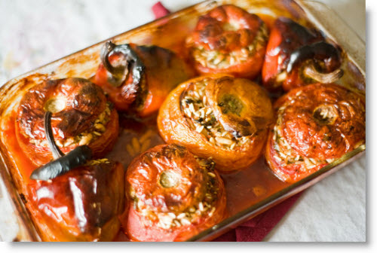
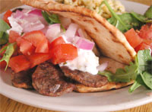

Slide 17
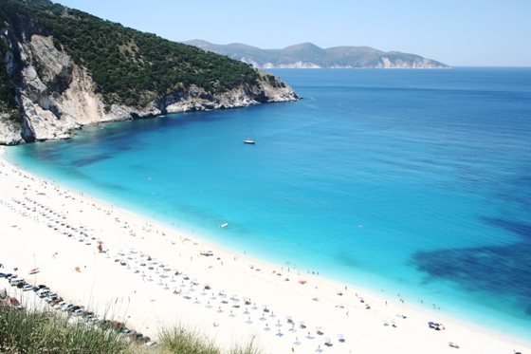
The Beautiful Greek seas.
Greece has a beautiful extensive coastline – in fact the longest coastline in Europe. It is also the 11th longest coastline in the world. The coastline is home to many islands 227 are inhabited. The Greeks rely heavily on their coastline for food (they eat a lot of fish) but also for the countries main income – tourism. Every summer thousands of tourists flock to the the beautiful beaches and islands around Greece and are amazed by the pristine blue seas. The Greek flag is partly blue to represent the amazing colour of the Mediterranean the surrounds mainland Greece and its islands.

Slide 18
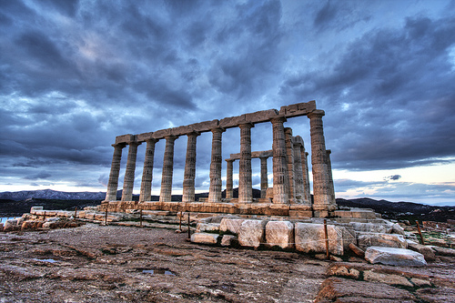
Ancient Greek buildings

Slide 19
Famous Greek architecture
Ancient Greek architecture is best known for its temples, many of which are found throughout the region, mostly as ruins but many substantially intact. Some ruins are almost 4000 years old. Below are some famous Greek buildings
Acropolis: The Acropolis is a group of ancient temples (including the Parthenon) that were built on a high, rocky hill in Athens, Greece. The word acropolis even means 'high city' in Temple & theatre of Apollo: These are located in Delphi. In ancient times this was considered the center of the known world, the place where heaven and earth met. Delphi is known as the center of worship for the God Apollo, son of Zeus who represented moral discipline and spiritual clarity.
Temple of Poseidon: The temple is perched above the sea at a height of almost 60 m. The ruins of this temple are located in Sounion (not far from Athens). This is where the Aegean and Ionian sea meet.
The Parthenon is a temple in the middle of the Acropolis in Athens, Greece (Europe). It was a temple to Athena for nearly 2000 years and originally had a huge idol to her. The name Parthenon means the virgin's place in Greek. It was built between 447 BC and 432 BC during the reign of Pericles.

Slide 20
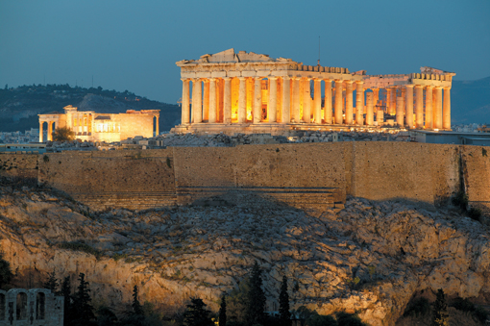
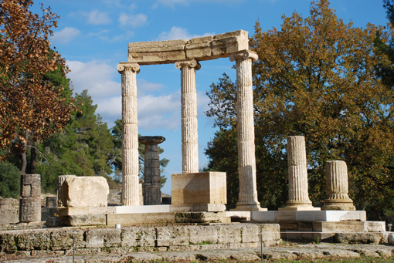
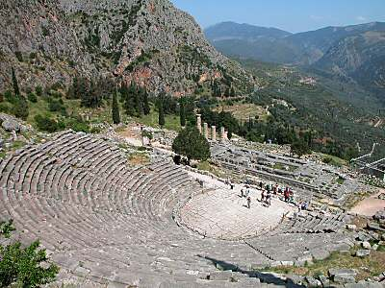
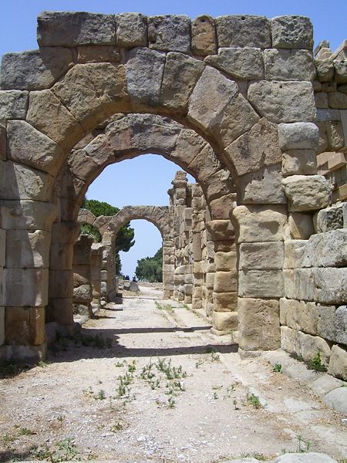
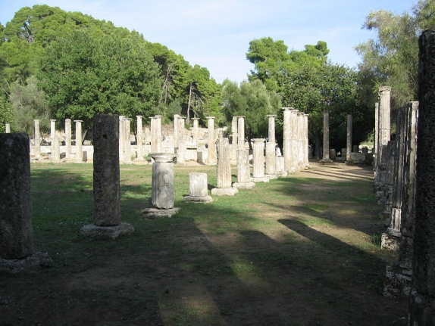
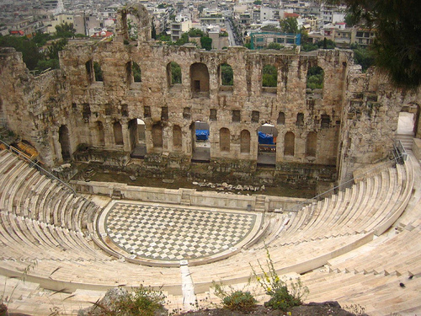
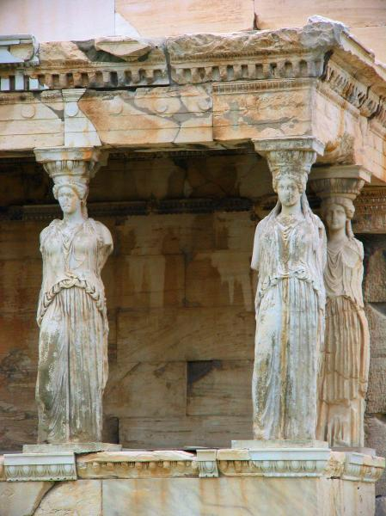
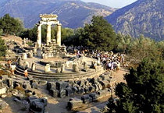

Slide 21
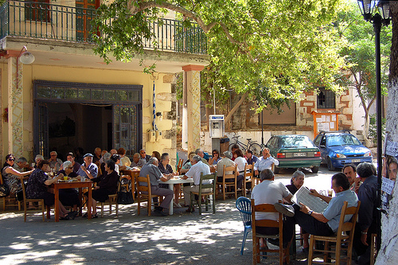
The Greek people...

Slide 22
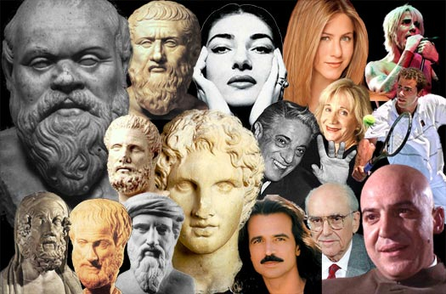
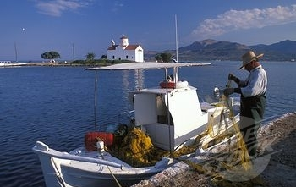
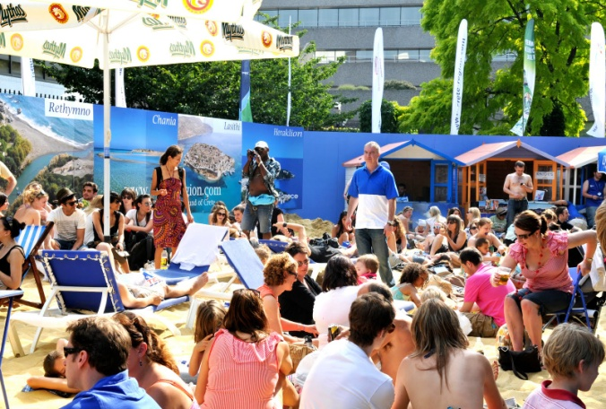
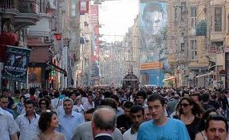
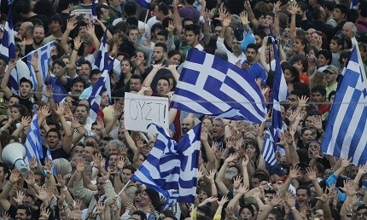
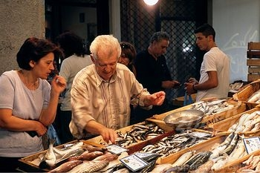

Slide 23
The Greek people are renowned for their hospitality and generosity to foreigners. Greece is still one of the few places where you may be invited into a local's home and given a meal, or where they may wish to take you out and treat you for a meal. Most Greeks would consider it an insult if their guests paid for the meal.
Greece is a very religious country, with about 98% of the population belonging to the Greek Orthodox Church. Other religious minorities are a few Roman Catholics and Jews, mainly in the north.
Religion dominates many aspects of everyday life and churches are abundant all over the land. Religion also plays a part in all the main festivals. Weddings, baptisms and name's days are the most celebrated events, with much feasting, drinking and merrymaking. Greek people do not normally celebrate birthdays, although it is becoming more popular now for the person whose birthday it is, to treat his guests.
The majority of Greeks speak English or another European language such as Italian, French or German and, indeed, many speak several of these!
Greek people use extravagant body language and are very charismatic people.
There are many famous Greek people from history

