Slide 1
Tuesday 23rd February 2021

Slide 2
Tuesday 23rd February 2021
Maths
WALT:Know and use Multiplication by 1 and 0.

Slide 5
12 $+$ 0 $=$
2) 12 $−$ 0 $=$
12 $+$ 1 $=$
12 $−$ 1 $=$

Slide 6
12 $+$ 0 $=$
2) 12 $−$ 0 $=$
12 $+$ 1 $=$
12 $−$ 1 $=$
12
12
13
11

Slide 8
There are 4 plates.
1 $×$ 4 $=$ 4
Each plate has 1 doughnut on it.
4 $×$ 1 $=$ 4
There are 4 doughnuts altogether.
There is 1 plate.
1 $×$ 4 $=$ 4
The plate has 4 doughnuts on it.
4 $×$ 1 $=$ 4
There are 4 doughnuts altogether.

Slide 9
There are 4 plates.
0 $×$ 4 $=$ 0
Each plate has 0 doughnuts on it.
4 $×$ 0 $=$ 0
There are 0 doughnuts altogether.
Have a think
There are 3 plates.
0 $×$ 3 $=$ 0
Each plate has 0 doughnuts on it.
3 $×$ 0 $=$ 0
There are 0 doughnuts altogether.

Slide 10
Have a go at questions 1 – 4 on the worksheet

Slide 11
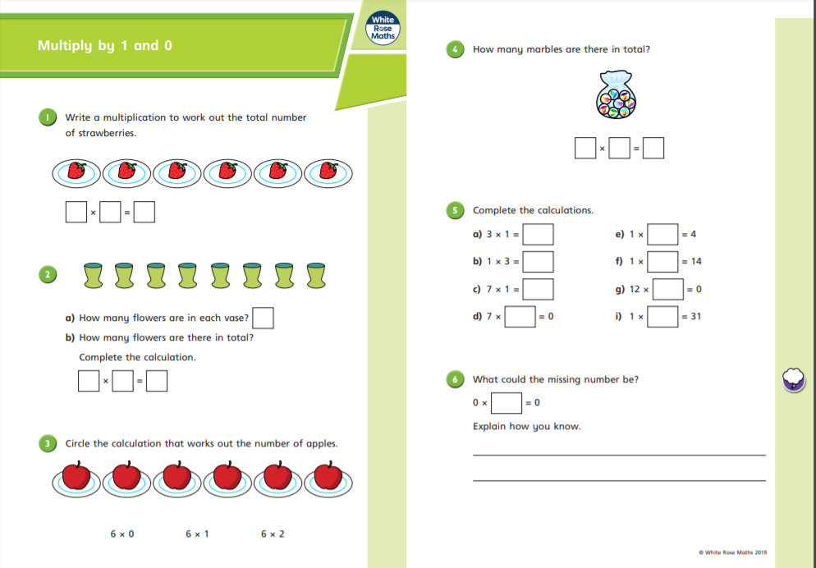

Slide 12
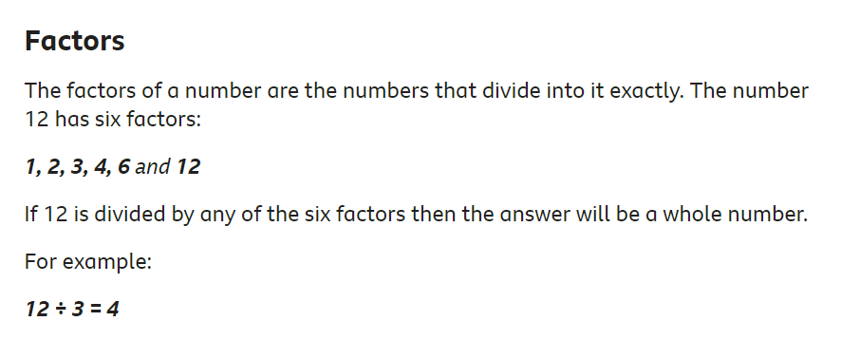
What is a factor?
https://www.bbc.co.uk/bitesize/topics/z6j2tfr/articles/zv9sv9q#:~:text=A%20factor%20is%20a%20number,the%20number%20itself%20and%201.

Slide 13
factor $×$ factor $=$ product
2-times table | 4-times table | 8-times table
2 $×$ 0 $=$ 0 | 4 $×$ 0 $=$ 0 | 8 $×$ 0 $=$ 0
2 $×$ 1 $=$ 2 | 4 $×$ 1 $=$ 4 | 8 $×$ 1 $=$ 8
2 $×$ 2 $=$ 4 | 4 $×$ 2 $=$ 8 | 8 $×$ 2 $=$ 16
2 $×$ 3 $=$ 6 | 4 $×$ 3 $=$ 12 | 8 $×$ 3 $=$ 24
What’s the same?
What’s different?
When one of the factors is 0,
the product is 0
One of the factors is 0
The factor that is not 0
One of the factors is not 0
The product is 0

Slide 14
factor $×$ factor $=$ product
2-times table | 4-times table | 8-times table
2 $×$ 0 $=$ 0 | 4 $×$ 0 $=$ 0 | 8 $×$ 0 $=$ 0
2 $×$ 1 $=$ 2 | 4 $×$ 1 $=$ 4 | 8 $×$ 1 $=$ 8
2 $×$ 2 $=$ 4 | 4 $×$ 2 $=$ 8 | 8 $×$ 2 $=$ 16
2 $×$ 3 $=$ 6 | 4 $×$ 3 $=$ 12 | 8 $×$ 3 $=$ 24
What’s the same?
What’s different?
One of the factors is 1
The factor that is not 1
When one of the factors is 1, the product is equal to the other factor.
One of the factors is not 1
The product
The product is the same as one of the factors.

Slide 15
Have a go at questions 5 – 8 on the worksheet

Slide 17
When there are 2 factors and one of the factors is 1, the product is equal to the other factor.
When one of the factors is 1, the product is equal to the other factor.
5 $×$ 1
$×$ 3
When there are 3 factors and one of the factors is 1, the product is equal to the product of the other factors.

Slide 18
Have a go at the rest of the worksheet

Slide 19
