Slide 1
29.1.21
Maths
WALT: Compare numbers

Slide 2
Draw a grid like this and fill it with any numbers 10-20
Tick off your numbers when the spinner shows the answer when your number is doubled.
https://numbergenerator.org/randomnumbergenerator/20-40#!numbers=1&low=20&high=40&unique=true&csv=&oddeven=even&oddqty=0&sorted=false&addfilters=&start=false

Slide 3
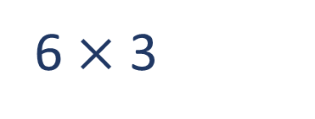
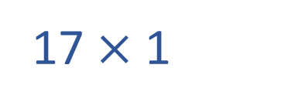



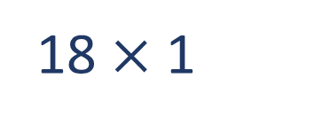

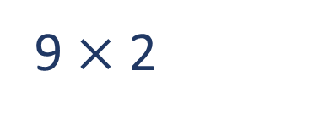
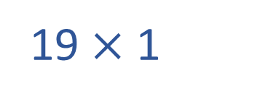
Tommy has a multiplication fact which is greater than Dexter’s but less than Jacks.
What multiplication fact could Tommy have?
Which card has the greater value?
5 $×$ 4
4 $×$ 4
5 $×$ 4
4 $×$ 4
$$<$$
?
$$<$$
$$<$$
16
17
18
19
20
6 $×$ 3
17 $×$ 1
19 $×$ 1
9 $×$ 2
Have a think
18 $×$ 1

Slide 4
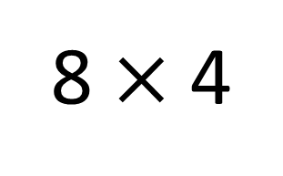
Use $<, >$ or $=$ to complete the comparison
Have a think
8 $×$ 4
$$=$$
8 × 2 × 2
8
8
8
8
8
8
8
8

Slide 5
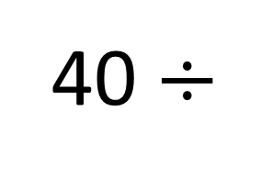
Complete the comparison
40 $÷$
2
4
8
$$=$$
× 5
4
2
1
Have a think

Slide 6
Complete the comparison
Have a think
0
$$>$$
1
3 $×$ 8 8 $×$
2
$$=$$
$$>$$

Slide 7
