Slide 1
Lesson 3 Block quiz practise

Slide 2
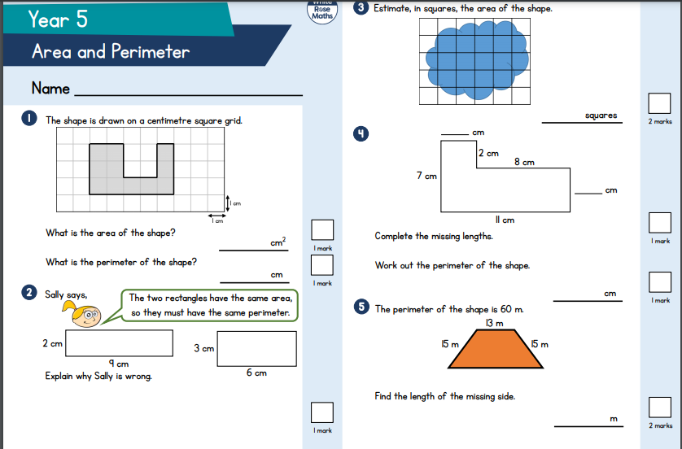

Slide 3
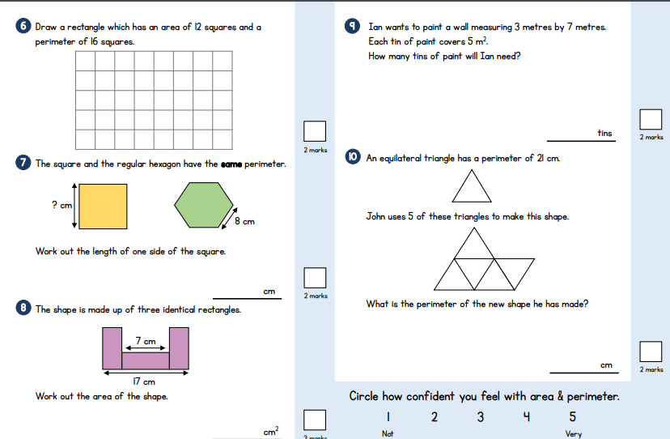

Slide 4
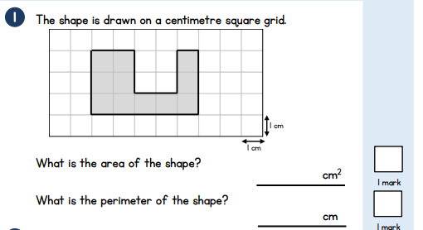
Questions 1

Slide 5
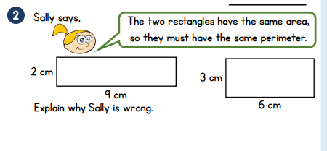
Question 2

Slide 6
Question 4

Slide 7
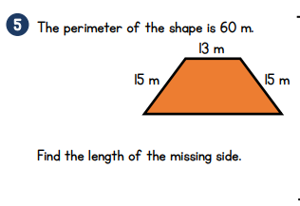
Question 5
15 + 15 + 13 + ? = 60
How do we find something?
60
15 | 15 | 13 | ?

Slide 8
Question 6
Factors of 12
Do the edges added up make 16?

Slide 9
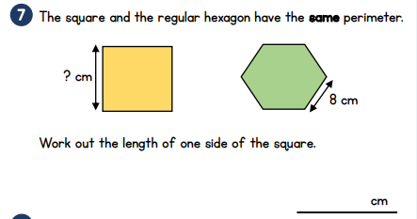
Question 7
What do we know?
What do we need to find out?
How can we work out the perimeter of the hexagon?

Slide 10
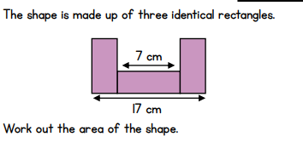
Question 8
?
7
?
17
7

Slide 11
Question 9
What is the wall area?
How do I find out how many tins of paint I need?

Slide 12
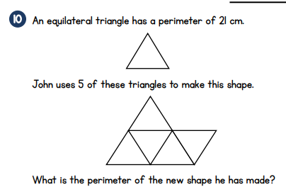
Question 10
What do we know?
What is special about an equilateral triangle?
Can we work out one side?

