Slide 1
WALT understand how to find the area of compound shapes.
Conjecture: Multiplying the width and the height of a rectangle will give me the area.

Slide 2
Vocabulary
area
rectangle
width
height
cm²
compound
distributive

Slide 3
Daily fluency
WALT understand how to find the area of rectangles.
SET A
4 X 4 =
A square has a length of 6cm what is the perimeter?
8 X 8 =
4 X 40 =
SET B
2 X 6 =
2 X 8 =
2 X 12 =
2 X 5 =

Slide 4
What is this an example of?

Slide 5
https://youtu.be/lQyR2Ps9bWo

Slide 6
Conjecture: to work out the area of a simple rectangle, we can multiply the length by the width and it will give us the area
The length of this rectangle is 8
The width of this rectangle is 4
So to find the area of the rectangle we can use length times by width.
So 8 X 4 = 32²

Slide 7
Have a go at trying to find the area of these rectangles.
1
3
2
4
5
In question 5 the length of each individual box is 3cm and the height is 2cm. What is the are in cm²

Slide 8







Worked Example
Your Turn
$$4 cm$$
Area = $20{ cm}^{2}$
$$?=$$
$$2 cm$$
Area = $20{ cm}^{2}$
$$?=$$
$$?$$
$$?$$

Slide 9
5cm
Area = 15²
4cm
Area = 40²
?
?
5cm
6cm
Area = 48²
?
Area = 75²
?
3cm
Area = 48²

Slide 10
4cm
5cm
8cm
4cm
6cm
7cm
Tell me the area…

Slide 11
16cm²
30cm²
h
56cm²
8cm
4cm
w
What could the h and w be of the red rectangle?

Slide 12
16cm²
30cm²
h
56cm²
8cm
4cm
w
Tell me the missing length

Slide 13
Tell me the area of this compound shapes…Can you create your own?
4
8
5
4
6
7

Slide 14
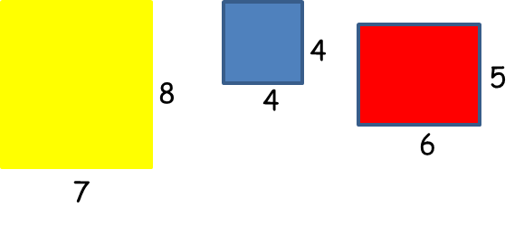
What is the area of the yellow area?
What is the area of the yellow area?
What is the area of the red area?

Slide 15
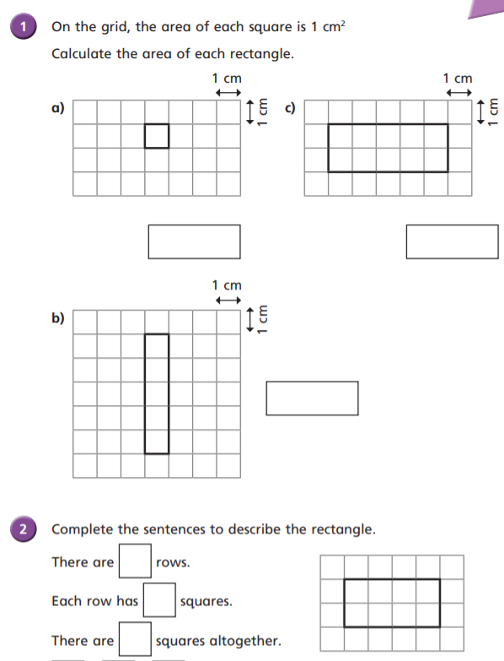
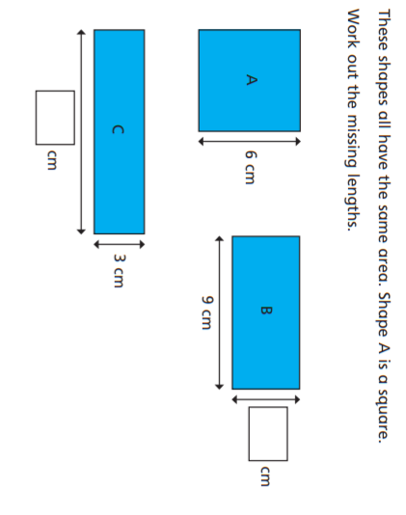

Slide 16
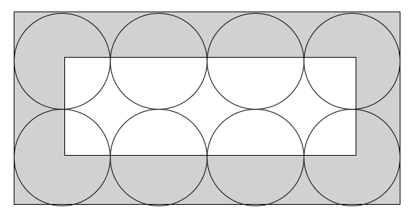
What do we need to know?
Is there an array? Does that give us the area?
12 cm
A length of___ cm multiplied by the height of ___cm is equal
to ____cm².

Slide 17
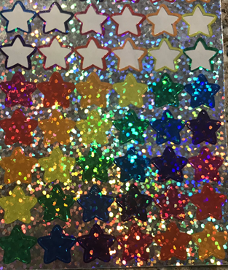
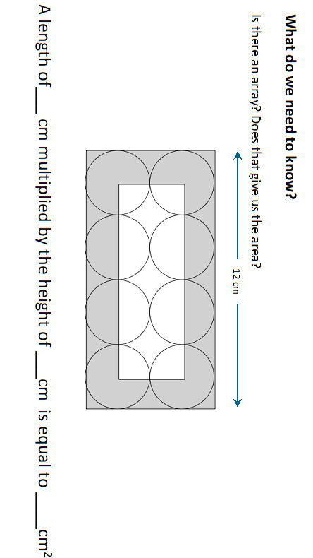
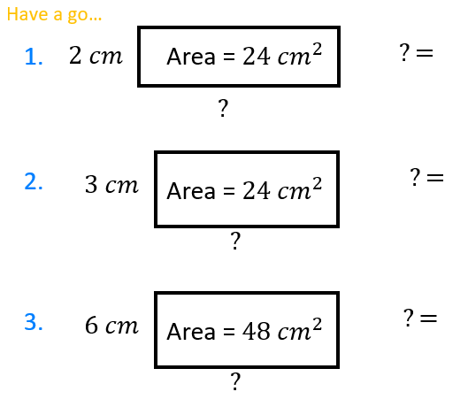

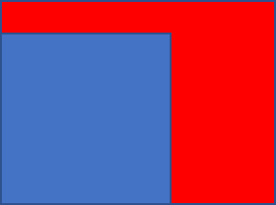
Conjecture: Mr Martin says…I can use the height and length of a rectangle to find its area. Is he right?
6
3
1. Can you write an equation to go with this array?
Use squared paper and cut out your shapes
2
4. If you have been using addition previously how would you work out the area of just the yellow section?
5. If you have been using addition previously how would you work out the area of just the red section?

