Slide 2
Revisit and Review
Let’s practise Sam’s Sounds and Common Exception Words!
oy
ay
ie
want
their
should
could
oh
would

Slide 3
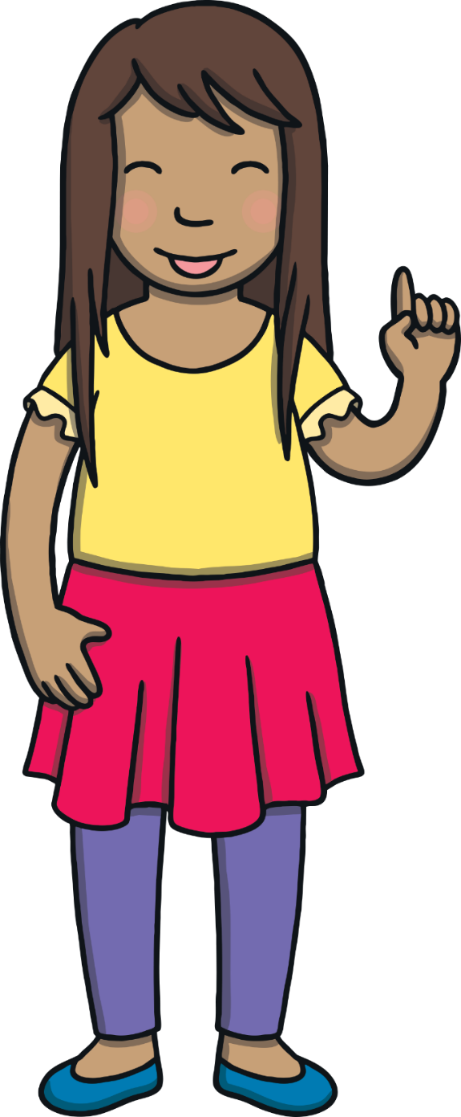
Teach
Today, we are learning to read and spell words that contain ie.

Slide 4
Teach
Let’s practise reading some of this week’s focus words which contain the ie sound.
cries
tries
spied
fried

Slide 5
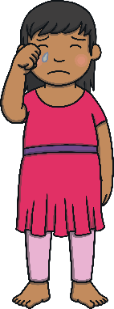
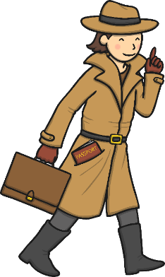
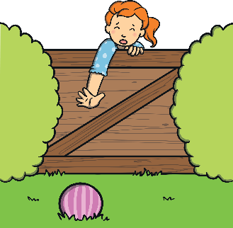
Teach
Can you write the words on a whiteboard or piece of paper?
cries
spied
tries
fried

Slide 6
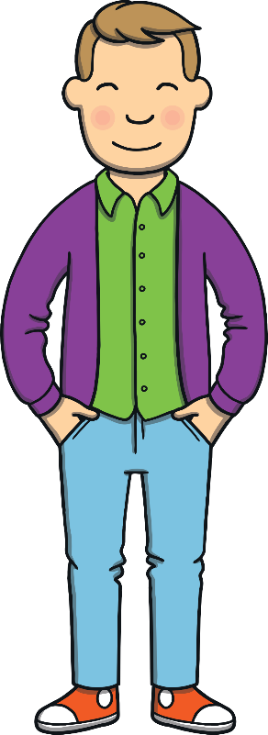
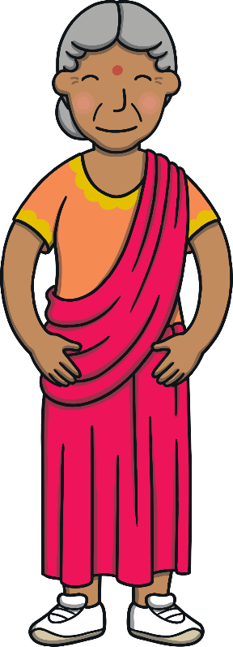
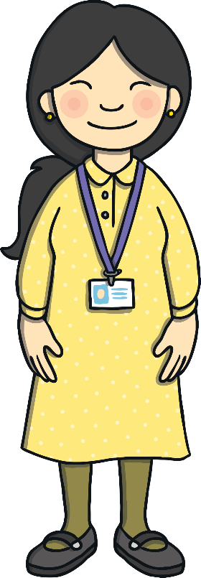
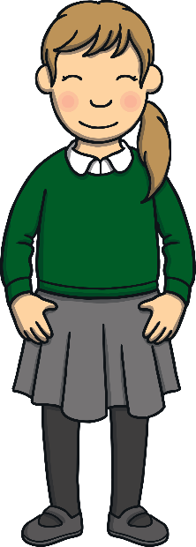
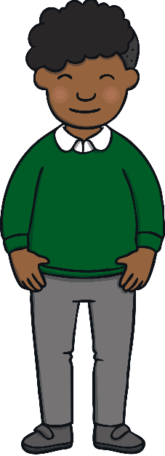
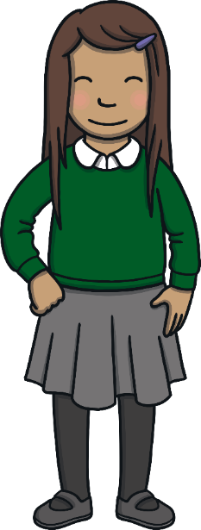
Teach
It was the end of Keeping Healthy Week and the children had invited their families in to take part in activities and try the food they had made.

Slide 7
Teach
Mum and Dad both had to go to work so Grandpa Dada and Grandma Dadi had travelled to join in on the fun. They were looking forward to it.

Slide 8
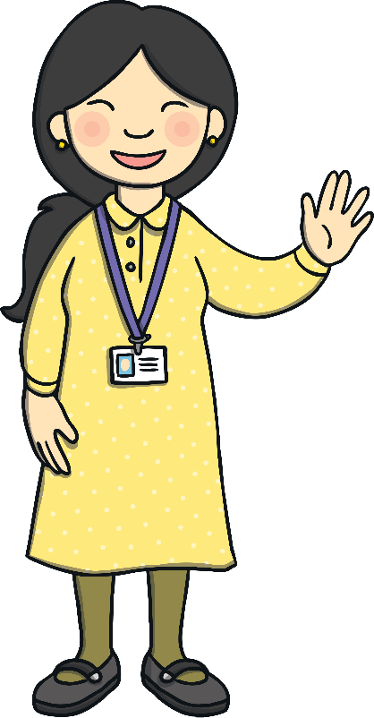
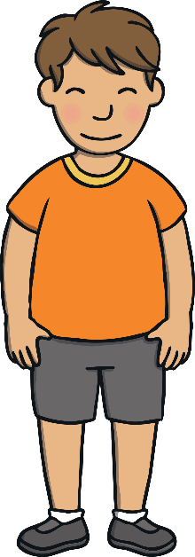
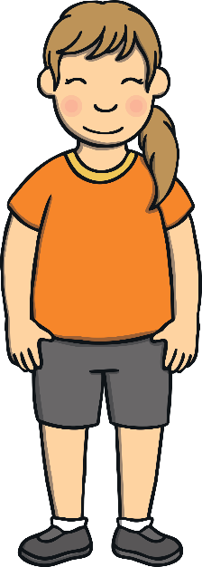
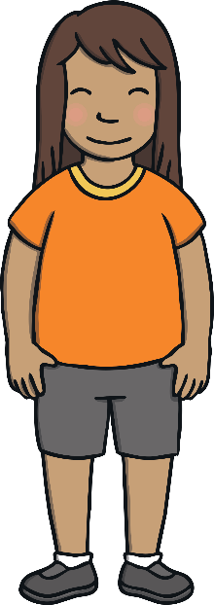
Teach
“Welcome grown-ups,” said Mrs Tan. “First, the children would like to show you some exercises and then we are going to have a healthy class picnic!”
“Welcome grown-ups,” said Mrs Tan. “First, the children would like to show you some exercises and then we are going to have a healthy class picnic!”

Slide 9
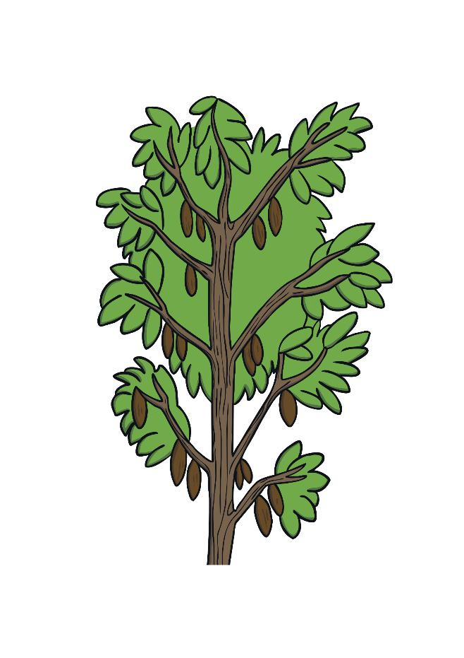
Teach
The children and their grown-ups are doing an orienteering trail. They must collect all the words from around the school playground. Can you work out the missing letters from these words?

Slide 10
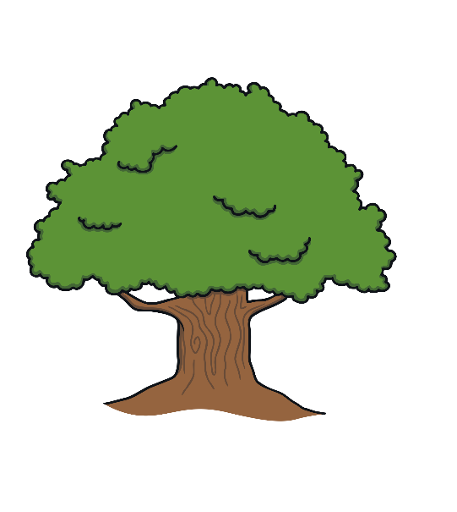
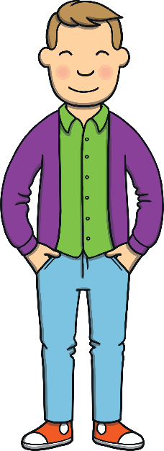
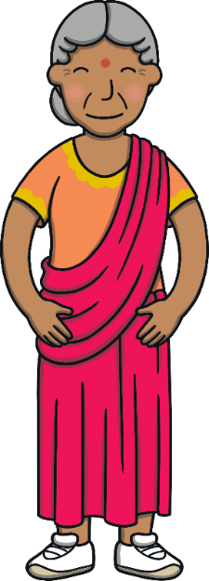
Teach
sk_es
_agpie
f_ied
l_e
c_ied
app_ied

Slide 11
ie Hide and Seek
Practise
The children and grown-ups need to find 6 pictures hidden in the school playground and write down a word that matches. Can you find them and write down
the matching words?

Slide 12
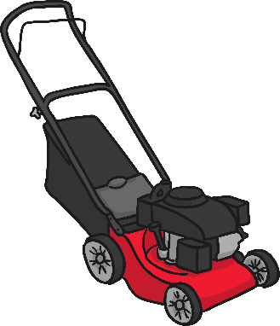
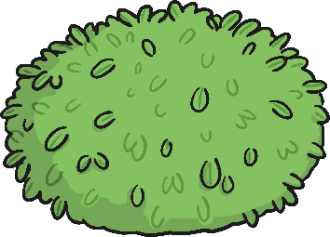
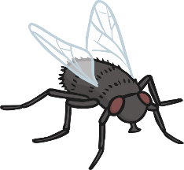
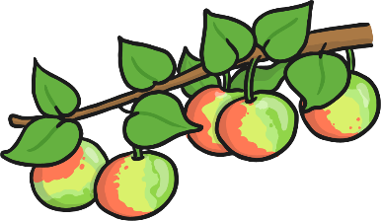
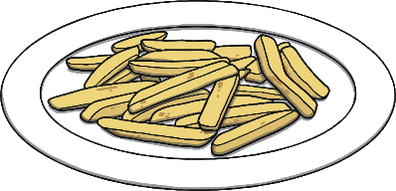
Practise

Slide 13
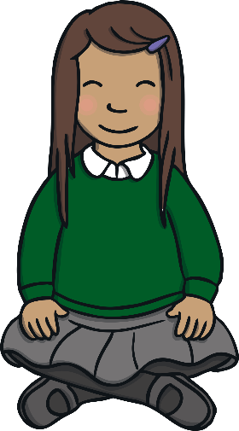
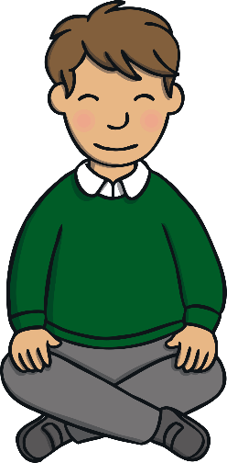
Apply
After all the fun and games, everyone was hungry. There were picnic blankets laid out ready for the picnic and they all sat down. Kit and Sam were excited.

Slide 14
Sentence Time
Apply
What did Kit say to Grandma Dadi and Grandpa Dada?
Look at the picture and write a caption to match.
Click ‘Show Suggestion’ to see a suggested caption for the picture.
X
Click me for Kit’s teaching tips!

Slide 15
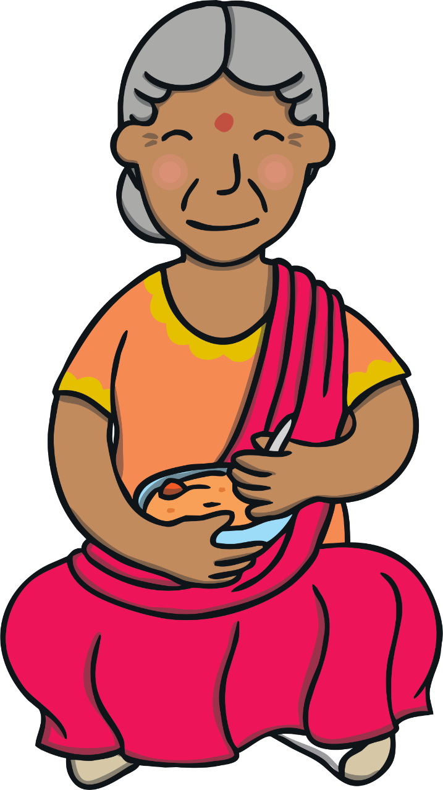
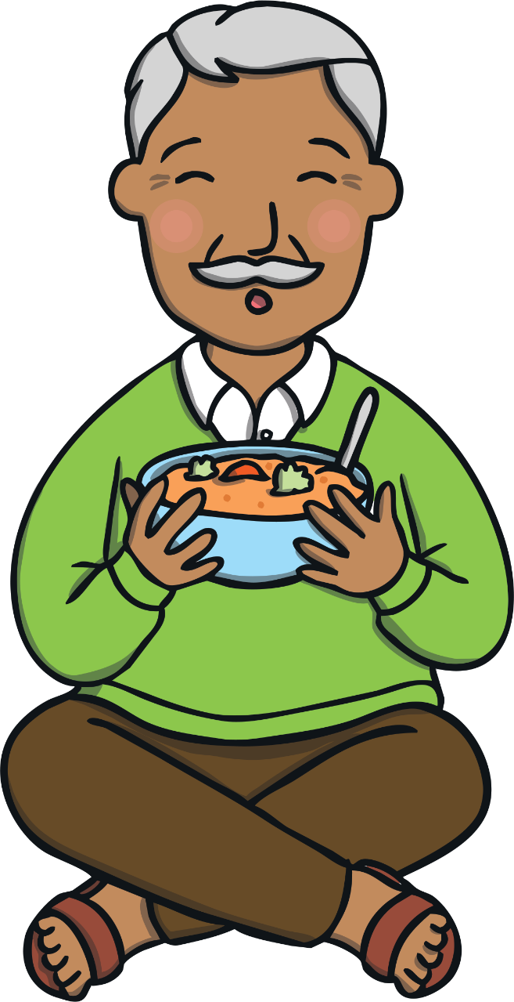
Apply
“Have you tried some of the
food that we have been
cooking?” cried Kit.
Show

Slide 16
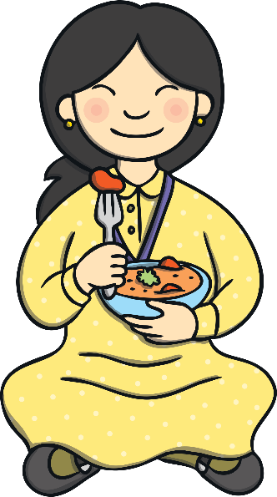
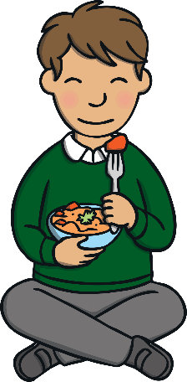
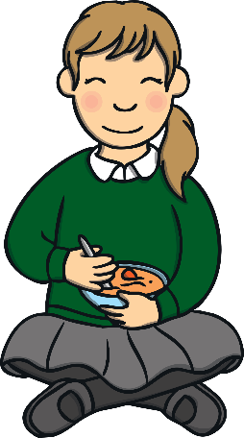
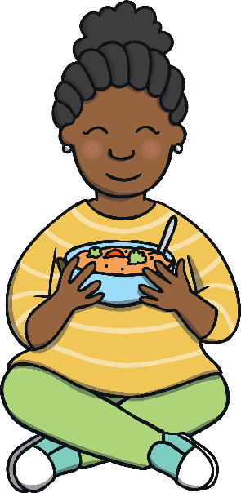
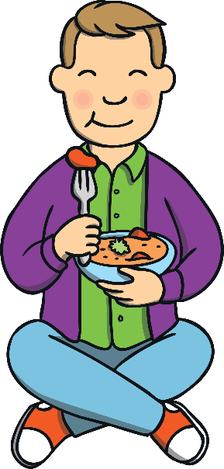
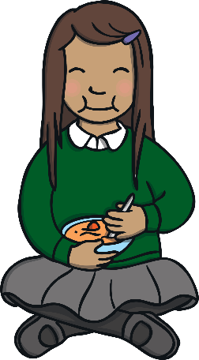
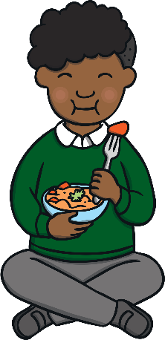
Apply
“This curry is delicious,” said Grandpa Dada. “Almost as good as mine!”
“Hey!” laughed Kit and Sam. It was a lovely end to Keeping Healthy Week.

Slide 17
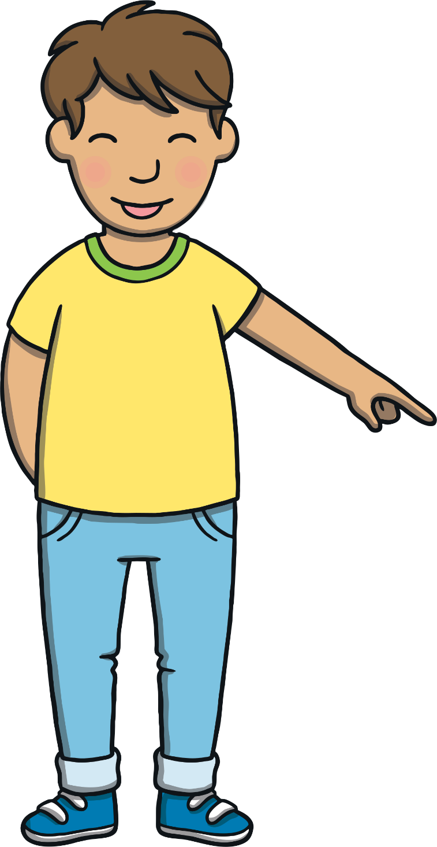
Today, we have learnt…
ie
saying /igh/
The adventure continues next lesson!

