Slide 1
25.02.21
Maths
WALT divide 2 digits by 1 digit with practical sharing of counters

Slide 2
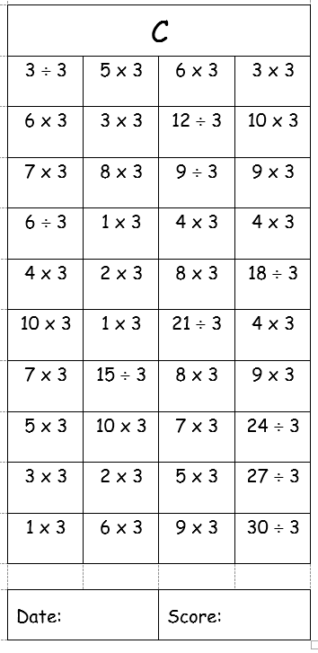
How many can you do in 3 minutes?

Slide 3
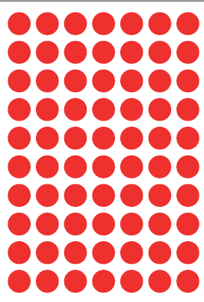
You will need:
Coloured counters
Use a black felt to write 1 or 10 on them
Some paper plates or small side plates, 3 to start with
These are 10’s
These are 1’s

Slide 4
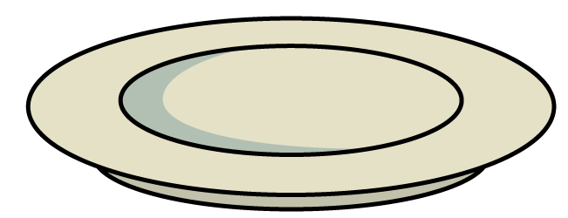
Here are 13 cakes.
They are shared equally between 4 plates.
There will be 3 cakes on each plate.
13 $÷$ 4 $=$ 3 r 1

Slide 5
13 $÷$ $=$6 r 1
2
13 $÷$ $=$ 2 r 3
5
Have a think

Slide 6
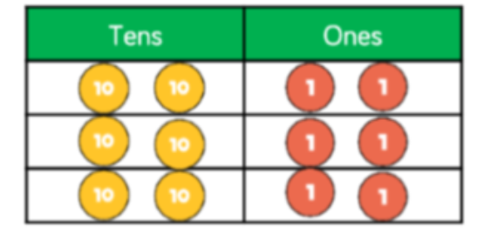
What is the division question that goes with this?
How much is there altogether?
How many groups has it been shared into?

Slide 7
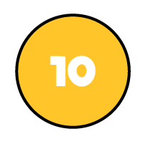
73 ÷ 3 =
24
remainder 1
Tens | Ones

Slide 8
73 ÷ 3 =
24
remainder 1
Tens | Ones
Here we are using a place value chart to help us divide. Look how many parts it has been divided into.

Slide 9
Here we are using circles to help us divide. Look how many groups there are.

Slide 10
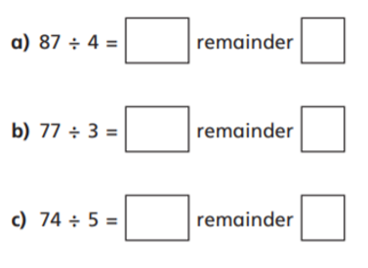
48 divided by 3
41 divided by 3
57 divided by 3
64 divided by 3
Your task
Mild
You will need your place value
counters that I’ve sent and
three small side plates
Spicy
Hot

Slide 11
Steps to Success:
Create dividend (the big number) using counters
Exchange left over tens for ones (One 10 = 10 ones)
Share into equal groups depending on divisor (the number you are sharing by)
Whatever is left over is your remainder

